Slide 1


Slide 2
Welcoming Remarks
Edith Ramirez
Chairwoman
Federal Trade Commission

Slide 3
A Historical FTC Perspective: Advertorials, Infomercials, and Paid Endorsement
Lesley Fair
Staff Attorney
Bureau of Consumer Protection, FTC

Slide 4
FEDERAL
TRADE
COMMISSION
DECISIONS
MARCH 16, 1915
TO
JUNE 30, 1919
1
Muenzen Specialty Co., 1 F.T.C. 30 (1917)

Slide 5
ISN’T THIS PHENOMENON OF “BLURRING” BRAND NEW?
no, not so much

Slide 6
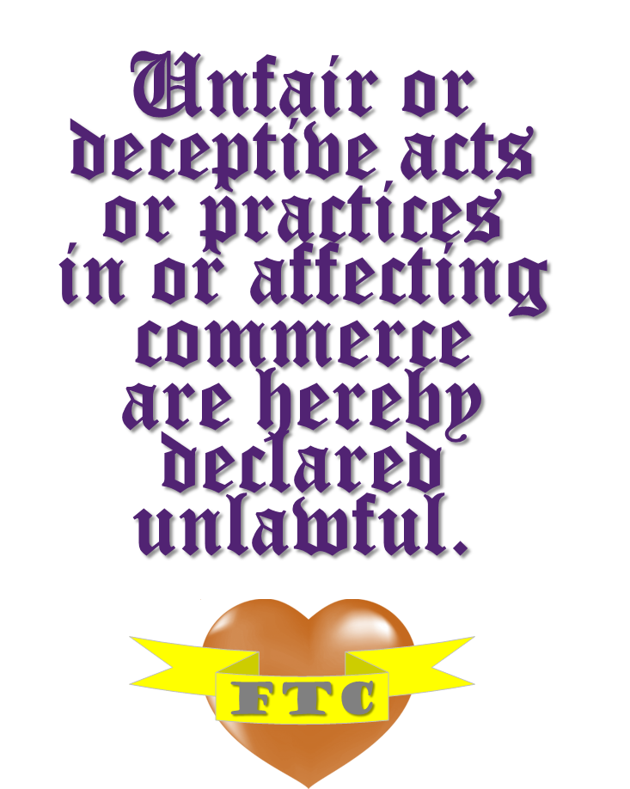


Slide 7
an act or practice is deceptive if:
AN ACT OR PRACTICE IS DECEPTIVE IF:
it’s likely to mislead consumers
who are acting reasonably under the circumstances, and
it would be material to their decision to buy or use the product.
FTC Deception Policy Statement, appended to Cliffdale Associates, Inc., 103 F.T.C. 110, 174 (1984)

Slide 8
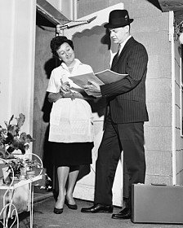
DECEPTIVE DOOR OPENERS
Encyclopedia Britannica, 87 F.T.C. 421 (1976), aff’d, 605 F.2d 964 (7th Cir. 1979)

Slide 9
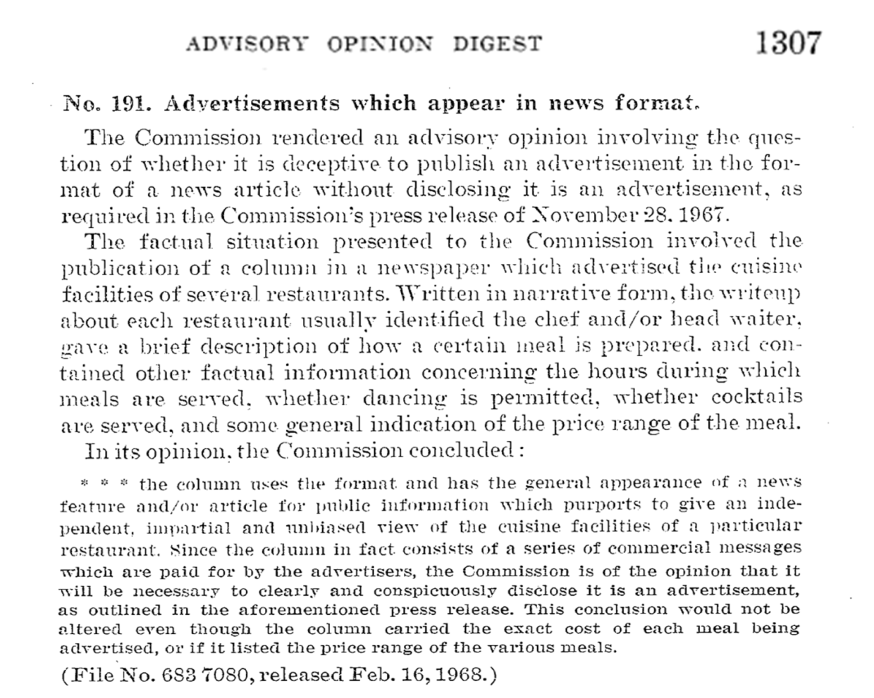

FTC ADVISORY OPINION ON ADS IN NEWS FORMAT
73 F.T.C. 1307 (1968)

Slide 10
“[T]he column uses the format and has the general appearance of a news feature and/or article for public information which purports to give an independent, impartial, and unbiased view of the cuisine facilities. Since the column in fact consists of a series of commercial messages which are paid for by advertisers, the Commission is of the opinion that it will be necessary to clearly and conspicuously disclose it is an advertisement . . .”
FTC ADVISORY OPINION ON ADS IN NEWS FORMAT
73 F.T.C. 1307 (1968)

Slide 11

SECTION 5
CASES ALLEGING DECEPTIVE FORMAT – “MASQUER-ADS”

Slide 12

DIRECT MAIL
PROMOTIONS

Slide 13
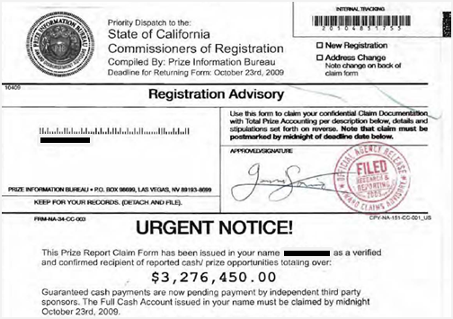
FTC v. National Awards Service Advisory, LLC., No. CV-10-5418 PJH (N.D. Cal. Apr. 26, 2012) (stipulated order)

Slide 14
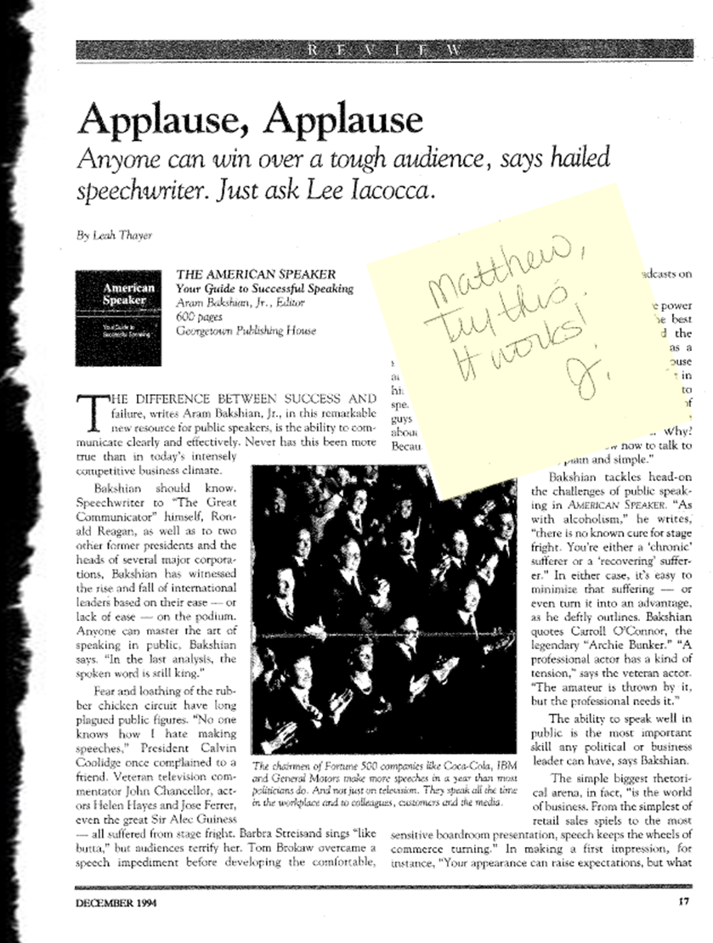
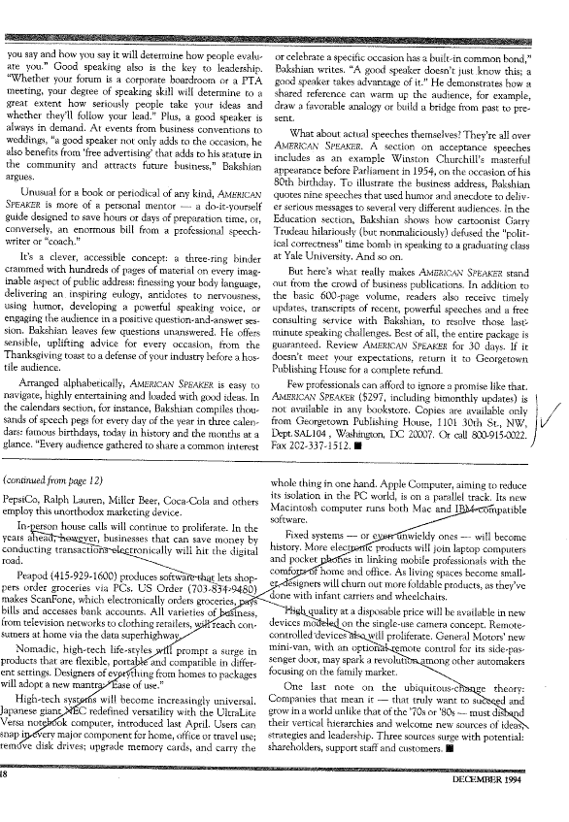

Georgetown Publishing House, Inc., 122 F.T.C. 392 (1996) (consent order)

Slide 15
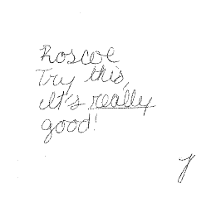
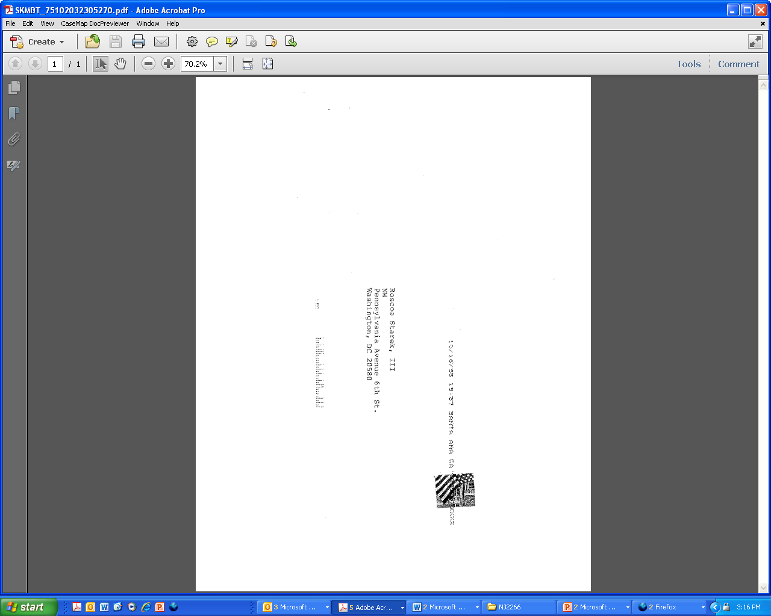

Slide 16
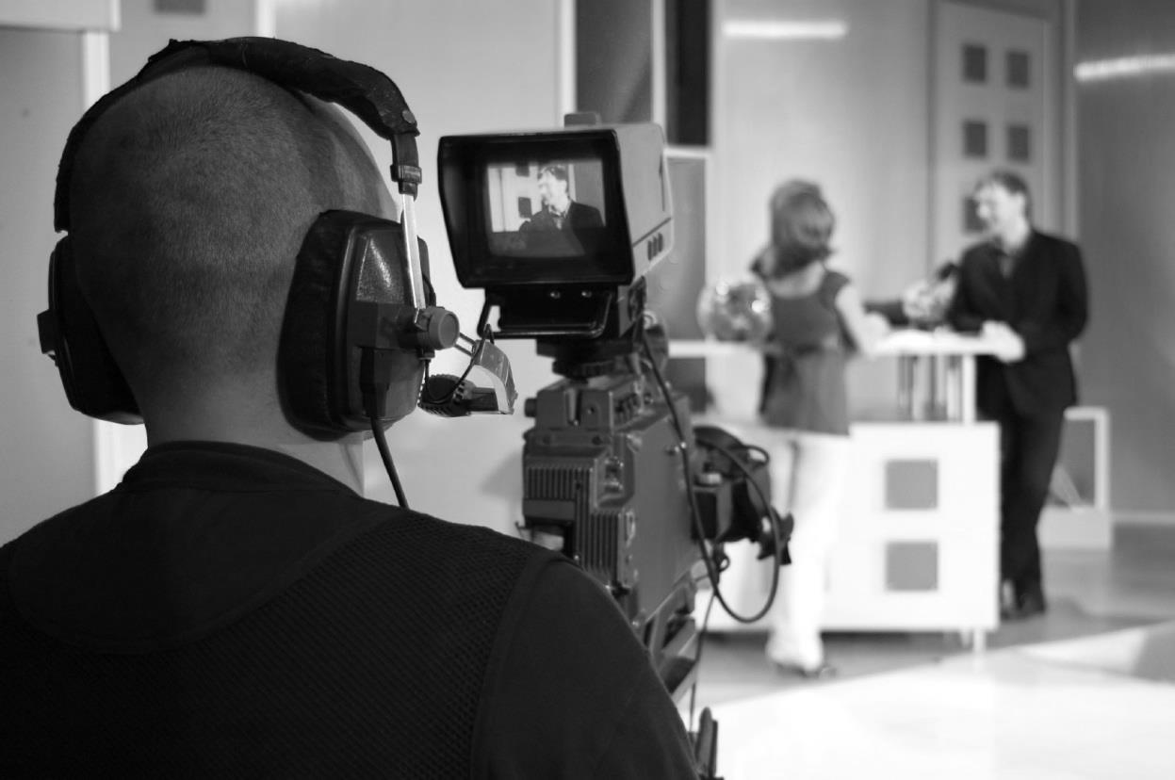
INFOMERCIAL
FORMAT

Slide 17
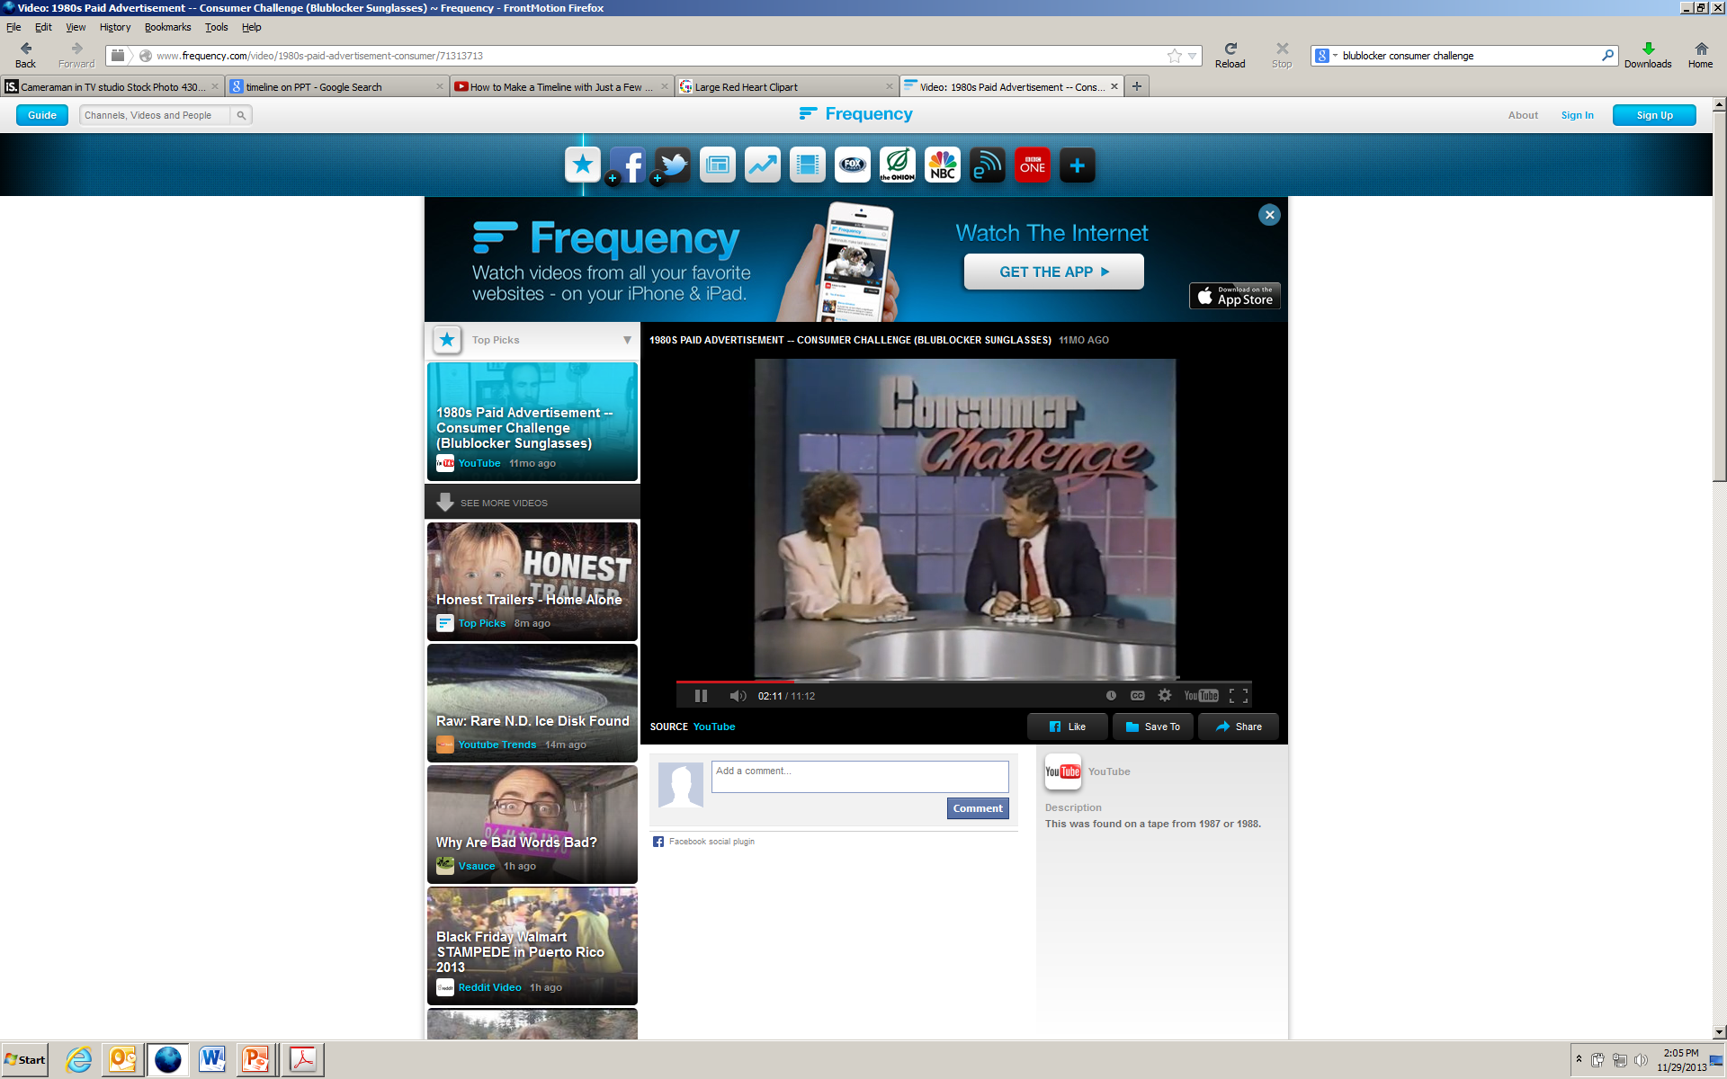
JS&A Group, Inc., 111 F.T.C. 522 (1989) (consent order)

Slide 18

FTC v. Direct Marketing Concepts, Inc., 648 F. Supp. 2d (D. Mass. 2009), aff’d, 624 F.3d 1 (1st Cir. 2010)

Slide 19

ONLINE
ADVERTISING

Slide 20

CAN-SPAM
BAN ON DECEPTIVE HEADERS
16 C.F.R. § 316

Slide 21
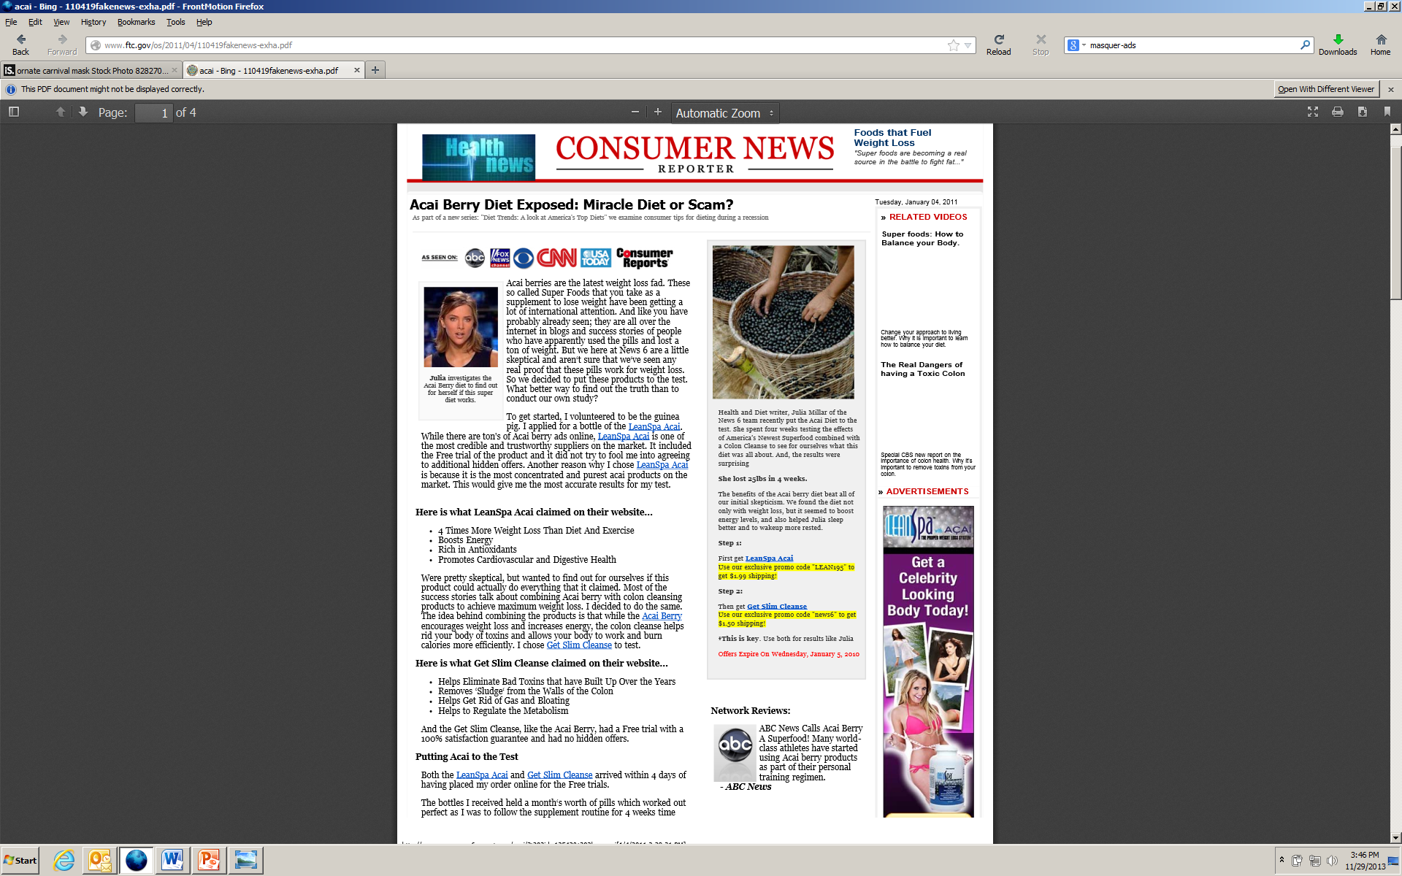
Press release, FTC Seeks to Halt 10 Operators of Fake News Sites from Making Deceptive Claims About Acai Berry Weight Loss Products
(Apr. 19, 2011)

Slide 22

FTC ENDORSEMENT GUIDES
16 C.F.R. § 255

Slide 23
“Where there exists a connection between the endorser and the seller of the advertised product that might materially affect the weight or credibility of the endorsement (i.e., the connection is not reasonably expected by the audience), such connection must be fully disclosed.”
FTC ENDORSEMENT GUIDES
16 C.F.R. § 255

Slide 24
ONE
of the BEST
One of the best apps just got better
Amazing new game!
[[[App developer] hits another home run with [app being reviewed].
GREAT,
family-friendly board game app
[[App developer] does it again!
Reverb Communications, Inc., 150 F.T.C. 782 (2010) (consent order)

Slide 25


SEARCH
ENGINE
LETTERS

Slide 26
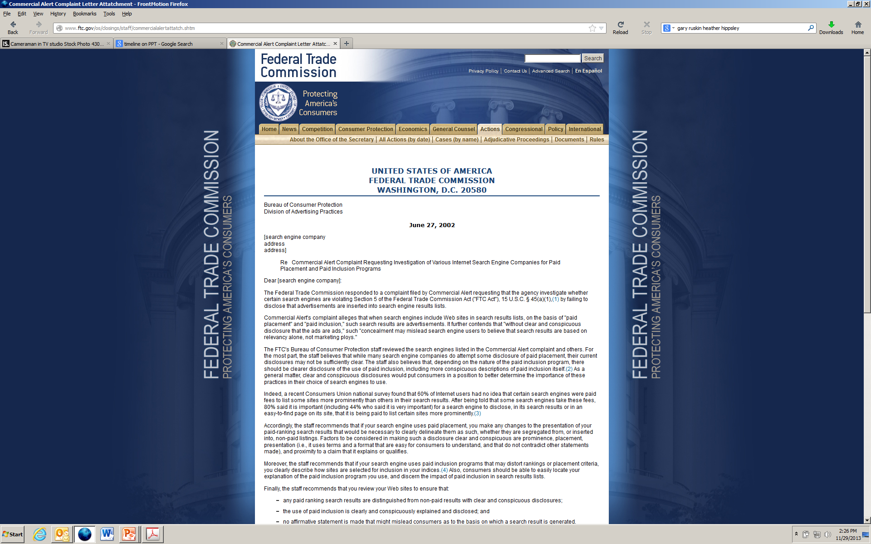
2002 FTC STAFF LETTER TO SEARCH ENGINES

Slide 27
2002 FTC
STAFF LETTER TO SEARCH ENGINES
“Finally, the staff recommends that you review your Web sites to ensure that:
any paid ranking search results are distinguished from non-paid results with clear and conspicuous disclosures;
the use of paid inclusion is clearly and conspicuously explained and disclosed; and
no affirmative statement is made that might mislead consumers as to the basis on which a search engine is generated.”

Slide 28
2013 FTC
STAFF LETTER TO SEARCH ENGINES

Slide 29
2013 FTC
STAFF LETTER TO SEARCH ENGINES
“Although the ways in which search engines retrieve and present results, and the devices on which consumers view these results, are constantly evolving, the principles underlying the 2002 Search Engine letter remain the same: consumers ordinarily expect that natural search results are included and ranked based on relevance to a search query, not based on payment from a third party. Including or ranking a search result in whole or in part based on payment is a form of advertising. To avoid the potential for deception, consumers should be able to easily distinguish a natural search result from advertising that a search engine delivers.

Slide 30
2013 FTC
STAFF LETTER TO SEARCH ENGINES
“We encourage you to review your websites or other methods of displaying search results, including your use of specialized search, and make any necessary adjustments to ensure you clearly and prominently disclose any advertising. In addition, as your business may change in response to consumers’ search demands, the disclosure techniques you use for advertising should keep pace with innovations in how and where you deliver information to consumers.”

Slide 31
The Wall Between Editorial and Advertising: Its Origins and Purpose
Nicholas Lemann
Professor of Journalism
Columbia University Graduate School of Journalism

Slide 32
Panel 1: Sponsored Content in Digital Publications
The forms it takes and how it operates

Slide 33
Panel 1: Sponsored Content in Digital Publications: The forms it takes and how it operates
MODERATOR:
Laura M. Sullivan
Staff Attorney
Division of Advertising Practices, FTC
PANELISTS:
Tessa Gould
Huffington Post
Todd R. Haskell
Hearst Corporation
Lisa LaCour
Outbrain, Inc.
Chris Laird
The Procter & Gamble Company
Jon Carmen
Adiant
Adam Ostrow
Mashable, Inc.
Steve Rubel
Edelman

Slide 34










Mashable + Brands: Connecting Around Common Themes
Female Founders Series
Leaders in Digital Series
Tails and Rails
What’s Inside
Styldby
Global Innovation Series
Photo Challenge
Future of Travel
Emerging Tech Hubs

Slide 35
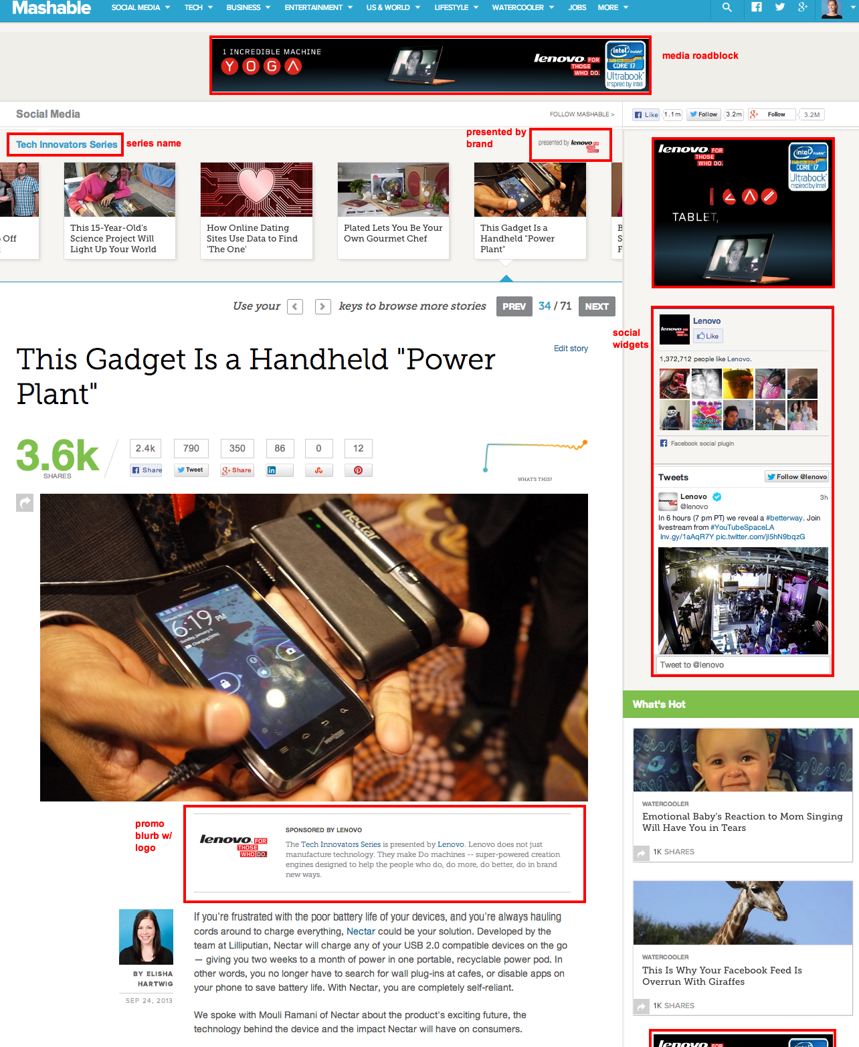
Branded Content: Article Page

Slide 36
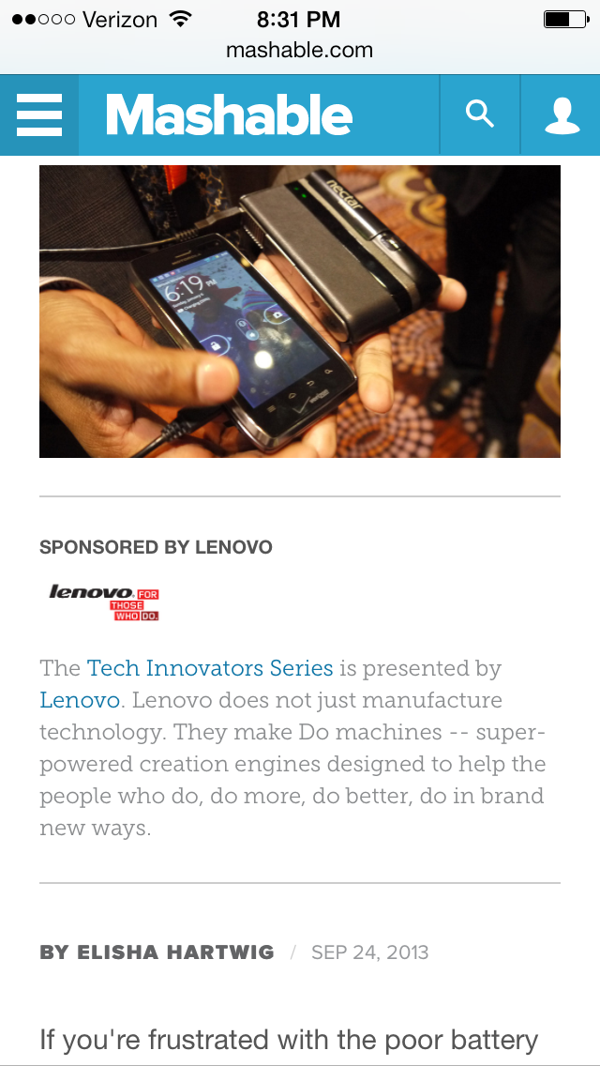
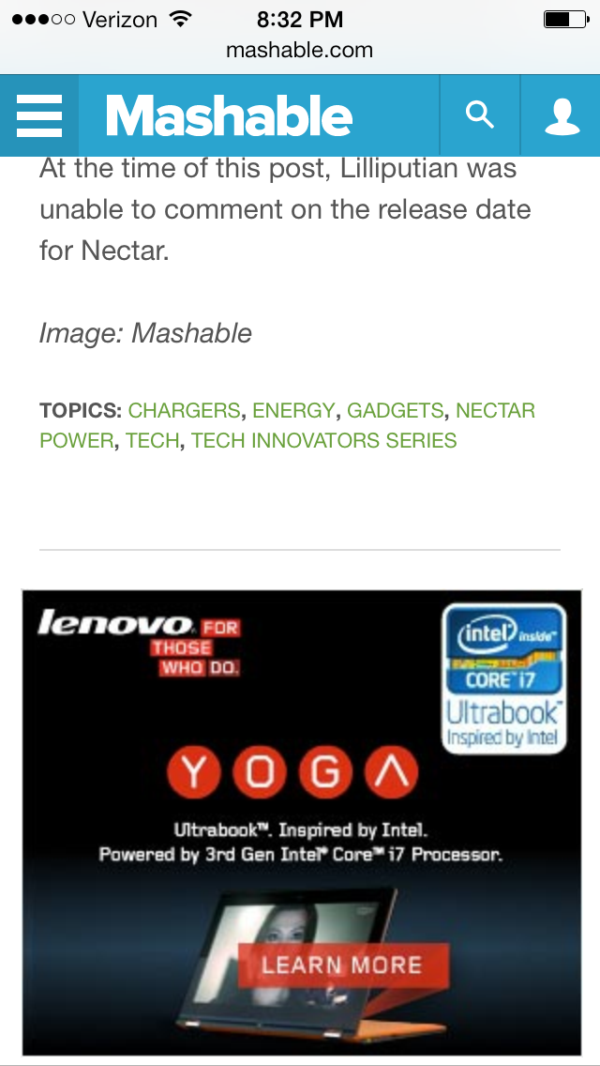
Branded Content: Mobile Article Page

Slide 37
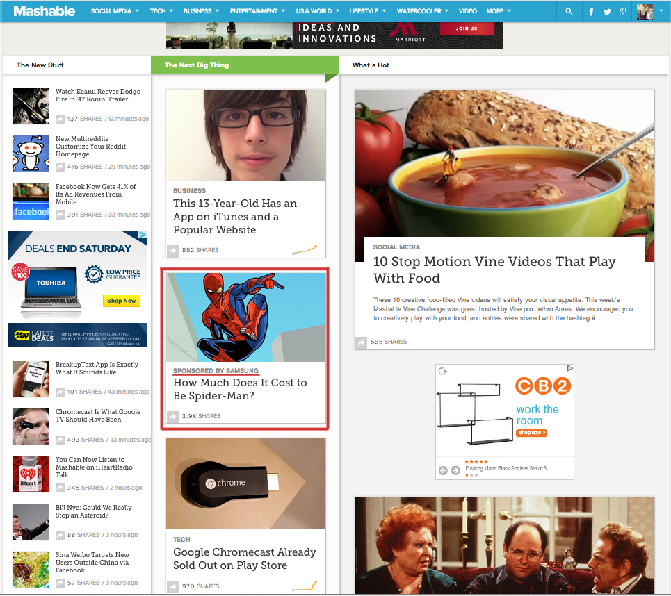
Mashable Lift Units: Our Native Ad Product

Slide 38
Panel 1: Sponsored Content in Digital Publications: The forms it takes and how it operates
MODERATOR:
Laura M. Sullivan
Staff Attorney
Division of Advertising Practices, FTC
PANELISTS:
Tessa Gould
Huffington Post
Todd R. Haskell
Hearst Corporation
Lisa LaCour
Outbrain, Inc.
Chris Laird
The Procter & Gamble Company
Jon Carmen
Adiant
Adam Ostrow
Mashable, Inc.
Steve Rubel
Edelman

Slide 39
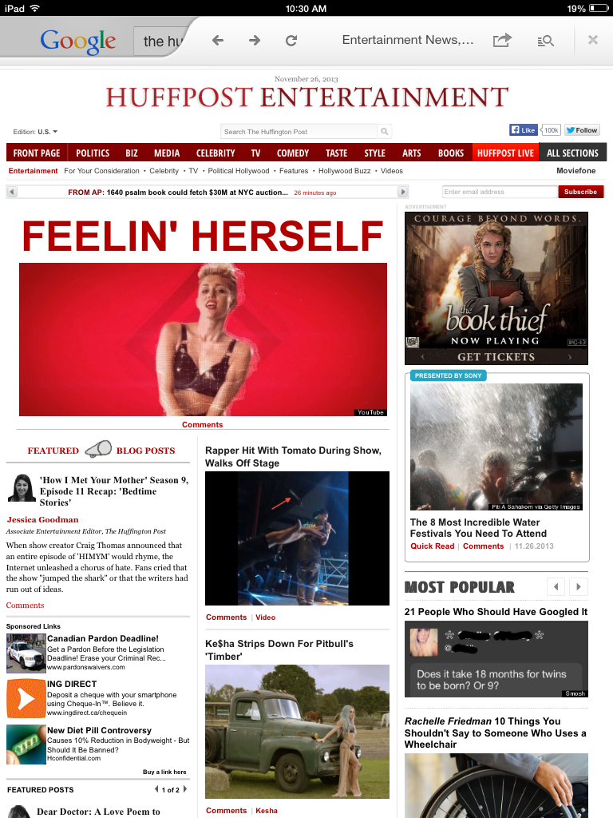
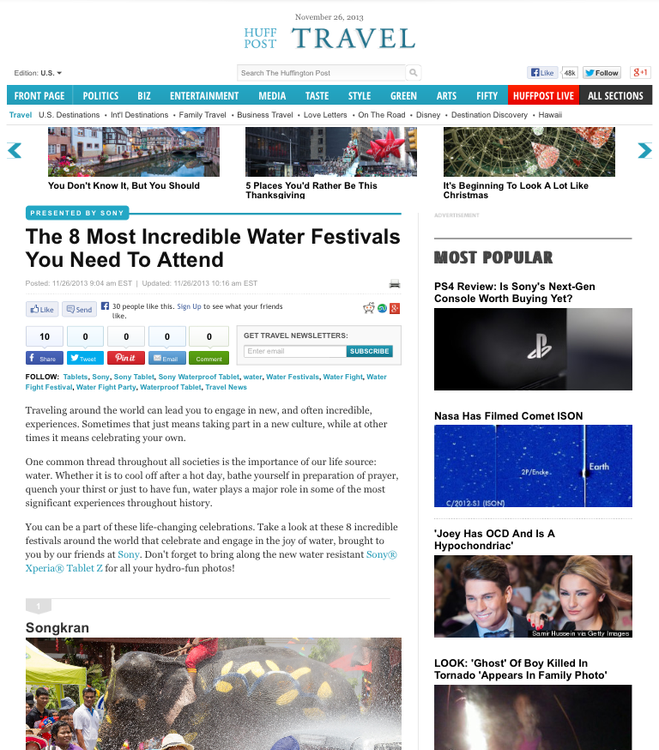
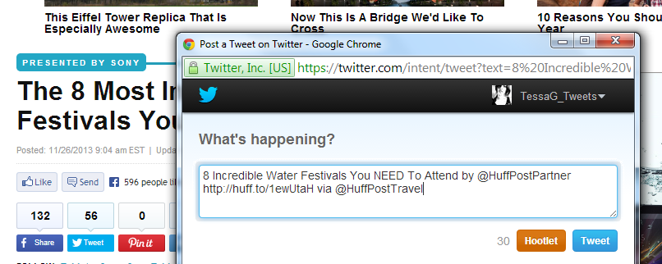
EXAMPLE 1: SPONSORED LISTICLE FOR SONY
2) Article Page = Presented by Sony + explanation within article text
1) Article Preview = Presented by Sony
3) Social share = Automatically identifies HuffPost Partner as author

Slide 40
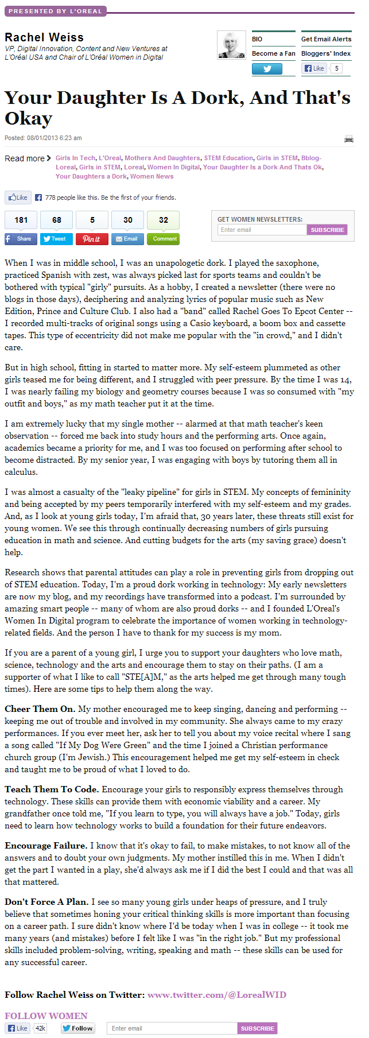
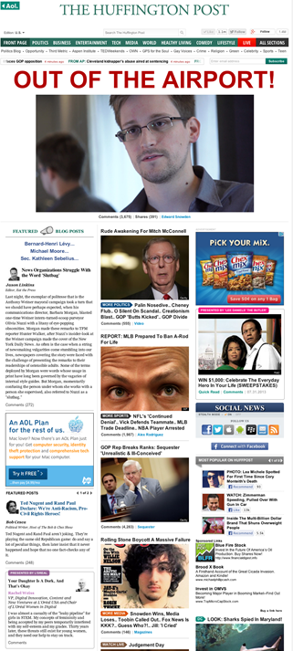
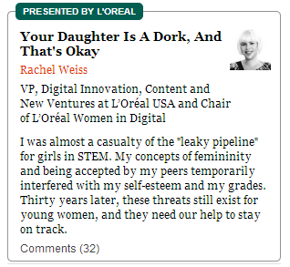
EXAMPLE 2: BRAND BLOG FOR LOREAL
2) Article Page = Presented by Loreal
1) Article Preview = Presented by Loreal. Original author directly attributed
Notes:
Promotes a cause (L’Oreal’s Women In Digital Awards), but from a deeply personal perspective
Zeroed in on the brand’s greater values, without pushing the brand’s products
Subtle mention of the brand towards the end of the blog fit organically with the theme of the piece

Slide 41
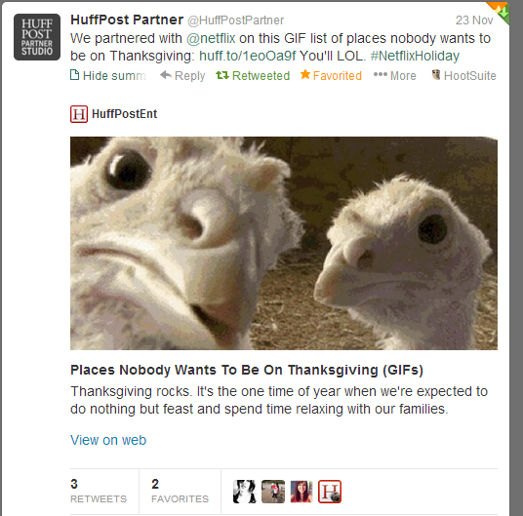
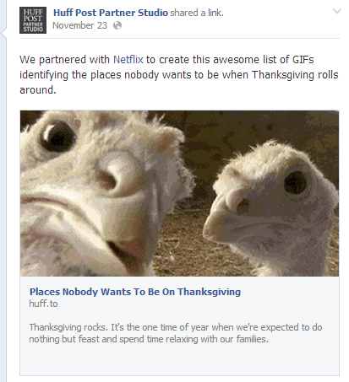
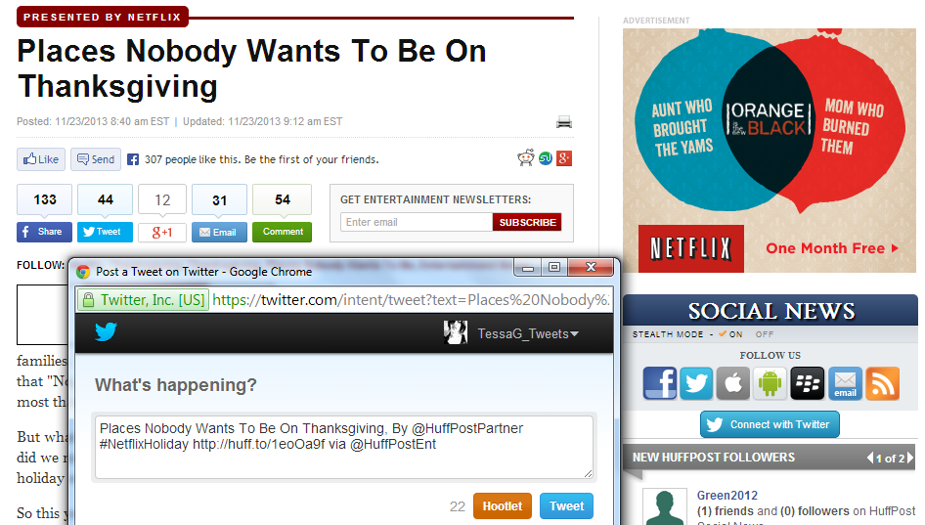
SOCIAL PROMO EXAMPLE: LISTICLE FOR NETFLIX
TWITTER
FACEBOOK
Posted to dedicated HuffPost Partner social media accounts, which are separate from HuffPost editorial accounts
Best practice to tag / identify brand in post
May be shared by editorial accounts, but is done so entirely at editors discretion and must be shared in original format (i.e., retweeted) to ensure the content is credited to HuffPost Partner Studio
Social share wording on article page is pre-populated to ensure content is credited to HuffPost Partner Studio
SOCIAL SHARE FUNCTIONALITY

Slide 42
Panel 1: Sponsored Content in Digital Publications: The forms it takes and how it operates
MODERATOR:
Laura M. Sullivan
Staff Attorney
Division of Advertising Practices, FTC
PANELISTS:
Tessa Gould
Huffington Post
Todd R. Haskell
Hearst Corporation
Lisa LaCour
Outbrain, Inc.
Chris Laird
The Procter & Gamble Company
Jon Carmen
Adiant
Adam Ostrow
Mashable, Inc.
Steve Rubel
Edelman

Slide 43

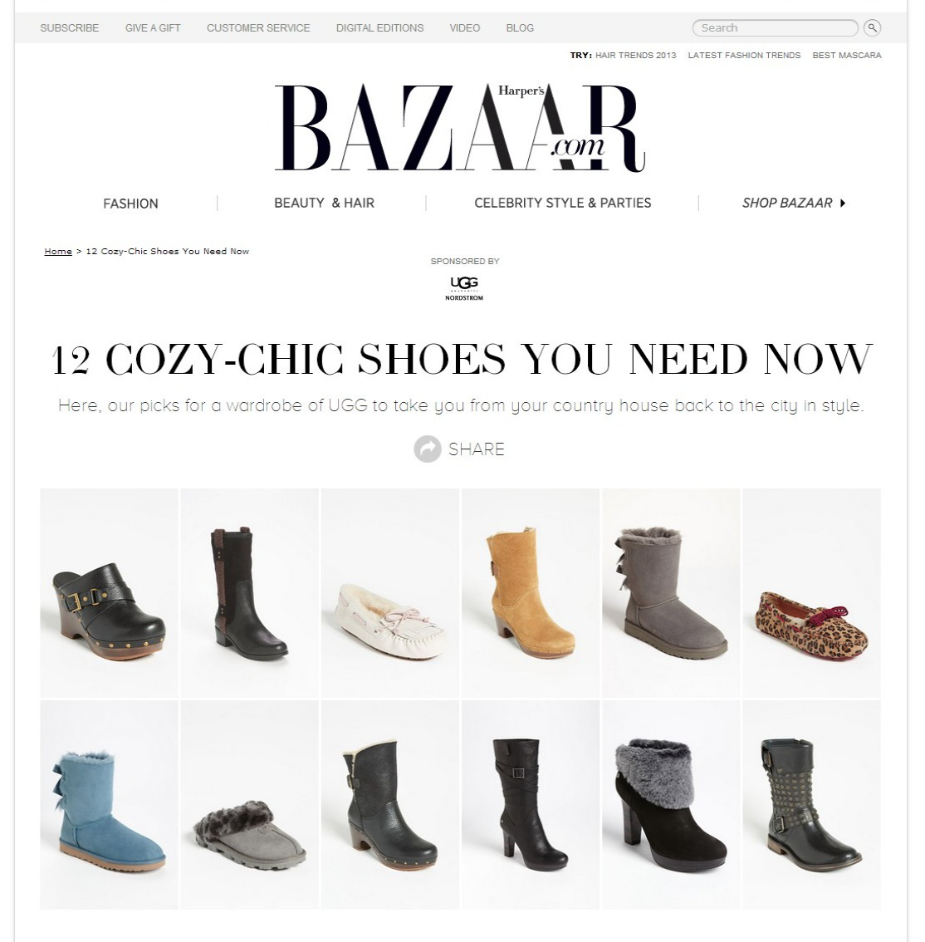
NORDSTROM UGG – Trend Collage

Slide 44
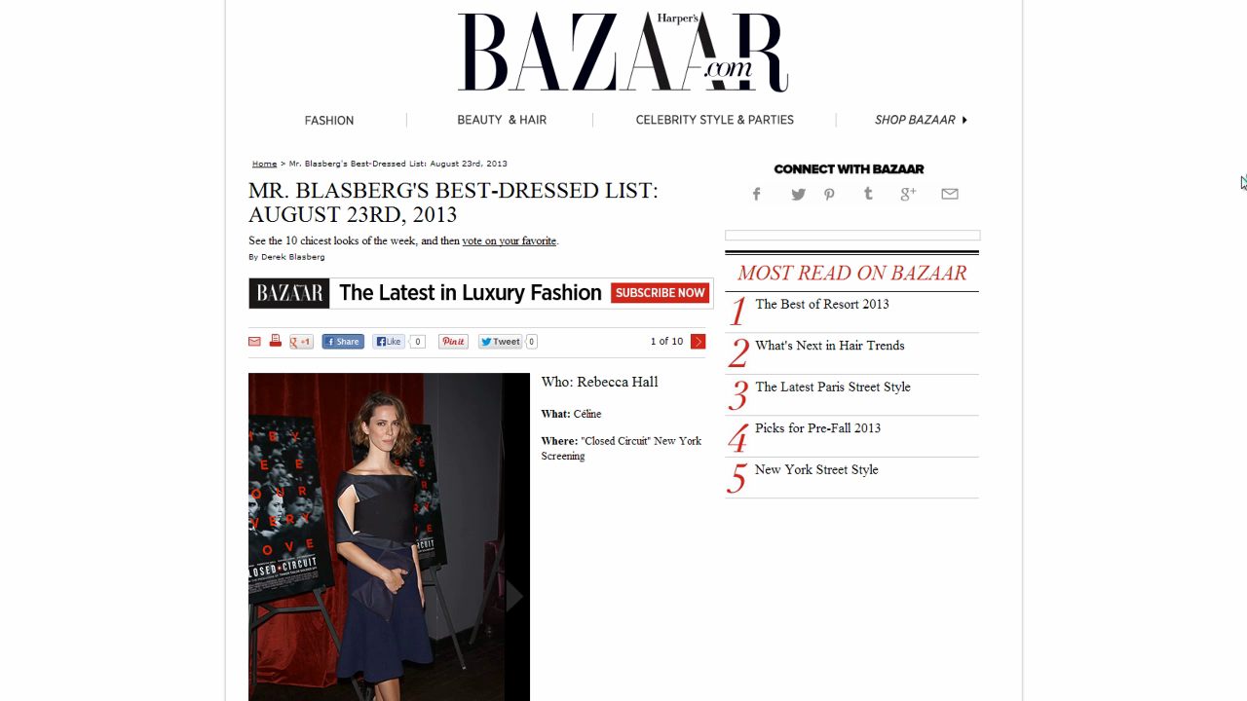
NORDSTROM UGG – Trend Collage

Slide 45
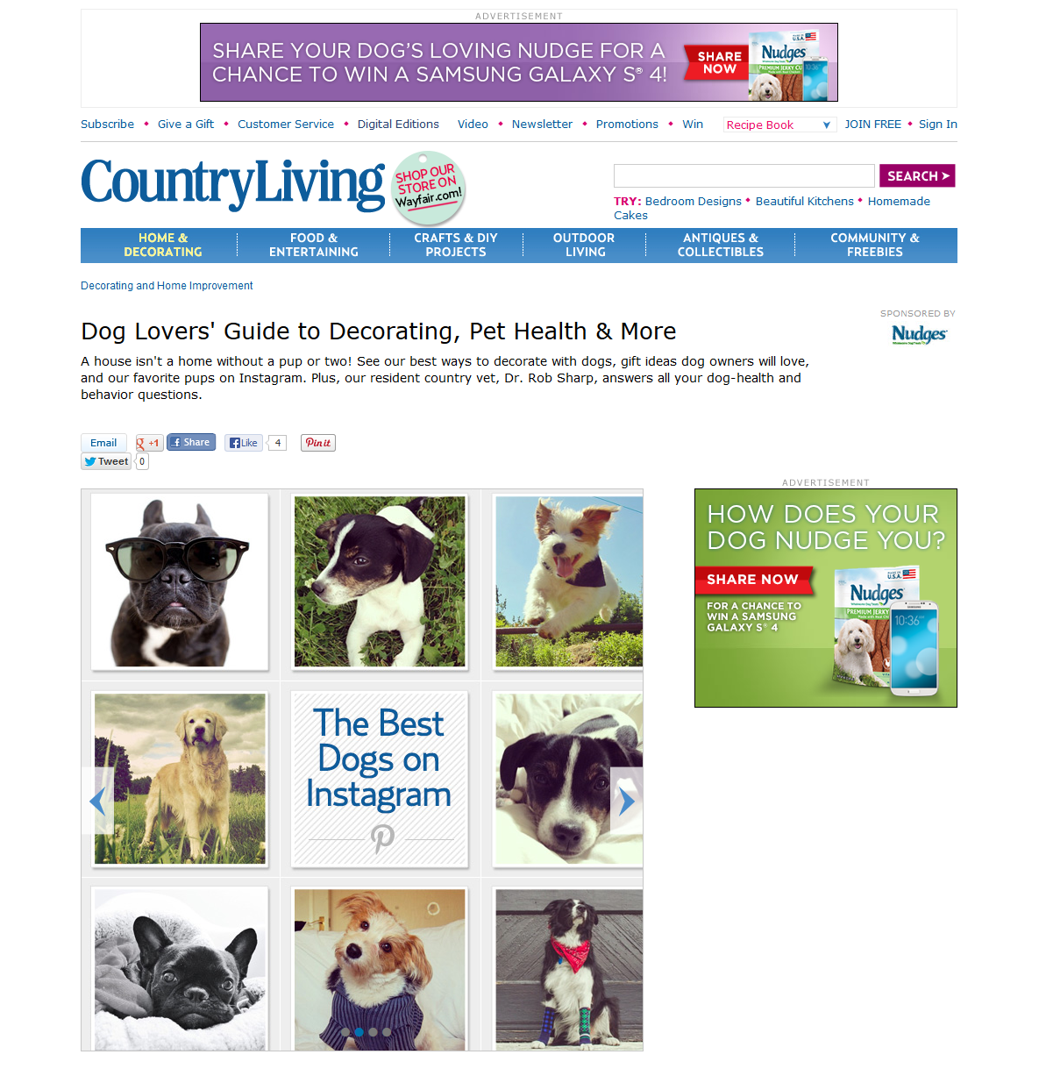
TYSON NUDGES – Mini Epic

Slide 46
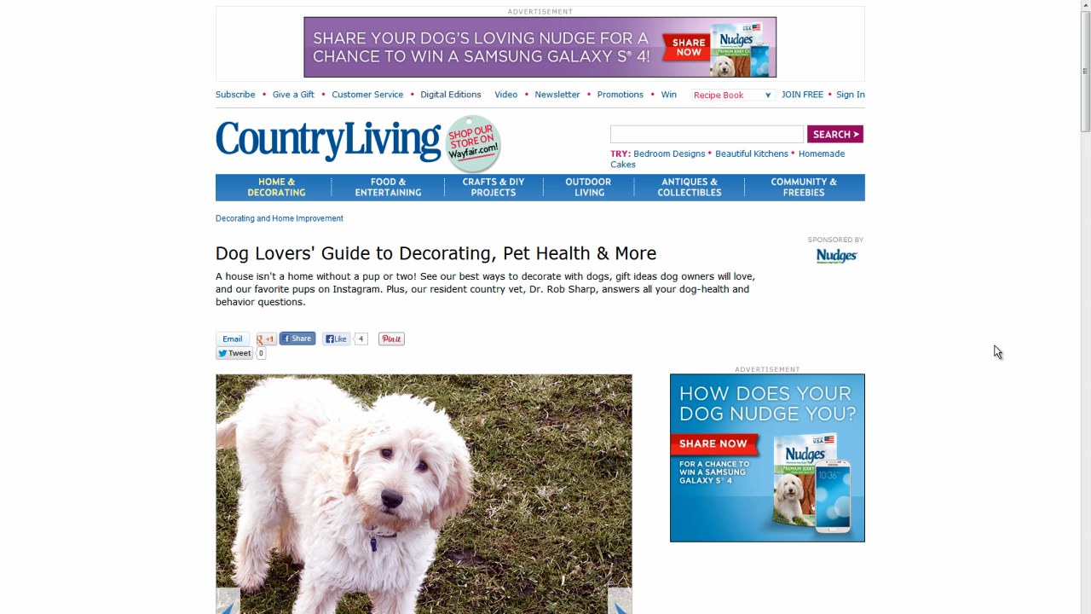
TYSON NUDGES – Mini Epic

Slide 47

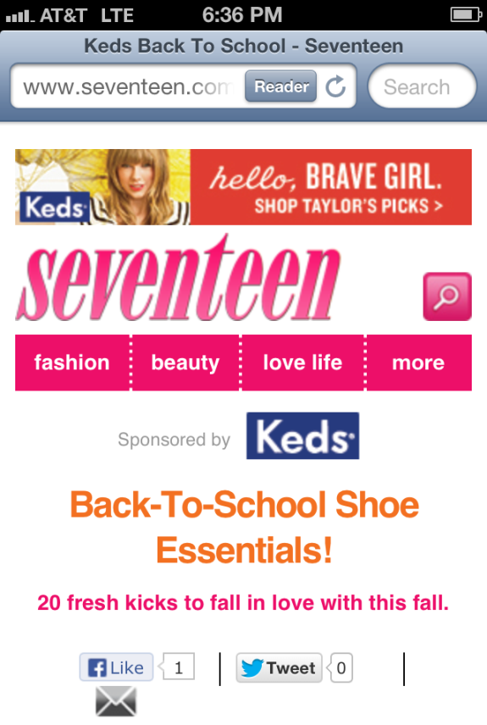
KEDS – Mobile Instream Gallery

Slide 48
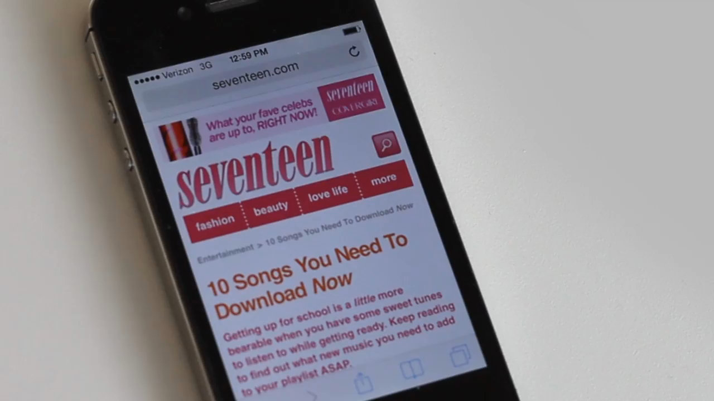
KEDS – Mobile Instream Gallery

Slide 49
Panel 1: Sponsored Content in Digital Publications: The forms it takes and how it operates
MODERATOR:
Laura M. Sullivan
Staff Attorney
Division of Advertising Practices, FTC
PANELISTS:
Tessa Gould
Huffington Post
Todd R. Haskell
Hearst Corporation
Lisa LaCour
Outbrain, Inc.
Chris Laird
The Procter & Gamble Company
Jon Carmen
Adiant
Adam Ostrow
Mashable, Inc.
Steve Rubel
Edelman

Slide 50
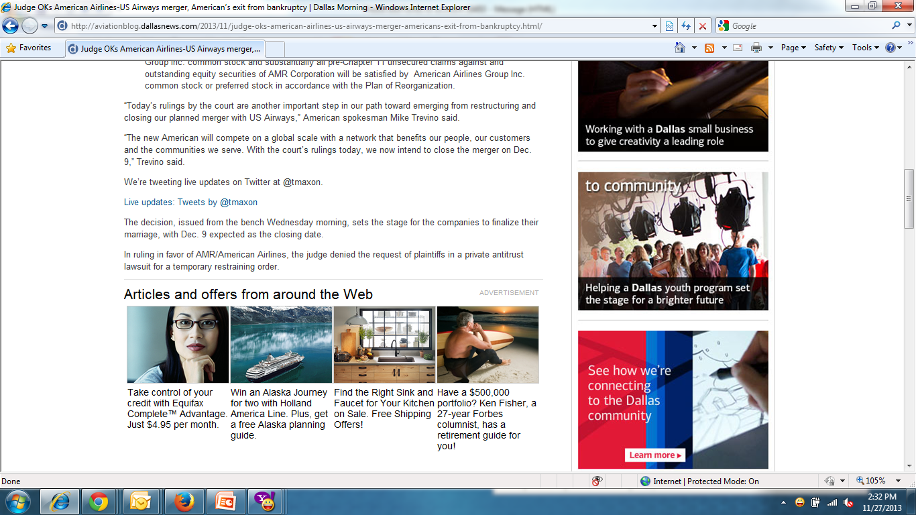

Slide 51
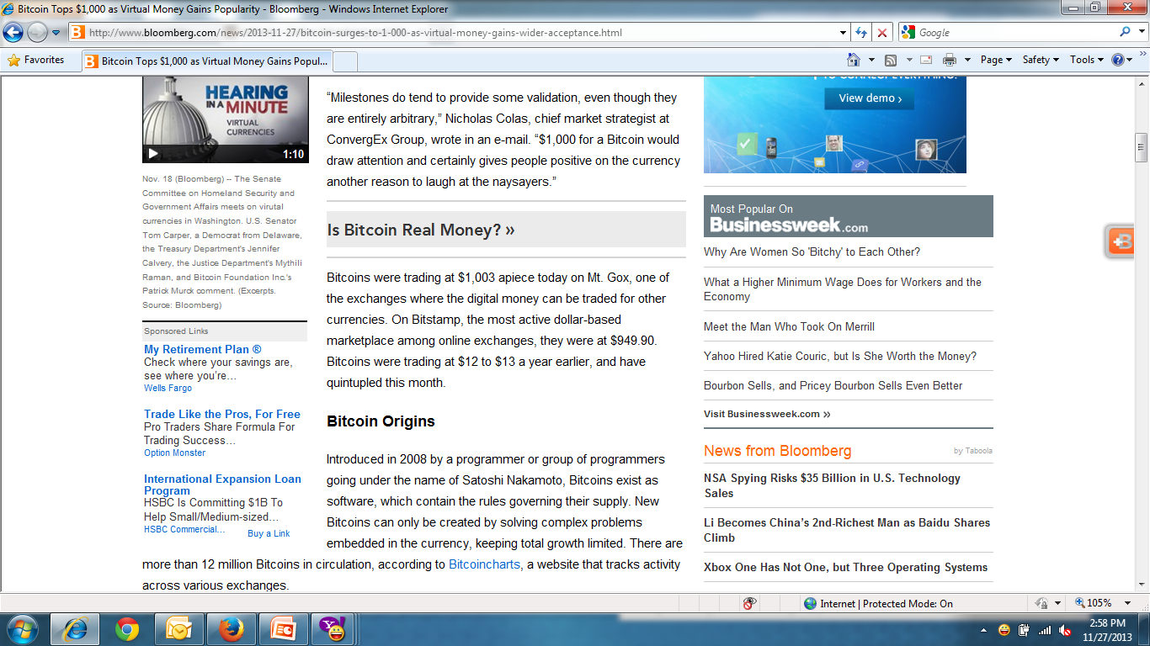

Slide 52
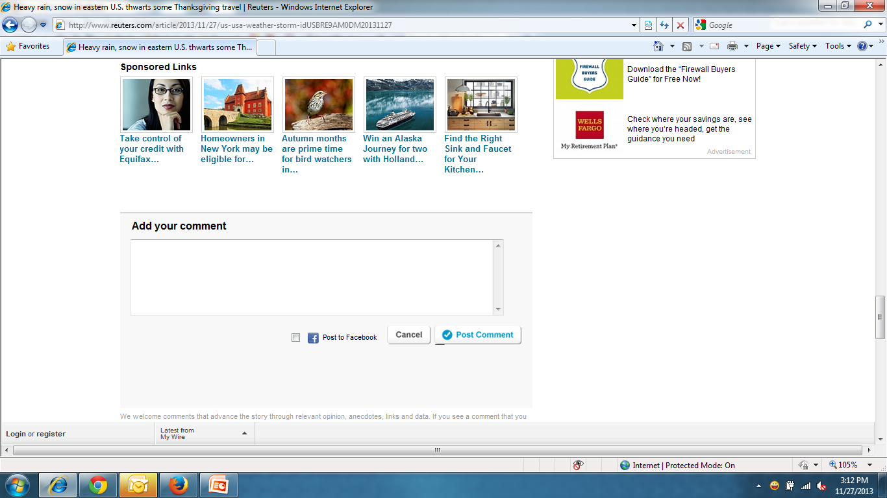

Slide 53
Panel 1: Sponsored Content in Digital Publications: The forms it takes and how it operates
MODERATOR:
Laura M. Sullivan
Staff Attorney
Division of Advertising Practices, FTC
PANELISTS:
Tessa Gould
Huffington Post
Todd R. Haskell
Hearst Corporation
Lisa LaCour
Outbrain, Inc.
Chris Laird
The Procter & Gamble Company
Jon Carmen
Adiant
Adam Ostrow
Mashable, Inc.
Steve Rubel
Edelman

Slide 54
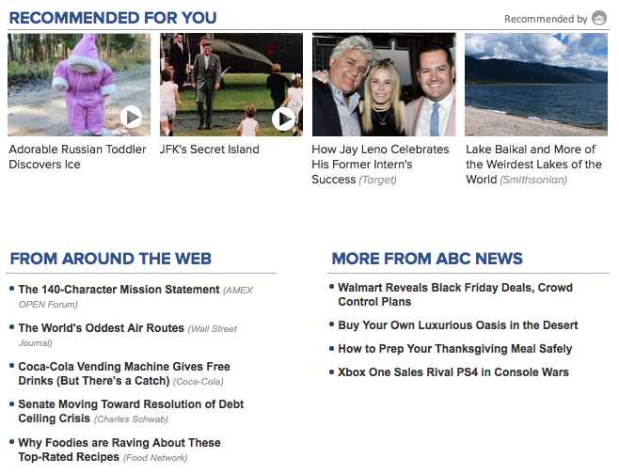

Slide 55
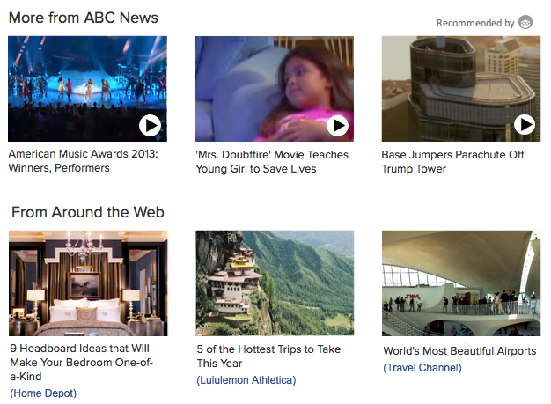

Slide 56
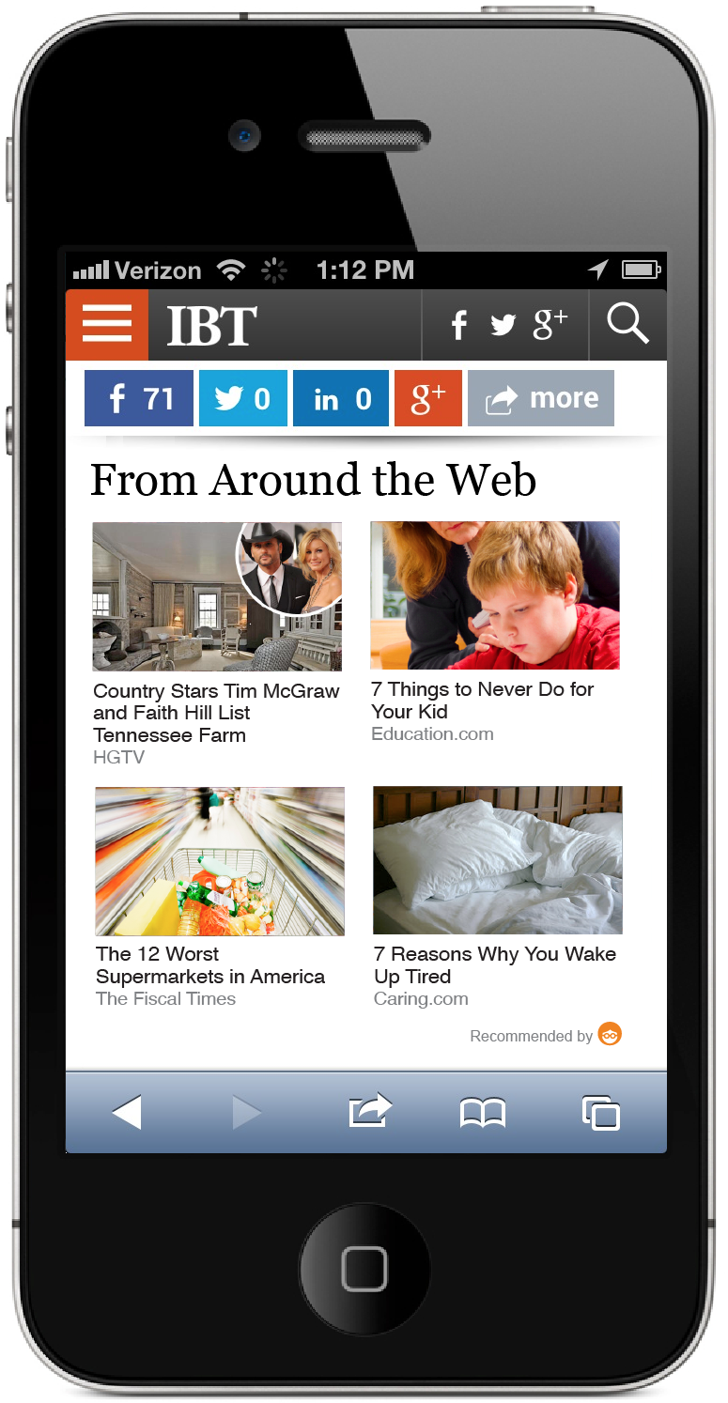

Slide 57
Panel 1: Sponsored Content in Digital Publications: The forms it takes and how it operates
MODERATOR:
Laura M. Sullivan
Staff Attorney
Division of Advertising Practices, FTC
PANELISTS:
Tessa Gould
Huffington Post
Todd R. Haskell
Hearst Corporation
Lisa LaCour
Outbrain, Inc.
Chris Laird
The Procter & Gamble Company
Jon Carmen
Adiant
Adam Ostrow
Mashable, Inc.
Steve Rubel
Edelman

Slide 58
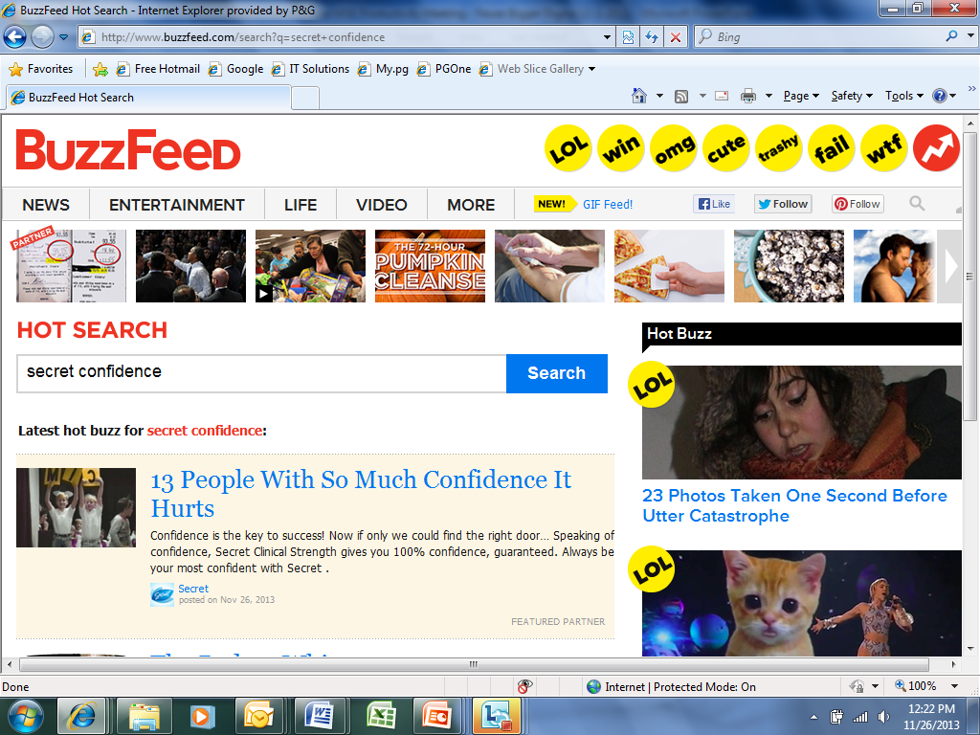
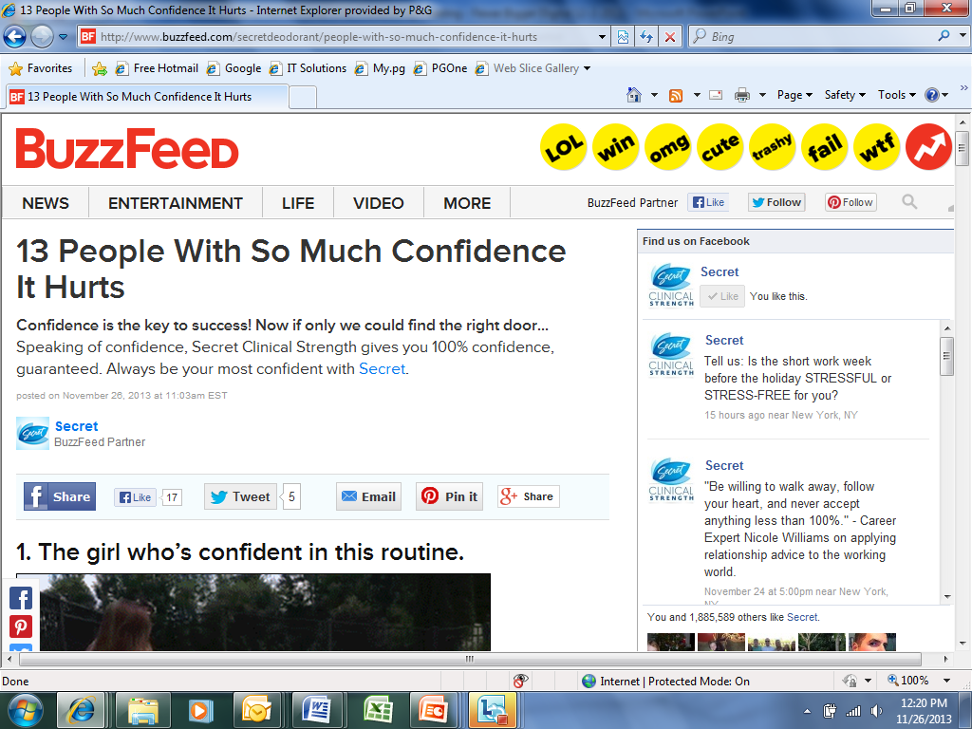
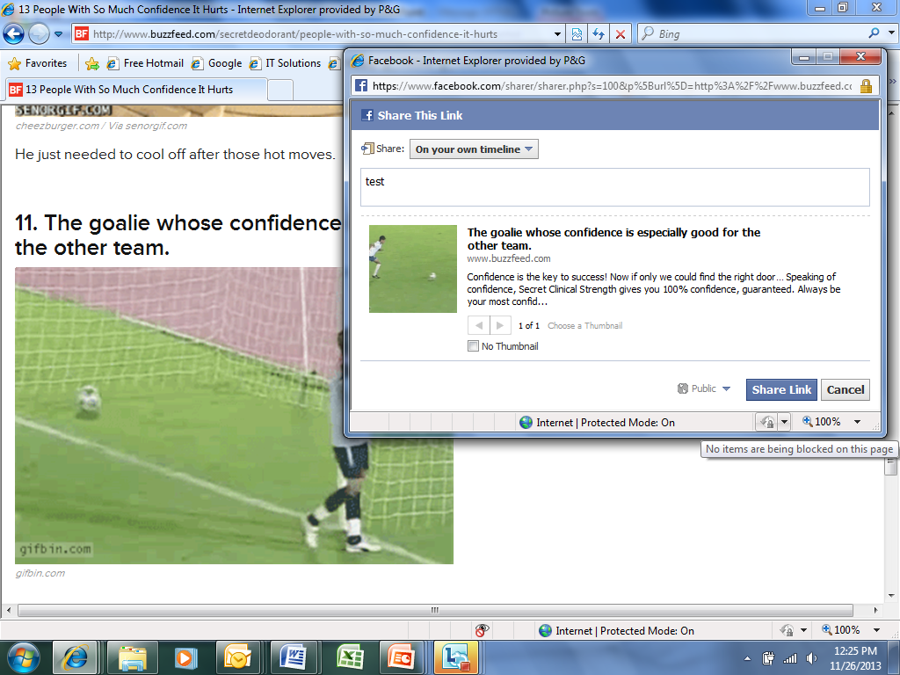
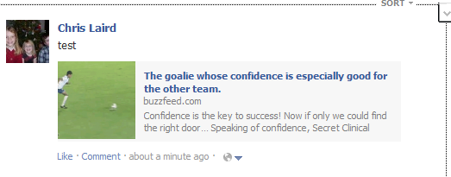
Example 1– Secret Clinical Sponsorship of Buzzfeed Slideshow
1. Tile on homepage, Secret-branded
2. Opened article, Secret-branded
3. “Like” a specific video & share link
4. Wall-post, Secret-branded

Slide 59
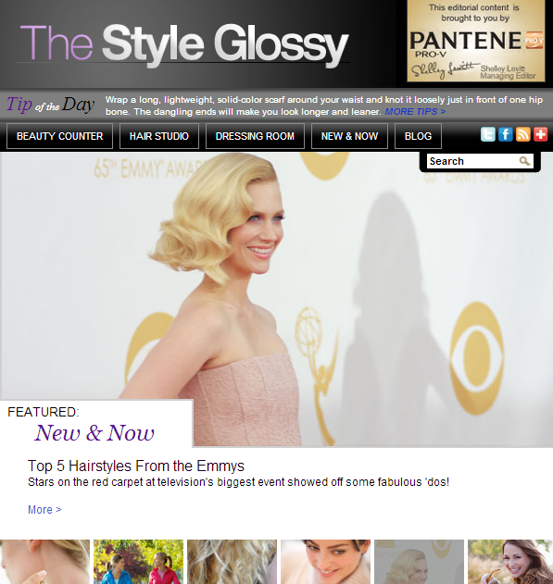
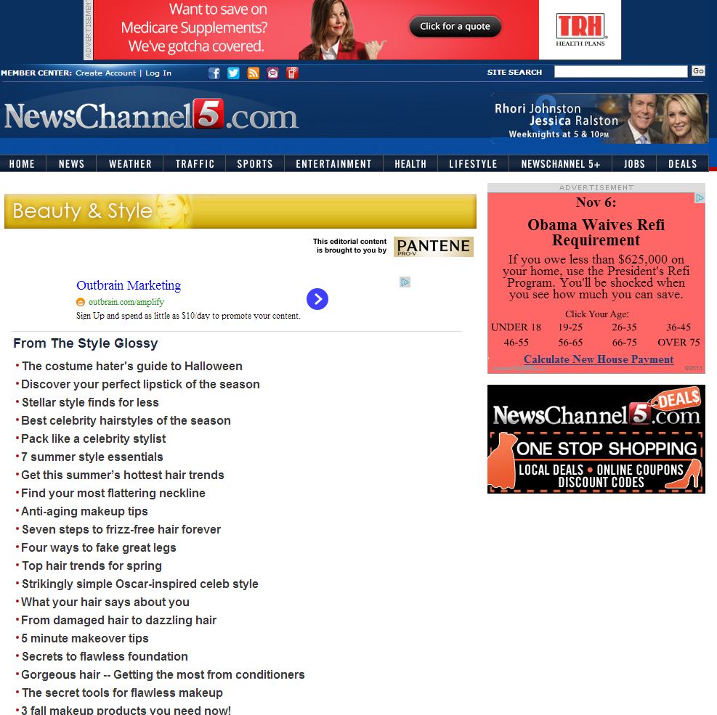
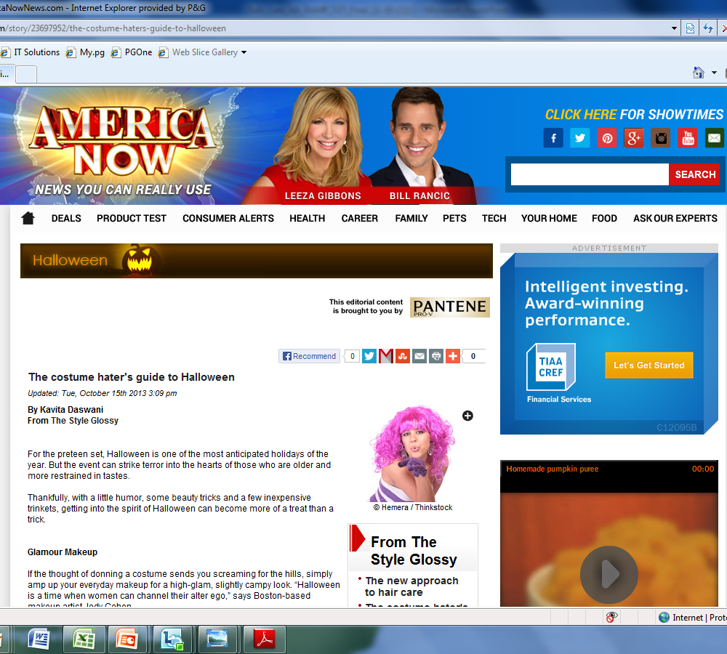
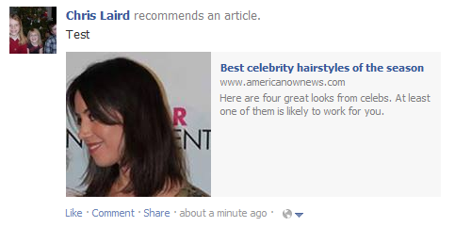
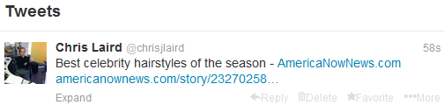
Example 2 – Pantene Sponsorship of Studio One Produced & Syndicated Property
1. Digital Property, Pantene-sponsored
2. Syndicated out to long-tail, Pantene-sponsored
3. Open article, Pantene-sponsored
4. Amplified through social media

Slide 60
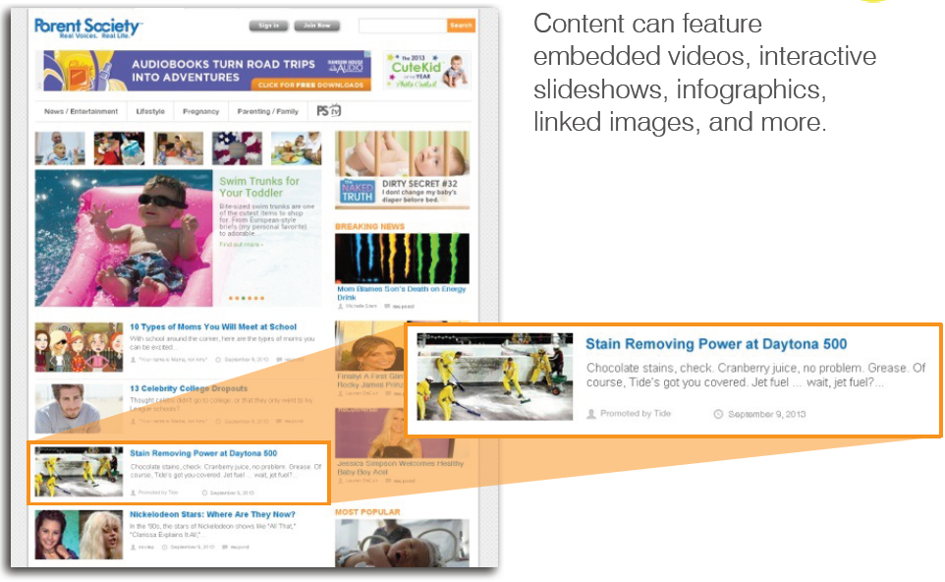
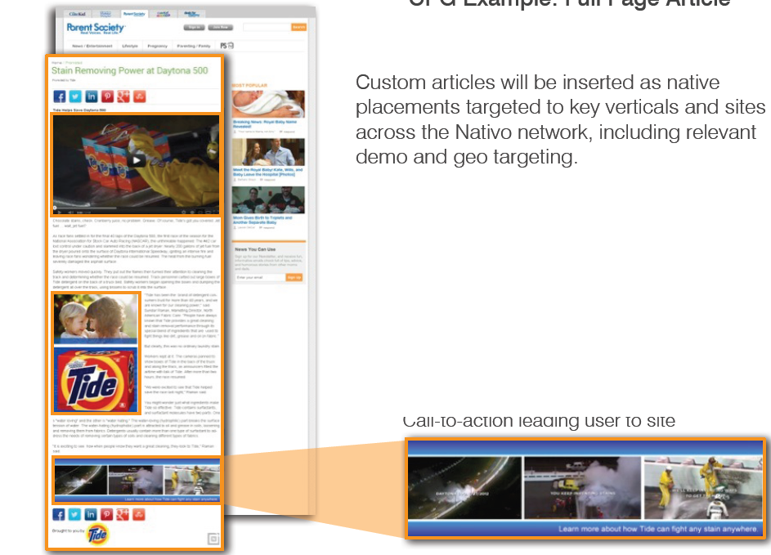
Example 3 – Distribution Channel for Tide Daytona 500 Oil Spill News
2. Tide-sponsored article with link to original video.
1. Tide-sponsored oil spill content formatted for native.

Slide 61
Panel 1: Sponsored Content in Digital Publications: The forms it takes and how it operates
MODERATOR:
Laura M. Sullivan
Staff Attorney
Division of Advertising Practices, FTC
PANELISTS:
Tessa Gould
Huffington Post
Todd R. Haskell
Hearst Corporation
Lisa LaCour
Outbrain, Inc.
Chris Laird
The Procter & Gamble Company
Jon Carmen
Adiant
Adam Ostrow
Mashable, Inc.
Steve Rubel
Edelman

Slide 62
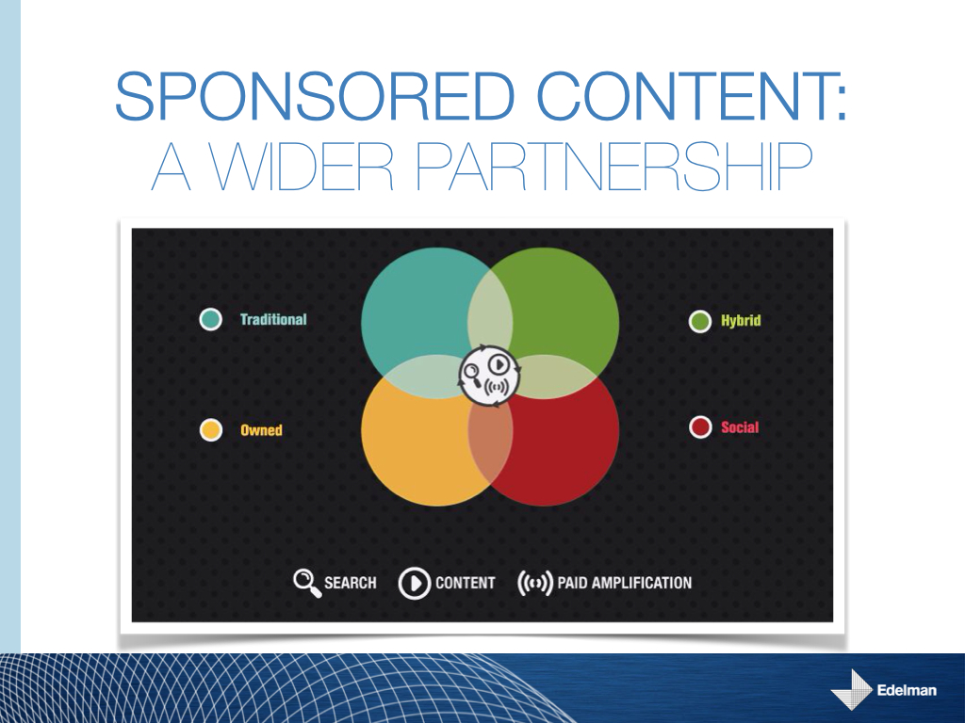

Slide 63
Panel 1: Sponsored Content in Digital Publications: The forms it takes and how it operates
MODERATOR:
Laura M. Sullivan
Staff Attorney
Division of Advertising Practices, FTC
PANELISTS:
Tessa Gould
Huffington Post
Todd R. Haskell
Hearst Corporation
Lisa LaCour
Outbrain, Inc.
Chris Laird
The Procter & Gamble Company
Jon Carmen
Adiant
Adam Ostrow
Mashable, Inc.
Steve Rubel
Edelman

