Slide 1
Panel 3: The Way Forward on Transparency
A discussion of best practices

Slide 2
Panel 3: The Way Forward on Transparency: A discussion of best practices
MODERATOR:
Mary K. Engle
Associate Director
Division of Advertising Practices, FTC
PANELISTS:
Laura Brett
National Advertising Division of the
Council of Better Business Bureaus
Sid Holt
American Society of Magazine
Editors
Amy Ralph Mudge
Venable LLP
Jon Steinberg
BuzzFeed Inc.
Robin Riddle
The Wall Street Journal
Robert Weissman
Public Citizen
Mike Zaneis
Interactive Advertising Bureau

Slide 3
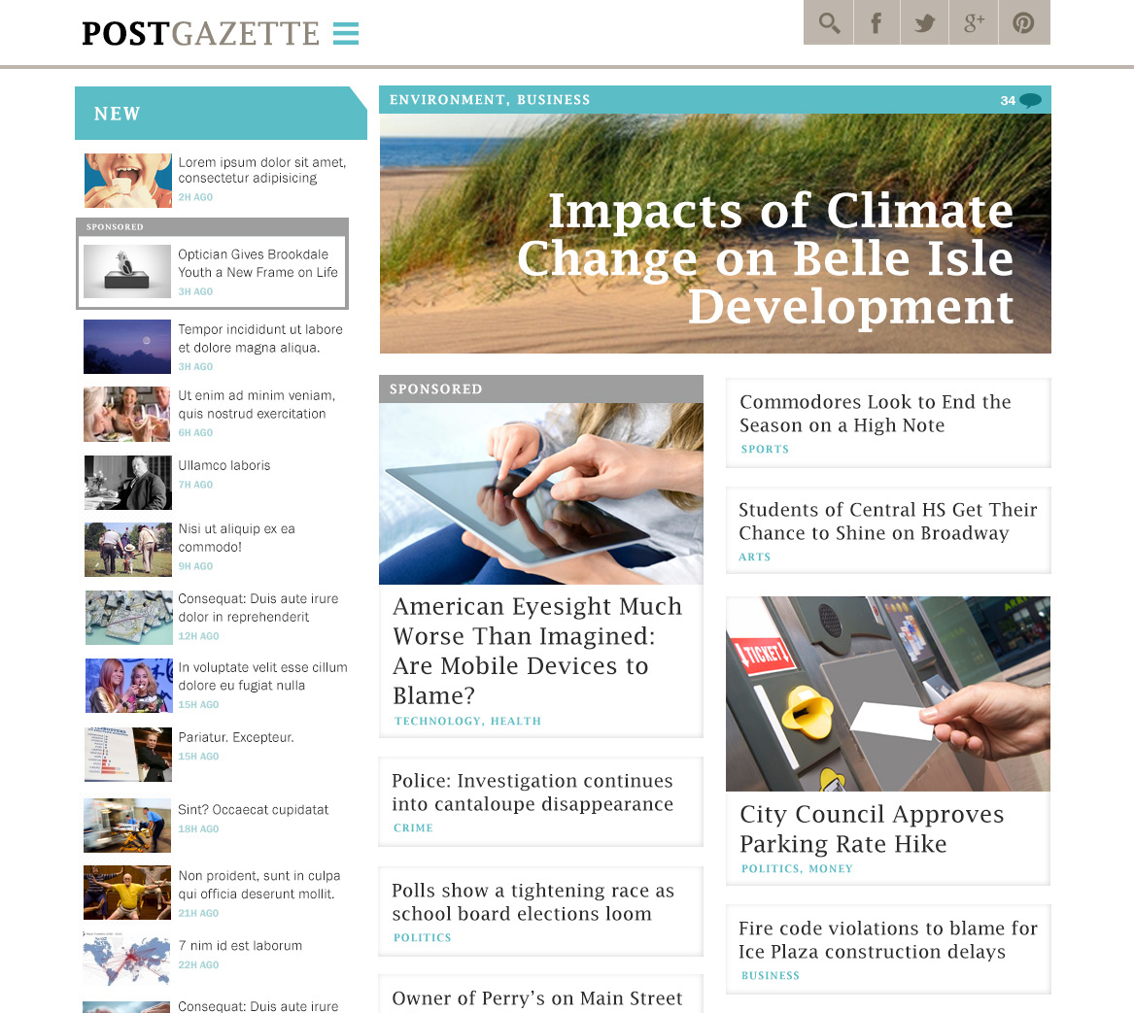

Slide 4
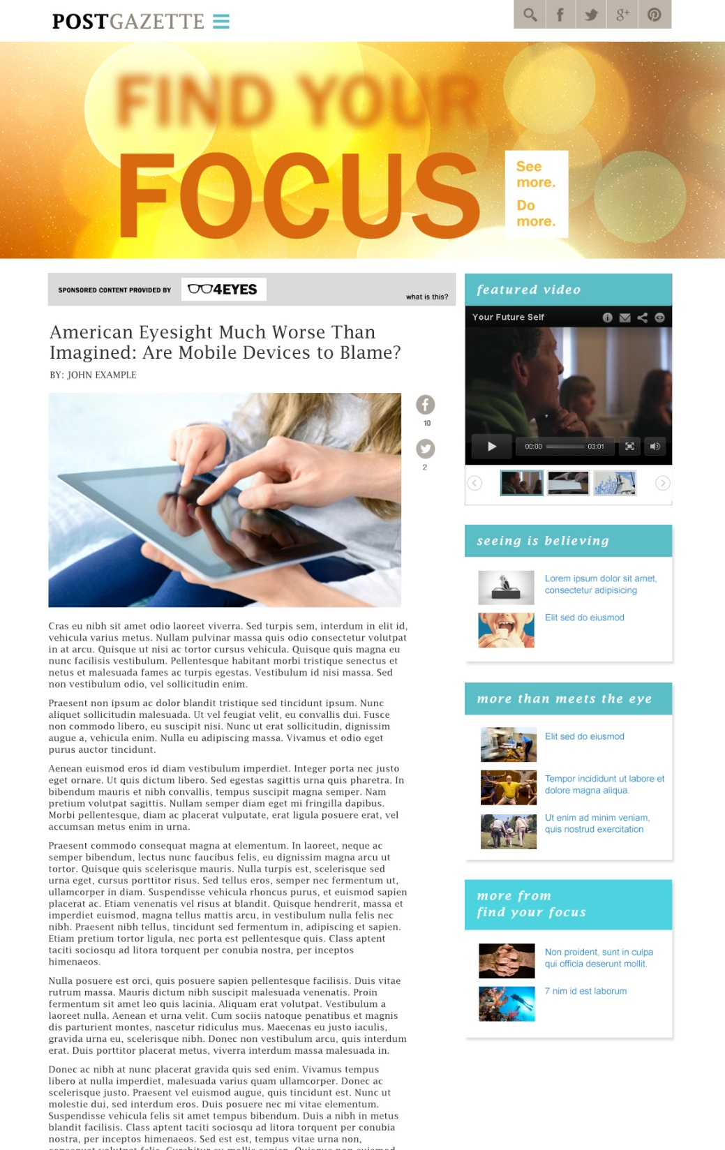

Slide 5
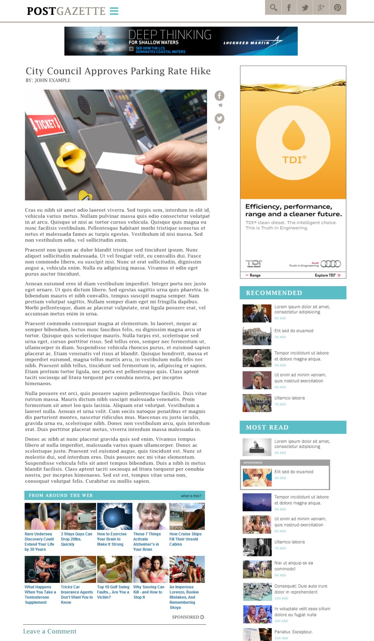

Slide 6


Slide 7
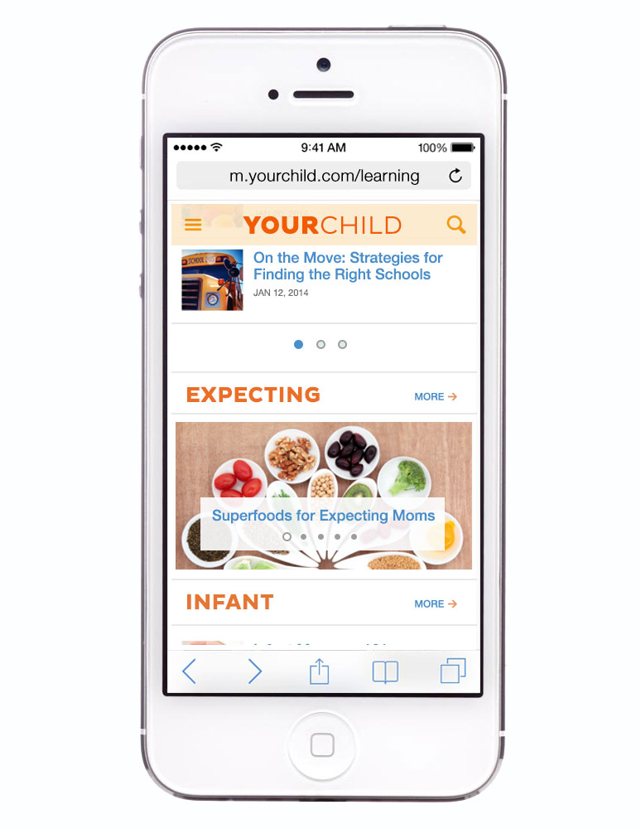

Slide 8
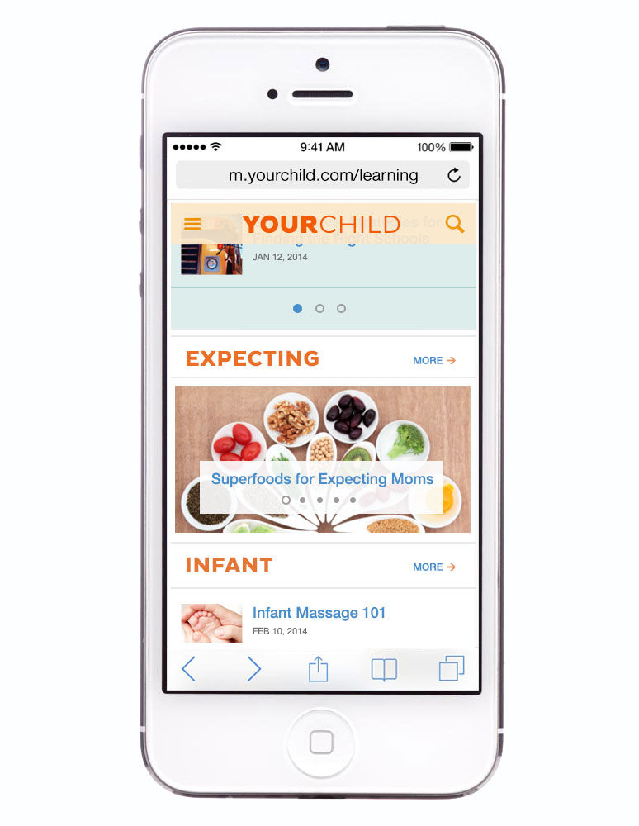

Slide 9
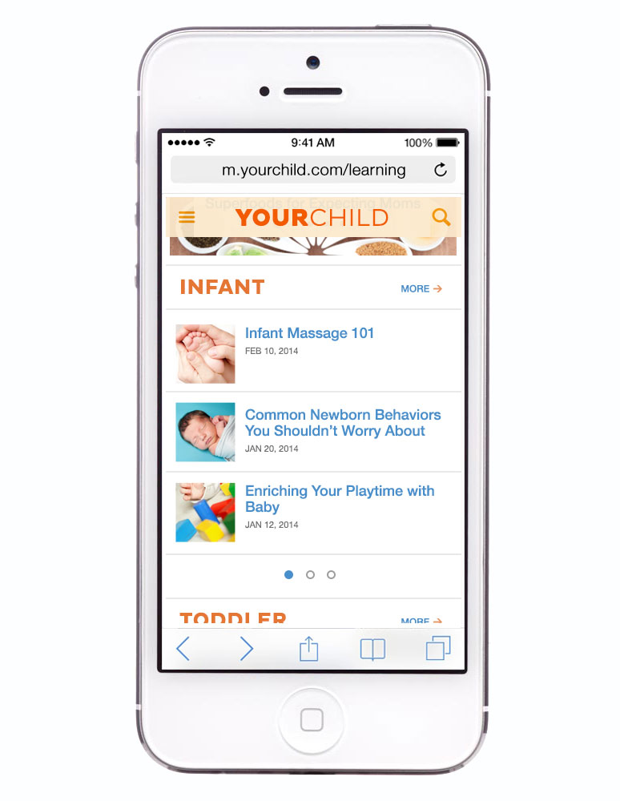

Slide 10
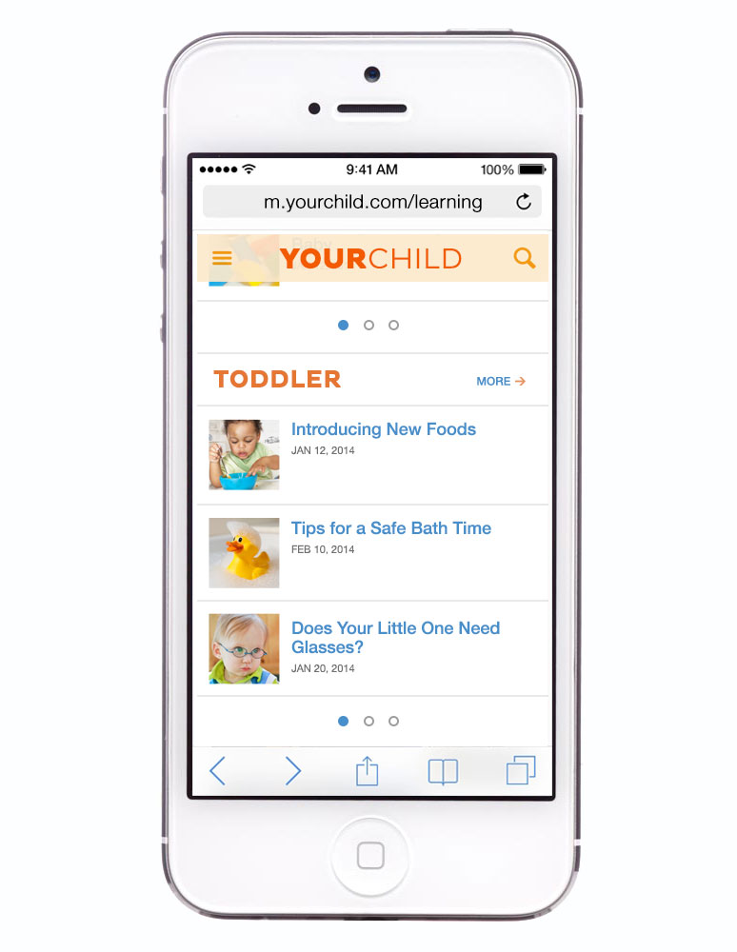

Slide 11


Slide 12
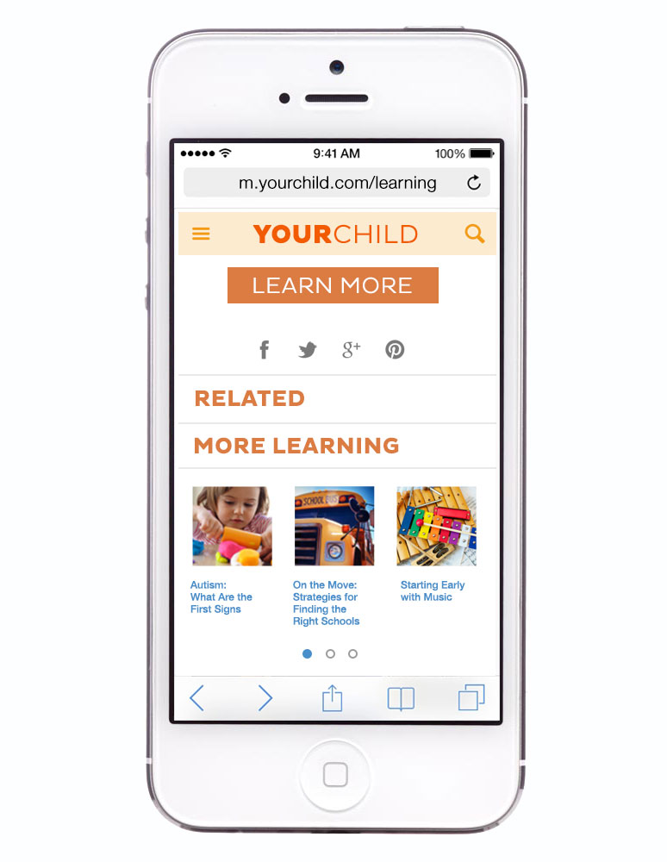

Slide 13
Panel 3: The Way Forward on Transparency: A discussion of best practices
MODERATOR:
Mary K. Engle
Associate Director
Division of Advertising Practices, FTC
PANELISTS:
Laura Brett
National Advertising Division of the
Council of Better Business Bureaus
Sid Holt
American Society of Magazine
Editors
Amy Ralph Mudge
Venable LLP
Jon Steinberg
BuzzFeed Inc.
Robin Riddle
The Wall Street Journal
Robert Weissman
Public Citizen
Mike Zaneis
Interactive Advertising Bureau

Slide 14
Closing Remarks
Jessica Rich
Director
Bureau of Consumer Protection, FTC

