Slide 1
ASTM F963 – A Unique Government / Industry /
Public Interest Partnership
Alan P. Kaufman
Senior Vice-President, Technical Affairs
Toy Industry Association
November 29, 2012
Washington, DC

Slide 2
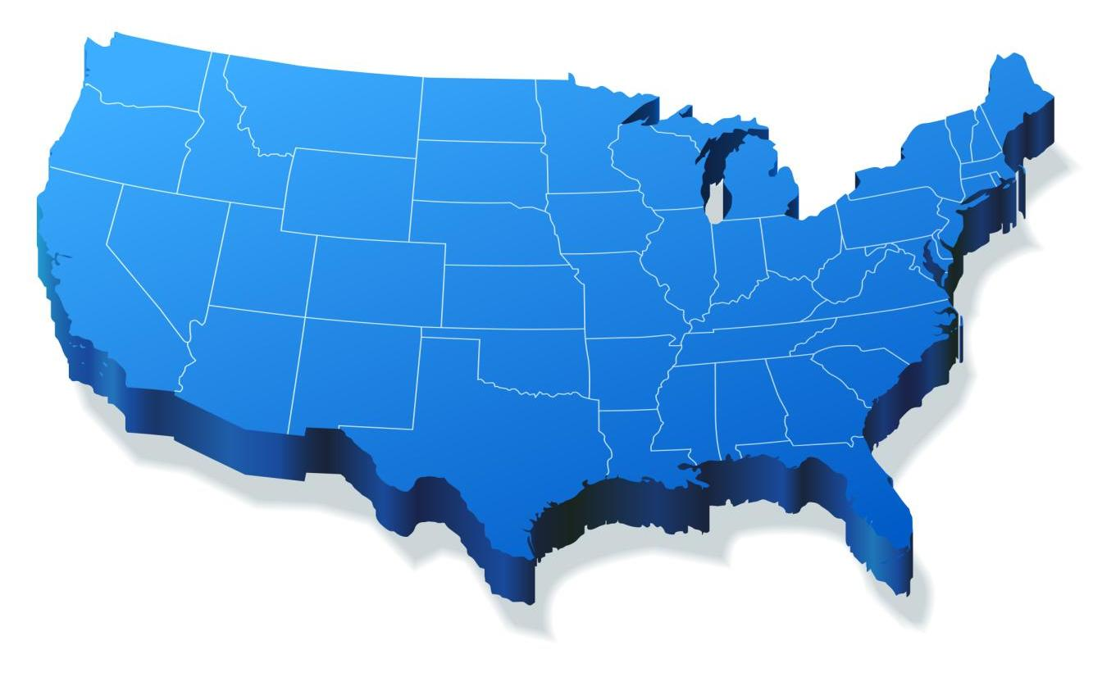
A Snapshot of the U.S. Toy Industry
Average price of a toy is less than US$8.00
An estimated 3 Billion units sold each year
US$22.2 Billion in direct toy sales (2011)
Estimated 533,177 FTE toy industry jobs in the United States
Total annual economic impact of US$80.9 Billion

Slide 3


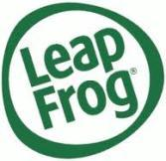



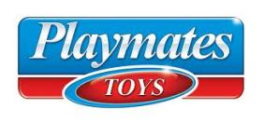






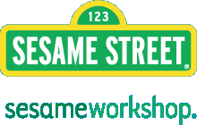




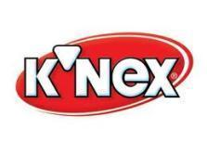

Current TIA Membership
Toy Brands, Manufacturers, Licensors, Inventors, Mfr Reps, Retailers, Labs
Founded 1916 – 550+ Members – 85% of North American Toys

Slide 4
A History of Leadership in Safety
1930s | 1940s | 1950s | 1970s | 1990s | 2000s | 2010-
TIA institutes its Safety Standards Committee and begins partnership with the National Safety Council (NSC). | TIA and NSC collaboration leads to establishment of a National Accident Reporting Service. | TIA and NSC efforts continue with development of National Clearinghouse for Toy Injuries. TIA joins with American National Standards Institute (ANSI) to develop a standard for the coating finishes on toys and other children’s articles. | TIA leadership results in publication of first comprehensive national toy safety standard (known today as ASTM F963). TIA launches a Toy Safety Educational Program. | TIA institutes an annual Toy Safety Conference for Chinese manufacturers in conjunction with the U.S. Consumer Product Safety Commission (CPSC) and Chinese government. | TIA advocates for mandatory toy safety testing; works with legislators to develop enhanced, uniform toy safety laws; and develops safety compliance best practices. Congress passes Consumer Product Safety Reform legislation. | TIA develops www.ToyInfo.org website as a resource for parents and other caregivers on safe and fun toys and the importance of play.
Notes:
TIA and the toy industry have a long history of leadership in toy safety, dating back to the 1930s, and working with a number of partners in this regard.
In the 1970s, industry helped develop the first comprehensive toy safety standard.
Continue to lead technical committee on toy safety today.
And we do consumer outreach to consumers to provide guidance on selecting toys and ensuring safe play.

Slide 5
The Basics
Congress explicitly endorsed both the content of the F963 standard and the ASTM consensus process used to develop and revise it as part of the Consumer Product Safety Improvement Act of 2008 (CPSIA)
ASTM F963 was adopted as a mandatory rule by CPSC, as required in CPSIA
  Copyright still owned by ASTM International – copies of ASTM standards referenced in federal requirements are available at no charge at www.astm.org
  Read-only copies also available for viewing online at www.cpsc.gov when ASTM proposes revisions to CPSC
F963 is the key requirement for safety of children’s toys in the US

Slide 6
History of the Standard
First version (known as PS72-76) developed by industry and published by the National Bureau of Standards (now NIST) – 1976
First version of ASTM F 963, developed by the American Society for Testing and Materials (now ASTM International) –1986
ASTM F 963- 07e1 adopted as a mandatory standard by the CPSIA in 2008; 2008 version also published and accepted by CPSC
Most recent version (ASTM F 963-11) became mandatory June 12, 2012

Slide 7
Overview of the Standard
Addresses thermal, electrical, and mechanical hazards of toys, packaging, and toy chests
Sections for prevention of choking, lacerations, strangulation, impalement, suffocation, falls, burns, poisoning, eye injuries, etc.
Developmental Age Grading: Advice for matching toys to children of various ages

Slide 8
Mandatory Standard Revision Process
ASTM F15.22 Subcommittee discusses, develops, and finalizes proposed revisions-subcommittee is balanced between industry, consumer advocates, general public, medical and child development experts, and government (CPSC and Health Canada both actively participate)
Revisions must achieve consensus at both subcommittee and F15 Consumer Products Committee levels
ASTM F963 revisions sent to CPSC for review upon publication by ASTM
CPSC may reject revisions within 90 days
Unless rejected, changes become mandatory 180 days after publication

Slide 9
Key Advantages of ASTM F963 Process
ASTM consensus standards development process assures that a multiplicity of viewpoints are considered - industry, consumer advocates, medical and child development professionals, public, government
Nimble process - Revisions can be developed more quickly than a regulatory agency can under Administrative Procedures Act requirements – emerging hazards and innovative products can be addressed expeditiously
CPSC has veto if Commission does not agree with changes
Revised standard, once adopted, has force of federal law and is enforceable by CPSC
Process combines benefits of a consensus standard with those of a mandatory regulation

