Slide 1

Advertising Industry Self-Regulation
FTC Workshop On Enforceable Codes of Conduct: Protecting Consumers Across Borders
C. Lee Peeler
President, National Advertising Review Council
EVP, National Advertising, CBBB
November 29, 2012
Washington D.C.

Slide 2
U.S. National Advertising Programs
NAD – 1971: Developed in response to consumers’ concerns about truth and accuracy in advertising.
CARU – 1974: Chartered to assure that advertisers would take special care in addressing advertising messages to a vulnerable audience.
ERSP – 2004: Developed at the request of ERA to help combat a negative perception of direct-response marketing and monitor industry “outliers.”
Initiative – 2006: Formed to address broad public concern over advertising and childhood obesity.
NAD/CRN – 2007: Created in cooperation with the Council for Responsible Nutrition to expand NAD’s review of dietary-supplement advertising and rein in outrageous claims.
Online Interest-Based Advertising Accountability Program –
2011: Developed in cooperation with the Digital Advertising Alliance to ensure industry compliance with the Self-Regulatory Principles for Online Behavioral Advertising (Principles).

Slide 3
Four Characteristics of Effective
Self-Regulation
Meaningful Standards
Independent: Administered by a respected third party – Council of Better Business Bureaus.
Transparent: The outcome of every case is publicly reported.
Accountable: Companies that refuse to comply are publicly identified and referred to the appropriate government agency.

Slide 4
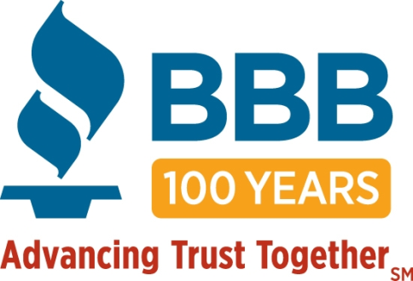
INDEPENDENT: Administered by the Council of Better Business Bureaus
100 year –old organization to advance trust in marketplace
114 Bureaus nationwide in U.S. & Canada
Complaint Resolution -1 million consumer complaints
Business Ratings
No Government funding

Slide 5
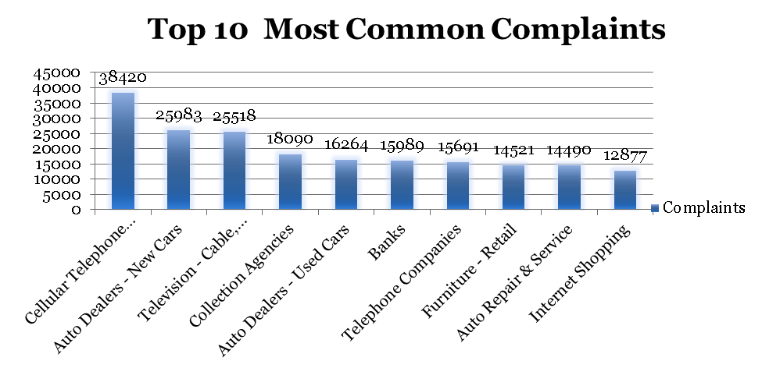

BBB System

Slide 6
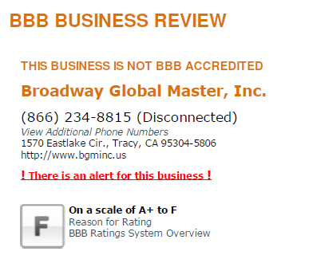
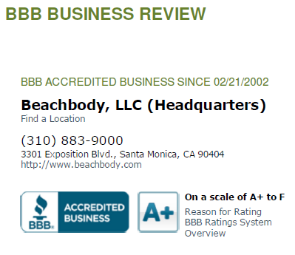
BBB Business Reviews

Slide 7
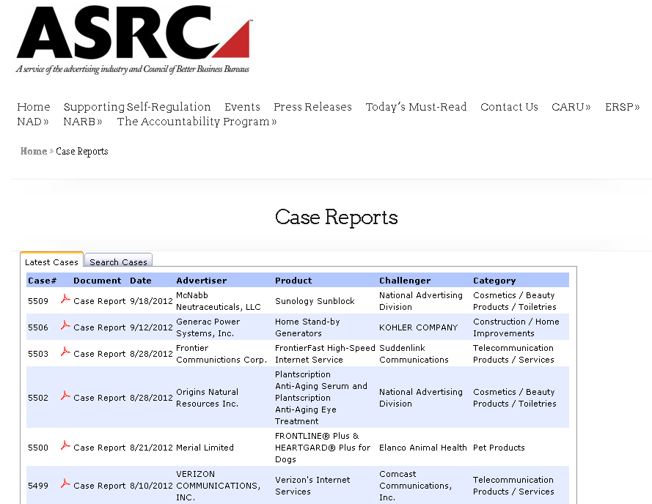
TRANSPARENT: Public Decisions
The U.S. Advertising Self-Regulation process is
transparent. All decisions are reported in a press release and published at our website.

Slide 8
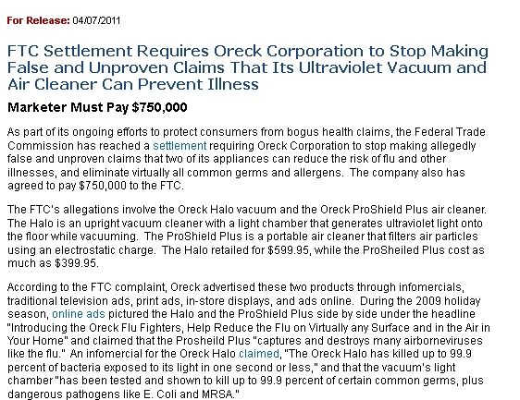
ACCOUNTABLE: Non-Compliance?
Non-Participation?
FTC Requires Oreck to Stop Making ‘False,’ ‘Unproven’ Claims
“The FTC acknowledges the National Advertising Division of the Council of Better Business Bureaus for its referral in this case.”

Slide 9
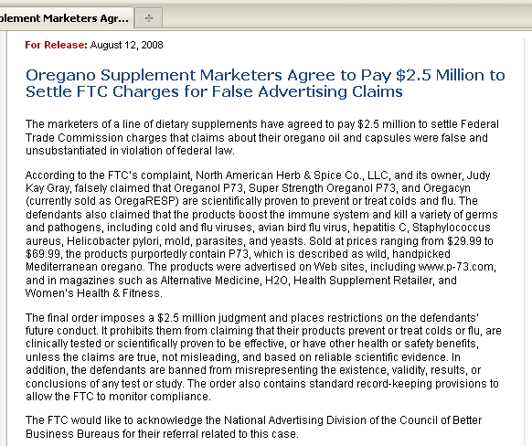
Maker of Oregano Supplement Agrees to Pay $2.5 Million to Settle FTC Charges
“The FTC would
Like to acknowledge
The National Advertising Division
Of the Council of Better Business Bureaus for their referral related to this case.”

Slide 10
CARU
Truthful ad claims
Clear audio & visual disclosures
Don’t advertise inappropriate products
Always show safe use
Don’t use peer pressure
Protect privacy

Slide 11

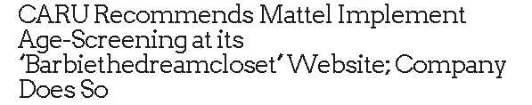

CARU and COPPA
9.12.12
7.25.12
7.11.12

Slide 12
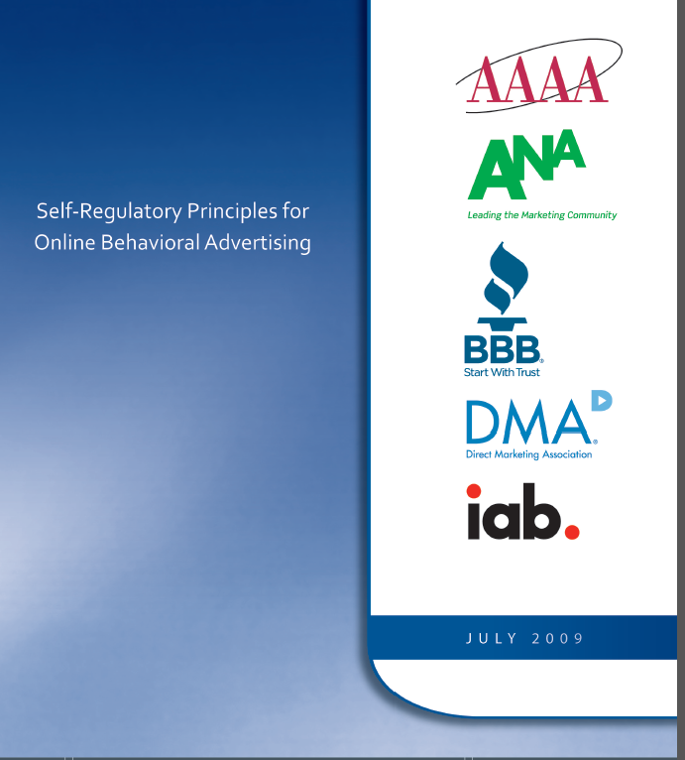
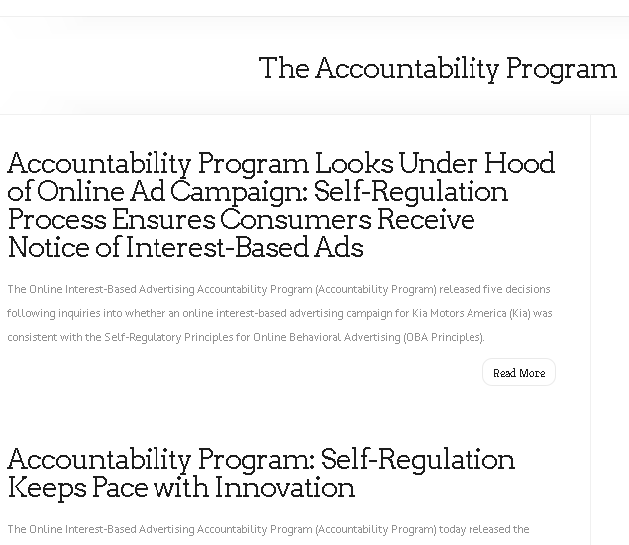

Slide 13



Online Interest-Based
Accountability Program
The “Advertising Option Icon” and
accompanying language should be displayed in
or near online advertisements or on Web pages
where data is collected and used for behavioral
advertising. The Icon indicates adherence to the
Principles.
By clicking on the Icon, consumers will be able to link to:
  a clear disclosure statement regarding the company’s OBA data collection and use practices.
  an easy-to-use opt-out mechanism.
Notes:
The program promotes the use of the “Advertising Option Icon” and accompanying language, to be displayed within or near online advertisements or on Web pages where data is collected and used for behavioral advertising. The Advertising Option Icon indicates a company’s use of online behavioral advertising and adherence to the Principles guiding the program. By clicking on it, consumers will be able to link to a clear disclosure statement regarding the company's online behavioral advertising data collection and use practices as well as an easy-to-use opt-out option.
Effectively immediately, companies collecting or using information for behavioral advertising are encouraged to visit www.AboutAds.info to acquire and begin displaying the Advertising Option Icon, signaling their utilization of behavioral advertising and adherence to the Principles. The launch of an industry-wide icon will enhance the efforts of the growing number of companies that are already using similar mechanisms to deliver enhanced notice to millions of consumers. Interested companies engaged in behavioral advertising can also register to participate in the easy-to-use consumer opt-out mechanism on the www.AboutAds.info site.

Slide 14
New for 2013
Expanded coverage to multi-site data collection
Restrictions on use for eligibility for credit, insurance, employment

Slide 15
Thank you.
For more information, please visit us on the Web @
www.asrcreviews.org
www.bbb.org

