Slide 1



The Fifth Annual African Dialogue
Consumer Protection Conference
Brief ove
Deon Woods Bell and Brian Lingela f Consumer protection and Competition highlights in Namibia
Livingstone, Zambia
10-12 September 2013

Slide 2




The FTC’s International Cooperation
The Office of International Affairs
(Consumer Protection)
* Provide litigation support
* Expand cooperation and information sharing
*Develop international e-commerce policies
*Provide international technical assistance/collaborations

Slide 3
INCREASED FTC CROSS BORDER COLLABORATION
The Federal Trade Commission (FTC) has conducted more than 100 investigations with international components, such as foreign targets, evidence, or assets, and has filed more than 50 cases involving cross-border components, since January 2007. The FTC has used the Act’s authority in many of these matters, and in related actions brought by other U.S. and foreign enforcement agencies.
The FTC has provided evidence in response to 63 information-sharing requests from 17 foreign law enforcement agencies as of mid-2012.
The FTC has issued 52 civil investigative demands (equivalent to administrative subpoenas) in 21 investigations on behalf of nine agencies in five countries.
In cases relying on the SAFE WEB Act, the FTC has to date collected more than $10 million in restitution for injured consumers, despite the challenges of collecting money from defendants in foreign jurisdictions, and has stopped frauds costing consumers hundreds of millions of dollars.

Slide 4
THE AFRICAN CONSUMER
PROTECTION DIALOGUE
* Sharing Information
* Best Practices
* Cross Border Enforcement Collaboration . . .

Slide 5
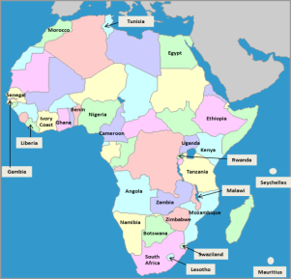

African Dialogue & U.S. FTC
      The African Consumer Protection Dialogue (“African Dialogue”) is an initiative of the U. S. Federal Trade Commission aimed at encouraging regional cooperation and sharing of best practices among consumer protection agencies within Africa, the United States and the rest of the world.
      It also seeks to create informal opportunities to interface with each other, the U.S. and rest of world on consumer protection and competition issues.

Slide 6

African Dialogue & U.S. FTC
Priority Initiatives and Target Projects
Hosting monthly teleconferences/videoconferences to share best practices;
Facilitating information sharing between African consumer protection authorities and U.S. Government and other authorities;
Publishing a Newsletter;
Organizing and participating in consumer education initiatives - including initiatives regarding children's online safety and mobile issues;
Disseminating competition and consumer protection policy information;
Creating or participating in a rapid alert system for cross-border consumer protection issues in Africa and America;
Engaging African regional and economic organizations regarding consumer issues;
Gathering African consumer laws and creating a legal framework toolkit; and
THE PROPOSED AFRICAN DIALOGUE PRINCIPLES ON COOPERATION

Slide 7

African Dialogue & U.S. FTC
Topics for 2013 AD Monthly Teleconferences
January – African Dialogue Planning Call and Highlights from 2012
February - Online and Mobile fraud (including with regard to children - privacy and disclosures) Kenya and Nigeria
March - Travel Scams - Thursday, March 28. U.S. FTC leads and announces FTC Travel Scam Sweep
April - Cross Border Collaboration - Complaints and Cases, Thursday, April 25. Zimbabwe, Zambia and U.S. FTC
May - Health-related issues (including patients' rights issues) - Thursday, May 30. Swaziland, Zambia, Angola and U.S. FTC
June - Privacy and Children's issues - Thursday, June 27. U.S. FTC, Kenya and Egypt
July - Financial Issues - Thursday, July 25. South Africa, Tanzania, U.S. FTC
August - 5th Annual Conference Preparation - Friday, August 30. Zambia and U.S. FTC
September – Competition and Trade Issues impacting consumers - Thursday, September 26 . Uganda, Tanzania and Swaziland
October – Spam and Cyber security - Thursday, October 31. London Action Plan expert – Betsy Broder, Nigeria and South Africa
November - Negative Options and recurring billing issues - Thursday, November 28, U.S. FTC, Seychelles and ICPEN experts
December – 2013 Highlights and major cases – All countries

Slide 8
African Dialogue & U.S. FTC
Members (Government Consumer Agencies and NGOs from 30 African countries)
Angola, Benin, Botswana, Cameroon, Cote d’Ivoire, Egypt, Ethiopia, Gambia, Ghana, Ivory Coast, Kenya, Lesotho, Liberia, Malawi, Mauritius, Morocco, Mozambique, Namibia, Nigeria, Rwanda, Senegal, Seychelles, South Africa, Swaziland, Tanzania, Tunisia, Uganda, United States, Zambia and Zimbabwe
Conference Observer - Oman

Slide 9


Slide 10





African Dialogue & U.S. FTC
Regional Liaisons
      * EAST AFRICA - Kenyan Competition Authority
      * WEST AFRICA - Nigerian Consumer Protection Council
      * NORTH AFRICA - Egyptian Consumer Protection Agency
      * SOUTHERN AFRICA - Zambian Competition and Consumer Protection Commission

Slide 11

African Dialogue & U.S. FTC
Annual Conferences
      * August 2009 - Johannesburg, South Africa
      * July 2010 – Arusha, Tanzania
      * September 2011 – Abuja, Nigeria
      * August 2012 – Rabat, Morocco
      * September 2013 – Livingstone, Zambia

Slide 12


The African Consumer Protection Dialogue
The Fifth Annual Conference, September 10-12, 2013
Livingstone, Zambia
Theme: Moving Cross Border Enforcement Collaboration Forward

Slide 13
Conference Partners
      World Bank
      Washington & Lee University
      Organization for Economic Cooperation and Development
And, more collaboration with regional entities and International bodies
      COMESA, SADC, EAC, ECOWAS and (hopefully) AU
      INTERPOL and UNCTAD

Slide 14
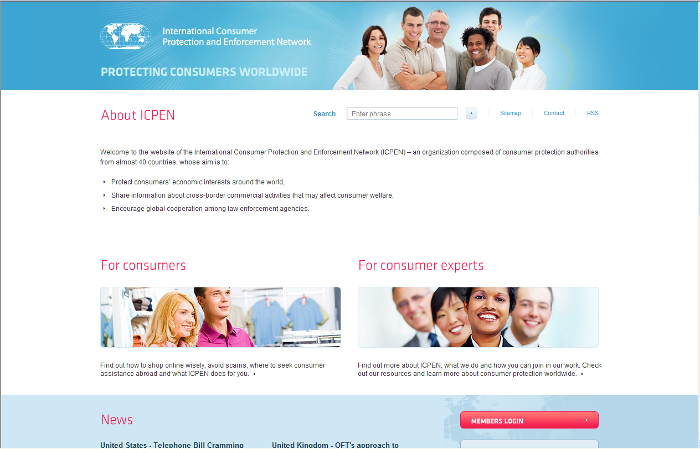
International Consumer Protection and Enforcement Network (ICPEN)

Slide 15
APRIL 2013 ICPEN Updates
48 Member Organizations: Australia, Austria, Azerbaijan, Barbados, Belgium, Canada, Chile, China, Costa Rica, Cyprus, Czech Republic, Denmark, Egypt, El Salvador, Estonia, the EC, France, Finland, Germany, Greece, Hungary, Ireland, Israel, Italy, Japan, Korea, Latvia, Lithuania, Luxembourg, Malta, Mexico, Mongolia, Netherlands, New Zealand, Nigeria, Norway, Panama, Papua New Guinea, Poland, Portugal, Slovakia, Spain, Sweden, Switzerland, Turkey, United Kingdom, United States, and Vietnam
7 Partner Organizations: Angola, Bulgaria, Colombia, Dominican Republic, Philippines, Seychelles, and Zambia.
3 Observers: The European Commission (EC), Organization of Economic Cooperation and Development (OECD) and the United Nations Conference on Trade and Development (UNCTAD).
Guests: India, Malaysia, Morocco, Suriname
Regional Collaborations: Latin America (FIAGC), Asia/Pacific (APEC), Africa (African Consumer Protection Dialogue), Europe (European Commission).

Slide 16
Mission
  ICPEN’s mission is to protect consumers by encouraging and facilitating practical action to prevent cross border marketing malpractice.
  These actions include -
  information sharing on market developments and regulatory best practice,
  as well as coordination and cooperation to tackle market problems.
  a new project includes stakeholders – including regional organizations and businesses

Slide 17
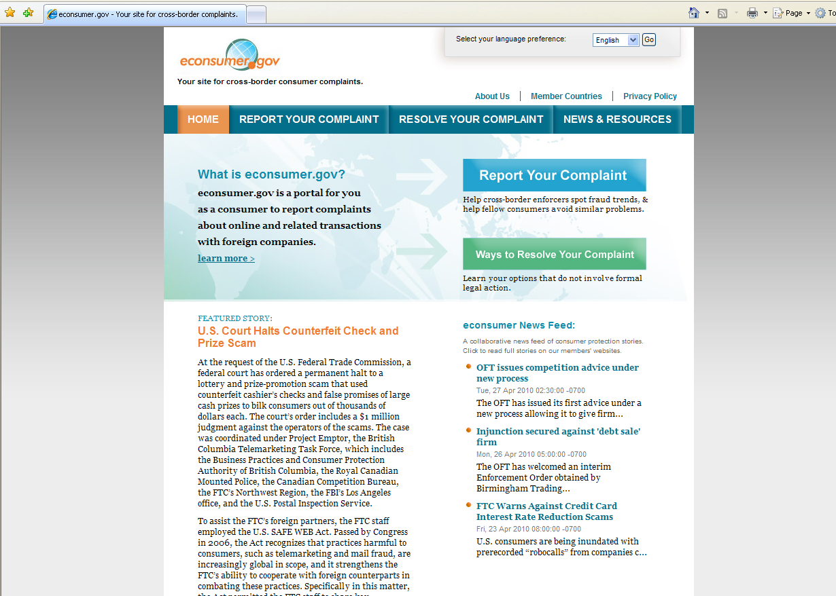

Slide 18
African Complaint Categories
Shop-at-home/Catalog Sales
Romance Scams
Imposter: Government Scams/Family-Friend
Advance Fee Loans
Internet auction scams
Housing/Real estate
Prizes/sweepstakes/lotteries
Employment Agencies
Spyware/Adware/Malware
Business Opportunities/Investment
Investment Scams
Credit Card/Banking
Multi-level marketing

Slide 19
African Dialogue, Zambia CCPC
& U.S. FTC
Thank you!

