Slide 1
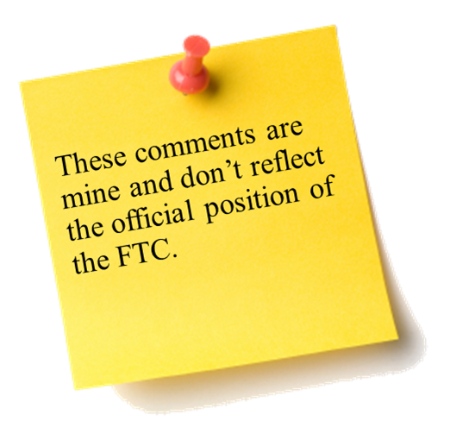



The Fifth Annual African Dialogue
Consumer Protection Conference
Mobile and Cyber Threat
Case Study
Livingstone, Zambia
10-12 September 2013

Slide 2


Summary
Four Case Study Areas of Concentration
  A Bank Interest Opportunity Scam
  A Lottery Scam
  Tech Support Scam
  An SMS Scam
Discussion Questions
FTC Cases
International Cooperation
African Complaint Categories

Slide 3
A Bank Interest Opportunity Scam
Facts – 1/2
Kojo, a computer savvy guy in Ghana, would like to impress a woman he knows by making her think he is wealthy. But the truth is he barely makes enough to support himself and his gambling habit.
Kojo uses his computer skills to gain access to a database maintained by Moto Phone Africa, an Angola-based mobile service provider with customers in Senegal, Togo, Angola, Malawi, Zambia, the Seychelles, and Egypt. The internal database contains information about the company’s 350,000 customers.
Kojo downloads the phone numbers of all Moto Phone Africa’s customers and sends a text message to 3,000 customers in each of the seven countries. The text reads: “Have $ just sitting in a bank? Make that $ work for you. Deposits at Ghana Volta Bank earn 4% interest. Just text your account # to us and we’ll transfer for free!”
Notes:
FTC v. Acquinity (2013)
News release: http://www.ftc.gov/opa/2013/07/revenuepath.shtm
Complaint: http://www.ftc.gov/os/caselist/1223161/130729revenuepathcmpt.pdf
Final resolution is pending.
FTC v. Henry Kelly (2013. One of the series of 8 cases against 29 Defendants who offered “free” gift cards.)
News release: http://www.ftc.gov/opa/2013/03/textmessages.shtm
Complaint: http://www.ftc.gov/os/caselist/1323057/130307hnkcmpt.pdf
Stipulated Final Judgment and Order for Permanent Injunction: http://www.ftc.gov/os/caselist/1323057/130718hnkstip.pdf

Slide 4
A Bank Interest Opportunity Scam
Facts – 2/2
At least 100 mobile users in each country provided their current account number. In total, more than $50,000 in funds were removed, but after two months no one has received any communication from Ghana Volta Bank. Many have started to complain that their money is lost.
Kojo now has a new car and fancy watch but the woman remains uninterested.
Notes:
FTC v. Acquinity (2013)
News release: http://www.ftc.gov/opa/2013/07/revenuepath.shtm
Complaint: http://www.ftc.gov/os/caselist/1223161/130729revenuepathcmpt.pdf
Final resolution is pending.
FTC v. Henry Kelly (2013. One of the series of 8 cases against 29 Defendants who offered “free” gift cards.)
News release: http://www.ftc.gov/opa/2013/03/textmessages.shtm
Complaint: http://www.ftc.gov/os/caselist/1323057/130307hnkcmpt.pdf
Stipulated Final Judgment and Order for Permanent Injunction: http://www.ftc.gov/os/caselist/1323057/130718hnkstip.pdf

Slide 5
A Bank Interest Opportunity Scam
Discussion Questions
How would you go about investigating a case like this?
Is it important whether your agency has received any consumer complaints?
What factors would be important as your agency considers whether it will pursue this matter?
If you decided to pursue this matter, what would your agency have to establish?
Is there any other agencies that may have a role, including NPO’s and self-regulatory industry body?
What type of relief would you seek in this matter?
What type of consumer or business education, if any, do you think would be effective?

Slide 6
A Bank Interest Opportunity Scam
Discussion Questions
What difficulties does the mobile aspect present?
What if some customers have already agreed to receive marketing SMS messages?
Do cases involving a bank raise particular concerns or invoke particular laws?
Is there any differences to pursue a case against an individual, as opposed to a company?
Could Moto Phone Africa have prevented hacking? If you are a legal counsel for Moto Phone Africa, what advice would you give to prevent further hacking?
How does the fact that this case involves victims in other countries impact your investigation?
Would your agency work with foreign counterparts on this matter?

Slide 7
A Lottery Scam
Facts – 1/2
Jamila (a college student in Zambia) was playing with her smartphone (provided by Moto Phone Africa) as always and received the following email:
“Congratulations! Your email was selected and you WON 1 million NGN (worth 6,250 USD) cash in a Pan-African Lottery! Claim your prize here: www.happychance.com”
When Jamila visited the website, she saw a Nigerian flag and a banner from the national lottery agency. The website said that “Winners need only pay fees for shipping, customs duties and taxes before they can claim their prizes.”
Jamila was very excited about the prize, so she proceeded to claim the prize.
  (1) She provided her address and mobile phone number as shipping information.
  (2) In the next page, she was required to accept 5 third party promotions to qualify fot the prize. She put her bank account information to purchase such promotions.
  (3) In the last page, she was obliged to pay shipping fees, customs duties and taxes, which amounted to 10,000 NGN (60 USD).
Notes:
(1) International Lottery Scams – Consumer Information (http://www.consumer.ftc.gov/articles/0086-international-lottery-scams)
(2) Jamaican Fraudsters Targeting U.S. Consumers (http://www.consumer.ftc.gov/articles/0119-jamaican-fraudsters-targeting-us-consumers)
(3) FTC v. Phillip Flora (2011)
News release: http://www.ftc.gov/opa/2011/09/loanmod.shtm
Complaint: http://www.ftc.gov/os/caselist/1023005/110223phillipcmpt.pdf
Stipulated Permanent Injunction and Final Order: http://www.ftc.gov/os/caselist/1023005/110929loanmodorder.pdf
(4) FTC v. World Media Brokers, Inc., et. al. (2002)
Defendants illegally marketed lottery tickets to senior citizens in the US.
News release: http://www.ftc.gov/opa/2002/12/ems.shtm
Complaint: http://www.ftc.gov/os/2002/12/emscmp.pdf
(5) FTC v. HTC America, Inc.
News release: http://ftc.gov/opa/2013/02/htc.shtm
Complaint: http://ftc.gov/os/caselist/1223049/130222htccmpt.pdf
Consent Order: http://ftc.gov/os/caselist/1223049/130222htcorder.pdf

Slide 8
A Lottery Scam
Facts – 2/2
Jamila started to receive 30 emails/day in her spam folder. Unknown to her, her email address was leaked when she accessed the website, due to a software defect of her smartphone.
In addition, she noticed several unauthorized withdrawals from her bank account.
  Cause 1: A key logger was also automatically installed to her smartphone through the website.
  Cause 2: All the personal information obtained was sold to third parties.
The perpetrator was a Nigerian corporation named Smart Win, and they sent out the email to college students in Zambia, Ethiopia, and Nigeria. The number of affected students amounted to 10,000. Smart Win obtained the list of email addresses by hacking into college databases.
In the end, Smart Win collected 60 million NGN (375,000 USD).
Notes:
(1) International Lottery Scams – Consumer Information (http://www.consumer.ftc.gov/articles/0086-international-lottery-scams)
(2) Jamaican Fraudsters Targeting U.S. Consumers (http://www.consumer.ftc.gov/articles/0119-jamaican-fraudsters-targeting-us-consumers)
(3) FTC v. Phillip Flora (2011)
News release: http://www.ftc.gov/opa/2011/09/loanmod.shtm
Complaint: http://www.ftc.gov/os/caselist/1023005/110223phillipcmpt.pdf
Stipulated Permanent Injunction and Final Order: http://www.ftc.gov/os/caselist/1023005/110929loanmodorder.pdf
(4) FTC v. World Media Brokers, Inc., et. al. (2002)
Defendants illegally marketed lottery tickets to senior citizens in the US.
News release: http://www.ftc.gov/opa/2002/12/ems.shtm
Complaint: http://www.ftc.gov/os/2002/12/emscmp.pdf
(5) FTC v. HTC America, Inc.
News release: http://ftc.gov/opa/2013/02/htc.shtm
Complaint: http://ftc.gov/os/caselist/1223049/130222htccmpt.pdf
Consent Order: http://ftc.gov/os/caselist/1223049/130222htcorder.pdf

Slide 9
A Lottery Scam
Discussion Questions
How would you go about investigating a case like this?
Is it important whether your agency has received any consumer complaints?
What factors would be important as your agency considers whether it will pursue this matter?
If you decided to pursue this matter, what would your agency have to establish?
Is there any other agencies that may have a role, including NPO’s and self-regulatory industry body?
What type of relief would you seek in this matter?
What type of consumer or business education, if any, do you think would be effective?

Slide 10
A Lottery Scam
Discussion Questions
Do cases involving regulated industry (e.g. lottery) raise particular concerns or invoke particular laws?
How does the fact affect that personal information was obtained without authorization and that they were sold thereafter?
After Smart Win sold the personal information, to what extent would it be liable for the damages sustained by customers?
What would be reasonable and appropriate measures to protect personal information against unauthorized access?
Assume that there was no advanced fee to claim the prize – would it be different?
Would your agency work with foreign agencies or counterparts on this matter?
How do you work with criminal authority when a case involves criminal violation?

Slide 11

Tech Support Scam
Facts
Support Pro (an Indian company) was one of the third parties which obtained the list of personal information from Smart Win, and it selected customers in Zambia and Nigeria from the list to make the following phone calls:
“Hello, this is Support Pro. We have been working with Microsoft for cyber security issues, and today we wanted to help you check the condition of your computer. Please follow the instructions I give you from now.”
Following such statements, Support Pro directed consumers to a utility area of their computer and claimed that “your computer is infected by a malware. Would you like further instruction to remove it? The fee is $50.”
When consumers agreed, Support Pro directed them to a website to download a software that allowed Support Pro to remotely access the consumers’ computers.
Indeed, Support Pro was not affiliated with Microsoft, and none of the customers’ computers had any problems.
Notes:
FTC v. Pecon Software Ltd.
News release: http://ftc.gov/opa/2012/10/pecon.shtm
Complaint: http://ftc.gov/os/caselist/1223118/121003peconcmpt.pdf

Slide 12
Tech Support Scam
Discussion Questions
How would you go about investigating a case like this?
Is it important whether your agency has received any consumer complaints?
What factors would be important as your agency considers whether it will pursue this matter?
If you decided to pursue this matter, what would your agency has to establish?
Is there any other agencies that may have a role, including NPO’s and self-regulatory industry body?
What type of relief would you seek in this matter?
What type of consumer or business education, if any, do you think would be effective?

Slide 13
Tech Support Scam
Discussion Questions
What difficulties does the telemarketing aspect present?
If the wrongdoer is outside Africa, what impact would it have on your investigation?
Would your agency work with foreign agencies or counterparts on this matter?
Would you seek cooperation from any international organization?
Assume that Smart Pro installed additional software programs and charged customers for them without authorization utilizing remote access – How would it be different?
Assume Support Pro was in fact affiliated with Microsoft and abused its status – would there be any difference? Would Microsoft be held liable to any extent?

Slide 14
SMS Scam
Facts – 1/2
Abebe and Ife, friends at a college in Ethiopia, received this text message:
“Weekly Horoscope – Want to know your destiny? Text NOW to 28490!”
Although Abebe noticed that there is no description about cost, he followed the instruction. He suggested Ife subscribe as well, but she was not interested and discarded the text.
Unknown to them, the fee of 60 ETB (worth $3) for Weekly Horoscope was placed on their monthly phone bills thereafter. However, neither Abebe nor Ife noticed the charge because they were never in the habit of checking their bills.
Notes:
Mobile phone cramming;
FTC v. Wise Media, LLC (2013)
News release:
Complaint: http://www.ftc.gov/os/caselist/1223182/130417wisemediacmpt.pdf
Landline cramming;
FTC v. American eVoice (2013)
News release: http://www.ftc.gov/opa/2013/01/evoice.shtm
Complaint: http://www.ftc.gov/os/caselist/1223008/130122americanevoicecmpt.pdf
FTC v. Hold Billing Services, Ltd. (2012)
News release: http://www.ftc.gov/opa/2012/05/bsg.shtm
Complaint: http://www.ftc.gov/os/caselist/x980069/120508bsgmotion.pdf
FTC v. Inc21.com (2010)
News release: http://www.ftc.gov/opa/2010/03/inc21.shtm
Complaint: http://www.ftc.gov/os/caselist/0923171/100301inc21cmpt.pdf

Slide 15
SMS Scam
Facts – 2/2
eBilling (a billing aggregator in Liberia) also obtained the list of personal information from Smart Win, and invited SMS Fun (a service marketer in the US) to market SMS subscription services using the phone numbers on the list.
They placed such charges on the bills of consumers who (1) sent a text to 28490, (2) discarded the text, and (3) declined any further offers.
They have collected 500,000 ETB (worth $26,000) in total.
Notes:
Mobile phone cramming;
FTC v. Wise Media, LLC (2013)
News release:
Complaint: http://www.ftc.gov/os/caselist/1223182/130417wisemediacmpt.pdf
Landline cramming;
FTC v. American eVoice (2013)
News release: http://www.ftc.gov/opa/2013/01/evoice.shtm
Complaint: http://www.ftc.gov/os/caselist/1223008/130122americanevoicecmpt.pdf
FTC v. Hold Billing Services, Ltd. (2012)
News release: http://www.ftc.gov/opa/2012/05/bsg.shtm
Complaint: http://www.ftc.gov/os/caselist/x980069/120508bsgmotion.pdf
FTC v. Inc21.com (2010)
News release: http://www.ftc.gov/opa/2010/03/inc21.shtm
Complaint: http://www.ftc.gov/os/caselist/0923171/100301inc21cmpt.pdf

Slide 16
SMS Scam
Discussion Questions
How would you go about investigating a case like this?
Is it important whether your agency has received any consumer complaints?
What factors would be important as your agency considers whether it will pursue this matter?
If you decided to pursue this matter, what would your agency has to establish?
Is there any other agencies that may have a role, including NPO’s and self-regulatory industry body?
What type of relief would you seek in this matter?
What type of consumer or business education, if any, do you think would be effective?

Slide 17
SMS Scam
Discussion Questions
Would your agency work with foreign agencies or counterparts on this matter?
Would there be any difference among the following 3 groups, if there is redress for damaged consumers?
  (1) Those who responded , e.g. Abebe
  (2) Those who ignored, e.g. Ife
  (3) Those who sent a text to decline the offer
Would there be any difference between customers who noticed unauthorized charges and who did not because they do not usually read their bills?
Is it important to disclose the condition and cost for subscription? If yes, how should a company disclose such information to customers, and what sort of consent would be appropriate?
To what extent, would companies be held liable? (e.g.) Service marketer, billing aggregator, mobile service provider…

Slide 18
FTC Cases

Slide 19
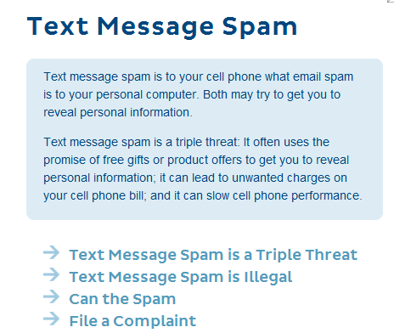
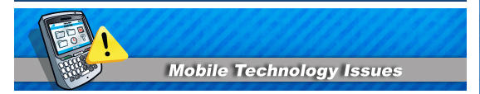
FTC v. Henry Kelly
1 of the series of 8 cases against 29 Defendants.
Facts:
  Defendant sent text messages to consumers which led consumers to websites where they can claim “free” gift cards, and collected personal information.
  Claiming such “free” gift cards required them to purchase various services.
Resolution:
  Permanent Injunction
Notes:
FTC v. Henry Kelly (2013. One of the series of 8 cases against 29 Defendants who offered “free” gift cards through text messages.)
News release: http://www.ftc.gov/opa/2013/03/textmessages.shtm
Complaint: http://www.ftc.gov/os/caselist/1323057/130307hnkcmpt.pdf
Stipulated Final Judgment and Order for Permanent Injunction: http://www.ftc.gov/os/caselist/1323057/130718hnkstip.pdf
[Facts]
Defendant Henry Kelly (an individual) sent millions of text messages to consumers which led consumers to a website where they can claim "free" gift cards, because they “won” a contest, or has been “specifically selected.”
Defendant collected their personal information at the website, e.g. name, mailing address, email address, date of birth, cell and home phone numbers.
When the consumers followed the website’s direction, they were brought to a third party’s website and were required to participate in at least 10 offers. In most cases, completing an offer entailed paying money or incurring some other detriment. Many of these offers also contain negative option components in which consumers who do not cancel will be billed automatically.
In addition, consumers were never informed of the conditions to claim the "free" gifts and of the possibility that they would be required to spend money to receive the gifts.
[Resolution]
- Stipulated final judgment was entered and permanent injunction was ordered against Defendant.

Slide 20
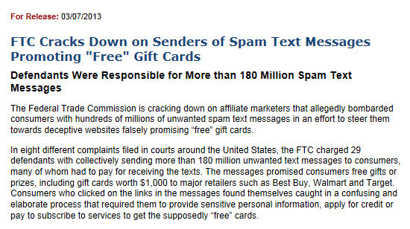
FTC v. Henry Kelly
Notes:
FTC v. Henry Kelly (2013. One of the series of 8 cases against 29 Defendants who offered “free” gift cards through text messages.)
News release: http://www.ftc.gov/opa/2013/03/textmessages.shtm
Complaint: http://www.ftc.gov/os/caselist/1323057/130307hnkcmpt.pdf
Stipulated Final Judgment and Order for Permanent Injunction: http://www.ftc.gov/os/caselist/1323057/130718hnkstip.pdf
[Facts]
Defendant Henry Kelly (an individual) sent millions of text messages to consumers which led consumers to a website where they can claim "free" gift cards, because they “won” a contest, or has been “specifically selected.”
Defendant collected their personal information at the website, e.g. name, mailing address, email address, date of birth, cell and home phone numbers.
When the consumers followed the website’s direction, they were brought to a third party’s website and were required to participate in at least 10 offers. In most cases, completing an offer entailed paying money or incurring some other detriment. Many of these offers also contain negative option components in which consumers who do not cancel will be billed automatically.
In addition, consumers were never informed of the conditions to claim the "free" gifts and of the possibility that they would be required to spend money to receive the gifts.
[Resolution]
- Stipulated final judgment was entered and permanent injunction was ordered against Defendant.

Slide 21
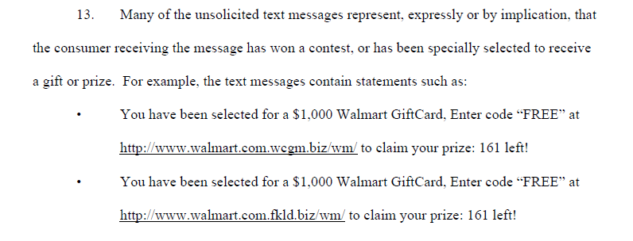
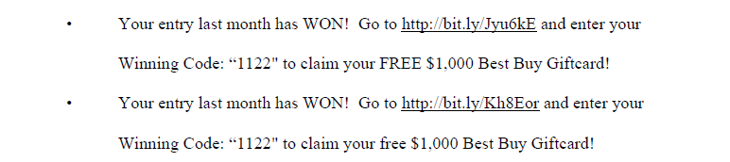
FTC v. Jason Cruz
Notes:
This is another case in the series of 8 cases brought by the FTC at the same time as FTC v. Henry Kelly.

Slide 22
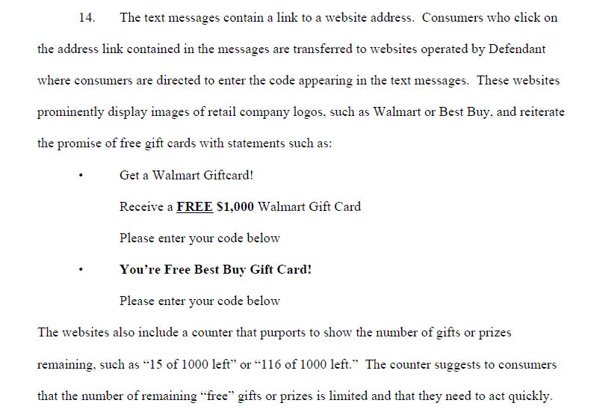
FTC v. Jason Cruz
Notes:
This is another case in the series of 8 cases brought by the FTC at the same time as FTC v. Henry Kelly.

Slide 23
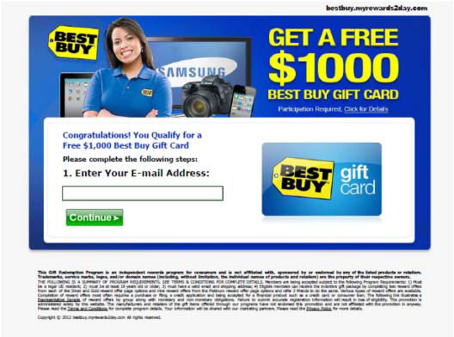
FTC v. SubscriberBASE
Notes:
This is another case in the series of 8 cases brought by the FTC at the same time as FTC v. Henry Kelly.

Slide 24
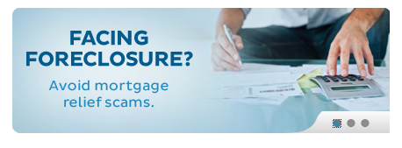
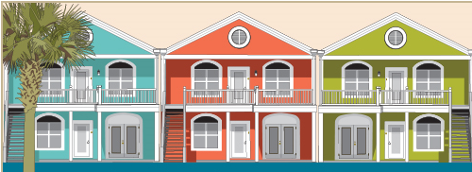
FTC v. Phillip Flora
Facts:
  Defendant sent unsolicited text messages and emails to customers promoting products and services such as loan modification programs and debt relief services.
  Customers were then led to websites which appeared to be associated with the U.S. federal government, which in fact they were not.
Resolution:
  Stipulated Permanent Injunction
Notes:
FTC v. Phillip Flora (2011)
News release: http://www.ftc.gov/opa/2011/09/loanmod.shtm
Complaint: http://www.ftc.gov/os/caselist/1023005/110223phillipcmpt.pdf
Stipulated Permanent Injunction and Final Order: http://www.ftc.gov/os/caselist/1023005/110929loanmodorder.pdf
[Facts]
Defendant sent unsolicited text messages and emails to customers promoting products and services such as loan modification programs and debt relief services.
Customers were then led to websites which appeared to be associated with the U.S. federal government, which in fact they were not.
[Resolution]
Stipulated permanent injunction and final order was obtained against Defendant.

Slide 25
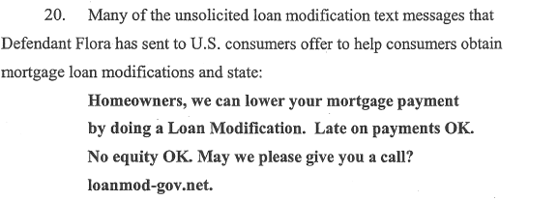
FTC v. Phillip Flora
Notes:
FTC v. Phillip Flora (2011)
News release: http://www.ftc.gov/opa/2011/09/loanmod.shtm
Complaint: http://www.ftc.gov/os/caselist/1023005/110223phillipcmpt.pdf
Stipulated Permanent Injunction and Final Order: http://www.ftc.gov/os/caselist/1023005/110929loanmodorder.pdf
[Facts]
Defendant sent unsolicited text messages and emails to customers promoting products and services such as loan modification programs and debt relief services.
Customers were then led to websites which appeared to be associated with the U.S. federal government, which in fact they were not.
[Resolution]
Stipulated permanent injunction and final order was obtained against Defendant.

Slide 26
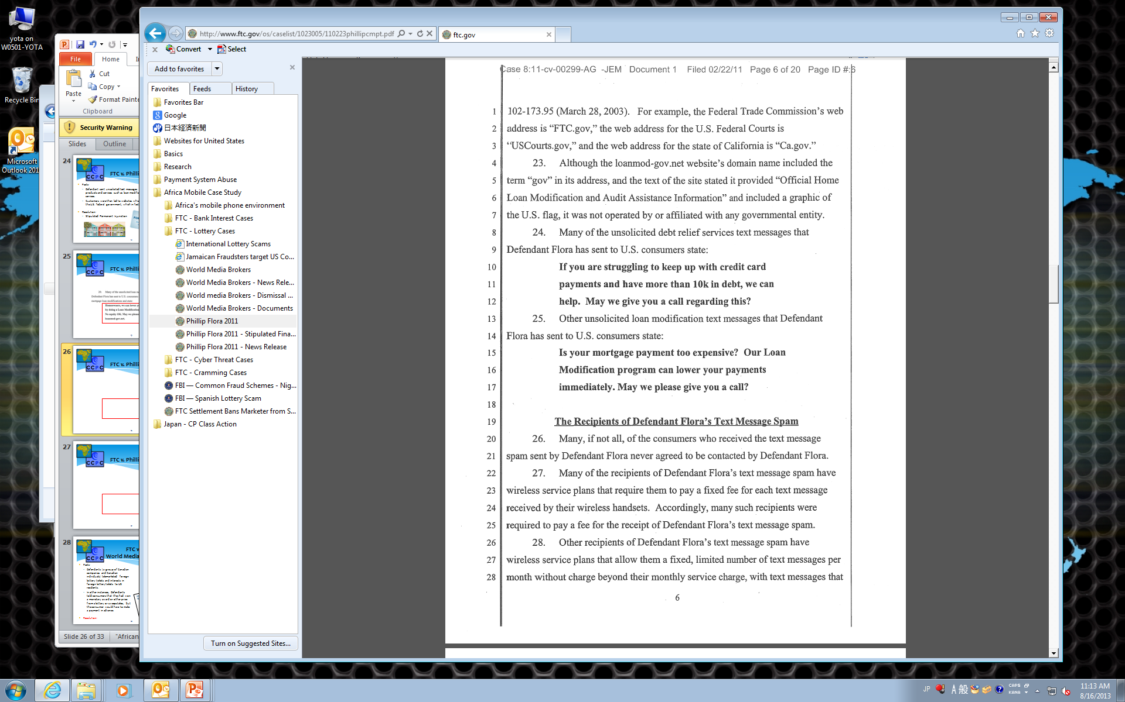
FTC v. Phillip Flora
Notes:
FTC v. Phillip Flora (2011)
News release: http://www.ftc.gov/opa/2011/09/loanmod.shtm
Complaint: http://www.ftc.gov/os/caselist/1023005/110223phillipcmpt.pdf
Stipulated Permanent Injunction and Final Order: http://www.ftc.gov/os/caselist/1023005/110929loanmodorder.pdf
[Facts]
Defendant sent unsolicited text messages and emails to customers promoting products and services such as loan modification programs and debt relief services.
Customers were then led to websites which appeared to be associated with the U.S. federal government, which in fact they were not.
[Resolution]
Stipulated permanent injunction and final order was obtained against Defendant.

Slide 27
FTC v. Phillip Flora
Notes:
FTC v. Phillip Flora (2011)
News release: http://www.ftc.gov/opa/2011/09/loanmod.shtm
Complaint: http://www.ftc.gov/os/caselist/1023005/110223phillipcmpt.pdf
Stipulated Permanent Injunction and Final Order: http://www.ftc.gov/os/caselist/1023005/110929loanmodorder.pdf
[Facts]
Defendant sent unsolicited text messages and emails to customers promoting products and services such as loan modification programs and debt relief services.
Customers were then led to websites which appeared to be associated with the U.S. federal government, which in fact they were not.
[Resolution]
Stipulated permanent injunction and final order was obtained against Defendant.

Slide 28
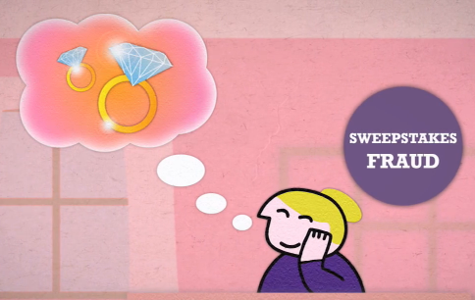
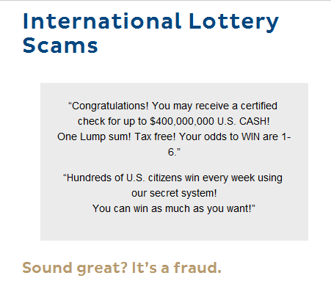
FTC v.
World Media Brokers
Facts:
  Defendants (a group of Canadian companies and Canadian individuals) telemarketed foreign lottery tickets and interests in foreign lottery tickets to US residents.
  In other instances, Defendants told consumers that they had won a monetary award or other prize from a lottery or sweepstakes, but the consumer would have to make a payment in advance.
Resolution:
  Permanent injunction
  Consumer redress of $19 million
Notes:
FTC v. World Media Brokers, Inc., et. al. (2002)
Defendants illegally marketed lottery tickets to senior citizens in the US.
News release: http://www.ftc.gov/opa/2002/12/ems.shtm
Complaint: http://www.ftc.gov/os/2002/12/emscmp.pdf
News release for final judgment: http://www.ftc.gov/opa/2004/07/worldetal.shtm
[Facts]
Defendants (a group of Canadian companies and Canadian individuals) deceptively and illegally telemarketed foreign lottery tickets and interests in foreign lottery tickets to US residents. They falsely claimed that the chances of winning are high if the consumers purchase tickets with Defendants.
In other instances, Defendants told consumers that they had won a monetary award or other prize from a lottery or sweepstakes in which the consumer had recently participated, but the consumer would have to make a payment in advance before collecting their winnings “for taxes or other duties.”
[Resolution]
Permanent Injunction
Consumer redress of $19 million

Slide 29
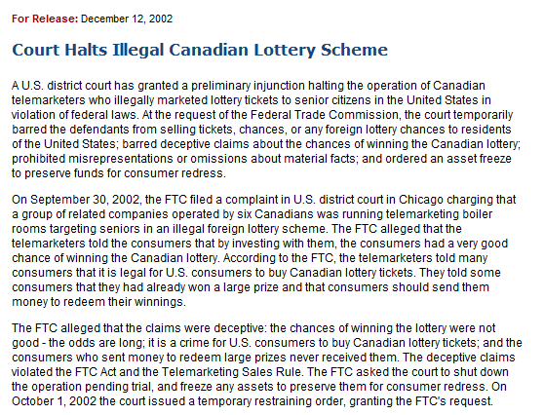
FTC v.
World Media Brokers
Notes:
FTC v. World Media Brokers, Inc., et. al. (2002)
Defendants illegally marketed lottery tickets to senior citizens in the US.
News release: http://www.ftc.gov/opa/2002/12/ems.shtm
Complaint: http://www.ftc.gov/os/2002/12/emscmp.pdf
[Facts]
Defendants (a group of Canadian companies and Canadian individuals) deceptively and illegally telemarketed foreign lottery tickets and interests in foreign lottery tickets to US residents. They falsely claimed that the chances of winning are high if the consumers purchase tickets with Defendants.
In other instances, Defendants told consumers that they had won a monetary award or other prize from a lottery or sweepstakes in which the consumer had recently participated, but the consumer would have to make a payment in advance before collecting their winnings “for taxes or other duties.”
[Resolution]
Permanent Injunction
Consumer redress of $19 million

Slide 30
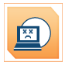
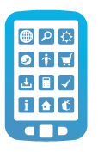
FTC v. HTC America
Facts:
  HTC has customized its Android-based mobile devices and components in order to differentiate its products.
  HTC also customized both its Android and Windows Mobile devices in order to comply with the requirements of certain network operators.
  HTC engaged in a number of practices that failed to employ reasonable and appropriate security in the design and customization of the software on its mobile devices.
Resolution:
  Consent Order
Notes:
FTC v. HTC America, Inc.
News release: http://ftc.gov/opa/2013/02/htc.shtm
Complaint: http://ftc.gov/os/caselist/1223049/130222htccmpt.pdf
Consent Order: http://ftc.gov/os/caselist/1223049/130222htcorder.pdf
[Facts]
HTC has customized its Android-based mobile devices by adding and/or modifying various pre-installed applications and components in order to differentiate its products from those of competitors.
HTC also customized both its Android and Windows Mobile devices in order to comply with the requirements of certain network operators.
HTC engaged in a number of practices that failed to employ reasonable and appropriate security in the design and customization of the software on tis mobile devices.
[Resolution]
Consent Order was rendered, in which HTC America was required to
(1) develop and release software patches to fix vulnerabilities of the devices,
(2) establish a comprehensive security program designed to address security risks during the development of HTC devices, and
(3) undergo independent security assessments every other year for the next 20 years.

Slide 31
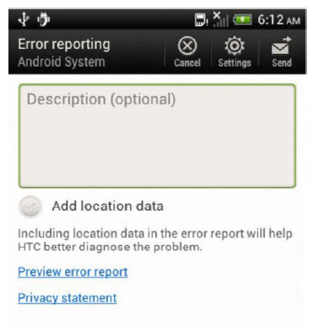
FTC v. HTC America
Notes:
FTC v. HTC America, Inc.
News release: http://ftc.gov/opa/2013/02/htc.shtm
Complaint: http://ftc.gov/os/caselist/1223049/130222htccmpt.pdf
Consent Order: http://ftc.gov/os/caselist/1223049/130222htcorder.pdf
[Facts]
HTC has customized its Android-based mobile devices by adding and/or modifying various pre-installed applications and components in order to differentiate its products from those of competitors.
HTC also customized both its Android and Windows Mobile devices in order to comply with the requirements of certain network operators.
HTC engaged in a number of practices that failed to employ reasonable and appropriate security in the design and customization of the software on tis mobile devices.
[Resolution]
Consent Order was rendered, in which HTC America was required to
(1) develop and release software patches to fix vulnerabilities of the devices,
(2) establish a comprehensive security program designed to address security risks during the development of HTC devices, and
(3) undergo independent security assessments every other year for the next 20 years.

Slide 32
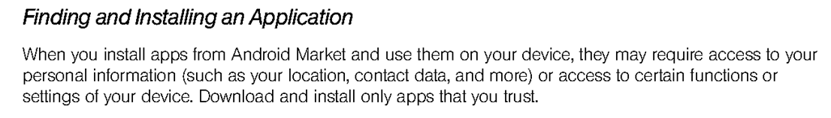
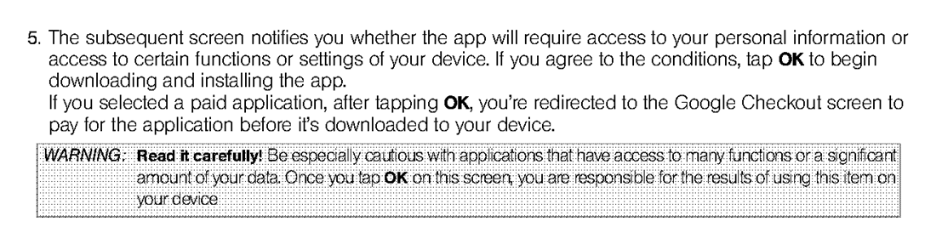
FTC v. HTC America
. . .
Notes:
FTC v. HTC America, Inc.
News release: http://ftc.gov/opa/2013/02/htc.shtm
Complaint: http://ftc.gov/os/caselist/1223049/130222htccmpt.pdf
Consent Order: http://ftc.gov/os/caselist/1223049/130222htcorder.pdf
[Facts]
HTC has customized its Android-based mobile devices by adding and/or modifying various pre-installed applications and components in order to differentiate its products from those of competitors.
HTC also customized both its Android and Windows Mobile devices in order to comply with the requirements of certain network operators.
HTC engaged in a number of practices that failed to employ reasonable and appropriate security in the design and customization of the software on tis mobile devices.
[Resolution]
Consent Order was rendered, in which HTC America was required to
(1) develop and release software patches to fix vulnerabilities of the devices,
(2) establish a comprehensive security program designed to address security risks during the development of HTC devices, and
(3) undergo independent security assessments every other year for the next 20 years.

Slide 33
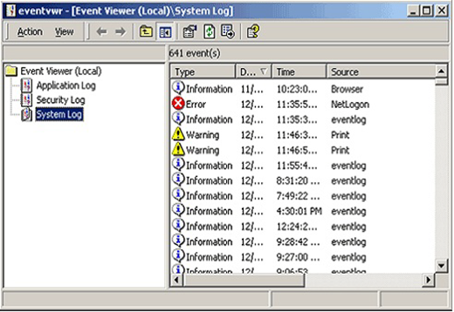
FTC v. Pecon Software
1 of the series of 6 cases regarding tech support scams.
Facts:
  Defendants, mostly located in India, called consumers in the US and falsely claimed that they are from or affiliated with well-known computer manufactures or computer security companies.
  Defendants convinced the consumers that their computers are infected, and made them install software applications and pay for such “repairs.”
Notes:
FTC v. Pecon Software Ltd. (Complaint: http://ftc.gov/os/caselist/1223118/121003peconcmpt.pdf)
[Facts]
Defendants, mostly located in India, called consumers in the US and other English speaking countries and falsely claimed that they are from or affiliated with well-known computer manufactures or computer security companies.
Defendants directed the consumers to see a log of their computer’s operation.
A red X and a yellow triangle could be generated during the normal operation, but Defendants told the consumers that they are signs of viruses or malwares.
After the consumers are convinced that their computers are infected, Defendants directed them to a website and had them install a software application which allowed Defendants remote access to the computers.
[Resolution]
Temporary Restraining Order has been obtained.
Final resolution is pending.

Slide 34
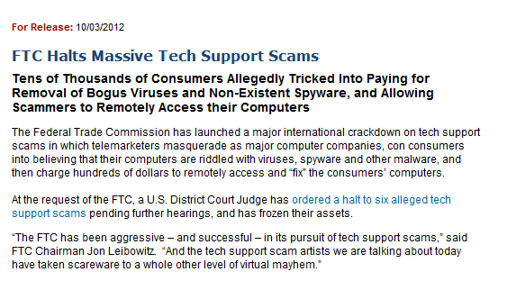
FTC v. Pecon Software
Notes:
FTC v. Pecon Software Ltd. (Complaint: http://ftc.gov/os/caselist/1223118/121003peconcmpt.pdf)
[Facts]
Defendants, mostly located in India, called consumers in the US and other English speaking countries and falsely claimed that they are from or affiliated with well-known computer manufactures or computer security companies.
Defendants directed the consumers to see a log of their computer’s operation.
A red X and a yellow triangle could be generated during the normal operation, but Defendants told the consumers that they are signs of viruses or malwares.
After the consumers are convinced that their computers are infected, Defendants directed them to a website and had them install a software application which allowed Defendants remote access to the computers.
[Resolution]
Temporary Restraining Order has been obtained.
Final resolution is pending.

Slide 35
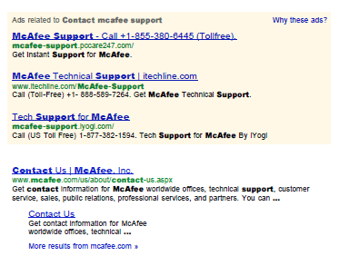
FTC v. PCCare247
Notes:
This is another case in the series of 8 cases brought by the FTC at the same time as FTC v. Pecon Software.

Slide 36
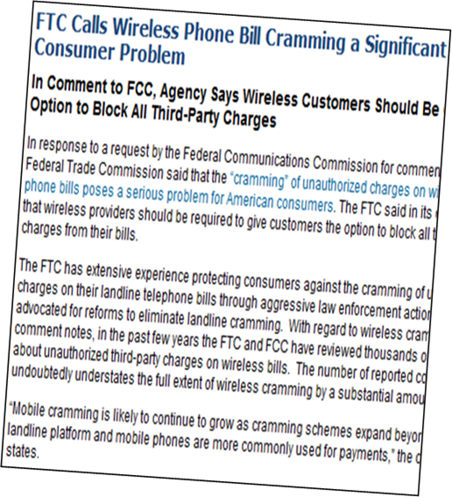
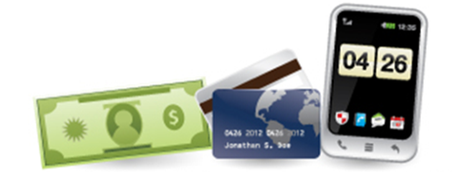
FTC v. Wise Media
This is the first case against mobile phone cramming by the FTC.
Facts:
  Defendants operated a scam in which they caused unauthorized charges on consumers’ mobile phone bill for text message-based subscriptions.
Notes:
FTC v. Wise Media, LLC (2013. Complaint: http://www.ftc.gov/os/caselist/1223182/130417wisemediacmpt.pdf)
[Facts]
Defendants operated a scam in which they bill consumers for text message-based subscription services without consumers' authorizations.
Defendants caused such unauthorized charges to be placed on consumers' phone bills ($9.99/month).
[Resolution]
Final resolution is pending.
Stipulated temporary restraining order and stipulated supplement preliminary injunction have been ordered.

Slide 37
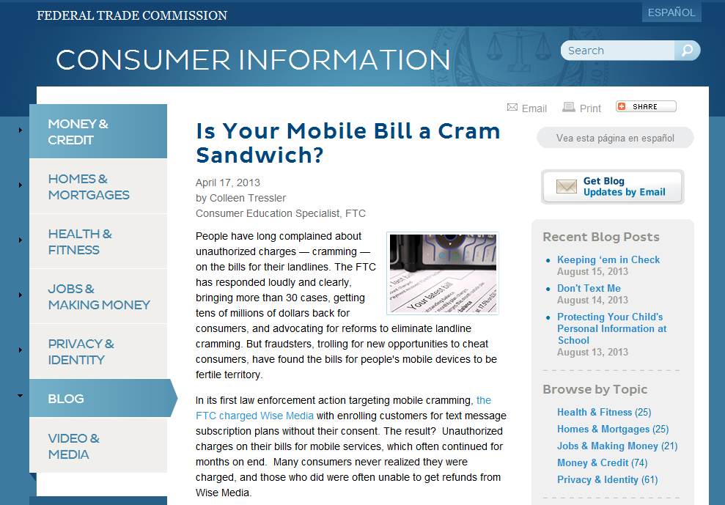
FTC v. Wise Media
Notes:
FTC v. Wise Media, LLC (2013. Complaint: http://www.ftc.gov/os/caselist/1223182/130417wisemediacmpt.pdf)
[Facts]
Defendants operated a scam in which they bill consumers for text message-based subscription services without consumers' authorizations.
Defendants caused such unauthorized charges to be placed on consumers' phone bills ($9.99/month).
[Resolution]
Final resolution is pending.
Stipulated temporary restraining order and stipulated supplement preliminary injunction have been ordered.

Slide 38
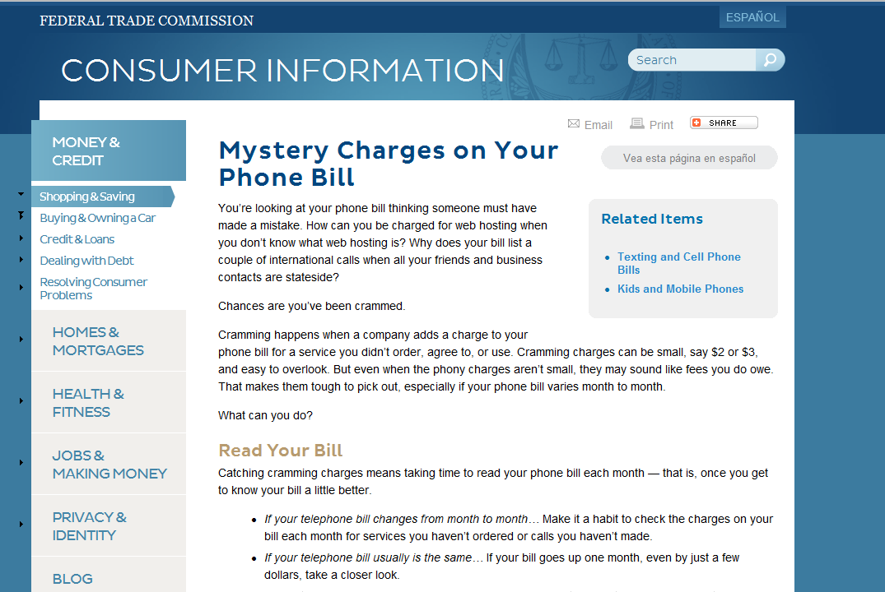
FTC v. Wise Media
Notes:
FTC v. Wise Media, LLC (2013. Complaint: http://www.ftc.gov/os/caselist/1223182/130417wisemediacmpt.pdf)
[Facts]
Defendants operated a scam in which they bill consumers for text message-based subscription services without consumers' authorizations.
Defendants caused such unauthorized charges to be placed on consumers' phone bills ($9.99/month).
[Resolution]
Final resolution is pending.
Stipulated temporary restraining order and stipulated supplement preliminary injunction have been ordered.

Slide 39
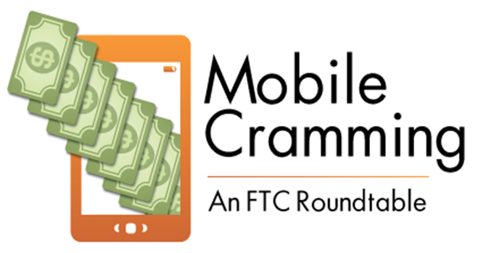
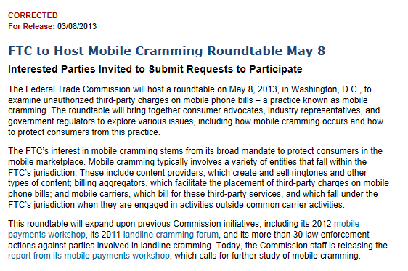
FTC v. Wise Media
Notes:
FTC v. Wise Media, LLC (2013. Complaint: http://www.ftc.gov/os/caselist/1223182/130417wisemediacmpt.pdf)
[Facts]
Defendants operated a scam in which they bill consumers for text message-based subscription services without consumers' authorizations.
Defendants caused such unauthorized charges to be placed on consumers' phone bills ($9.99/month).
[Resolution]
Final resolution is pending.
Stipulated temporary restraining order and stipulated supplement preliminary injunction have been ordered.

Slide 40
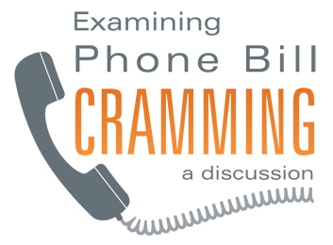
FTC v. Inc21.com
Facts:
  Defendants made unsolicited calls and offered their Internet services without asking consumers to purchase anything.
  Even when their offer was declined or their offer was for a free trial, Defendants then placed unauthorized charges on consumers' telephone bills for such services.
  Defendants collected over $37 million.
Resolution:
  Permanent Injunction
  Monetary Restitution
Notes:
FTC v. Inc21.com (2010. Complaint: http://www.ftc.gov/os/caselist/0923171/100301inc21cmpt.pdf)
[Facts]
Defendants made unsolicited calls to verify business contact information and in some instances to offer their Internet services without asking consumers to purchase anything.
Even when their offer was declined or their offer was for a free trial, Defendants then placed unauthorized charges on consumers' telephone bills (between $12.95 and $39.95 per month) for such services.
Defendants collected over $37 million.
[Resolution]
The FTC's motion for summary judgment was granted.
The FTC obtained orders for permanent injunction and monetary restitution.

Slide 41
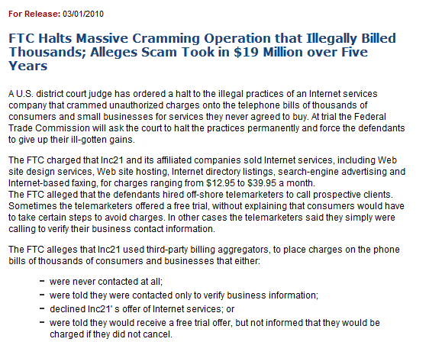
FTC v. Inc21.com
Notes:
FTC v. Inc21.com (2010. Complaint: http://www.ftc.gov/os/caselist/0923171/100301inc21cmpt.pdf)
[Facts]
Defendants made unsolicited calls to verify business contact information and in some instances to offer their Internet services without asking consumers to purchase anything.
Even when their offer was declined or their offer was for a free trial, Defendants then placed unauthorized charges on consumers' telephone bills (between $12.95 and $39.95 per month) for such services.
Defendants collected over $37 million.
[Resolution]
The FTC's motion for summary judgment was granted.
The FTC obtained orders for permanent injunction and monetary restitution.

Slide 42
International
Cooperation

Slide 43
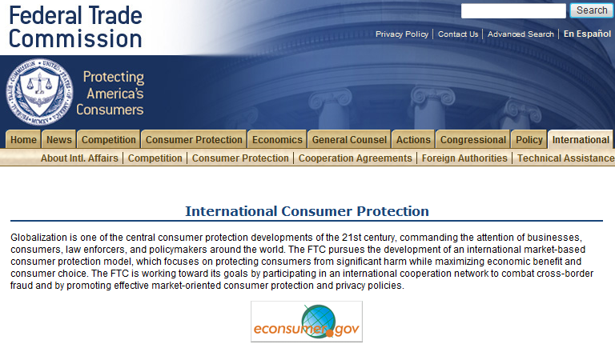
The FTC’s International
Cooperation
      The Office of International Affairs, Consumer Protection
        Provide litigation support.
        Expand cooperation and information sharing.
        Develop international e-commerce policies.
        Provide international technical assistance/collaborations.

Slide 44
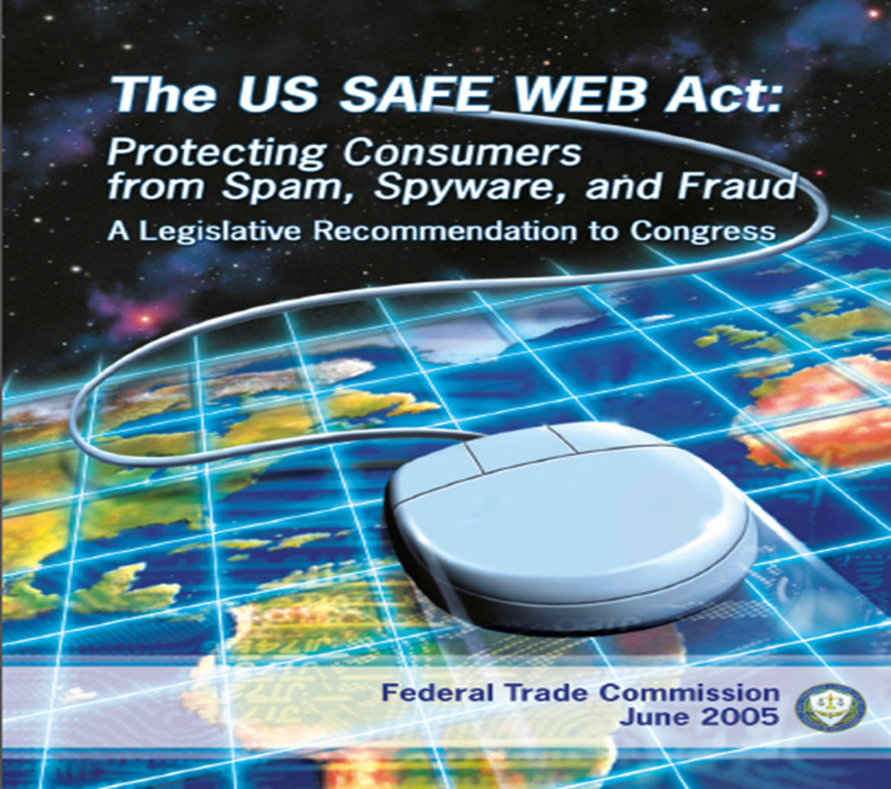
The US Safe Web Act

Slide 45
Increased FTC Cross-
Border Collaboration
      The FTC has:
        conducted more that 100 investigations with international components, such as foreign targets, evidence, or assets;
        filed more that 50 cases involving cross-border components, since January 2007;
        used the Act’s authority in many of these matters, and in related actions brought by other U.S. and foreign enforcement agencies.
      The FTC has provided evidence in response to 63 information-sharing requests from 17 foreign law enforcement agencies as of mid-2012.
      The FTC has issued 52 civil investigative demands (equivalent to administrative subpoenas) in 21 investigations on behalf of nine agencies in five countries.
      In cases relying on the SAFE WEB Act, the FTC has to date collected more that $10 million in restitution for injured consumers, despite the challenges of collecting money from defendants in foreign jurisdictions, and has stopped frauds costing consumers hundreds of millions of dollars.

Slide 46
African Complaint
Categories
      Shop-at-home/Catalog sales
      Romance scams
      Imposter: Government scams/Family-Friend
      Advance fee loans
      Internet auction scams
      Housing/Real estate
      Prizes/Sweepstakes/Lotteries
      Employment Agencies
      Spyware/Adware/Malware
      Business Opportunities/Investment
      Investment scams
      Credit card/Banking
      Multi-level marketing

Slide 47

African Dialogue &
U.S. FTC
      The African Consumer Protection Dialogue (“African Dialogue”) is an initiative of the U. S. Federal Trade Commission aimed at encouraging regional cooperation and sharing of best practices among consumer protection agencies within Africa, the United States and the rest of the world.
      It also seeks to create informal opportunities to interface with each other, the U.S. and rest of world on consumer protection and competition issues.

Slide 48
Thank you!
Questions?
For all questions, please contact Deon Woods Bell dwoodsbell@ftc.gov
+1-202-326-3307

