Slide 1

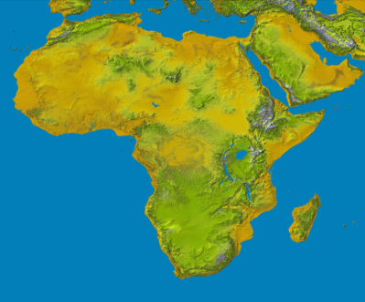


The Fifth Annual African Consumer Protection Dialogue Conference
10th- 12th September 2013
Livingstone, Zambia
Consumer Protection and Competition Framework
John Nderitu Mwangi
Competition Authority of Kenya

Slide 2
INTRODUCTION
The Competition Act No. 12 of 2010 became operational on 1st August 2010.
The Act applies to all persons including the Government, State corporations and Local authorities.

Slide 3
Competition and Consumer Provisions
The Competition Act deals in:
Restrictive Trade Practices-cartels and abuse of dominance.
Control of mergers
Unwarranted concentration of economic power
Consumer Welfare
Kenya’s Constitution (2010) enumerates some consumer rights under Article 46.

Slide 4
Functional Framework
The Competition Act provides for the establishment powers and functions of the Competition Authority.
The Authority has various functions including:
receiving and investigating complaints from legal/natural persons and consumer bodies.
Recognizing consumer bodies duly registered.
Liaising with regulatory bodies and other public bodies and matters relating to competition and consumer welfare
Reviewing practices, policies and programs of the government and sector regulators.
The Act provides for establishment and powers of the Competition Tribunal for appeals.
The Tribunal determine competition and consumer welfare cases
The appellant have a right to appeal to the High Court.

Slide 5
Cont.
Other Regulators includes:
The Communication Commission of Kenya
Anti-counterfeit Agency
Insurance Regulatory Authority
Kenya Bureau of Standards
Energy Regulatory Commission,
Department of Weight and Measures
Pharmacy and Poisons Board
Central Bank of Kenya, and; Kenya Plant Inspectorate Service.
The Authority is legally mandated to liaise with these organisations.

Slide 6
Case Example :1
XYZ Rolling Mills Vs. CAK (Misleading Representation)
An advert in the electronic media claimed that galvanized sheets could last 4 times longer than ordinary mabati(Iron Sheets).The investigators visited the rolling mills to verify the claims, saltation and natural weather experiments were demonstrated to confirm the claim. The team further reviewed scientific data and liaised with KEBS(Kenya Bureau of Standards) for confirmation of the claims. Case in Progress

Slide 7

Case Example :2
ABC Engines Ltd and Easton EA Ltd (Misleading Representation)
Easton EA Ltd was using ABC Engines trade mark, logo and warranty on their engine illegally. Authority conducted investigations and the defendant’s legal counsel admitted liability, the Authority passed the case to the Directorate of Public Prosecutions(DPP).

Slide 8


