Slide 1



The Fifth Annual African Dialogue Consumer Protection Conference
STATUS OF EAC & RWANDA COMPETITION LAW
By
INNOCENT HITAYEZU ( ADECOR T.A)
Livingstone, Zambia
10-12 September 2013

Slide 2


EAC COMPETITION LAW BACKGROUND
Five Countries in Total: since 1967 the idea failed ; in 2005 three countries ( Uganda, Kenya and Tanzania) revived the idea ; then in 2009 two more (Rwanda & Burundi)-
KEY EAC ACHEIVEMENTS:
------ EAC Common Market protocol: 1) Free movement of goods, 2) services, 3) Capital and 4) labour
----- Custom Union- Removal of NTBs: To address issues differences in standards, taxes, border procedures, working hours and other issues that may restrict trade.
EAC Single tourist Visa & One ID card for Citizens- almost done- already Kenya, Uganda and Rwanda.
EAC Competition Law in place since 2009-
Common Currency: negotiations very far ( fear that only 3 coountries have so far agreed on the move) next decision making in Nov.2013- ( WB & EC have advised to postpone the move) but Heads seem moving forward despite the advice-

Slide 3
THE EAC IMPLEMENTATION ROADMAP
Common Market Protocol
Custom Union
Common Currency
Political Integration
NB: This can only happen if there is competition in the region!! But how and who regulates it?

Slide 4


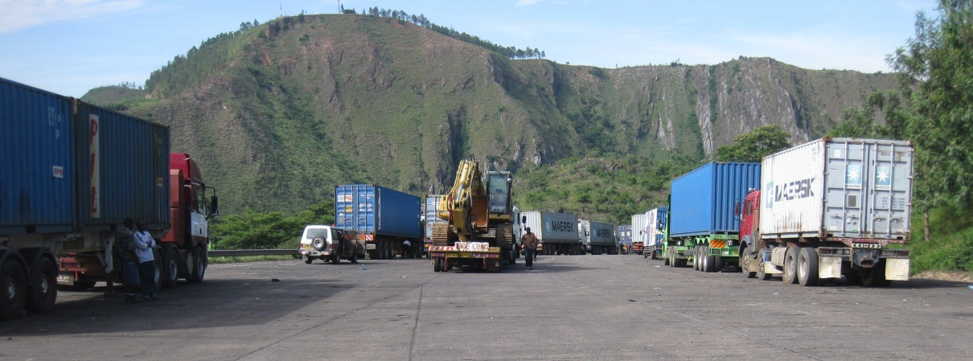
Free Movement of People, Goods, Capital & Labour; So what? Any Impact?
e.g.: How Does an ordinary Rwandan consumer benefit from the EAC market of a population of 130M?
Long Time to cross borders
Price of food & beverages still high
Transport Costs still high

Slide 5
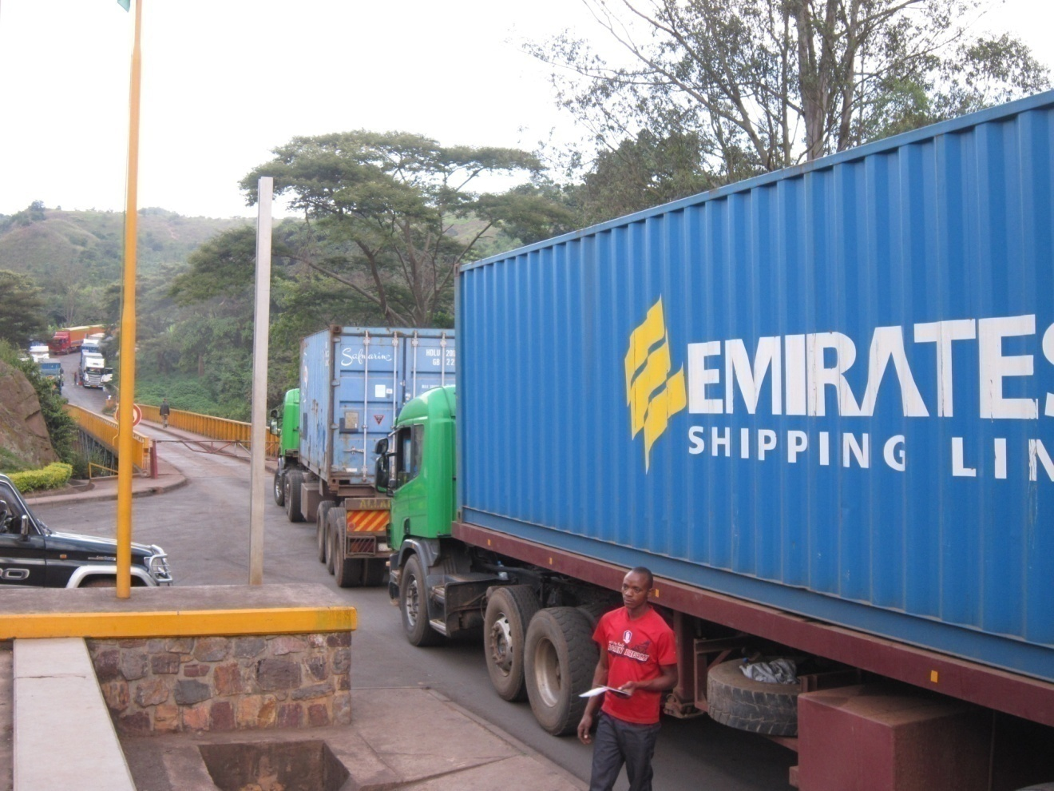
EAC Competition Law Challenges
Common Market Protocol Implementation and Removal of NTBs still a challenge:
Not all member countries agree take measures to remove NTBs
State of roads, No d maintenance fee:
Many Road blocks on Corridors
Congestion and delays at ports
Country CCP Law Vs EAC competition Law –
Which Law takes precedence?

Slide 6
EAC Competition Law Challenges
Common Market Protocol Implementation and Removal of NTBs still a challenge:
Not all member countries agree take measeures to remove NTBs
No harmonization of road maintenance fee:
Many Road blocks on Corridors
Congestion and delays at ports
In normal circumstance, a driver takes 3 days
from Kigali to Dar es Salaam plus 3 days
at the port and 4 days back to Kigali
which makes 10 days n total for a round trip
Not the same political will different understandings/systems
Harmonization and reinforcement of country CCP Laws

Slide 7
RWANDA TRACKS ON COMPETITION
Law no.39/2001 of 13/09/2001 establishing Rwanda Utility Regulatory Agency with specific mandate to regulate:
Telecommunication; 2) Transport; 3) Energy and power.
Gaps in other sectors created opportunities for unfair business practices as well as monopolies and cartels and many intermediaries btn the producer and the buyer
ADECOR was established in 2008, h and actively pushed for the adoption of CC P Law
Since 2010 ADECOR worked with MINICOM & Parliament from draft to enactment of the Law
In 2011, after adoption of Competition Policy the Gov. established competition and consumer protection unit under Ministry of Trade and Industry (MINICOM)
In October 2012, the GoR enacted the Competition and Consumer Protection Law.

Slide 8
Rwanda Competition Law takes care of Consumers
Law provides legal framework for ensuring fairness and competition are promoted and Rwanda consumers are protected.
The Law has two Main Principles:
i)To prevent anti-competitive conduct thereby encouraging competition and efficiency in business, resulting into a greater choice for consumers in price, quality and services
ii) To ensure the interest and welfare of consumers are adequately protected in their dealing with products and providers/traders

Slide 9
RWANDA COMPETITION CHALENGES
Reinforcement mechanisms – so far coordination, monitroing not well coordinated – the authority still missing
Alignment to the EAC Competition Law- need for Law review
The competition Law mainly focuses on trading goods much little of services;
Low private sector profile- and dominance of a few players; Government–led competition ( in many and important cases)
Very low level of knowledge about the Law among CSOs and Consumers
Very Limited participation of CSOs in the drafting ( only ADECOR)
Competition Law not clear about many sectors- such as Health, Education, ICT, Transport

Slide 10
ADECOR’S PERSPECTIVES
“Owning Competition and Consumer Protection Law”- ADECOR already designed the campaign document, shared it with different stakeholders- signed an MOU with MINICOM. The campaign targets INGOs, Key Development Partners, UN agencies, CSOs, CBOS and Media groups.
ADECOR spearheading “Accelerating the implementation of EAC Competition Law Project” in Rwanda as funded by TradeMark East Africa via CUTS: assessing anti-competitions practices- the level of implementation- and identify challenges in implementing the Law
Ends

