Slide 1

NATIONAL CONSUMER TRIBUNAL SOUTH AFRICA
CONTEXT AND APPROACH IN EXECUTING ITS MANDATE
Presentation by Ms. D. Terblanche
Chairperson – National Consumer Tribunal
September 2013

Slide 2
Outline of Presentation
GENESIS OF CURRENT CONSUMER PROTECTION FRAMEWORK IN SA
BACKGROUND -
CONSUMER PROTECTION MECHANISMS
CONSUMER PROTECTION STRUCTURES
SA CONSUMER PROTECTION IMPLEMENTATION MODEL
NCT ITS ROLE AND INVOLVEMENT -
Purpose and approach to execution of mandate derived from and informed by Constitution, Policy and Law
Parameters of mandate and adjudication
Process and engagement
Reflecting NCT’s interpretation of the constitutional, policy and legislative imperatives
Judgments

Slide 3
Background: Genesis of Consumer Protection and Redress
Arising out of national and international imperatives
Freedom of contract mainstay of SA law – “Caveat subscriptor”
Widespread consumer abuse and exploitation
Lack of coherent system of consumer protection
Lack of access to redress endemic
Constitutional imperatives of SA constitution
Need to align to global imperatives
Internationally recognized consumer rights
UN Guidelines on consumer protection

Slide 4
Background: Empowering mechanisms for consumer protection and redress
The Constitution of the Republic of South Africa
Access to justice provisions:
Section 34: Access to courts
Section 33: Just Administrative Action
Bill of Rights:
Section 7 – 39 of the Constitution

Slide 5
Background: Empowering mechanisms for consumer protection and redress (cont.)
Consumer Protection legislation
Economy wide
The Consumer Protection Act, 68 of 2008 (defined through purpose, application, scope, standing, tools of legislative / constitutional (purposive interpretation)
Others e.g Competition Act
Industry specific legislation
The National Credit Act, 34 of 2005 (defined through purpose, application, scope, standing, tools of legislative / constitutional (purposive interpretation)
Others e.g. Long Term Insurance Act, etc.

Slide 6
Background: Empowering Structures for consumer protection and redress
The Constitution of the Republic of South Africa
Section 34: Access to courts
Courts
Tribunals (section 34 and specific founding laws)
Consumer Protection legislation
Economy wide –
Tribunals and Consumer Courts
Commissions / Provincial Consumer Affairs offices – investigate, prosecute,education, compliance
Alternate dispute resolution / consumer Affairs Offices

Slide 7
Background: Empowering Structures for consumer protection and redress (cont.)
Consumer Protection legislation (cont.)
Industry specific legislation
Tribunals and Consumer Courts
Regulators / Consumer Affairs Offices– investigate, prosecute, education, compliance
Alternate dispute resolution / Consumer Affairs Offices

Slide 8
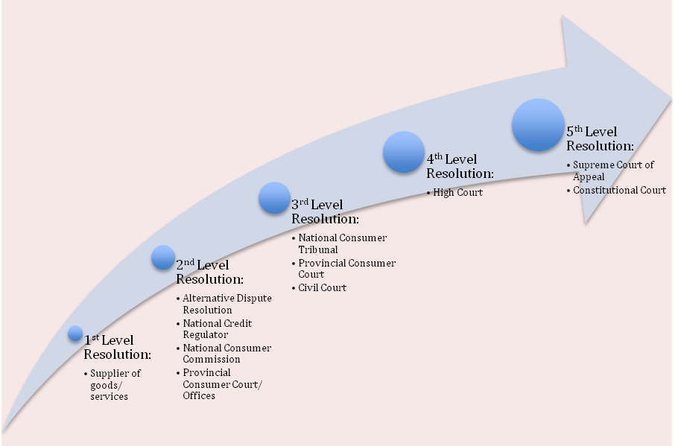
Delivery Model for Consumer Protection and Redress
I

Slide 9
Delivery Model for Consumer Protection and Redress
Investigation (to establish facts and whether legal basis for complaint exist)
Commissions / Regulators - on complaints or out of own accord
Tribunal and Consumer Courts - inquisitorial powers
ADR
Consensual resolution through ADRs - with or without them being made an order of the Tribunal / Court
Adjudication
Tribunal / Consumer courts / Civil courts
Determinations of prohibited conduct and repayments of moneys overcharged / overpaid
Damages
From civil courts after issuance of certificate of prohibited conduct

Slide 10
NCT role and involvement
Establishment – in terms of Section 26 of the National Credit Act
Has jurisdiction throughout South Africa;
Is a juristic person;
Is a Tribunal of record; and
Must exercise its functions in accordance with the NCA or other applicable legislation
Mandate – To adjudicate on matters arising from the NCA and CPA
Functions – Applications, Referrals, Reviews, Settlements, Interim Relief
Composition – Tribunal Members (Full- and Part Time) and Support Staff
Obligation to be - Inquisitorial, Quick, Accessible, Informal, Fair

Slide 11
NCT – purpose and approach to execution of mandate derived from and informed by Constitution, Policy and Law
Purpose of NCA and CPA
To promote and advance the social and economic welfare of consumers in South Africa…”
NCA – fair, transparent, competitive, sustainable, responsible, efficient, effective, and accessible credit market …
CPA – establishing a legal framework for the achievement of a consumer market that is fair, accessible, efficient, sustainable and responsible for the benefit of consumers generally …

Slide 12
Parameters of mandate and adjudication
Establishing rights and obligations
Prohibited and required conduct and applications both under the NCA and CPA
Scope
Broad definition of Consumer -
Section 1 of the CPA
SMMEs
Broad definition of Supply Chain -
Section 1 of the CPA
Collectivity of all suppliers
Includes Producer, Importer, Distributor, Retailer

Slide 13
Parameters of mandate and adjudication
Standing to Sue
Classes who might bring applications and referrals and Section 4 of the CPA
Process of referrals
Certain processes to be exhausted in certain circumstances
Intervention rights
Rules provide for …
Interpretation
Section 2 of the CPA
Must be innovative and promote consumer rights established by the CPA
Develop common law (courts)
Consider national and international law – NCA / CPA and Constitution
Effect and Enforcement of orders
Equivalent to orders of high court
Enforcement by regulators through courts

Slide 14
NCT - Process and engagement
S143 NCA also applies to CPA matters
Inquisitorial - directives, summonses, engagements with parties, new and technical provisions
Quick – postponements, service levels, performance management
Accessible – location, langauge, technological interventions, legal representation, in chambers if no dispute (constitutional provisions) Informal – approach
Fair – PAJA, interaction with parties always simultaneously

Slide 15
NCT - Interpreting constitutional, policy and legislative purpose
Rights of responsibilities of role-players interpreted contextaully and purposefully e.g.
Compliance notices issued by Regulators – regulatory responsibilities
Approach to technical non-compliance by registrants and impact on regulatory approach (Lightning Loans matter)
Standing – what constitutes public interest in consumer protection and process matters
Broad application of NCA to persons and suppliers
MTN matter – interlocutory and international precedent
Intervention rights and rights to information enabling intervention
Filings with NCT – PAIA, Auction Alliance v NCC

Slide 16
NCT - Interpreting constitutional, policy and legislative purpose (cont.)
Right to sue for damages in civil court after issuance of certificate
Certificate issued to a person affected by decision – content and form of referral and contents of judgments - section 164 Otto-matter
Administrative fines
Administrative fines and penalties – when and amounts Werlan, De Noons (Other - NCR vs AB)
Rule of Law – appeals and reviews
PAJA
Caution and carefull in decision-making of courts and Tribunals, etc.
Other (notable judgments AR2013)

Slide 17

Judgments
All judgments issued in applications before the Tribunal are available on
www.thenct.org.za
www.saflii.org
17

Slide 18
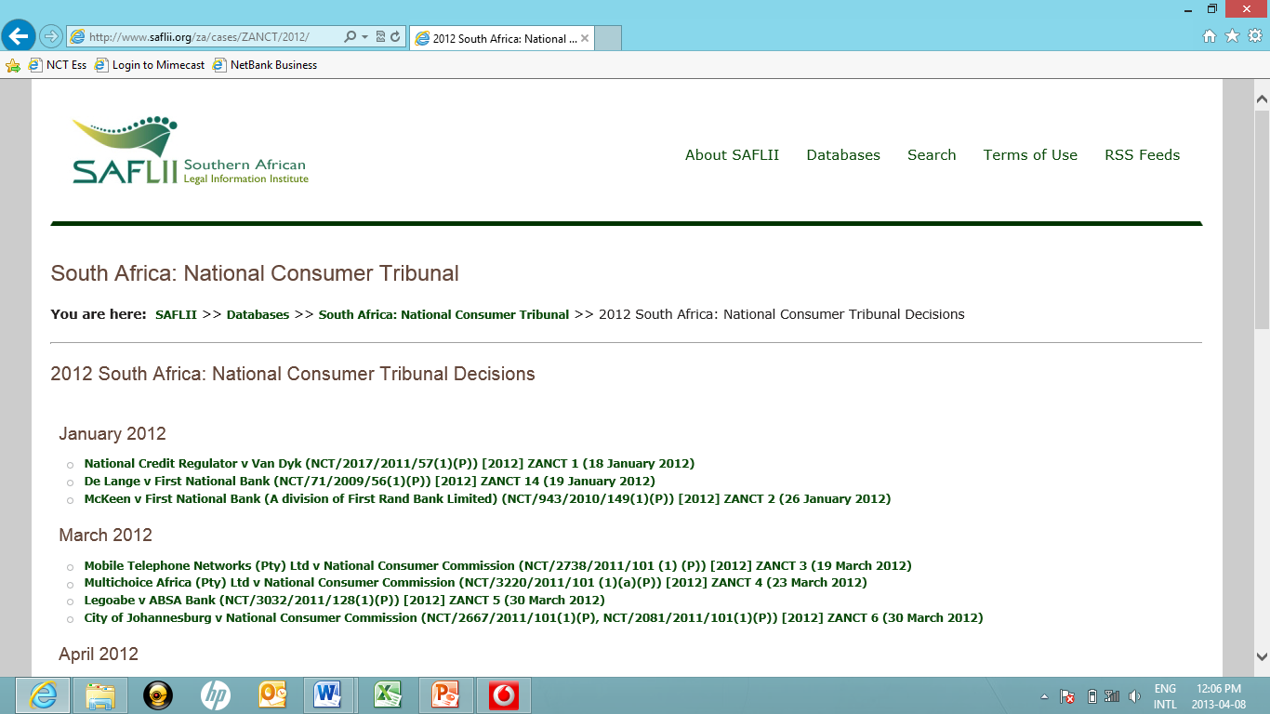
Judgments
18

Slide 19
Q & A
19

Slide 20
Our contact details
Office Hours:
Monday to Friday, excluding public holidays, from 09:00 to 16:00.
Postal Address:
Private Bag X 110
CENTURION
0046
Physical Address
The National Consumer Tribunal
Ground Floor, Building B,
272 West Avenue
Lakefield Office Park
Centurion, Pretoria
Telephone: (012) 683 8140.
Facsimile: (012) 663 5693.
E-mail: Registry@thenct.org.za
20

