Slide 1


The National Consumer Commission
Fifth Annual African Dialogue consumer Protection Conference
10 -12 September 2013
Livingstone, Zambia
Presentation by: Ebrahim Mohamed & Sipho Tleane

Slide 2
NCC’s Legal Framework and Objectives
Consumer Protection Act 68 of 2008
Policy Objectives
Promote a fair, efficient and transparent market place for consumers and business;
Provide a consistent, predictable and effective regulatory framework that fosters consumer confidence, but also recognizes the developmental imperatives of the South African economy;
Provide access to effective consumer redress for economic citizens;
Promote better customer service in the public and private sector;
Harmonize our consumer protection framework with international best practice.

Slide 3
Consumer Rights
New set of rights based on internationally accepted and UN adopted consumer rights.
Right of equality to consumer market:
prohibit any form of unfair discrimination in line with the Equality Act and the Constitution.
Right to privacy:
Limits use of consumer’s personal information for unsolicited direct marketing. Provides for “Opt out” option.
Right to Choose
Prohibits automatic renewal of fixed term agreements, Requires quotes for maintenance and repair services
Disclosure and information:
Simple and transparent contracts and improves disclosure.
Fair and responsible advertising, marketing and promotion:
Prohibits unfair marketing practices (bait, referral, negative option.)
Fair and honest dealings
Prohibits false, misleading and deceptive representations;

Slide 4
Consumer Rights
Right to Fair, just and reasonable terms and conditions
Prohibits unfair, unreasonable or unjust contract terms
Right to Fair Value, Good Quality and safety:
Facilitates access to quality service, safe goods and services and redress by providing statutory warranties for safety and quality
Protection of Consumer Rights and Consumer’s Voice
Provides for various access points for consumers to lodge complaints (accredited ombudsman, provincial structures, the Commission and Tribunal)
Provides for alternative dispute resolution and for agreements reached through this process to be recorded as consent orders that can be confirmed by the court
Support of Consumer Protection Groups
Provides for the Commission to co-operate with, facilitate or support various activities by consumer protection groups (education, research, market monitoring, advocacy and alternative dispute resolution)

Slide 5
Collaborating with International Partners
The President may assign to the Commission any duty of the Republic to exchange information with a similar foreign agency in terms of an international agreement relating to the purposes of this Act.
The Commission may liaise with any foreign or international authorities having any objects similar to the functions and powers of the Commission.
When interpreting or applying this Act, a person, court or Tribunal or the Commission may consider—
(a) appropriate foreign and international law;
(b) appropriate international conventions, declarations or protocols relating to consumer protection;

Slide 6
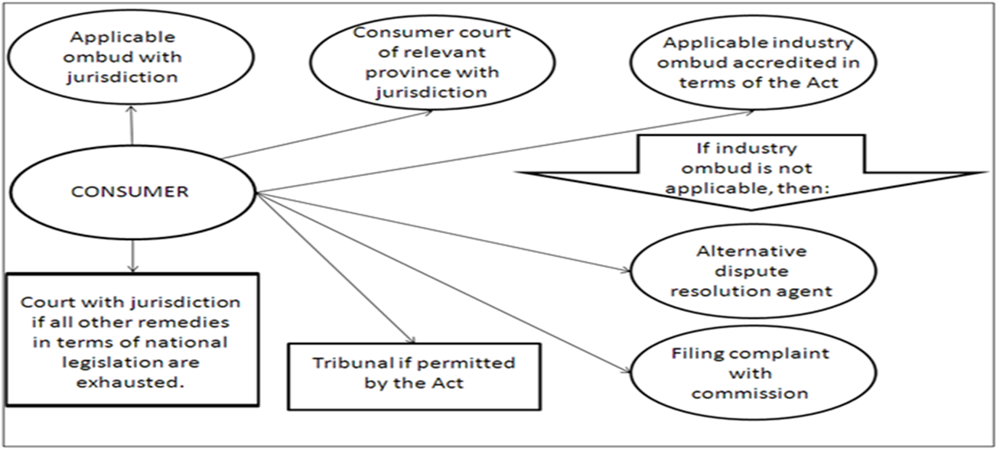
Enforcement Policy of the Act

Slide 7
Competition-Consumer Interface
The Competition Act (89 of 1998) empowers the competition authorities to investigate and prosecute cartels, abuse of dominance and restrictive practices and are also responsible for merger control.
The Competition Commission and the National Consumer Commission are currently pursuing a Memorandum of Agreement regarding matters of concurrent jurisdiction between the two institutions. The Competition Act, Section 82(3) requires the Competition Commission to enter into such agreements in order to:
“identify and establish procedures for the management of areas of concurrent jurisdiction;
Promote co-operation between the regulatory authority and the Competition Commission;
Provide for the exchange of information and the protection of confidential information”

Slide 8
Competition Cases with Consumer aspects
The Bread Cartel
The “bread cartel” investigation was into four firms which control approximately 90% of the milling of maize and wheat These companies being Pioneer Foods, Foodcorp, Premier Foods and Tiger Brands, are all vertically integrated in wheat milling and baking. It is worth noting that the major product of the baking industry is bread, a staple food among many South Africans, with between 70% and 80% of all flour milled in South Africa being used for bread baking.
Tiger Brands entered into a consent order agreement with the Commission and paid a fine of R45 million.
Pioneer Foods was found guilty of contravening the Competition Act, and given a penalty of R196 million.
Further, the consent agreement required that Pioneer invest in capital expenditure to the minimum value of R150 million, which would have the outcome of creating jobs.

Slide 9
Competition Cases with Consumer aspects
The Banking Enquiry of 2006
The Commission undertook a market inquiry into the South African retail banking market, which was concluded in 2008.
The Banking Enquiry diagnosed a number of competition problems and consumer protection challenges in the South African retail banking market.
The Enquiry proposed 28 remedies, encompassing regulatory and rule changes, structural reforms to the ways certain prices are set.
There were also proposals related to the need for improvements to consumers’ banking experience, such as the lowering of penalty fees on rejected debit orders and the setting of standards for product and price information disclosure to consumers.

Slide 10
Conclusion
Consumer matters and competition matters often overlap;
Competition authorities typically encounter consumer issues in the course of their investigations and through advocacy initiatives such as market inquiries;
There are important lessons to be learnt from the Commission’s successful cases with high consumer impact;
Market inquiries remain an important inquisitorial tool to unlock matters beyond competition, including consumer matters;
Institutional co-operation on matters of concurrent jurisdiction thus remains important.
National Consumer Commission is only 2 years old and will learn from the Competition Commission success.

Slide 11

THANK YOU

