Slide 1



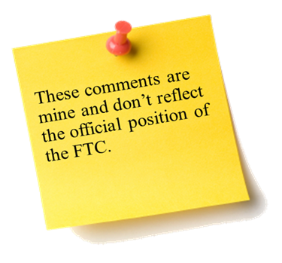
Case Selection Criteria for Consumer Protection Agencies
The Fifth Annual African Dialogue
Consumer Protection Conference
Deon Woods Bell
U.S. Federal Trade Commission
Livingstone, Zambia
10-12 September 2013

Slide 2

Case Selection Considerations
Enforcement Priorities
Consumer Complaints
Consumer Injury
Legal Considerations
Educational Goals
Partnership Opportunities
Resources

Slide 3

Enforcement Priorities
Have there been political/social/economic forces that make your consumer population particularly susceptible to a certain type of consumer fraud?
Does your consumer population have an impression that a particular type of product/industry is harming them and that government intervention is needed?

Slide 4
Consumer Complaints and Consumer Injury
Can you establish trends in complaints with respect to a particular industry or trader?
Have any third parties noticed a spike in the complaint rate with a particular industry or trader?
Do the complaints help you assess consumer injury?

Slide 5

Legal Considerations
Is there an area of law or your agency’s legal authority that should be advanced? Or, conversely, is the law well-established?
Do the traders or industry believe that they are exempt from a particular law and your agency wants to dispel that belief?
Do the potential defendants have valid defenses?

Slide 6

Educational Goals
Will a case promote consumer education or awareness about a particular type of scam or problematic business practices?
Will a case promote education to traders and the industry about a particular type of commercial behavior?

Slide 7

Partnership Opportunities
How does your potential case overlap with other agencies?
Domestic partnership v. international partnership
Civil and criminal partnership
Formal v. Informal Partnership
Parallel cases
Information-sharing

Slide 8
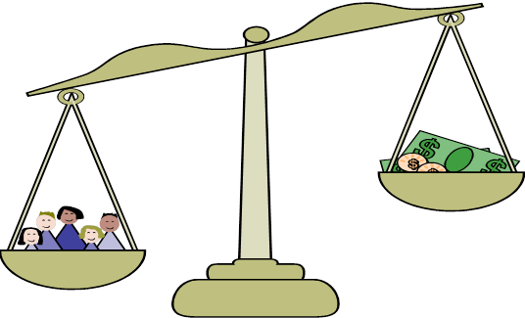
Resources
Can your agency afford to do the case? Does your agency/office have sufficient available staff? Does your agency/office have sufficient non-staff resources?
How long will the investigation take?
What is the likelihood of settlement or litigation?

Slide 9
FTC v. Coulomb Media
In April 2011, the FTC sued Coulomb Media, Inc., and its sole officer and owner, Cody Low.
The lawsuit alleged that the defendants violated the FTC Act by:
Falsely and without substantiation representing that the use of acai berry products would result in rapid and substantial weight loss
Misrepresenting that the websites used to market the acai berry products were objective news reports
Failing to disclose that their websites were not authorized by an objective news journalist

Slide 10
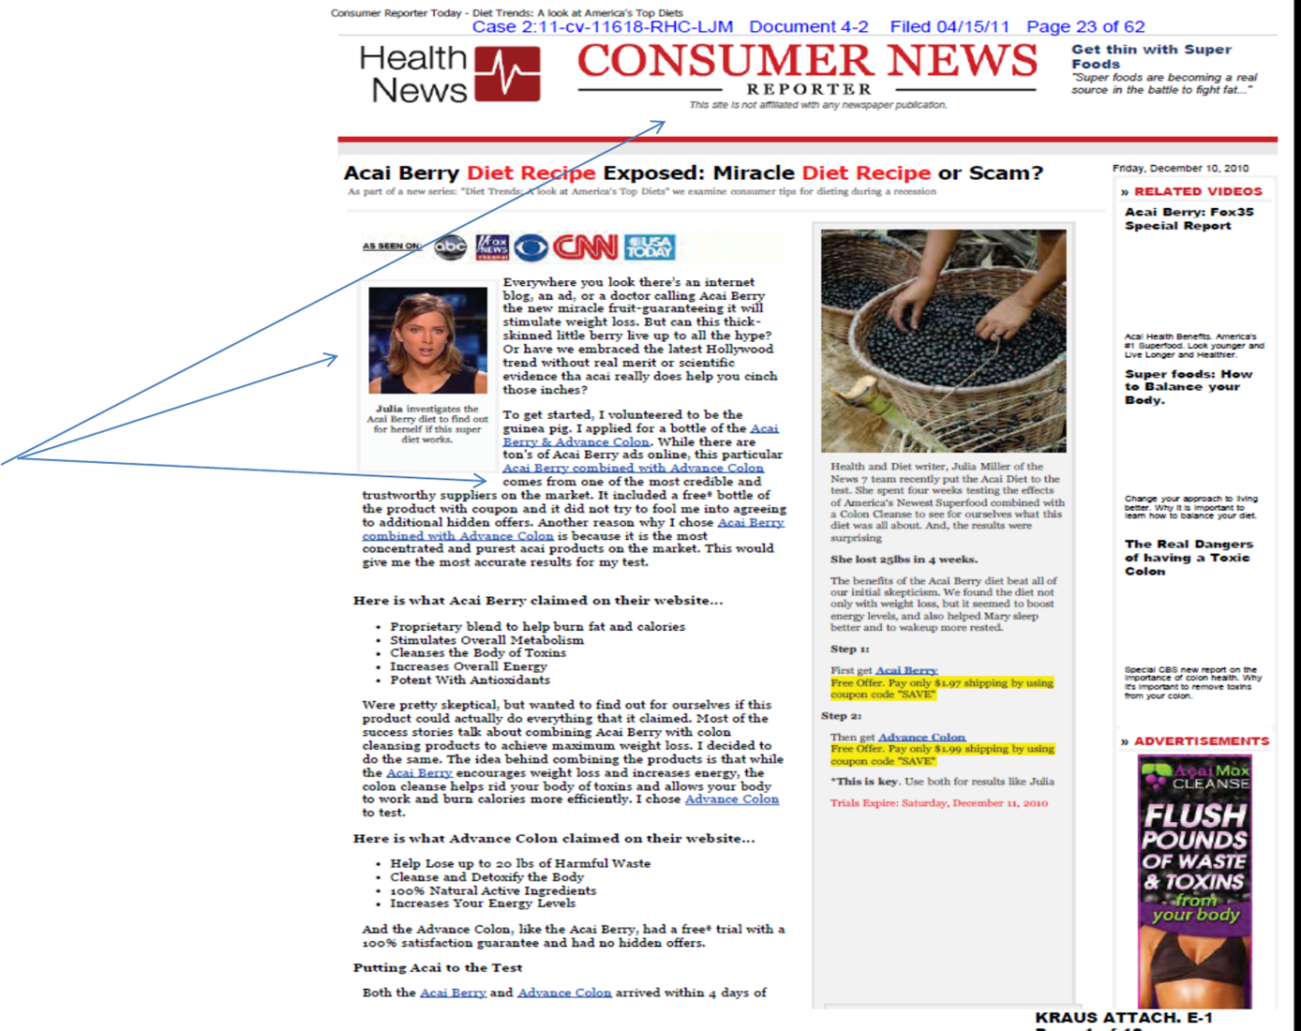


Slide 11


Slide 12
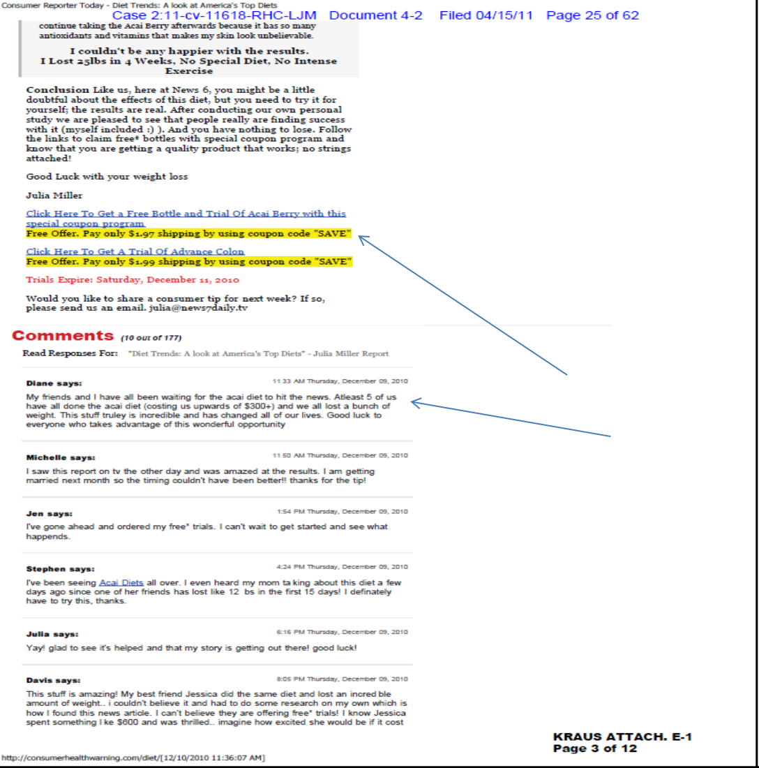

Slide 13
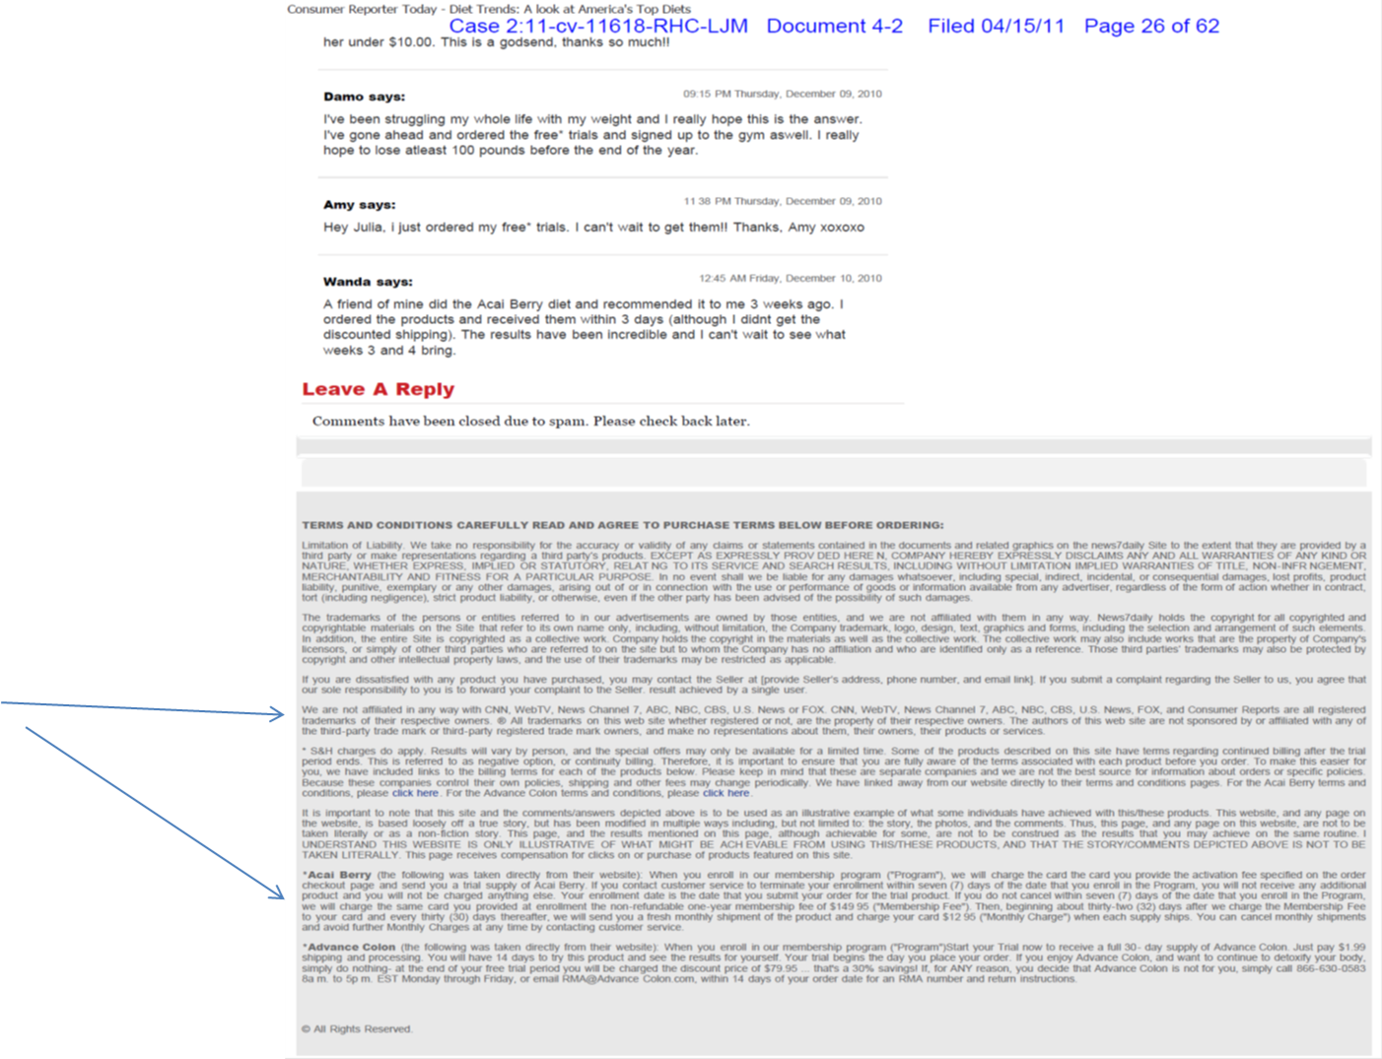

Slide 14

Special Circumstances of the Case
Law Enforcement Sweep
The FTC filed 10 cases against different affiliate marketers that deceptively marketed acai berry products using fake news websites
FTC v. Central Coast Nutraceuticals
Case filed in August 2010
Deceptively marketed acai berry products and colon cleansers
Additional Cases
FTC v. Coleadium, Inc.
FTC v. Clickbooth.com LLC

Slide 15

Outcome
Permanent Injunctions
Conduct provisions prohibiting further unlawful behavior
Monetary judgments (global recovery approximately $9.4 million)
Cooperation provisions
Compliance reporting/monitoring provisions
Recordkeeping requirements

Slide 16

Why did the FTC select these cases?
Enforcement Priorities:
Fake news websites by affiliate marketers became a trend
Deceptive weight loss claims to market acai berry products is a trend
Nefarious affiliate marketing becoming a trend

Slide 17

Why did the FTC select these cases?
Consumer Injury
High aggregate harm
Legal Considerations
Law was well established that these activities violated the FTC Act
Few substantive defenses for the conduct
Messaging benefits: no prior enforcement industry; quash the bravado of the affiliate marketers

Slide 18

Why did the FTC select these cases?
Education
Opportunity to educate consumers about dietary supplements and free trials
Opportunity to educate the affiliate marketing industry about the FTC’s stance on deceptive marketing

Slide 19

Why did the FTC select these cases?
Resources
For one office, it would have been a huge undertaking. But by incentivizing collaboration amongst offices within the agency, the resource burden became manageable
For the sweep, the danger of adjudication was reduced by well-founded law establishing the alleged violations
Sweep streamlined collection of evidence against additional targets

Slide 20
Thank you! Questions? For all questions, please contact Deon Woods Bell dwoodsbell@ftc.gov +1-202-326-3307

