Slide 1
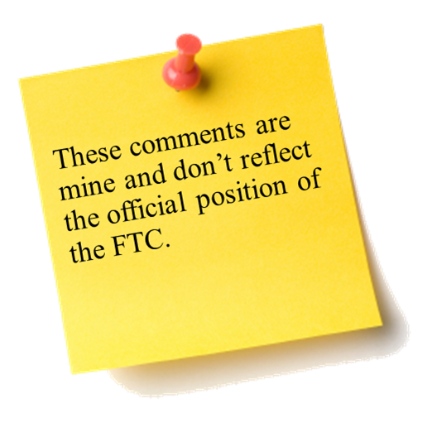
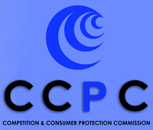
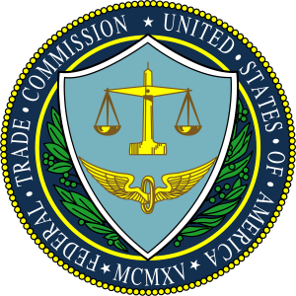

The Fifth Annual African Consumer Protection Dialogue Conference
Mobile Technology and Cyber Threats
Deon Woods Bell
Office of International Affairs
Livingstone, Zambia
10-12 September 2013

Slide 2

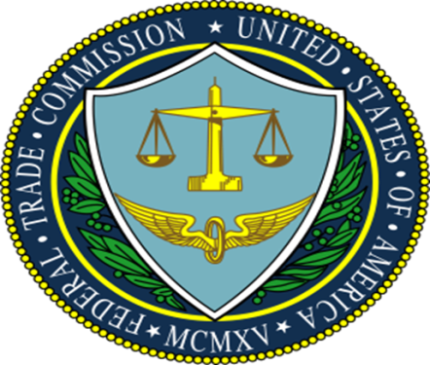
The U.S. Mobile Market
87 percent of Americans have a mobile phone
Of those, only about 12 percent currently use them to make mobile payments
Some believe that mobile payments will achieve “widespread mainstream consumer adoption” by 2015
Third party charges on wireless bills are estimated at $1.5 billion per year
Few mobile devices have antivirus protection
According to one survey, less than one-third of mobile users felt in control of their personal information on their device
More than 800,000 apps are available in the Apple App Store and 700,000 in Google Play
Notes:
12 percent use mobile phones to make mobile payments: Mobile Payments report, page 3.
“Widespread mainstream consumer adoption” by 2015: Mobile Payments report, page 1.
Estimate of third party charges: Cramming Roundtable transcript page 14, line 8-9.
Less than one-third of mobile users felt in control: Mobile Privacy Disclosures Report, page 3.

Slide 3
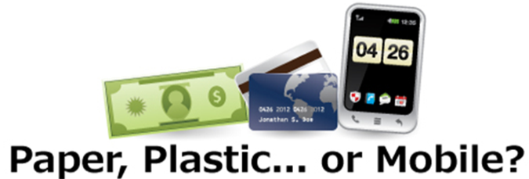
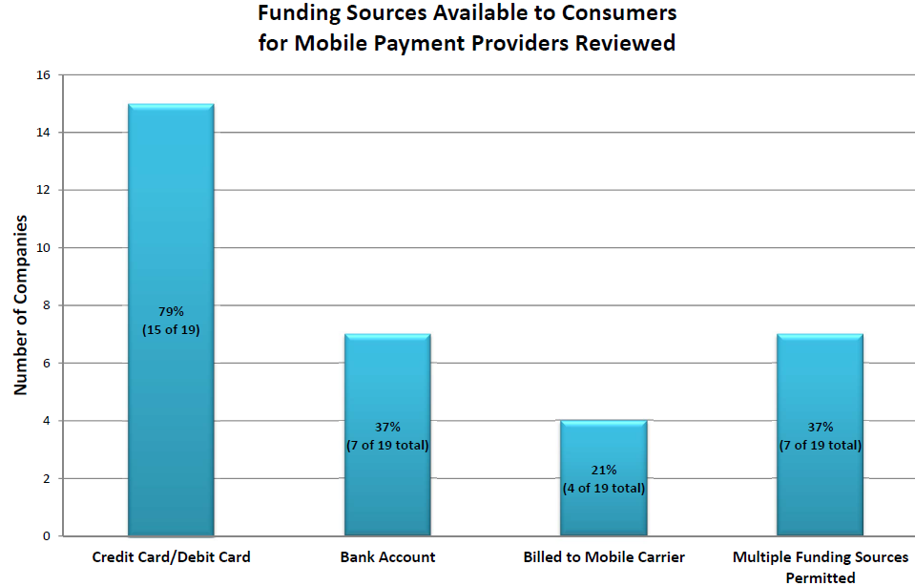
Mobile Payments
Issues:
There are many kinds of mobile payments
Protections against fraudulent or unauthorized mobile payments vary by funding source
Security of mobile payments
FTC Initiatives:
Workshop and Report on Mobile Payments

Slide 4
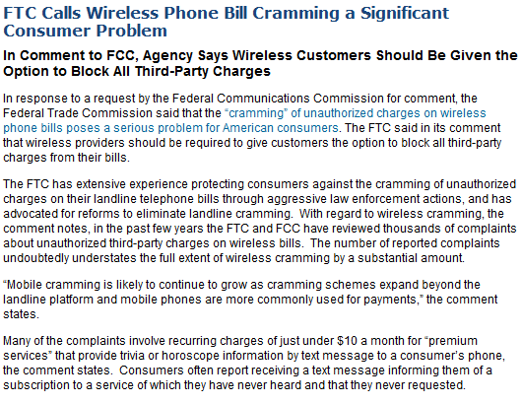
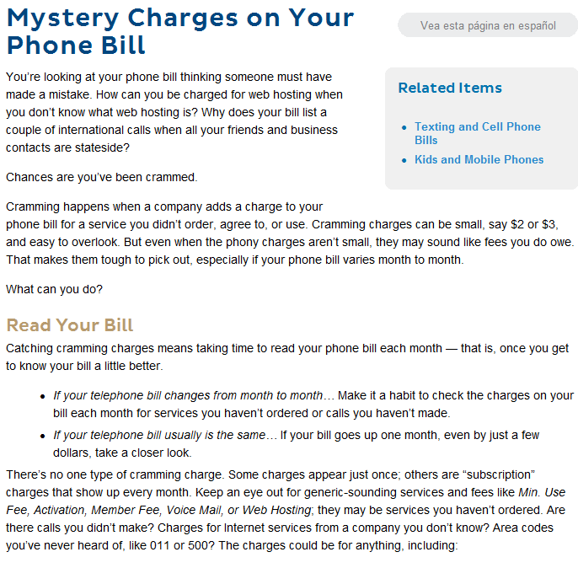
Mobile “Cramming”
Issues:
Third parties place unexpected charges on consumers’ phone bills
Many consumer are unaware this can occur and often fail to spot such charges on their bills
FTC Initiatives:
Roundtable on Mobile Cramming
Law Enforcement:
Wise Media, LLC

Slide 5
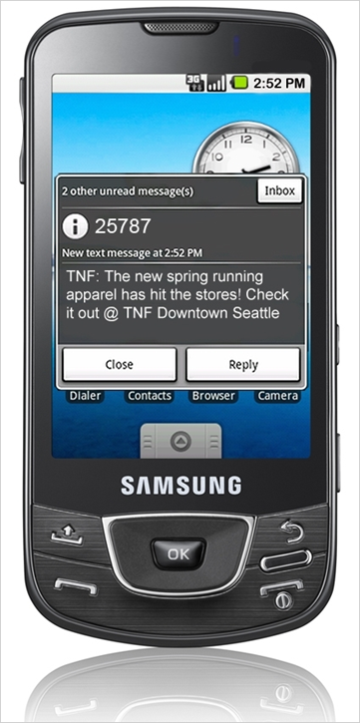
Mobile Security
Issues:
Personal information now regularly stored on smartphones
Vectors for attack include malware as well as network and operating system vulnerabilities
Concerns about the security of mobile payment systems are slowing their use
FTC Initiatives:
Workshop on mobile security
Video: Public Wi-Fi Networks
Law Enforcement:
HTC America, Inc.

Slide 6
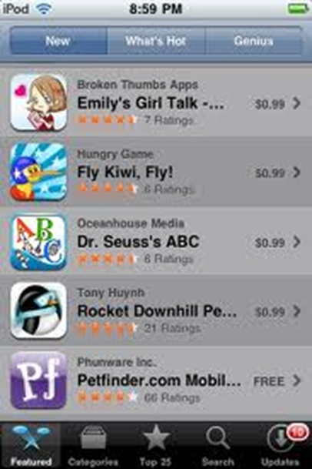
Mobile Privacy
Issues:
Mobile devices are typically personal to an individual, always on, and with the user
A single device can facilitate data collection and sharing among many entities
Small screens constrain how critical privacy-related information is conveyed to consumers
FTC Initiatives:
Report: Mobile Privacy Disclosures: Building Trust Through Transparency

Slide 7
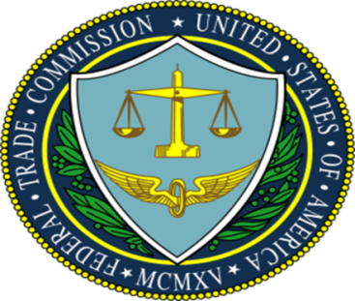
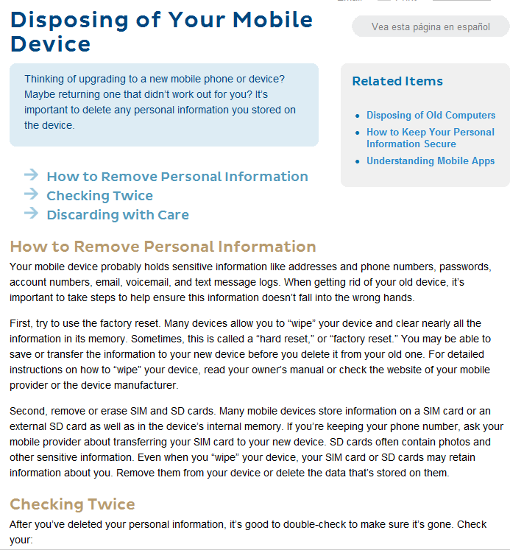
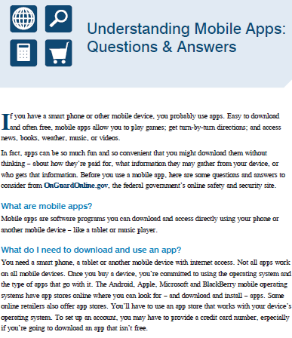
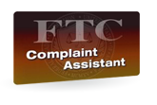



Mobile Consumer and Business Education
The FTC’s website offers a wealth of information on mobile issues for consumers and businesses. In addition, consumers from the U.S. and abroad can use FTC sites to report complaints about mobile-related transactions.
www.business.ftc.gov
www.consumer.ftc.gov
www.onguardonline.gov
www.econsumer.gov

Slide 8
Cyber Threats to Consumers and Countermeasures
Threats
Malware – viruses, worms, spyware, and Trojan horses
Phishing
Wireless and operating system vulnerabilities
Spam
Countermeasures
Anti-virus software
Firewalls
Intrusion detection systems
Authentication systems
Encryption

Slide 9
FTC Cyber-related Law Enforcement
Wyndham Worldwide Corp.
The FTC alleges that data security failures led to three data breaches at Wyndham hotels in less than two years, resulting in the theft of information on hundreds of thousands of payment accounts and millions of dollars in fraud loss
Cbr Systems, Inc.
The FTC reached a settlement with the cord blood bank over allegations CBR failed to provide reasonable and appropriate security for customers’ personal information, resulting in a security breach
Tech Support Scams
Collaborating with foreign partners, the FTC halted telemarketing operations that allegedly tricked consumers into paying for the removal of non-existent viruses and malware

Slide 10

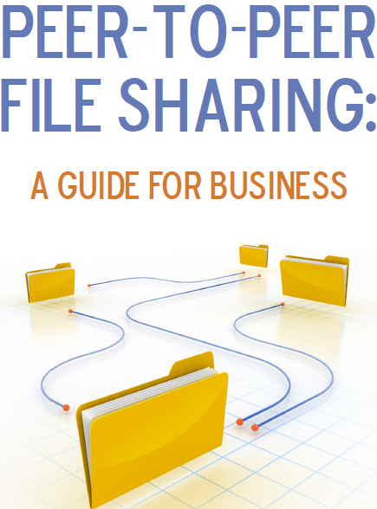
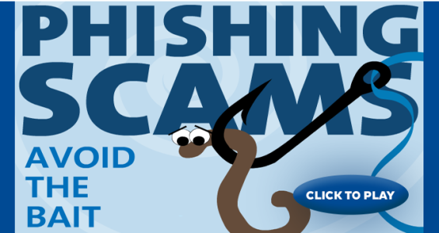
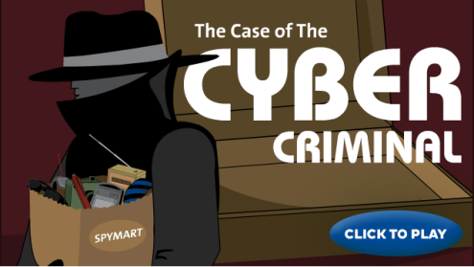
Consumer and Business Cyber Threat Education
FTC Initiatives:
Video: Computer Security
Video: Protect Your Computer from Malware
Game: Phishing Scams: Avoid the Bait
Game: Beware of Spyware
Game: The Case of the Cyber Criminal
Peer-to-Peer File Sharing: a Guide for Business

Slide 11
THANK YOU!

