Slide 1
THE TEXTILE CLEANING PROCESS
CHARLES L. RIGGS, Ph.D.
Texas Woman’s University

Slide 2
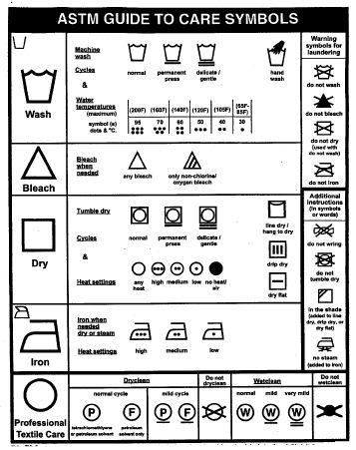
The Textile Cleaning Process

Slide 3


The Textile Cleaning Process

Slide 4
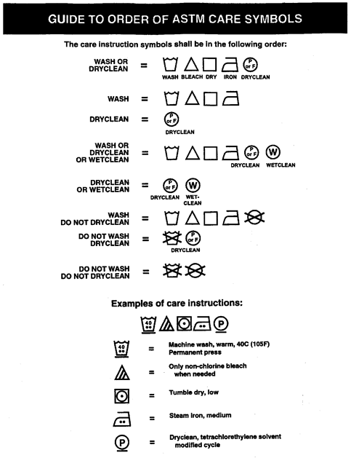
The Textile Cleaning Process

Slide 5
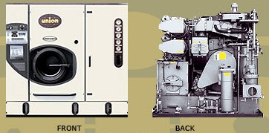
The Textile Cleaning Process
Drycleaning Machine

Slide 6
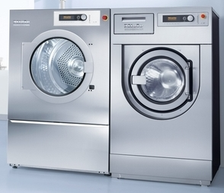
The Textile Cleaning Process
Wetcleaning Machine and Dryer

Slide 7
The Textile Cleaning Process
Expectations
Remove soils and stains
Avoid damage to the item

Slide 8
The Textile Cleaning Process
Cleaning Fluid Options
An aqueous solvent that, chemically, is a polar solvent
Water
A nonaqueous solvent that, chemically, is a nonpolar solvent
Currently includes petroleum and tetrachloroethylene

Slide 9
The Textile Cleaning Process
Observed Damage
Solvent
Water
Odor retention
Embellishment damage, especially some types of beads and sequins
Shrinkage
Color loss
Bleeding
Change in surface character

Slide 10
The Textile Cleaning Process
Shrinkage
Relaxation
Progressive
Based on how fabric has been processed or worn
Fiber is elongated
Does not recover
Relaxed by washing
Shrinkage stops when fiber is fully relaxed
Fiber is not compatible with a specific treatment causing an irreversible shortening of the fiber
Shrinkage continues and is cumulative based on amount of exposure

Slide 11
The Textile Cleaning Process
Soils and Stains
Soils
Stains
Removed by agitation
Dissolved in water or solvent
Polar (water soluble) includes salts, sugars, blood, urine, and other bodily fluids
Nonpolar (solvent soluble) includes oils, greases, fats, waxes
Particulate (not soluble) includes sand, dust, soot
Material bound in the fabric that must be modified and/or removed with chemical treatments
Attempted before cleaning, during cleaning (prespotted), or after cleaning (post spotted)

Slide 12
The Textile Cleaning Process
Matching Cleaning Method to Soil
Dryclean
Wetclean
No problem with nonpolar soils
Problem with polar soils
Add detergents and water to the solvent (up to 75% RH)
Pre/post spot with water
Knowledge of soil type present necessary for success
No problem with polar soils
Problem with nonpolar soils
Add special detergents, emulsifiers, etc.
Pre/post spot with solvents
Knowledge of soil type present necessary for success

Slide 13
The Textile Cleaning Process
Environmental Issues with Drycleaning
Process developed in the 1800s
Quality of solvent was poor, but recycling was standard practice
No method for disposal of dirty solvent and removed soils – typically poured on the ground
Same as for used motor oil and industrial solvents
Problem water-soluble soils were removed by hand wetcleaning
Remediation is underway

Slide 14
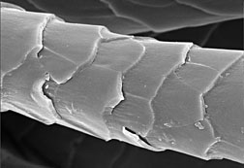
The Textile Cleaning Process
Wool Shrinkage
Fiber can be elongated, recovery is slow
Recovery accelerated by humidity
Fiber is covered with scales that provide both positive and negative attributes
Felting occurs when fiber is exposed to heat, moisture, and agitation
Fiber shortens with scales overlapping and locking in position
Narrow end of one fiber moves out of yarn structure and entangles with adjacent fiber

Slide 15
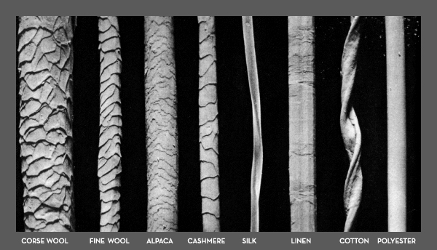
The Textile Cleaning Process
Textile Fibers

Slide 16
The Textile Cleaning Process
Traditional Wool Fabrics
Dryclean
Wetclean
Regular cycle regardless of solvent
Local hand wetcleaning is normal procedure based on soil type
Mild detergent
Minimum mechanical action
Relaxation and minor felting can be recovered by elongation
Shrinkage progressive with multiple cleanings

Slide 17
The Textile Cleaning Process
Washable Wool Fabrics
Limited success
Partially removes the scale structure and/or coats the scales with a finish
Potential Issues
Changes the feel (or hand) of the fabric
Degrades the durability of the finish
Alkali found in standard laundry detergents attacks the wool protein

Slide 18
The Textile Cleaning Process
Current Technology
Dryclean
Wetclean
No connection to water or sewer
All solvent, soils, and additives captured, filtered, distilled
Solvent reused in same machine
Approx. 1 gallon of solvent lost for every 1000 lbs. cleaned
Water, removed soils, detergents discharged to sewer
Fresh water at 85˚ F to 104˚ F with consumption usually 2.4 gallons of water/lb.
Detergents based on soil and fabric type

Slide 19
The Textile Cleaning Process
Environmentally Friendly?
Washing and wetcleaning use water treated for drinking and discharge soils, detergents, solvents, and used water to the sewer
Dry-to-dry drycleaning uses solvents that are recycled by filtration and distillation
Soils and detergents concentrated and disposed by licensed hazardous waste company

Slide 20
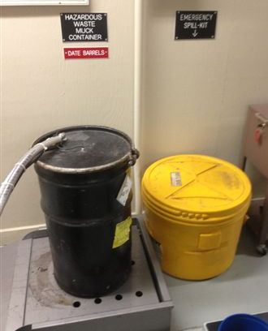
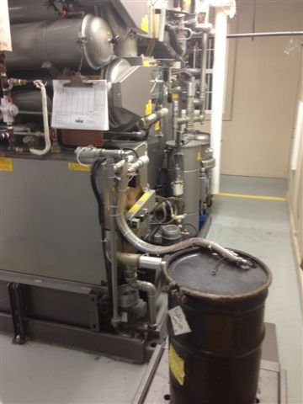
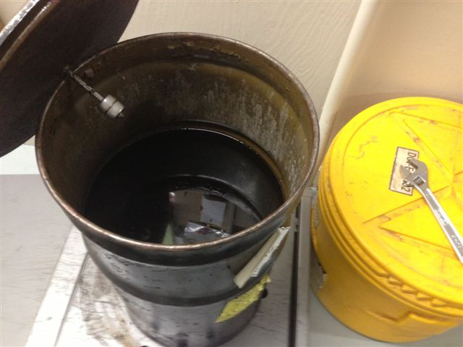
The Textile Cleaning Process

Slide 21
The Textile Cleaning Process
Scenario to Consider
Workwear that is heavily soiled with oil, grease, perspiration, and particulate soils
Problem for all technologies to clean
Commonly processed in industrial laundries that use water and special additives
Discharge waste water to an onsite pretreatment plant before discharge to sewer

Slide 22
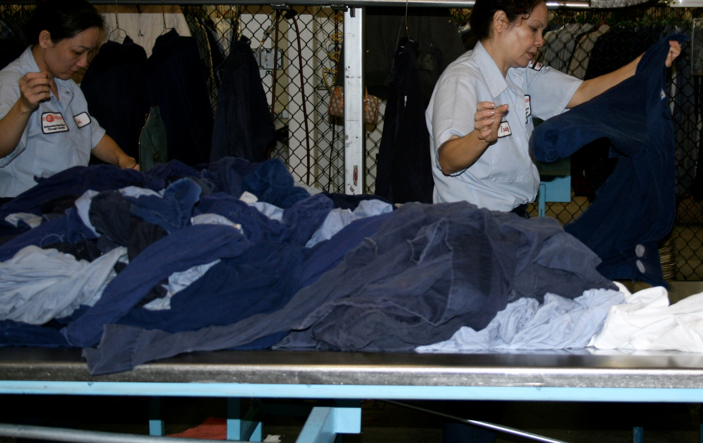
The Textile Cleaning Process

Slide 23
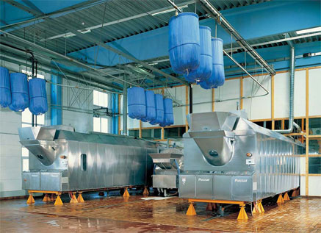
The Textile Cleaning Process
Tunnel Washer

Slide 24
The Textile Cleaning Process
Could dryclean with no additives to remove oil, grease and most of the particulates.
Solvent and soils go directly to distillation
After complete solvent recovery, items are washed using water and small amount of detergent to aide in wetting
Waste is concentrated and goes to appropriate recycle/waste disposal
Very little is discharged with the waste water to the sewer

Slide 25
The Textile Cleaning Process

