Slide 1
Ownership Concentration and Strategic Supply Reduction
Katja Seim, Wharton and NBER
Joint with Ulrich Doraszelski (Wharton), Michael Sinkinson (Yale SOM), and Peichun Wang (Microsoft)
FTC Microeconomics Conference 2018

Slide 2
Spectrum is Scarce and Valuable
US Wireless Frequency Allocations over time:
MHz:
54
216
470
700
900
Broadcast TV
12 VHF Channels
Broadcast TV
56 UHF Channels
Cellular
1983-2008
Broadcast TV
12 VHF Channels
Broadcast TV
37 UHF Channels
Cellular & Wireless
2009-Today
Broadcast TV
12 VHF Channels
23 UHF Channels
New Mobile
Cellular & Wireless
2020+
As mobile broadband becomes more valuable and over-the-air broadcast viewership falls, the government wants to re-purpose broadcast TV’s UHF spectrum for mobile broadband usage.
This paper: to what extent can firms that own multiple television licenses distort this process?

Slide 3
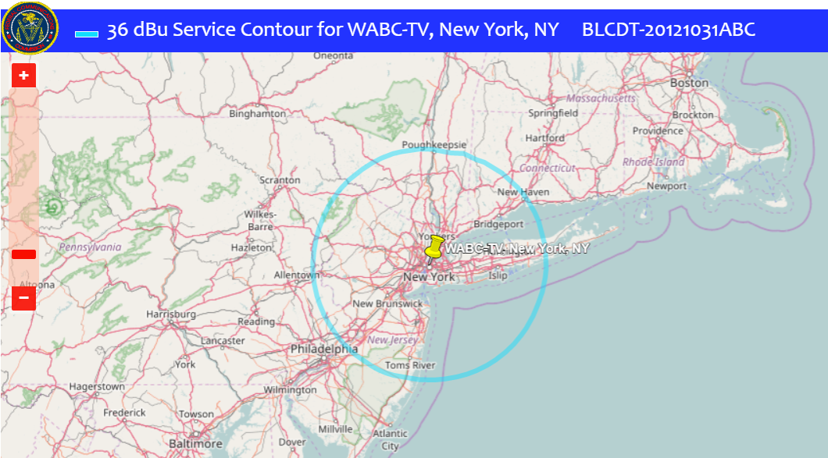
Challenge: Spectrum Ownership is Fragmented
Each license gives broadcasting rights in a 6 MHz band of spectrum over a specific geographic area. In 2015: 2,173 full-power licenses in the USA.

Slide 4
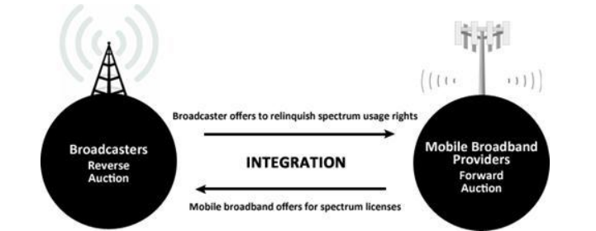
Challenge: How to Efficiently Re-Allocate
Problem: how to re-allocate spectrum held by thousands of broadcasters to potentially more valuable mobile broadband use.
Solution: In 2016-17, the Federal Communications Commission (FCC) conducts an “Incentive Auction”. They buy back broadcast licenses (reverse auction) and sell mobile broadband spectrum (forward auction).
Key: FCC will “repack” stations that remain on-air into lower part of UHF band to free up a nationwide, continuous block of spectrum in the upper part.

Slide 5
Challenge: Constraints on “Repacking”
The FCC will be able to “repack” (effectively “move”) stations that remain on the air after the auction.
For example, a station currently broadcasting on UHF Channel 45 (which is 656-662 MHz on the spectrum band) could be moved to Channel 27 (548-554 MHz).
The right to move stations was granted by US Congress.
However: a station cannot see an “increase of more than 0.5% aggregate interference”.
Translation: if the FCC moves a station to a different channel, that station cannot lose more than 0.5% of its audience from interference with nearby stations.
Stations will be reimbursed for costs of moving to new channels.

Slide 6
Challenge: Repacking Feasibility
Given the constraints on repacking, the goal of the reverse auction is to, for a given amount of spectrum:
Identify the low-cost set of licenses that must be acquired by the FCC, such that remaining set of licenses can be feasibly repacked into the remaining spectrum.
Example: UHF Channels 14-51 occupy 470-698 MHz frequencies. Initial clearing target is 126 MHz. Goal is to identify low-cost set of licenses to acquire such that remaining can be feasibly repacked into 470-572 MHz.
Verifying if a set of licenses can be feasibly repacked is an NP-complete problem.
The auction must take this computational problem into account as it progresses.

Slide 7
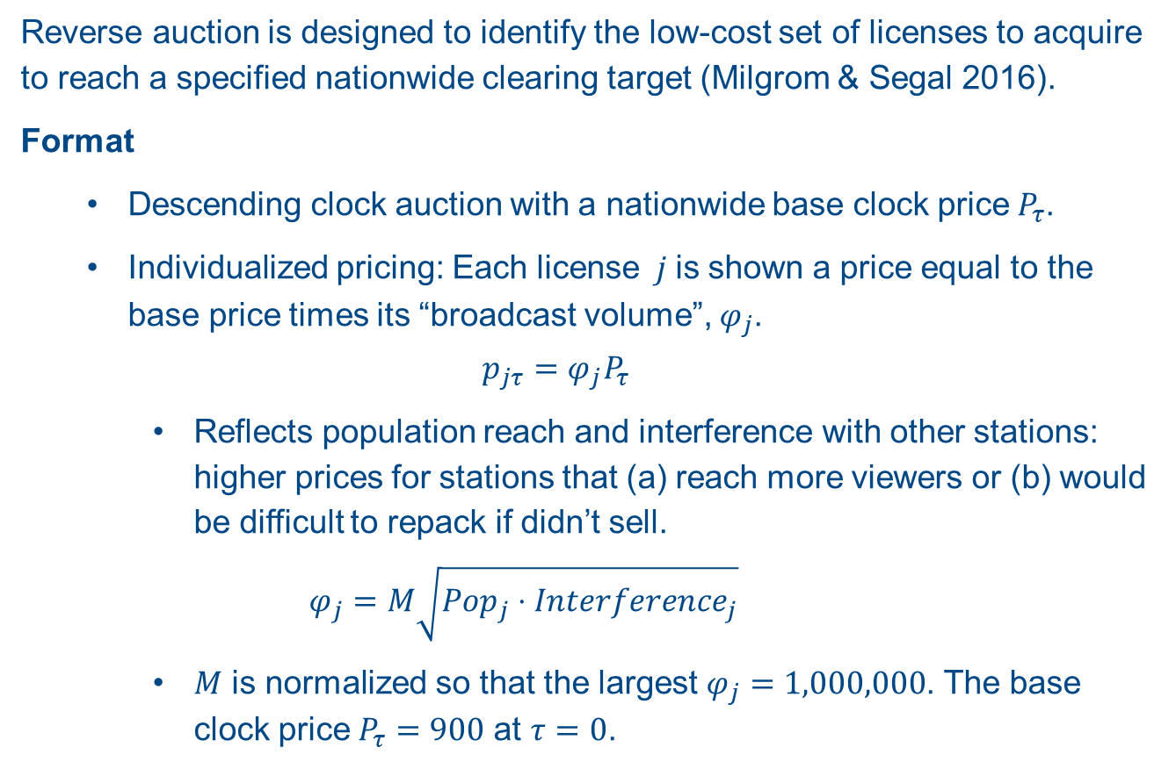
Bidding in the Reverse Auction
Reverse auction is designed to identify the low-cost set of licenses to acquire to reach a specified nationwide clearing target (Milgrom & Segal 2016).
Format
  Descending clock auction with a nationwide base clock price $P_{τ}$.
  Individualized pricing: Each license $j$is shown a price equal to the base price times its “broadcast volume”, $φ_{j}$.
  $$p_{jτ}=φ_{j}P_{τ}$$
    Reflects population reach and interference with other stations: higher prices for stations that (a) reach more viewers or (b) would be difficult to repack if didn’t sell.
    $$φ_{j}=M\sqrt{Pop_{j}⋅Interference_{j}}$$
    $M$ is normalized so that the largest $φ_{j}=1,000,000$. The base clock price $P_{τ}=900$ at $τ=0$.

Slide 8
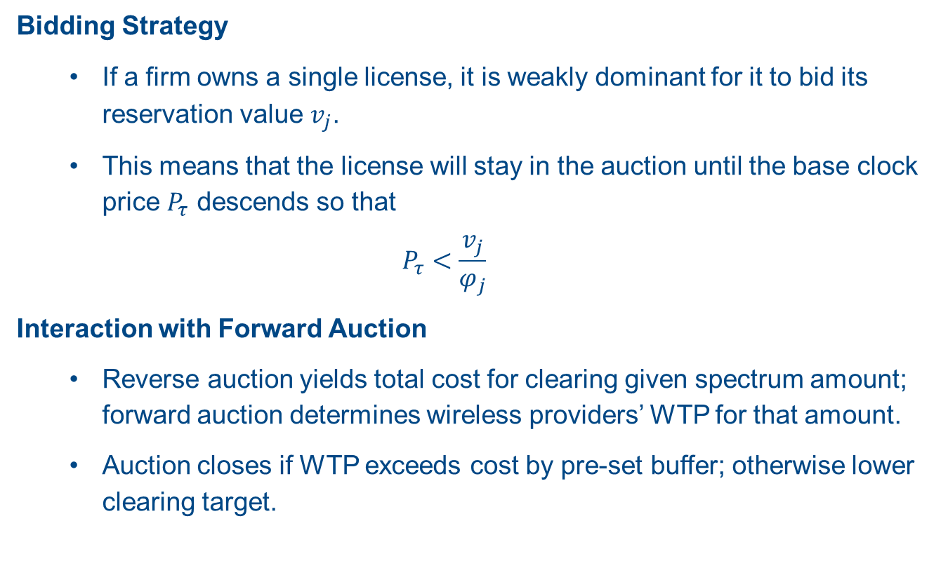
Bidding in the Reverse Auction
Bidding Strategy
  If a firm owns a single license, it is weakly dominant for it to bid its reservation value $v_{j}$.
  This means that the license will stay in the auction until the base clock price $P_{τ}$ descends so that
  $$P_{τ}<\frac{v_{j}}{φ_{j}}$$
Interaction with Forward Auction
  Reverse auction yields total cost for clearing given spectrum amount; forward auction determines wireless providers’ WTP for that amount.
  Auction closes if WTP exceeds cost by pre-set buffer; otherwise lower clearing target.

Slide 9



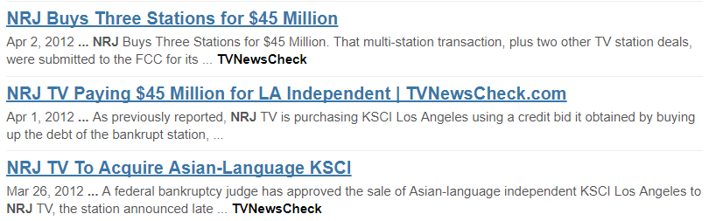
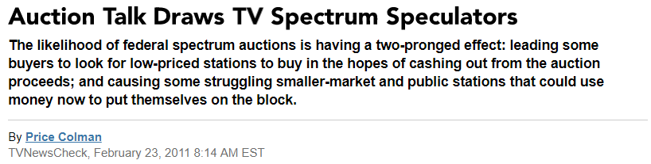
Multi-License Ownership
“Bidding war” among speculators for WSAH, a bankrupt station in Bridgeport, CT
Trade press focused on “flipping”.
Three firms: NRJ, LocusPoint and OTA.

Slide 10
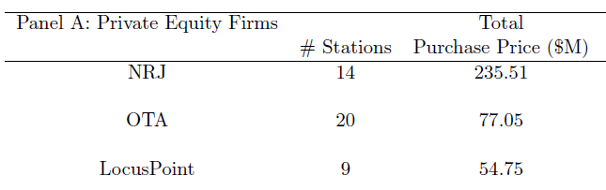
Multi-License Ownership and Bidding
However, multi-license ownership (across and within markets) is common. Majority of DMAs have multi-license owners.
  Within DMA, traditional concern about TV station market power in broadcasting, but not in spectrum holdings. Across DMAs, many large chains.
  Prior to auction, private-equity firms acquired significant holdings of licenses likely to be valuable in auction.
Three firms acquired 43 licenses in 18 markets. Independent affiliations for 25; only two are major network affiliates.

Slide 11
Multi-License Ownership and Bidding
These firms may have an incentive to withhold broadcast licenses from the auction to raise closing prices for other licenses they own.
Similar to effects shown in, say, electricity auction markets.
  Units are far more discrete and firms do not bid entire supply schedules.
  TV stations not a homogeneous product: Units are differentiated due to effect of interference patterns on repacking process
This paper addresses how multi-license ownership alters bidding behavior:
  Develop a simple model of how a firm would exploit owning multiple broadcast licenses in a single market
  Estimate reservation prices for all UHF license holders in the US
  Quantify the impact of multi-license bidding via large-scale auction simulation
    Consider both initial goal of clearing 126MHz and ultimately realized clearing target of 84MHz.

Slide 12
Main Findings
Total auction payouts increase by 7-22% ($3.7B at the high end) due to multi-license ownership.
  Effect is concentrated in a few dozen markets. Confirmed in several robustness checks and at different clearing targets.
  We evaluate a small rule change that reduces the impact.
Could be viewed as a simple transfer, or as an actual efficiency loss:
  Mis-allocation of which licenses are surrendered.
  Potential to affect the amount of spectrum that is repurposed.
Related issue: mechanism is sensitive to participation.
  We suggest “grandfathering” in must-carry regulations to increase participation.

Slide 13
The Reverse Auction and Repacking
Initial goal: clear 126 MHz of spectrum. This leaves UHF channels 14-30 for repacking of licenses that want to remain on-air.
Station decision: stay in the auction until its individualized price is so low that it prefers to continue operating as broadcast TV station
When a station withdraws from auction,
  It needs to be repacked into the lower part of the UHF spectrum that is not repurposed for wireless service
  The system verifies that all remaining active stations could be feasibly repacked were they also not to sell.
  If a station cannot be repacked because of interference with other non-selling stations, its price is “frozen”; its bid is marked as conditionally winning.
This continues until all licenses are either being feasibly repacked or are “winning”: they surrender their licenses at their frozen price. Note: A station’s bid does not directly affect the price at which it is “frozen”.

Slide 14
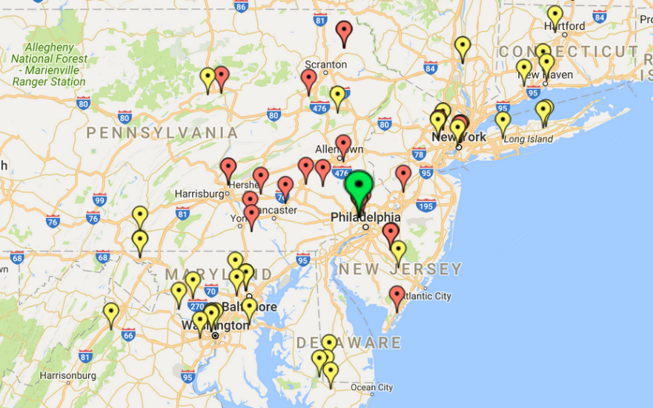
Simplified Example: Philadelphia
Interference Patterns
Interference constraints for NBC Philadelphia. Red – adjacent channel constraint. Yellow – same-channel constraint.

Slide 15
Mechanism Example
Currently Licensed Channels in the Philadelphia Market (aka Nielsen DMA)
14
15
16
17
18
19
20
21
22
23
24
25
26
27
28
29
30
31
32
33
34
35
36
37
38
39
40
41
42
43
44
45
46
47
48
49
50
51
A broadcast license entitles its owner to 6 MHz of broadcast spectrum in a certain geographic area.
UHF Broadcast Spectrum in 2020:
Channel:
14
15
16
17
18
19
20
21
22
23
24
25
26
27
28
29
30
?
?
?
?
?
?
?
?
?
Buffer
Mobile Broadband
What stations will continue to broadcast?

Slide 16
Mechanism Example
$650
$600
$550
Clock Price:
$500
$450
$400
Currently Licensed Channels in the Philadelphia DMA
14
15
16
17
18
19
20
21
22
23
24
25
26
27
28
29
30
31
32
33
34
35
36
37
38
39
40
41
42
43
44
45
46
47
48
49
50
51
System: All remaining licenses can still be repacked.
System: Ion, AsiaV, Unimas cannot be repacked.
CBS
MyNet
Ion
NBC
FOX
UniMas
AsiaV
Univis
Stations to Repack
Licenses Surrendered
Payouts are set by the bid of the station that makes another un-repackable

Slide 17
The Reverse Auction: Strategic Supply Reduction (1)
For an owner of a single license, it is a (weakly) dominant strategy to bid their reservation price, in terms of the base clock price.
  The auction is analogous to a second-price auction, in that a single-license owner’s “bid” cannot affect their own payouts.
For a multi-license owner, there is a chance that withdrawing one owned station from the auction can either:
  Set the price of another owned station if they cannot both be feasibly repacked together; or
  Change the station that sets the price of the other owned station. Likely to be at a higher clock price as repacking is more difficult with the withdrawn license.
  Bidding theory is much more difficult. Can show that it is weakly dominant to bid either true value or withdraw. (In rare cases “underbidding” a license to zero can be part of strategy; we evaluate for one market as robustness check).

Slide 18
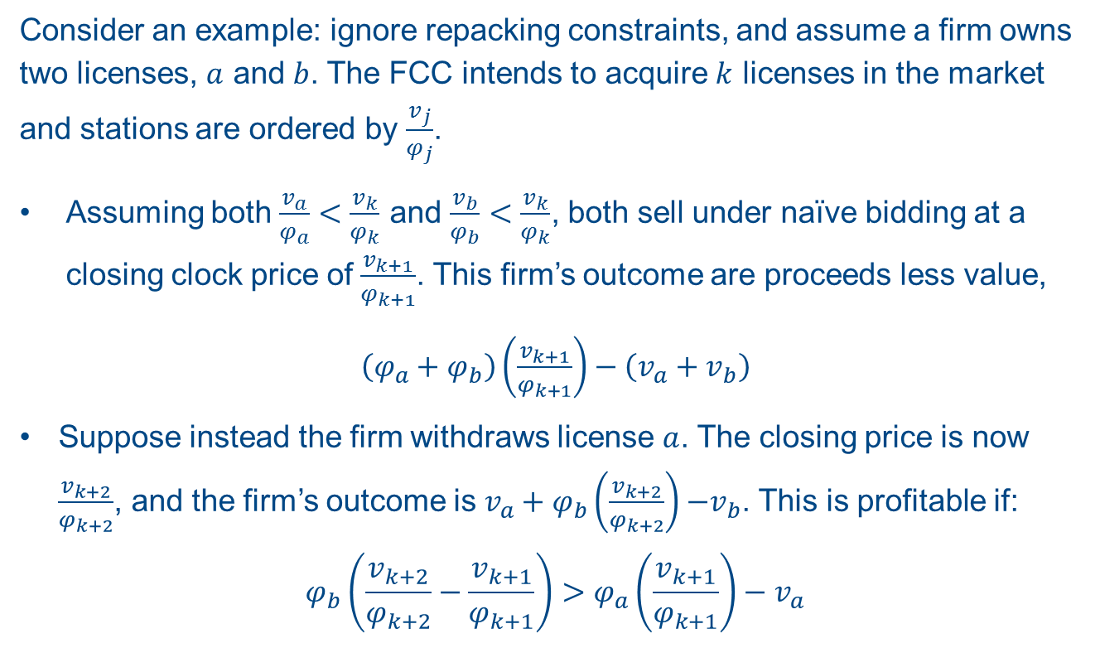
The Reverse Auction: Multi-License Bidding
Consider an example: ignore repacking constraints, and assume a firm owns two licenses, $a$ and $b$. The FCC intends to acquire $k$ licenses in the market and stations are ordered by $\frac{v_{j}}{φ_{j}}$.
Assuming both $\frac{v_{a}}{φ_{a}}<\frac{v_{k}}{φ_{k}}$ and $\frac{v_{b}}{φ_{b}}<\frac{v_{k}}{φ_{k}}$, both sell under naïve bidding at a closing clock price of $\frac{v_{k+1}}{φ_{k+1}}$. This firm’s outcome are proceeds less value,
$\left(φ_{a}+φ_{b}\right)\left(\frac{v_{k+1}}{φ_{k+1}}\right)−\left(v_{a}+v_{b}\right)$
Suppose instead the firm withdraws license $a$. The closing price is now $\frac{v_{k+2}}{φ_{k+2}}$, and the firm’s outcome is $v_{a}+φ_{b}\left(\frac{v_{k+2}}{φ_{k+2}}\right){−v}_{b}$. This is profitable if:
$$φ_{b}\left(\frac{v_{k+2}}{φ_{k+2}}−\frac{v_{k+1}}{φ_{k+1}}\right)>φ_{a}\left(\frac{v_{k+1}}{φ_{k+1}}\right)−v_{a}$$
Payout Increase
Cost of withdrawal

Slide 19
The Reverse Auction: Strategic Supply Reduction (2)
Analyzing full national problem is computationally intractable.
  NP-Complete problem: must repack for each remaining active license for each license withdrawal. Incredibly slow with hundreds of license withdrawals.
  National chains have enormous strategy space. Sinclair Broadcasting has 70+ eligible licenses, so (2^70)-1 strategies. Strategies are interacted in a game.
Our primary assumptions:
  Multi-licenses firms are only strategic within a DMA market. (Max licenses is 9)
  We simulate and repack a large radius around each DMA, but not entire country.
We contrast a “naïve” case ‒ all licenses are bid independently ‒ with a “strategic” case ‒ we compute all possible equilibrium outcomes for each DMA. We repack using FCC constraints.
  With 100 simulation draws from estimated reservation values, results in 1,713,600 total auction simulations for each clearing target (126 MHz and 84 MHz). 5 months of computation on 500+ computing cores at Wharton/ Amazon’s EC2 platform.

Slide 20
Estimating Reservation Values
We estimate distributions of reservation values for all eligible UHF licenses. Actual auction data not available, not necessarily useful (censoring).
Primary Data Sources
  BIA: Station characteristics and advertising revenue; transactions.
  NAB: Anonymized balance sheets and cash flows.
We estimate a model of station cash flows.
  Cash flows are primarily function of (observed) advertising revenue, as well as station characteristics.
Construct reservation prices and bids:
  Reservation price: max(private transaction value, “stick value”)
  Naïve bid in terms of clock price is (reservation price)/(broadcast volume)

Slide 21
Example: Philadelphia

Slide 22
Example: Philadelphia

Slide 23
Simulation
We simulate the auction as a full-information game among multi-license owners in a market (DMA), taking into account repacking constraints in a repacking region.
Full-information assumption: many firms have engaged consultants to value own and rival licenses (and bidding strategies)
Repacking region: all licenses in any market that has a license with an interference constraint on the focal market.
We use the FCC’s “SATFC” software to assert feasibility of repacking sets.
Outcome of interest: payouts under strategic bidding by multi-license owners versus each license bidding its true reservation value.
We interact all strategy profiles for multi-license owners and compute all equilibria of the game for a given draw of reservations values.

Slide 24
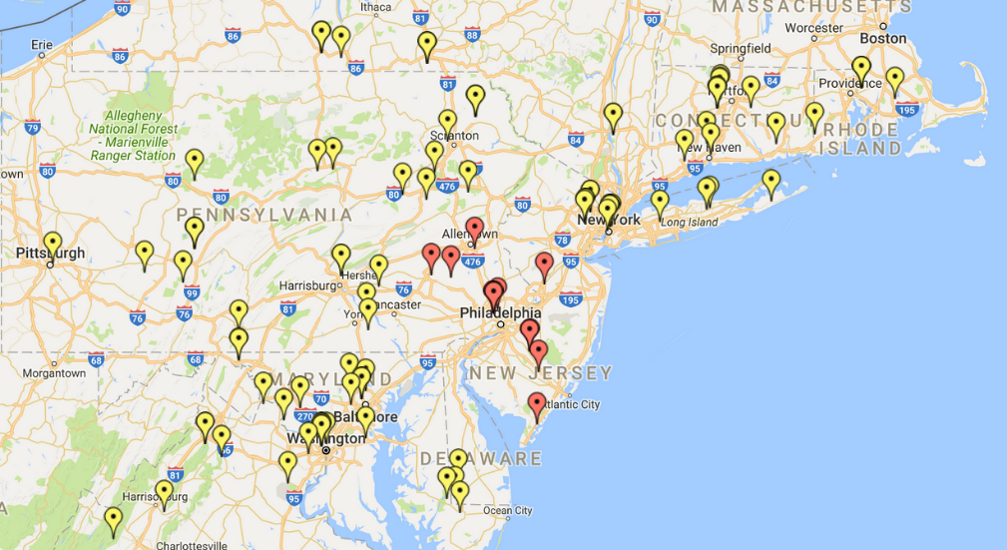
We Repack a DMA’s Neighborhood
Philadelphia’s DMA Neighborhood: the set of stations that can set prices

Slide 25
Example: Philadelphia

Slide 26
Example: Philadelphia

Slide 27
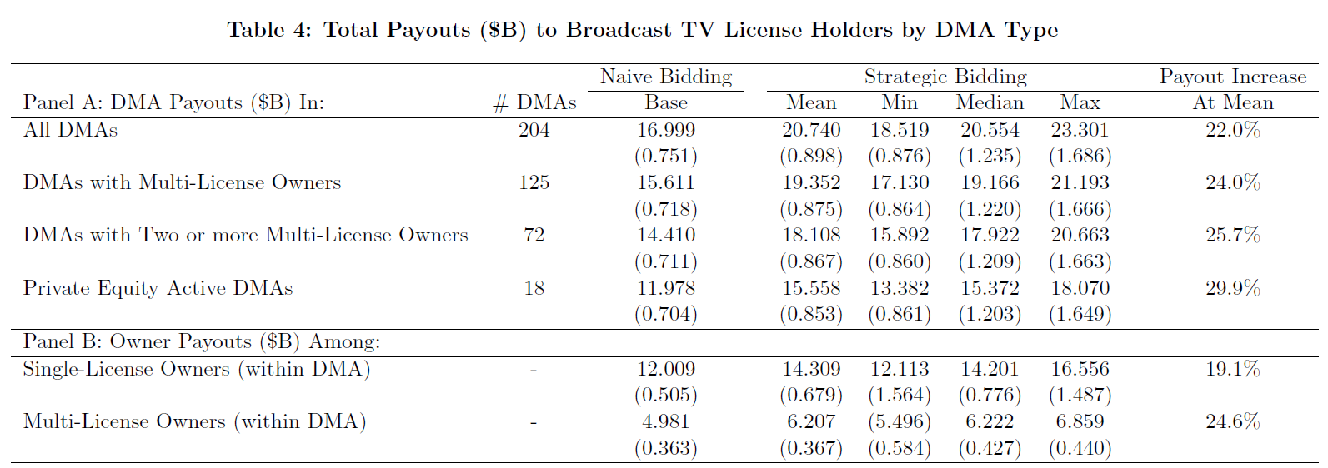
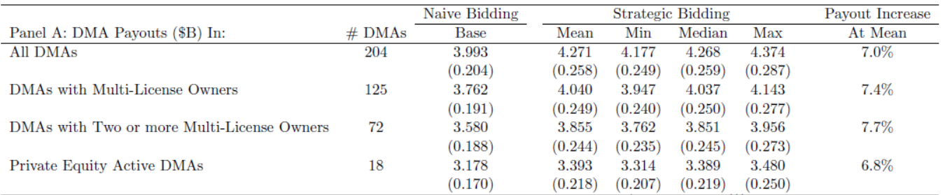
Main Results
126 MHz Clearing Target: Total Payouts ($B) to Broadcast TV License Holders
84 MHz Clearing Target: Total Payouts ($B) to Broadcast TV License Holders

Slide 28
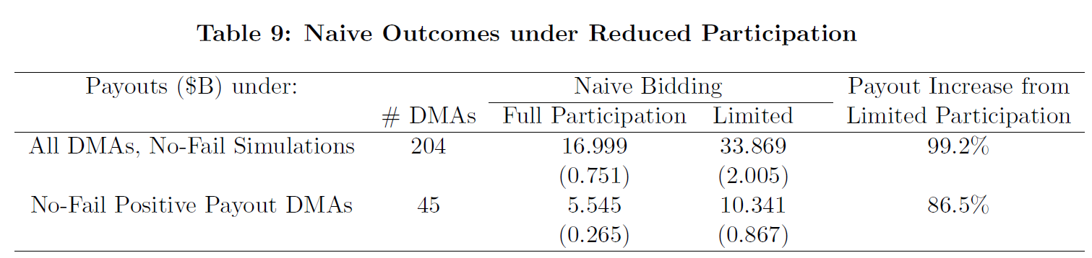
Extensions and Caveats
Robustness
  We show robustness to more generous repacking
Participation
  Reduced participation greatly increases payouts. Assume no religious, 50% non-commercial participation.
126 MHz Clearing Target: Naïve Outcomes under Reduced Participation
Similar effect even at 84 MHz (83.7% increase in payouts). Participation is vital (consider “grandfathering” must-carry laws for participating licensees to encourage greater participation).

Slide 29
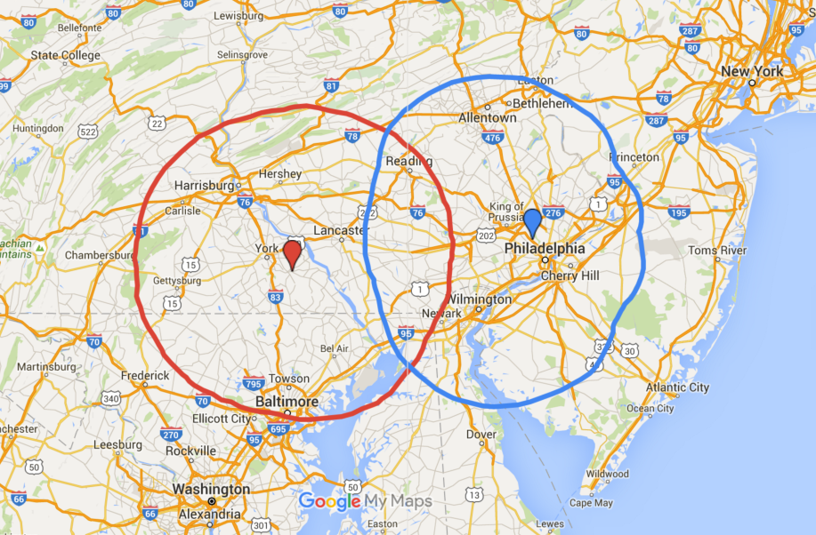
Extensions and Caveats
Cross-DMA bidding
  Case study shows how a single neighboring license can double payouts in a DMA.

Slide 30
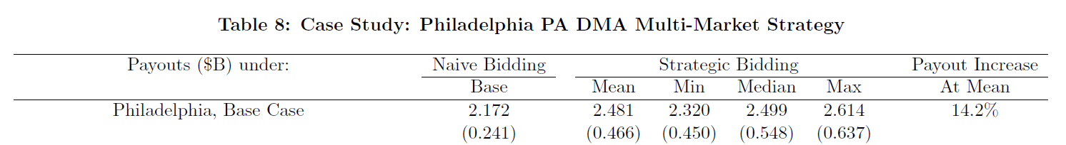
Extensions and Caveats
Cross-DMA bidding
  Case study shows how a single neighboring license can double payouts in a DMA.
126 MHz Clearing Target: Case Study: Philadelphia PA DMA Multi-Market Strategy
  84 MHz target: 47.8% payout increase at mean.

Slide 31
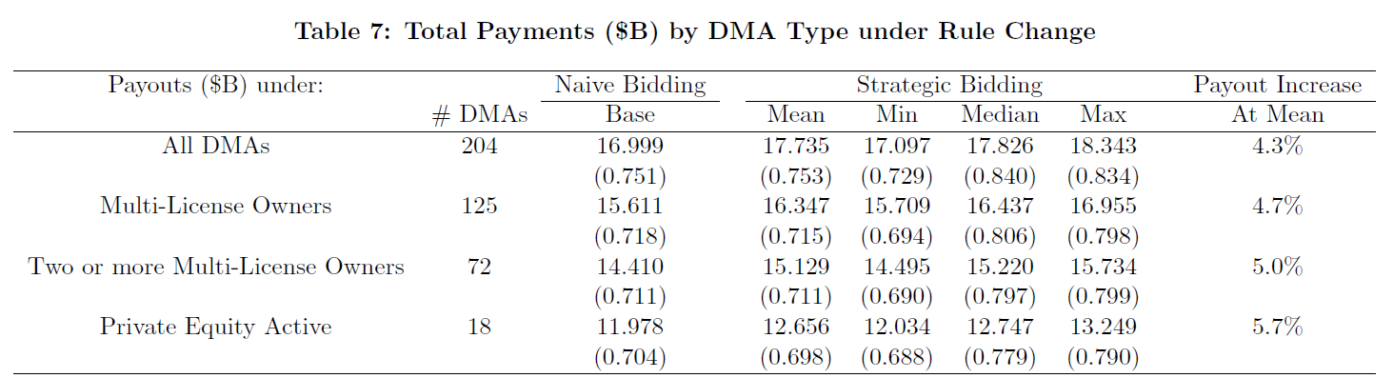
Extensions and Caveats
Rule Change
  Limit ability to withdraw low Broadcast Volume stations before high ones. Enforcing an ordering of bids helps in some but not all circumstances.
126 MHz Clearing Target: Total Payments ($B) by DMA Type under Rule Change
  Smaller effect at 84 MHz target (Payout increase goes from 7% to 2.9%).

Slide 32
Auction Results
Auction concluded in 3/2017. It is unclear what data beyond the set of acquired licenses and payouts to those licenses will be released.
The auction began in 2016 with a clearing target of 126 MHz:
Reverse auction: $86B to acquire necessary spectrum (!).
Forward auction: $23B willingness-to-pay for 100 MHz.
Subsequent stages:
114 MHz: $56.5B reverse, $21.5B forward willingness-to-pay.
108 MHz: $40.3B reverse, $20B forward
84 MHz: $10B reverse, $19.6B forward. Auction Concludes.
By mid 2020, 84 MHz of spectrum will be removed from UHF bands and 70 MHz awarded to mobile broadband usage.

Slide 33
Reconciliation
Our analysis predicted (based on our assumptions) that 126 MHz would cost $21B in the reverse auction. 84 MHz should cost ~$4B.
True value: $86B (126), $10B (84).
What happened? Our assumptions are conservative:
We assume full participation. We show that lower participation among non-commercial/religious stations can increase payoffs by 86-99%
We limit strategic bidding to within market. Our case study shows that even adding a single neighboring license to the strategy space increases the payout increase from 14% to 87%
Combining low participation and multi-market strategic bidding could plausibly explain the observed bidding.
Public data indicate few below our estimated reserve prices (one license accepted $0!).

Slide 34
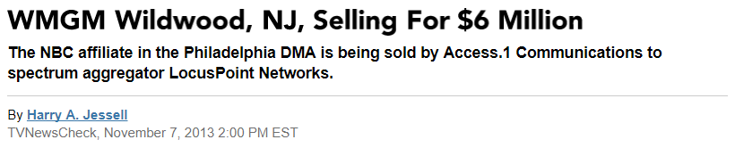
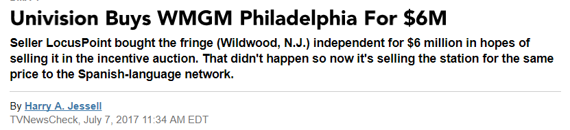
Reconciliation
2013: Locuspoint buys WMGM for $6M
2017: Locuspoint sells WMGM for $6M
Auction Proceeds
$604.5M (7 licenses)
$440.7M (10 licenses)
$15M + lawsuits (2 licenses)
New York ($1.42 billion), Los Angeles ($1.33 billion), Philadelphia ($1 billion), San Francisco ($825.7 million) and Boston ($803.4 million).

Slide 35
Conclusion
Multi-license ownership has potential to greatly increase payouts.
  Multi-license firms find it individually rational to withdraw licenses, but in doing so, increase payouts for all licenses.
  Our analysis shows the effect is economically significant
  Effect could be exacerbated by lowered participation and national bidding strategies.
Our alternative bidding rule reduces the distortion in full-participation case; cannot prove general effectiveness.
Future global efforts to re-allocate spectrum should be concerned about multi-license ownership.
We recommend encouraging participation through must-carry on cable/satellite, and considering new bidding rules on multi-license owners.
Work in progress: how does the 0.5% interference constraint affect this?

Slide 36


