Slide 2
INTERPOL SUPPORT IN LAW ENFORCEMENT COOPERATION IN CUSTOMER PROTECTION
Africa S. APOLLO
Anti-Corruption and Financial crimes Sub-Directorate
September 08, 2014

Slide 3
Scope
Overview of Interpol
The web based tools of INTERPOL
Recent support operations and initiatives organised by INTERPOL in the region
Summary on illicit trade

Slide 4
OVERVIEW ON INTERPOL

Slide 5


INTERPOL - A Global Presence
EU
OFFICE
IPSG LYON
UN
OFFICE
LO
BANGKOK
RB
SAN SALVADOR
RB
ABIDJAN
RB
NAIROBI
RB
BUENOS AIRES
RB
YAOUNDE
RB
HARARE
Notes:
INTERPOL has its General Secretariat in Lyon, France. INTERPOL operates seven regional offices – in Argentina, Cameroon, Côte d’Ivoire, El Salvador, Kenya, Thailand and Zimbabwe – and two representative offices at the United Nations in New York and at the European Union in Brussels.
An INTERPOL Global Complex for Innovation is under construction in Singapore. This state-of-the-art facility will offer cutting-edge research into emerging crime areas and trends, especially digital and cybercrime, as well as innovative training to tackle these new challenges. It is scheduled to open in 2014.
Each member country maintains a National Central Bureau (NCB) staffed by highly trained law enforcement officers. About 600 staff members from around 90 different countries work at these facilities, including around 160 police officers seconded to INTERPOL by member countries.

Slide 6
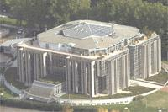
INTERPOL’S Strategic Priorities
24/7 Operational Support
to Policing & Law Enforcement
Capacity
Building
Secure Global
Communications
Network
Identification
of Crimes & Criminals
Notes:
There are four strategic priorities currently guiding INTERPOL’s action (2011-2013):
Secure global police communications network
Assisting in the Identification of Crimes and Criminals
24/7 Operational Support to Policing and Law Enforcement
Capacity Building
These priorities are an extension of policing activities at the national level

Slide 8
Anti-Corruption & Financial Crimes Sub-Directorate
Anti-Corruption
  Focus on addressing corruption issues affecting member countries
  International asset recovery for member countries
Financial Crimes
  Financial Institution Fraud
  Money Laundering
  Payment Card Fraud
Counterfeit Currency and Security Documents
  Genuine and counterfeit currencies for 190 member countries
  Genuine and counterfeit security and travel documents for 190 member countries
  Forensic laboratory for currencies, documents, and payment cards.

Slide 9
INTERPOL’S WEB BASED TOOLS AVAILABLE FOR MEMBER COUNTRIES

Slide 10
I-24/7 Network
Iceland
Finland
Norway
Ireland
U. K.
Sweden
Estonia
Russia
Poland
Lithuania
Canada
Denmark
Latvia
Luxembourg
Germany
Hungary
Netherlands
Czech Republic
Kazakhstan
France
Belgium
Austria
Belarus
Ukraine
Italy
Liechtenstein
Georgia
Azerbaijan
Mongolia
Andorra
Slovnia
Bulgaria
Moldova
Monaco
Fyrom
Slovakia
Uzbekistan
Kyrgyzstan
Japan
Spain
Albania
Romania
Armenia
United States
Portugal
Croatia
Greece
Turkey
Tajikistan
China
Vatican City
Serbia Montenegro
S. Korea (Rep. of)
Bosnia-Herzegovina
Syria
Malta
Cyprus
Lebanon
Tunisia
Jordan
Iran
Pakistan
Bhutan
Libya
Israel
Kuwait
Bahrain
Nepal
Mexico
Bermudas (SB)
Cap-Vert
Maroc
Algeria
Egypt
Irak
United Arab Emirates
Mynmar
Cuba
Mauritania
Saudi Arabia
Oman
Qatar
Bangladesh
Hong Kong - China (SB)
Guatemala
Belize
Puerto Rico - USA (SB)
Gambia
Mali
India
Laos
Macao - China (SB)
El Salvador
Dominican Republic
Senegal
Niger
Chad
Sudan
Yemen
Thailand
Honduras
Guinea-Bissau
Eritrea
Vietnam
Philippines
Barbados
Guinea
Nigeria
Cambodia
Sierra Leone
Côte d'Ivoire
Costa Rica
Nicaragua
Burkina Faso
CAR
Ethiopia
Sri Lanka
Marshall Islands
Netherland Ant.
Liberia
Togo
Cameroon
Somalia
Singapore
American Samoa - USA (SB)
Panama
Venezuela
Benin
Uganda
Kenya
Brunei
Colombia
Guyana
Guinea
Gabon
DRC
Rwanda
Malaysia
Nauru
Suriname
Malawi
Burundi
Indonesia
Ecuador
Angola
Tanzania
East Timor
Tonga
Peru
Zambia
Madagascar
Papua New Guinea
Brazil
Zimbabwe
Samoa
Fiji
Bolivia
Namibia
Botswana
Mozambique
Paraguay
Swaziland
Australia
Lesotho
Chile
South Africa
Uruguay
Argentina
New Zealand
Notes:
Slide 4
At the beginning of 2003, we launched the deployment of our new global communication network I-24/7 currently connecting INTERPOL’s 186 member countries.
Never before had our organization been able to connect such a high number of countries and to offer this communication tool for the secure exchange of information and data.

Slide 11
I-24/7 is a secure communication network offered and managed by INTERPOL used to exchange information between member countries.
Through this network, notices can be issued and shared among member countries.

Slide 12
Examples of notices that can be published by INTERPOL on request through NCBs:
Red Notice - To seek the provisional arrest of a wanted person with a view to extradition based on an arrest warrant or court decision.
Blue Notice - To collect additional information about a person’s identity, location, or illegal activities in relation to a criminal matter.

Slide 13
Orange Notice - To warn police, public entities and other international organizations of dangerous materials, criminal acts or events that pose a potential threat to public safety.
Green Notice - To provide warnings or criminal intelligence about persons who have committed criminal offences and are likely to repeat these crimes in other countries.

Slide 14
Notices contain two main types of information:
Identity particulars - comprehensive identity details, physical description, photograph, fingerprints and other relevant information such as occupation, languages spoken, identity document numbers, etc.

Slide 15
Judicial information - offence charged; references to the laws, maximum penalty, in the case of the Red Notice, references to the arrest warrant or sentence by a court; and countries from which the requesting country will seek fugitive’s extradition.

Slide 16
There is another INTERPOL parallel network called I-SECOM that is meant for anti-corruption and asset recovery.
This communication platform is also at the disposal of law enforcement and other organisations that may be approved (through respective NCBs) to share information about criminal activity and individual criminals.

Slide 17
The Command and Co-ordination Centre (CCC) at the General Secretariat provides 24-hour support to member countries.
A combination of I-24/7 and the CCC is a great opportunity to transmit your messages across all member countries regardless of time difference, language or coordination constraints.

Slide 18
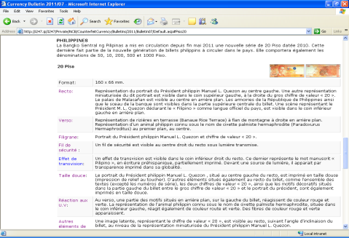
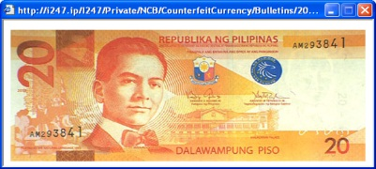
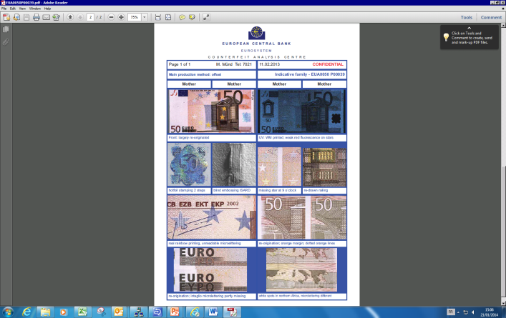
Some Web-Based Tools for financial crimes
A number of web-based tools have been developed and they are available via the INTERPOL secure communication network, I-24/7. These include:
Currency Bulletins
Counterfeit Currency Statistics
Counterfeit Alerts
Euro Early Warning Messages
Keesing Banknote Reference Tool (In development)

Slide 19
RECENT ACTIVITIES AND INITIATIVES IN THE REGION TO PROTECT CONSUMERS AGAINST ILLICIT TRADE, COUNTERFEIT GOODS & HARMFUL PRODUCTS

Slide 20
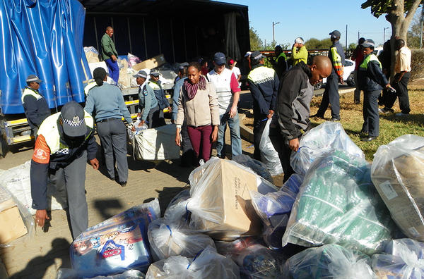
SOME RECENT OPERATIONS
OPERATION WIPE-OUT
Between April and June 2014 INTERPOL conducted an Operation code named “OPERATION WIPEOUT” across seven countries – Botswana, Kenya, Namibia, Rwanda, Tanzania, Uganda and Zambia –targeted products posing a particular danger to the public’s health and safety which resulted in 644,000 goods seized and more than 260 individuals arrested or placed under investigation

Slide 21
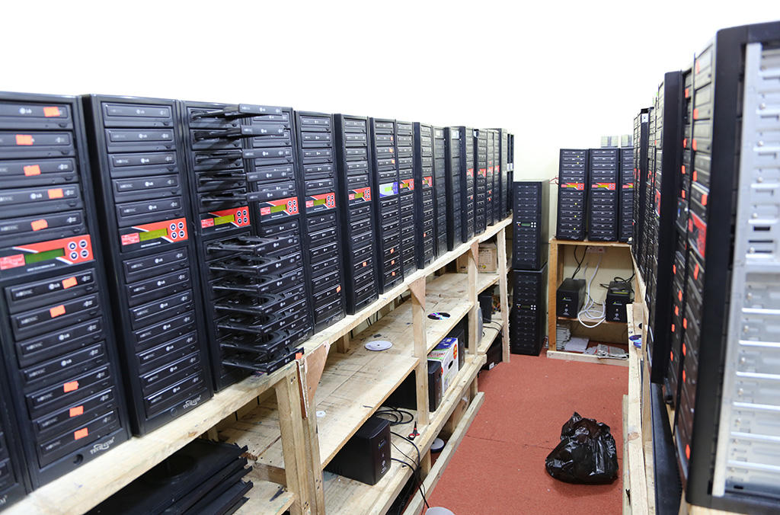
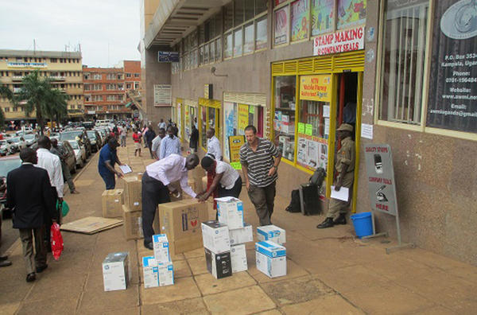
Seized items include:
Counterfeit electrical products,
dismantling of a factory producing fake CDs,
unapproved baby formula ,
cosmetics containing banned ingredients,
illegally refilled branded gas cylinders,
illicit insecticides and expired fertiliser; and many more.

Slide 22
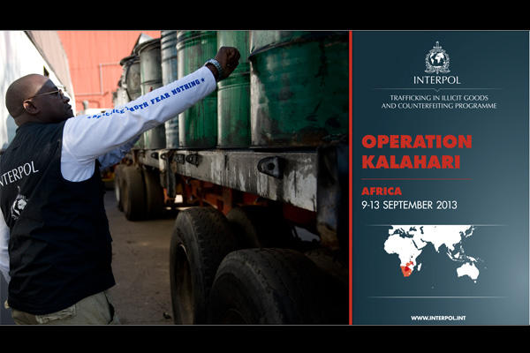
OPERATION KALAHARI
In September 2013 Series of raids coordinated by INTERPOL were conducted across Southern Africa targeting counterfeit and illicitly traded goods led to seizure of thousands of counterfeit products including: toys, chargers, cigarettes, shavers, pirated CDs and DVD players; and closure of a plant manufacturing fake sportswear.

Slide 23
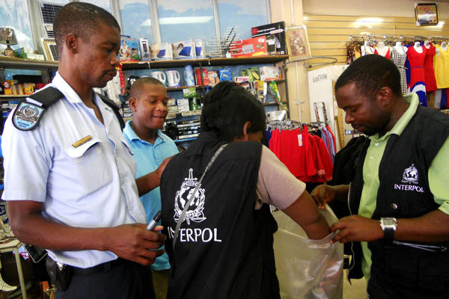
The operation was conducted by collaboration of Police, Customs and Prosecutors in Botswana, Namibia and South Africa which was key to its success in a short period of time.

Slide 24
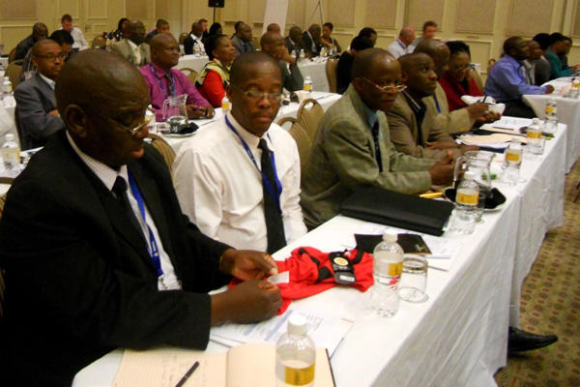
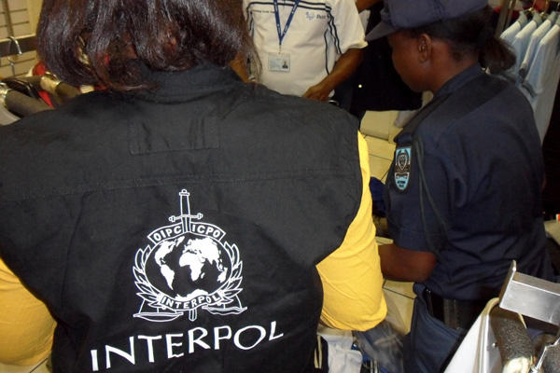
OPERATION ETOSHA
After INTERPOL’S 3-day training seminar in Windhoek gathering 60 Police/Customs Officers and Prosecutors from Namibia, Angola, Botswana, Mozambique, South Africa and Zambia, 2-day operational deployments were carried out in Windhoek and at four points of the Angolan border (Oshikango, Oshana, Kavango & Katima)

Slide 25
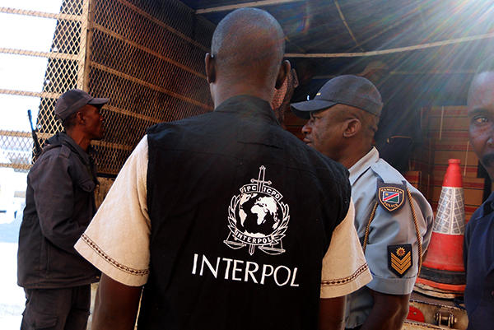
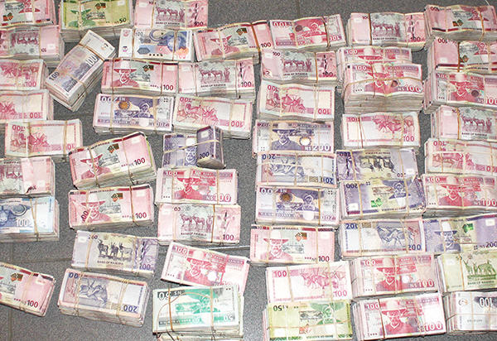
The operations involved 350 law enforcement officers from Police, Customs, Immigration and Health Inspection Department.
In total 72 raids were conducted leading to the seizure of 210,483 counterfeit items, valued at 4,074,640 US $ (clothing, perfumes, soaps, toys, spirits, sanitary towels, baby nappies, cigarettes, sunglasses, toys, and currency, among others)

Slide 26
MEDICAL PRODUCT COUNTERFEITING AND PHARMACEUTICAL CRIME
Africa presents a vast market for counterfeit, substandard, and illicit medicines. The adulteration of medicines used in the treatment of serious and life-threatening diseases is of particular concern, while substandard medicines (poor quality, purity, strength) also poses a great danger in Africa
Counterfeit antimalarial, antibiotic, antiretroviral and anti-parasitic medicine are prime examples of these improper medicines.

Slide 27
The global nature of pharmaceutical crime, with manufacture and trade relying on complex international criminal networks which are difficult to identify requires effective international collaboration of efforts and support from a broad spectrum of stakeholders in the public and private sectors to detect and prevent the criminality.
In response to these threats posed by pharmaceutical crime, INTERPOL’s Medical Product Counterfeiting and Pharmaceutical Crime (MPCPC) Sub-directorate has been initiating Operations in Eastern and Southern Africa in cooperation with law enforcement and partner agencies in the region.

Slide 28
The following operations were:
Operation GIBOIA: conducted in 2013 in Angola, Malawi, Swaziland, Tanzania and Zambia
Operations MAMBA 1,2, & 3: 2008,2009 & 2010 res in Burundi, Rwanda, Kenya, Tanzania and Uganda
The operations led to arrest of hundreds of suspects and the seizure of millions of illicit medicines.

Slide 29
SUMMARY ON ILLICIT TRADE

Slide 30
WHY ILLICIT TRADE?
Supply
  Easy access to the market
  High profit
  Weak enforcement, weak regulatory framework
  Non-deterrent penalties
  Vulnerable population
Demand
  Cheap products
  Brand attraction
  Low awareness of health and safety issues
  Low public concern regarding IP Crime

Slide 31
WHO ARE THE VICTIMS?
Consumers
Governments
Industry

Slide 32
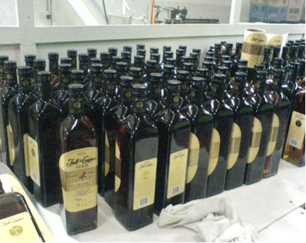
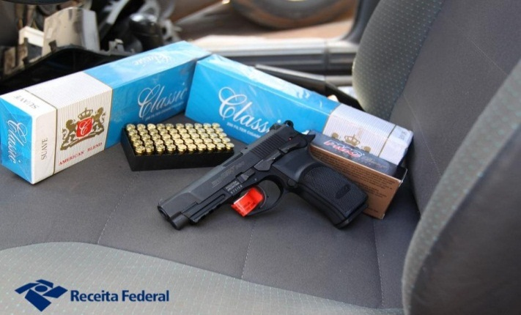
THE HARMFULNESS OF ILLICIT TRADE
Threat to the health and safety of consumers
Drop in state tax collection
Hamper to innovation
Decrease in company turnovers, loss of markets and jobs
Damage to the environment
Source of funds for transnational organized criminals

Slide 33
WAY FORWARD
INTERPOL remains committed to work in partnership with member countries and other international organizations to fight any sorts of criminality through:
  Capacity building,
  Bringing criminal suspects to Justice,
  Early detection and prevention of crimes,
  Any other law enforcement efforts

Slide 34
INTERPOL shall remain committed to the above by availing necessary tools that ensures secure law enforcement information sharing to track criminals, providing professional assistance, and training.

Slide 35
Thank you very much for your attention
Merci beaucoup pour votre attention
Muchas gracias por su atención
نشكركم جزيل الشكر على انتباهكم

