Slide 1
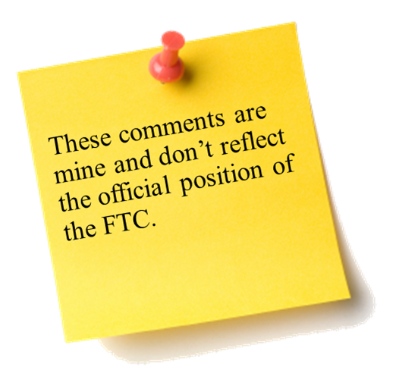



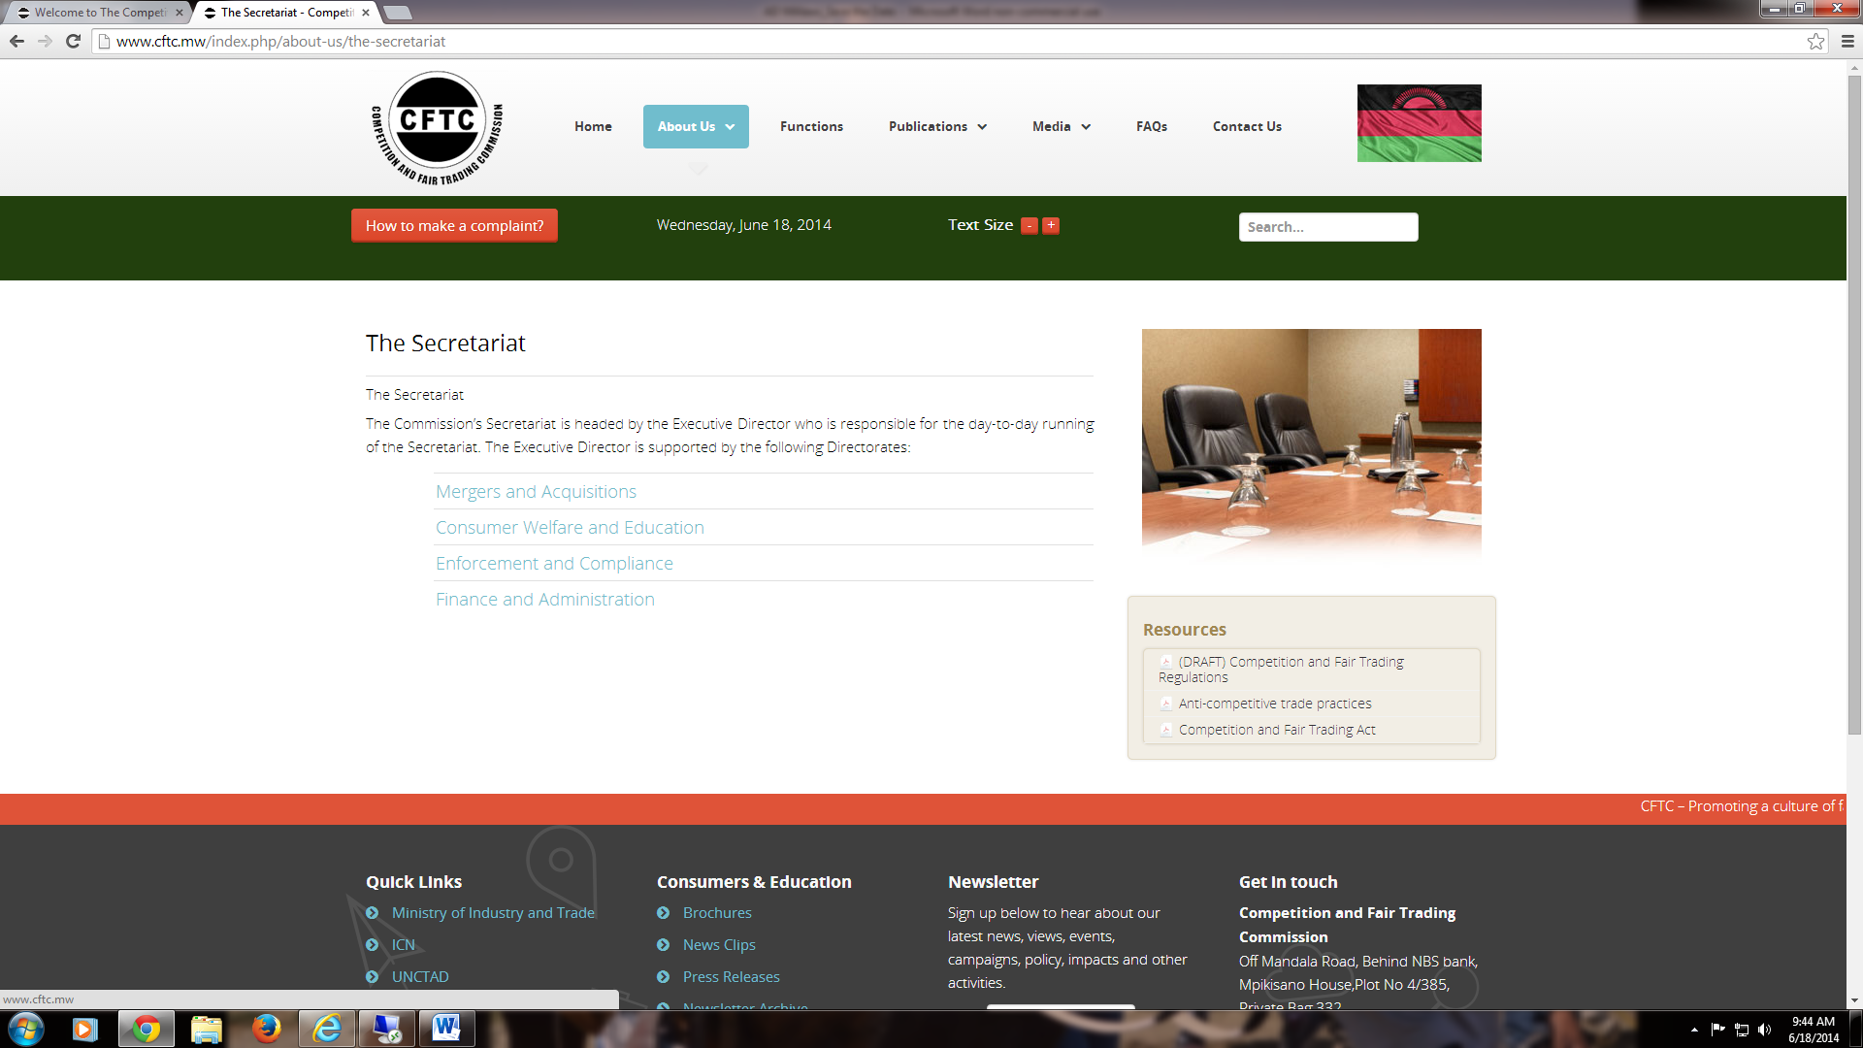
The Sixth Annual African Dialogue Consumer Protection Conference
Financial Issues: Case Studies
Deon Woods Bell
U.S. Federal Trade Commission
Lilongwe, Malawi
8-12 September 2014

Slide 2

Music to His Ears, Music to Their Wallets Facts 1/2
Mosegi, a park ranger from Botswana, received an e-mail from his good friend, Baruti, about a new website that he said was really awesome.
The Kenyan website, [[CoolTunes]] had two main features: a streaming service containing a large selection of music and a premium service access to a synthesizer where someone could compose their own music.
The premium service also gave users access to a personal website where he could publish his music and sell it to others.

Slide 3

Music to His Ears, Music to Their Wallets Exhibit A

Slide 4
Negative Options Facts 2/2
Mosegi signed up for a free seven-day trial for the premium version. When Mosegi signed up for the trial, the website asked him for his debit card information “as a means of identifying him.” When trying out the website, he found that a lot of his favorite music wasn’t available for streaming (most of it had labels such as “COMING SOON”). He tried out the synthesizer, but a lot of instruments he wanted to use were missing. Composing songs also took a lot more time and effort than he had thought, and the price was very steep for a monthly package. Mosegi therefore decided against buying anything.
Buried in the terms and conditions was a sentence saying that users of the trial would automatically be charged for a month’s service once the seven days were over if they did not call a number to cancel the service. The trial period ended just before Mosegi’s payday at his job, so there was not enough left in his account for the charge. When Mosegi went to the bank the next day to cash in his paycheck, he noticed the large overdraft charge on the account in addition to the large payment to the music site.
Notes:
FTC v. LeanSpa, LLC
Press Release: http://www.ftc.gov/news-events/press-releases/2014/01/sensa-three-other-marketers-fad-weight-loss-products-settle-ftc
Complaint: http://www.ftc.gov/sites/default/files/documents/cases/2011/12/111201leanspacmpt.pdf
Stipulated Settlement

Slide 5
Negative Options Questions for Discussion
Does the fact that Mosegi used a debit card instead of a credit card or mobile payment system matter to the way you would handle the case?
How would you go about investigating a case like this?
How would you approach the fact that the company here is based in another country?
What factors would be important as your agency considers whether it will pursue this matter?
Does your country require that consumers affirmatively agree to a service before they can be charged for something like this?
If you decided to pursue this matter, what would your agency have to establish?
Is there any other agencies that may have a role, including NPO’s and self-regulatory industry body?
What type of relief would you seek in this matter?
What type of consumer or business education, if any, do you think would be effective?

Slide 6
Pyramid Schemes Facts
Trying to get some money back from all of this, Mosegi started reading the terms on the website. There, he noticed a promotional campaign that would net him US$100 if he could sign up three other people for the music site and get them to buy into the service.
He contacted all his friends and managed to sign two people up for the basic service. His family did not have any interest in the music site, however, so he couldn’t find anybody to be the third person.
Due to the overdraft charge and the hefty premium service payment, Mosegi was really scrimped for cash and needed that money. He eventually created a fake profile using the last of the money in his account to sign up for the basic service in order to count as the third person.
Notes:
FTC v. BurnLounge
Press Release: http://www.ftc.gov/news-events/press-releases/2012/03/ftc-action-leads-court-order-shutting- down-pyramid-scamthousands
Complaint: http://www.ftc.gov/sites/default/files/documents/cases/2007/06/061207complaint.pdf
9th Circuit Decision in FTC’s favor, Matter Still Pending

Slide 7
Pyramid Schemes Questions for Discussion
How would you legally differentiate a pyramid scheme from an acceptable recruitment policy?
How would you go about investigating a case like this?
Is it important whether your agency has received any consumer complaints?
What factors would be important as your agency considers whether it will pursue this matter?
At what point in the process do you believe agencies should intervene and stop pyramid schemes?
If you decided to pursue this matter, what would your agency have to establish?
What type of consumer or business education, if any, do you think would be effective?

Slide 8
Debt Collection Facts
Before he got dinged again with another premium monthly payment, Mosegi tried calling the number to cancel the service, but it kept ringing and ringing with no answer. Mosegi kept trying over the next couple of days, but he could not get anyone on the phone to cancel his service.
Eventually, he contacted his bank and had a replacement debit card made with a different number. A couple of months went by and Mosegi finally got his finances in order. One day, however, a debt collection company rang him up on the phone stating that he owed money to the website that needed to be paid right away.
Apparently, the debt collection company accused him of not paying for five months of the service. Mosegi stated that he wasn’t able to contact anyone to cancel the service and he never used the website past the seven-day trial period. The debt collectors, however, were not fazed and stated that he could possibly face criminal charges and jail if he didn’t pay up. Mosegi hung up the phone right there since he thought he didn’t owe [[CoolTunes]] a cent.
Over the next week, he found out that some of his coworkers and his family members had been contacted by the debt collectors saying that he wasn’t paying his debts, so they had to pay it for him. Eventually, they called up his boss and told him this, which resulted in Mosegi getting fired from his job.
Notes:
FTC v. Goldman Schwartz, Inc.
Press Release: http://www.ftc.gov/news-events/press-releases/2014/05/ftc-puts-texas-based-operation- permanently-out-debt-collection
Complaint: http://www.ftc.gov/sites/default/files/documents/cases/2013/01/130131goldmanschwartzcmpt.pdf
District Court recently Ordered Shutdown of Company’s Operations; matter still pending

Slide 9
Debt Collection Questions for Discussion
Are there any established procedures in your country that debt collectors must follow?
How would you go about investigating a case like this?
What factors would be important as your agency considers whether it will pursue this matter?
How would a consumer dispute a collection claim when he/she does not believe that he/she owes anything?
If you decided to pursue this matter, what would your agency have to establish?
Is there any other agencies that may have a role, including NPO’s and self-regulatory industry body?
What type of consumer or business education, if any, do you think would be effective?

Slide 10
FTC v. LeanSpa, LLC
FTC alleged that this operation used fake news websites to promote their products, and made deceptive weight-loss claims
They told consumers they could receive free trials of acai berry and "colon cleanse" products, and only have to pay the nominal cost of shipping and handling.
The FTC alleged that many consumers ended up paying $79.99 for the trial, and for recurring monthly shipments of products that were hard to cancel
Resolution required the operation to surrender $7 million USD
Notes:
FTC v. LeanSpa, LLC
Press Release: http://www.ftc.gov/news-events/press-releases/2014/01/sensa-three-other-marketers-fad-weight- loss-products-settle-ftc
Complaint: http://www.ftc.gov/sites/default/files/documents/cases/2011/12/111201leanspacmpt.pdf
Stipulated Settlement

Slide 11


Slide 12
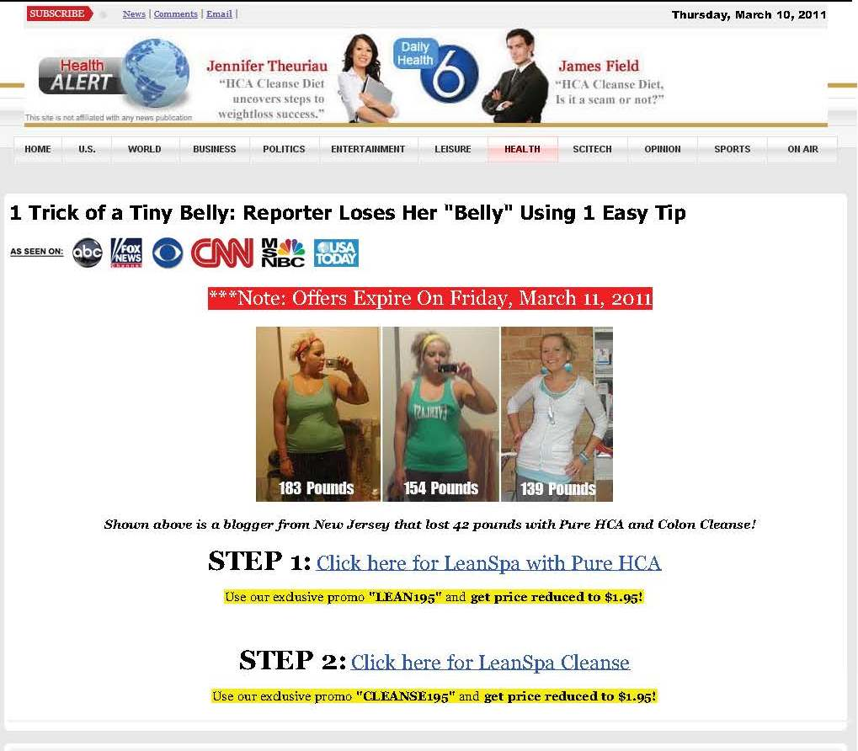

Slide 13

FTC v. BurnLounge
The FTC charged that BurnLounge sold opportunities to operate on-line digital music stores that was, in fact, an illegal pyramid scheme
BurnLounge represented that participants in BurnLounge were likely to make substantial income
BurnLounge recruited participants by selling them so-called “product packages,” ranging from $29.95 to $429.95 per year
More expensive packages purportedly provided participants with an increased ability to earn rewards through the BurnLounge compensation program
The BurnLounge compensation program primarily provided payments to participants for recruiting of new participants, not on the retail sale of products or services
The Ninth Circuit upheld the FTC’s determination that it was a pyramid scheme and halted all its marketing practices
Notes:
FTC v. BurnLounge
Press Release: http://www.ftc.gov/news-events/press-releases/2012/03/ftc-action-leads-court-order-shutting-down-pyramid-scamthousands
Complaint: http://www.ftc.gov/sites/default/files/documents/cases/2007/06/061207complaint.pdf
9th Circuit Decision in FTC’s favor, Matter Still Pending

Slide 14

FTC v. Goldman Schwartz, Inc.
A Houston-based debt collection operation that illegally used insults, lies, and false threats to collect on payday loans
The operation allegedly told some consumers their minor children would be taken into government custody; disclosed debts to family members and military superiors; falsely claimed to work hand-in-hand with local sheriff’s offices; and collected bogus late fees and attorneys’ fees
District Court ordered a shutdown of its operations
Notes:
FTC v. Goldman Schwartz, Inc.
Press Release: http://www.ftc.gov/news-events/press-releases/2014/05/ftc-puts-texas-based-operation-permanently-out-debt-collection
Complaint: http://www.ftc.gov/sites/default/files/documents/cases/2013/01/130131goldmanschwartzcmpt.pdf
District Court recently Ordered Shutdown of Company’s Operations; matter still pending

Slide 15
Thank you!
My contact information:
Deon Woods Bell
Office of International Affairs
U.S. Federal Trade Commission
600 Pennsylvania Ave, N.W. H-494
Washington, D.C. 20580
Email: dwoodsbell@ftc.gov
Telephone: +1 (202) 326-3307

