Slide 1


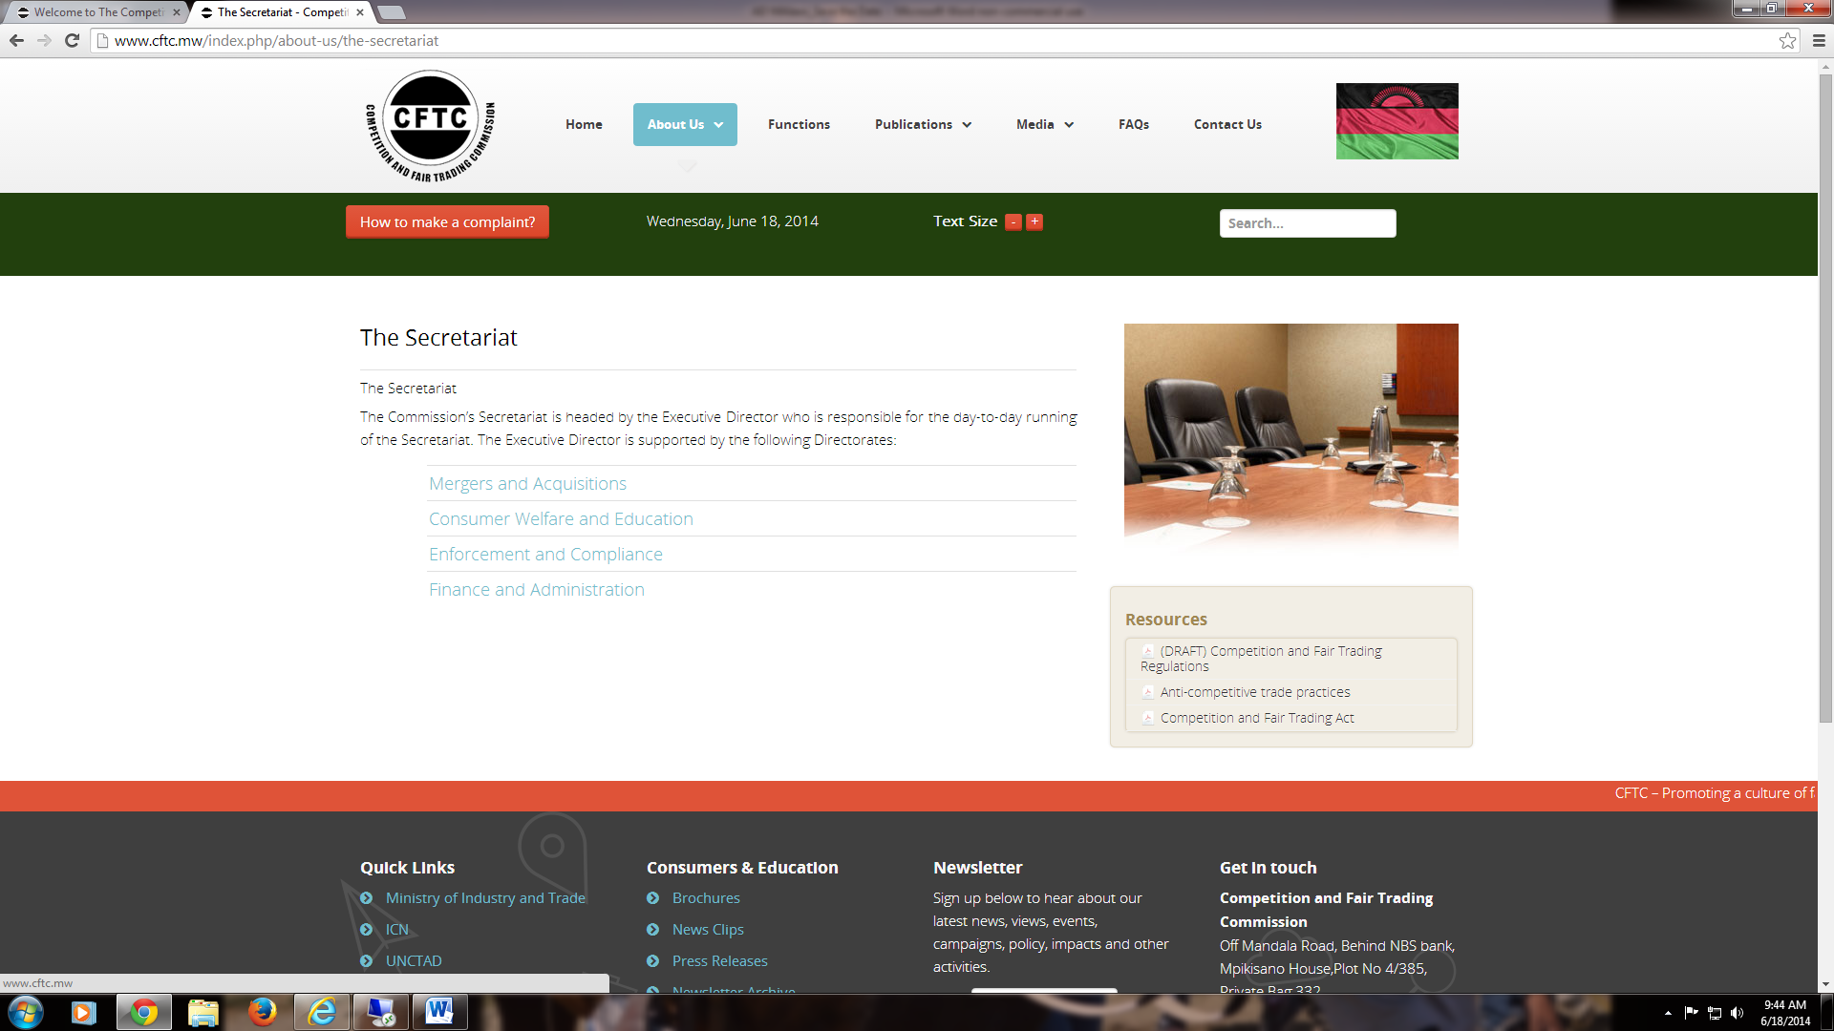



Sixth Annual African Dialogue Consumer Protection Conference
Working Lunch Day 1: Empowering and Educating Consumers
September 7-10, 2014 - Lilongwe, Malawi
Empowering and educating consumers on the Mobile Financial Services in Tanzania
Tanzania Consumer Advocacy Society

Slide 2

Presentation outline
Empowering and educating consumers on the MFS in Tanzania
About TCAS
Problems to be addressed when empowering and educating consumers on mobile financial services (MFS) in Tanzania
Why education is to be provided through mobile phone
Key topics to consider on empowering and educating consumers on MFS
Importance of the empowering consumers on MFS
Conclusion

Slide 3


About TCAS
TCAS is a member based consumers association established in July 2007 at BRELA as a company not limited by shares with 53 members, today we have about 6,927 members all over the country.
TCAS has 5 permanent employees and a pool of 1,256 ready to do volunteers based in urban, rural areas, colleges and universities all connected in VOICE TCAS’s mail list and members’ database. The organization has governing board of directors (seven) selected by members’ AGM.
TCAS operates consumers’ advisory centre (CAC) in Dar for one to one counseling since 2012 to date. The CAC has three trained financial advisors using well designed financial education manual for counselors.
TCAS has conducted several researches/mystery shopping, probed on the level of consumers’ financial literacy and service providers' practices in Tanzania which helped on designing the number of programs and financial education training manuals i.e. Financial education for secondary school students -Teacher’s-Kit June.2009 (with Anna Fransen funding); Financial education counselors’ guide 2011 (with FEF - DFiD funding); counselors’ guide - credit information sharing-2013 (with IFC funding) of which they helped on conducting the related campaigns.

Slide 4

Problems to be addressed when empowering and educating consumers on mobile financial services (MFS) in Tanzania
The market lacks impartial sources of financial education with generic advice on MFS, products, and financial education tips that focusing on improving consumers’ financial capability.
The market lacks timely and comparable information on products and services and sometimes provides confusing information caused by aggressive selling practices.
79% of the consumers are financially illiteracy rate and some of those are un-banked, they don’t believe that they would use an account enough to make it worthwhile (TCAS survey-2013)
Banks’ branches exist in only 7% of the wards, which contain 12% of the population i.e. Tanzania has a huge adult population (56 percent) that is totally excluded from accessing financial services.
(National Financial Inclusion framework - 2014)

Slide 5
Why education is to be provided through mobile phone
From big national chains to smaller regional financial institutions have improved the functionality of mobile banking so that consumers can transfer funds, pay bills or check balances whenever and wherever they may be.
Therefore MFS are regarded as a reliable starting point for encouraging usage of financial services hence improve financial inclusion as they reduce to a great extend physical proximity of financial service which used to be a barrier as for now mobile phones services providers are providing lower-cost payments infrastructure for money transfer (mobile wallet) such as: M-Pesa, Tigo-Pesa, Airtel Money, Zantel money, Maxi Malipo, mobile banking such as M-Pawa

Slide 6


Key topics on empowering and educating consumers on MFS
Consumer understands how to choose mobile financial service
Consumer understands concept of branchless and paperless transactions/mobile wallet
Consumer understands behavioral change on self consumer protection tips
Consumer understands how to avoid interceptions
Consumer understands how to avoid unauthorized access
Consumer understands what to do when there is password theft or lost
Consumer understands on what is savings and types of saving
Consumer understands importance of savings
Consumer understands key saving tips
Consumer understands the importance of budgeting
Consumer understands how to budget
Consumer understands ways to cut spending

Slide 7

Topics FE continue……
Consumer understands the meaning of loan/credit
Consumer understands the meaning credit contract
Consumer understands key questions must get answers before taking a credit.
Consumer understands cost of borrowing
Consumer understands behavioral change on credit management
Consumer ask her/himself the following before taking a credit
Consumers beware of aggressive lenders!
Consumer understands how to deal with over-indebtedness
Consumer understands the importance of credit information sharing
Consumer understands what credit information to be shared
Consumer understands what identification data to be shared
Consumer understands what Payment history to be shared
Consumer understands tips to consider when refused a credit

Slide 8
Importance of the empowering consumers
Support consumers to unleash inappropriate financial behaviors such as not budgeting, not saving, not paying back their credit on time.
Support consumers on using MFS with intension of reducing the un-banked and under-served population in rural or peri-urban areas including hard to reach areas
Increase branchless proximity of mobile financial access points through consumer’s personal mobile phone as reliable means of payment and store of value hence reduce the number of underserved/unbanked population.
achieve trust and understanding amongst potential consumers through improving their financial literacy , user factor and capability
Build the capacity of consumers on managing cash flows and mitigate their financial shocks
Reduce barriers to financial access and sustainability of financial market
Outsmart poverty by improving wealth creation activities among local communities with good management of their finances

Slide 9



Conclusion
Let us be critical and innovative enough when empowering the consumers based on the current trend on provision of financial services in the market…. Otherwise as consumers associations/agencies we are going to loose the game
--------THANK YOU---------

