Slide 1


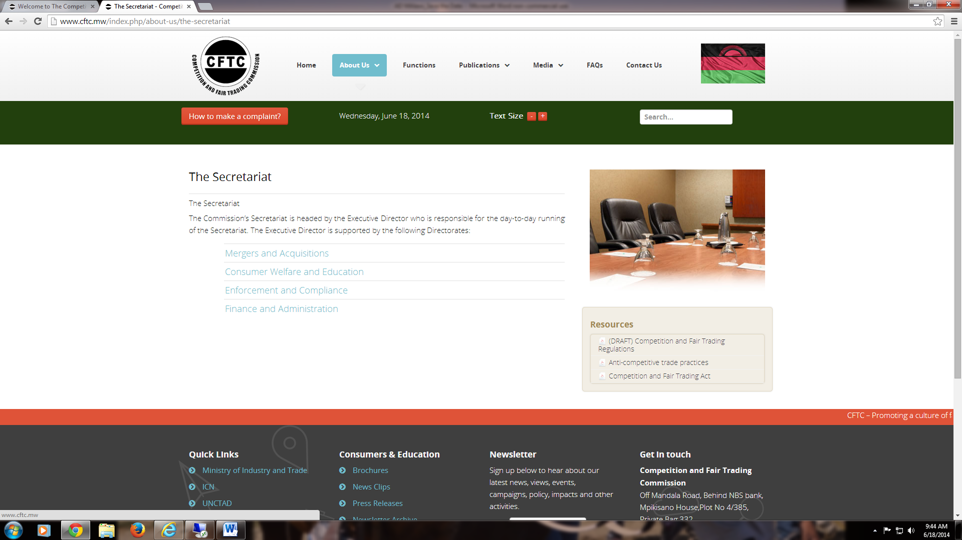


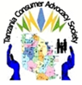


Sixth Annual African Dialogue Consumer Protection Conference
Session 4 - Developing Investigative Plans
September 7-10, 2014 - Lilongwe, Malawi
Developing investigative plans to probe on the reasons for high pharmaceutical products in Tanzania
Tanzania Consumer Advocacy Society

Slide 2
Presentation outline
TCAS,s proposed investigative plan
Rational of the plan
Regulation of pharmaceutical sector in Tanzania
Logical assumptions
Regulation of pharmaceutical sector in Tanzania
Why I'm using this platform to address this plan
What need to be done

Slide 3
The proposed investigative plan
The proposed investigative plan would like to explore on what could be the current ‘’availability of essential drugs in Tanzania: supply chain, pricing and regulation.
We are planning to probe on where there could be pharmaceutical monopolies that prohibit market entry and maintaining a monopoly that provide incentives for bribe-paying for privileged license holders to enjoy the monopoly of importing essential pharmaceutical products hence charge consumers with high prices resulting to low affordability and sufferings including hundred of thousands deaths that could be avoided
It has to be noted that more than 85% of pharmaceutical products used in Tanzania are imported from India, China, Egypt, Turkey, and other destinations

Slide 4
Rational of the plan
Despite the fact that there are good efforts done by the regulator on ensuring quality, safety and effectiveness of drugs and medical devices in the Tanzania. The proposed plan would like to find answers as to ‘’why drug prices for pharmaceutical products have big difference and not equal amongst in African countries, but actually higher than European prices’’.

Slide 5
Rational continue….
Study done by Médecins Sans Frontières (MSF) (1999) on comparing retail prices of drugs showed the same disturbing pattern: ten out of 13 commonly used drugs are more expensive in Tanzania than in Canada. The huge disparity in average income between the two countries also means that a Tanzanian would have to work 215 days to buy these 13 drugs, while a Canadian would only have to work 8 days. This signifies that there are several deaths by the poor consumers within EAC member states caused by not able to afford to buy essential medicines whose prices are set unnecessary higher sometime more than 50 folds.
Dr Christopher Ouma, AIDS project coordinator for Médecins Sans Frontières (MSF) said; "I am tired of not being able to treat patients because the medicines are too expensive. Africans should not be dying because of inability to pay when effective medicines can be available at affordable prices. - the poor are paying more than the rich. Among the many examples cited, potent antibiotic, ciprofloxacin, which was found to be twice as expensive in Uganda as in Norway’’

Slide 6
Logical assumptions
The assumption that an estimated 20 to 30 per cent are completely not afford to buy essential drugs
The assumption that an estimated 25 to 50 per cent of consumer and national spending on pharmaceutical products is lost to corruption through this organized curtail in pharmaceutical sector
The assumption that an estimated 20 to 30 per cent of deaths can be avoided if pharmaceutical products are sold at their real prices
The assumption that pharmaceutical sector is seen as untouchable with multinationals network and syndicates with only pharmacists and medial professionals who can ask and comment … in other words there are low awareness and understanding among consumers/civil society on how to engage in policy processes aimed at pharmaceutical regulatory reforms.
The assumption that the calculated monopoly within the pharmaceutical sector and healthcare is one of the contributing factors preventing the achievement of national and global health goals
There are not comprehension by civil society organisations on policy issues pertaining to pharmaceutical products supply chain and fair conducts of the market.

Slide 7
Regulation of pharmaceutical sector in Tanzania
The roles of assuring that quality, efficacy and safety medicines are available in Tanzania, had been tasked to TFDA however prices of essential drugs have been left to be controlled by market forces (free market economy) which are assumed to be subjected to monopolistic tendencies by some importers, manufacturers, and distributors due to;
Lack of standardized drugs importation procedures,
Cumbersome processes and procedures for medicine registration/licensing for importation.

Slide 8
Regulation
Theoretically prices for some essential drugs are regulated by neither the regulator nor the government but this proposed investigative plan needs to explore the regulatory causing high pries of essential pharmaceutical products in the market.
It has be revealed in the study that the government of Tanzania and other development partners have taken several initiatives to ensure essential drugs are available to the entire population by providing subsidies to some of the drugs for malaria, HIV, cancer, reproductive health and the like
It has be revealed in the study among others that lack of transparency has resulted in the sector losing the trust of its customers, that the sector is perceived to be enriching itself, often at the expense of those that need it most.
(TCAS Mystery shopping study at ADDOs:- Assessing drugs availability and affordability and needs of the community for pharmaceutical products. (2013). In the four regions of Tanga, Morogoro, Mbeya, Singida)

Slide 9

Why I'm using this platform to address this
I believe most of African countries have similar experiences…
It would be difficult to make multinational pharmaceutical companies accountable to individual member state such as Tanzania, but it could be possible if the voice is channeled through grassroots networks like in EAC, COMESA, SADC ECOWAS, AU platform.

Slide 10
What need to be done
The main objective of the proposed initiative is to build the capacity of consumers civil organizations within COMESA/EAC/SADC/ in action oriented research and advocacy with policymakers and regulatory agencies through influencing policy formulation and design of regulatory processes in pharmaceutical sector for consumers' welfare.
Promote dialogue and linkage between the grassroots consumer groups, private sector and the policy makers on regulatory reforms.
Identify cumbersome procedures on drugs importation and exportation within member states and beyond and recommend for possible measures
Work toward harmonizing policies, rules and regulations amongst COMESA/EAC/SADC for regulation and control on manufacture, production, importation, exportation and marketing of pharmaceutical products

Slide 11
What needs to be done
There will be list of identified policies, rules and regulations need to be reviewed in Tanzania and harmonized amongst COMESA/EAC/SADC countries for regulation and control on manufacture, production, importation, exportation, marketing and use of drugs that ensure the availability, at all times, of essential, efficacious and cost-effective drugs are made available to the entire population.
There will be other areas of weaknesses which need reviews i.e. consumers protection under pharmaceutical sector
Establish consumers as watchdogs to the sector for smooth regulation.

Slide 12
What can TCAS do?
To take up the challenge of analyzing, understanding and combating cartels, un- competitive behaviors in this vital sector in collaboration with all key partners in due tie
Building local and international alliance and network with FCC, Advocates for International Development (A4ID), Transparency International (TI), consumers international, consumers associations, civil societies, throughout the SADC, EAC, COMESA and other partners from the public and private sector who share our objectives.
We want to embark on a pilot project, in the expectation of launching a full program that will produce new evidence and information, and provide a clearly articulated case that will lead to policy changes and real progress in understanding corruption and improving anti-corruption resilience in pharmaceutical sector

Slide 13
Conclusion
Let us develop investigative plans to probe on the reasons for high prices for pharmaceutical products in our markets, together we can make pharmaceutical sector more fairer and responsive to consumers needs, demands and expectations.
As the initiative requires broader and inclusive partnership amongst stakeholders from COMESA/EAC/SADC – are you in? show your organization interest on this by contact us at info@tcas-tz.org or bernard@tcas-tz.org

