Slide 1
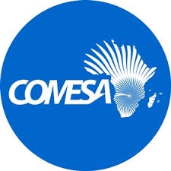

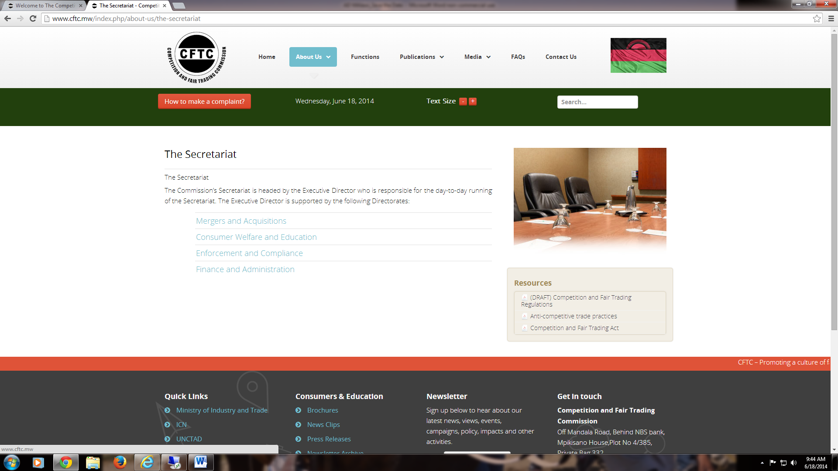


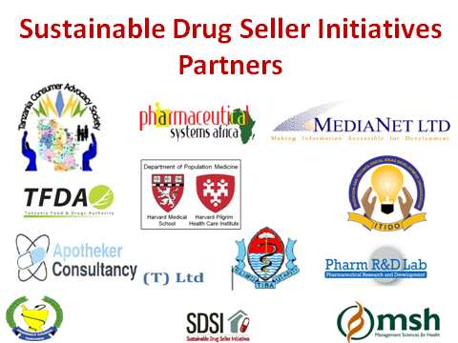
Sixth Annual African Dialogue Consumer Protection Conference Session 5: Panel Discussion – Mobile Technology, Mobile Payments and Cyber Threats September 7-10, 2014 - Lilongwe, Malawi
Mobile Financial Servicers threats and risks: the principles and procedures used to address vulnerabilities.
Tanzania Consumer Advocacy Society

Slide 2


Presentation outline
Any threat and risk to MFS is Tanzania number one major concern
Classification of MFS technology threats
Mobile financial services threats in Tanzania
Could we ask ourselves the following key questions
Five key principles guiding technology risk management in MFS
Five key principles explained
Conclusion

Slide 3


Any threat and risk to MFS is Tanzania number one major concern
With this speed growth of use of mobile phones and related MFS, as consumer association any threats and risk is our major concern

Slide 4
Classification of MFS technology threats
Threats | Data | Software | Hardware | Communications Channel
Modification | Occurs during storage, transmission, and change in physical hardware | Occurs when software is altered to perform additional functions or computations | --- | Occurs when packets are routed toward a different destination
Destruction | Caused by failure of hardware and/or software | Destruction due to malicious intent, i.e. malicious software (malware) | Caused by natural calamities such as floods, fire, or terrorist attacks | Caused by fiber optic or leased line cuts due to unexpected events, i.e. flooding, stealing, or road construction
Disclosure | Occurs when there is unauthorized access of another person’s data/information | Occurs when software programs are illegitimately copied from a computer resource | Occurs when unauthorized users gain physical access to hardware | Occurs when a third party was able to tap (listen to) ports without legitimate users’ knowledge
Interception | Occurs when confidential information is replicated by unauthorized users | Caused by erasing software programs and/or specific functionalities | Caused by damaged hardware | Caused by malicious attacks, such as flooding and denial-of-service
Interruption | -- | Caused by erasing software programs and/or specific functionalities Can be a result of operating system corruption | Caused by damaged hardware | Caused by malicious attacks, such as flooding and denial-of-service Can be a result of natural calamities, power outage, problem with base stations, or network problems
Fabrication | Caused by phishing attacks | - | - | -

Slide 5
Mobile financial services threats in Tanzania ………
Interceptions Text messages are not a method of securing data in transit, which means using a text message to receive updates or communicate with your service provider is more susceptible to interception. Sophisticated hackers could retrieve text messages, even if you have deleted individual messages.
Solution:
Experts say a good way around this threat is to refrain from corresponding via text when the information being transmitted could be potentially detrimental to your financial security if it falls into the wrong hands.
Unauthorized Access Because mobile platforms aren't equipped with the same security layers as websites or ATMs, they are more vulnerable to fraudsters, who repeatedly change their identities and gain access through a series of quick attempts.
Solution
the users can take extra steps to increase their protection, such as adding additional passwords and encryption barriers that aren't provided by your service provider. For example, you should set up the password-protect option on your phone and when it's not in use, lock it. Where available, another idea is to install security software on your mobile phone
Encourage consumers/victims to report the mobile number of malicious attackers to telecommunications service providers so that warning messages can be sent and that mobile number permanently blocked

Slide 6

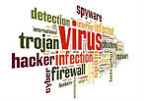
Password Theft Once someone has discovered your MFS password and hacked into your account, there isn't much you can do.
solution
Installing remote-wipe options, a way to erase the information on your phone without physically having it in your possession. You can activate this if our phone goes missing. Select service provider who offers remote-wiping as a free downloadable application.
Infection by mobile malware (risk)
Malware /worms can spread via Bluetooth and can attacks in mobile phones when downloaded. Malware common attacks include
Change icons and system applications
Manipulate a user by sending a SMS message
Gain remote access of mobile phones by spreading malware.
Install non-operational functions and applications.
Install other malicious programs.
Steal any data or information entered by the user and blocks the use of memory cards.
Solution/s
Don’t download software programs from malicious sources on the internet
Don’t make your blue tooth open all the time
Use of anti-virus specifically for smart phones
Educate consumers about malicious messages

Slide 7

Could we ask ourselves the following
There are five key principles guiding technology risk management in MFS:
Are mobile subscribers aware of such a threat?
What is the likelihood that subscribers would disclose their information voluntarily upon encountering such threat?
Can a subscriber easily distinguish a malicious act from a genuine one when faced with this type of threat?
Confidentiality,
Integrity,
Availability,
Authentication, and
Non-repudiation

Slide 8
Five key principles explained
These principles offer a framework for understanding vulnerabilities in MFS that is complementary to the discussion of threats and risks. We consumer associations can build our cases upon these principles
1) Confidentiality:
To protect user data from unauthorized access or theft. It is important to distinguish between financial and non-financial data because different confidentiality principles apply to each. In general, financial data requires the strongest encryption standards in display, storage, and transmission. Personal identification numbers should be stored in encrypted form and be unavailable to service provider staff..
2) Integrity:
Data integrity is most important during transmission because interception and data manipulation are most likely to happen at this stage.
3) Availability:
That data and service should be accessible whenever legitimate users want to use MFS. Technical risks to service availability include environmental calamities (such as power outages, terrorist attacks, and acts of nature) and malicious action, such as denial-of-service attacks.

Slide 9

key principles continue …
4. Authentication: establishing user and service provider identity.
Users must be confident that the host requesting connection is authorized and that there are no third parties involved in the connection between the terminal and host servers. This also includes access control, permission control, and password authentication.
Service providers are encouraged to conduct system audits regularly to ensure that system vulnerabilities are addressed and that no malicious activities are being overlooked.
5. Non-repudiation:
The service provider’s self-protection from possible abusive behavior of consumers and employees, ensuring transaction finality and security. Ensuring that individuals agree with the terms and conditions of the service before any action and using digital signatures prevent individuals from denying their actions. Public key certificates also allow service providers to trace the origin of the transaction in case there is no direct exchange of information between entities.
http://www.afi-global.org/sites/default/files/publications/mfswg_guideline_note_no.2_lo.pdf

Slide 10
conclusion
We have a common problem on Mobile Financial Servicers threats and risks: Let us discuss ways and means that can stop or reduce vulnerabilities.
-----THANKS--------

