Slide 1
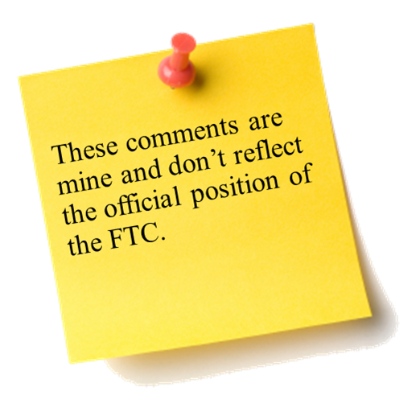

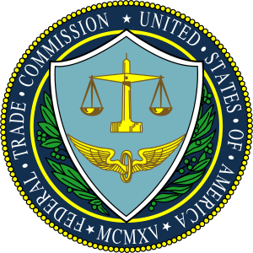

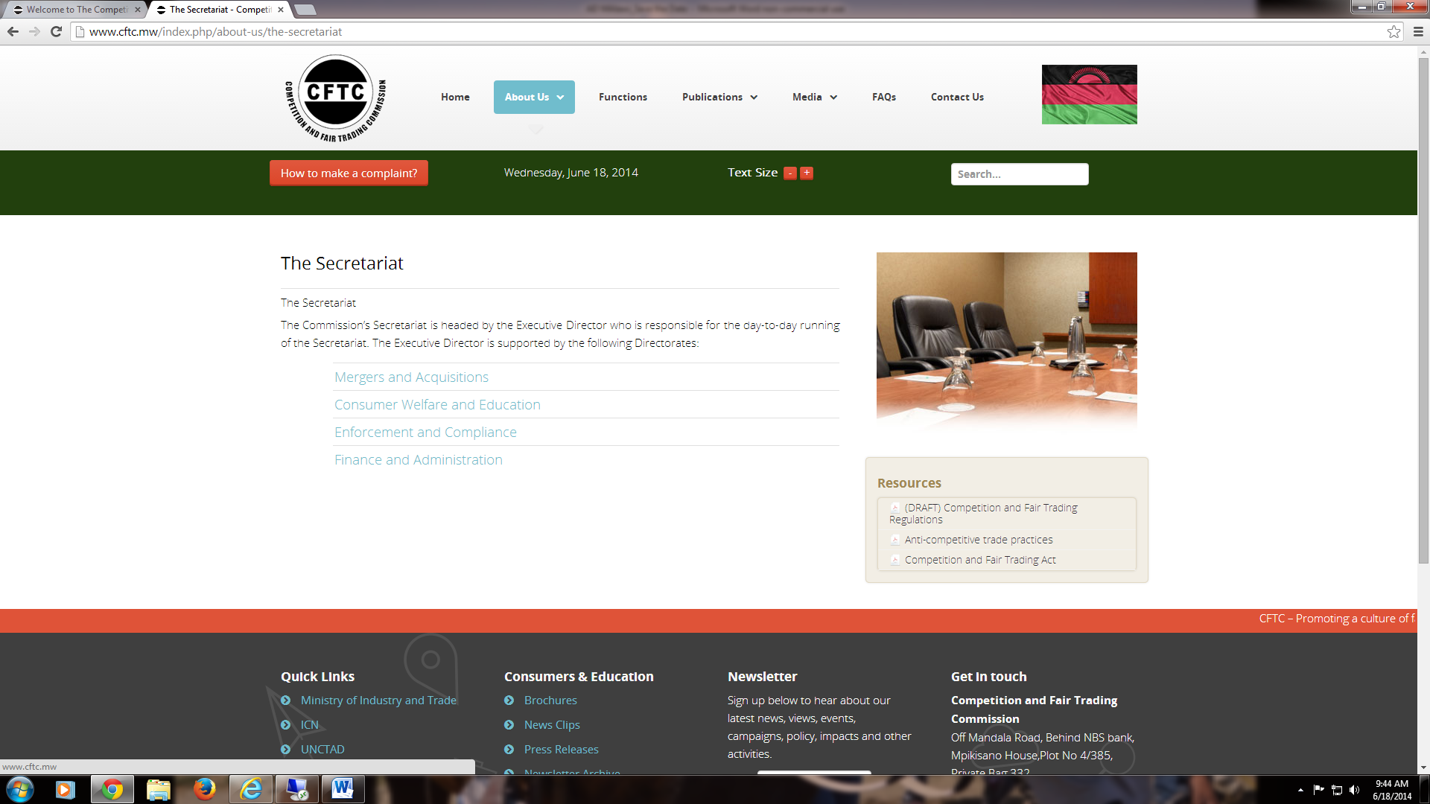
The Sixth Annual African Dialogue Consumer Protection Conference
Mobile and Cyber Threat Issues
Deon Woods Bell
U.S. Federal Trade Commission
Lilongwe, Malawi
8-12 September 2014

Slide 2

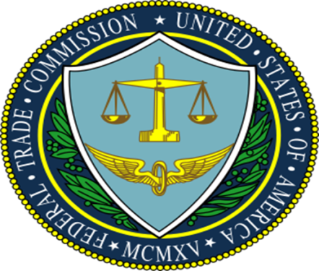
The U.S. Mobile Market
90 percent of Americans have a mobile phone
Of those, only about 12 percent currently use them to make mobile payments
Some believe that mobile payments will achieve “widespread mainstream consumer adoption” by 2015
Third party charges on wireless bills are estimated at $1.5 billion per year
Few mobile devices have antivirus protection
According to one survey, less than one-third of mobile users felt in control of their personal information on their device
More than 800,000 apps are available in the Apple App Store and 700,000 in Google Play

Slide 3
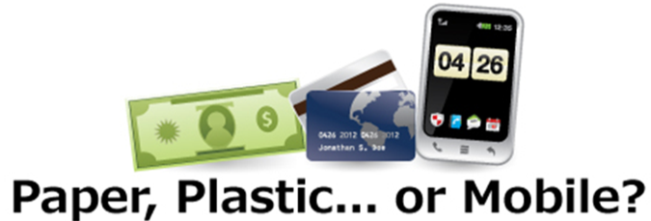
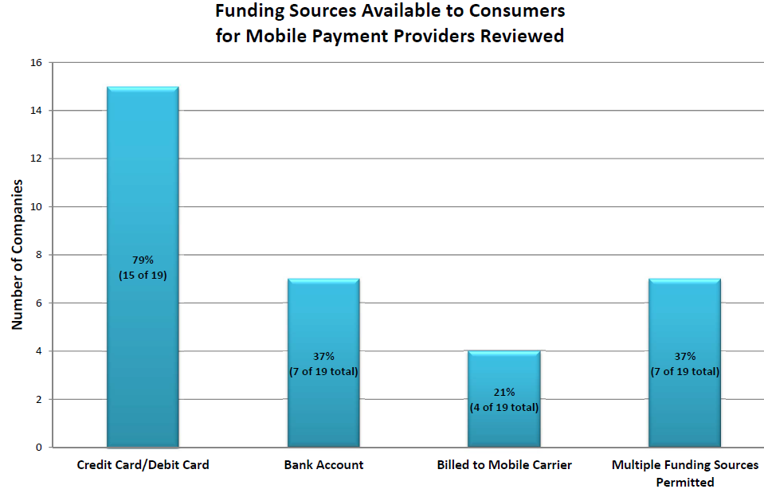
Mobile Payments
Issues:
There are many kinds of mobile payments
Protections against fraudulent or unauthorized mobile payments vary by funding source
Security of mobile payments
FTC Initiatives:
Workshop and Report on Mobile Payments

Slide 4
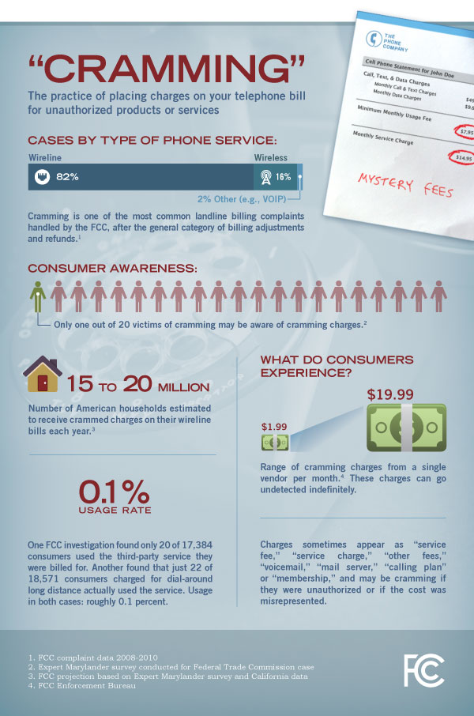
Cramming Charges
Issues:
Unauthorized or misleading charges from the phone company or third parties
Vague charge names on a phone bill such as “service fee,” “other fees,” or “membership.”
Charges may be buried deep in the bill so that they are hard for consumers to spot
FTC Initiatives:
Enforcement Actions:
FTC v. Tatto, Inc.
FTC v. INC21
FTC v. T-Mobile

Slide 5

FTC v. T-Mobile
FTC charged T-Mobile with including crammed charges on consumers’ bills and then profiting from the unauthorized charges.
FTC also alleges that the charges are buried in consumer’s bills so that it was hard to find them.

Slide 6
Mobile Security
App developers may misrepresent how they secure consumers’ data or how much data they actually collect
Insufficient security measures could lead to valuable data being lost: personal identification information, financial information, geolocational data, medical records, and credit card numbers
FTC Initiatives:
Global Privacy Enforcement Network
Participation
Enforcement Actions:
-FTC v. Snapchat
-FTC v. Goldenshores Tech.
-FTC v. Fandango
-FTC v. Credit Karma
Congressional Testimony on
Geolocation Data Use

Slide 7
Children and Mobile Security
The FTC works protect children’s privacy when they’re online and when they are using mobile devices by putting their parents in charge of who gets to collect personal information about their preteen kids.
The FTC enforces COPPA (Children Online Privacy Protection Act) by ensuring that parents have the tools they need to protect their children’s privacy.
FTC Initiatives:
COPPA
kidSAFE
Enforcement Actions
-FTC v. Apple
“Net Cetera” Program

Slide 8

FTC v. Apple
FTC charged Apple with charging consumers for in-app purchases made by their children without parental consent. By entering in their password, parents were not only approving a single in-app purchase, but also allowing their children 15 minutes of unlimited purchases without having to enter their password again.
Apple settled and agreed to rework the payment framework so that express consent was required before payment was received.

Slide 9
Cyber Threats to Consumers and Countermeasures
Threats
Malware – viruses, worms, spyware, and Trojan horses
Phishing
Wireless and operating system vulnerabilities
Spam
Countermeasures
Anti-virus software
Firewalls
Intrusion detection systems
Authentication systems
Encryption

Slide 10
Spam Texts
Consumers may receive unsolicited texts that offer “free” services or gifts that end up being untrue or simply a lead into other unrelated products
These spam texts may also automatically add crammed charges to users’ phone bills
FTC Initiatives:
Enforcement Actions
-FTC v. CPA Tank, Inc.
-FTC v. Eagle Web

Slide 12
Thank you!
My contact information:
Deon Woods Bell
Office of International Affairs
U.S. Federal Trade Commission
600 Pennsylvania Ave, N.W. H-494
Washington, D.C. 20580
Email: dwoodsbell@ftc.gov
Telephone: +1 (202) 326-3307

