Slide 1
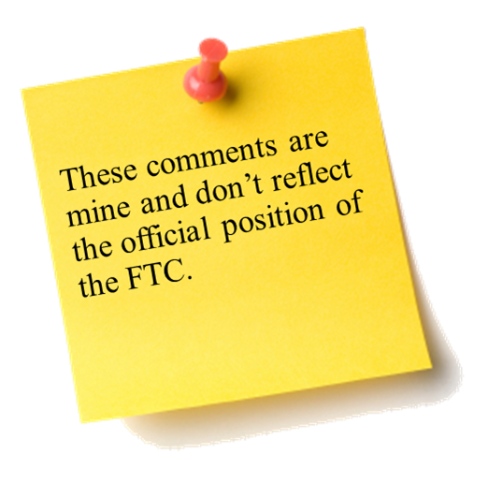

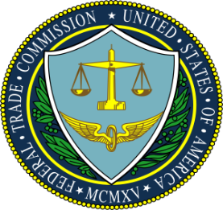
U.S. Federal Trade Commission
2013-2014
Consumer Protection and Competition Highlights
Deon Woods Bell
U.S. Federal Trade commission
Sixth Annual African Dialogue conference
Lilongwe, Malawi
September 2014

Slide 2

FTC’s Mission and Legal Framework
Mission:
To prevent business practices that are anticompetitive, deceptive, or unfair to consumers
Consumer Protection:
The Federal Trade Commission Act provides that “unfair or deceptive acts or practices in or affecting commerce…are…declared unlawful.” (15 U.S.C. Sec. 45(a)(1))
Competition:
The FTC Act also prohibits “unfair methods of competition.” (15 U.S.C. Sec. 45(a))
Including any conduct that violates the Sherman Antitrust Act or the Clayton Act

Slide 3

Challenging Deceptive Advertising and Marketing
Consumers should get what they pay for. The FTC works to ensure that national advertisers can back up the claims they make for their products, especially health and safety claims.
Law Enforcement:
Operation Steer Clear (Car-Dealer sweep)
POM Wonderful
Sketchers & Reebok Settlements
Your Baby Can Read!
Ab Circle Pro
Winfixer ($163M Scareware case)
John Beck ($478M “get rich quick” case)
Operation False Promises (Business Opportunity sweep)
International crackdown on massive tech support scams
Outreach:
Tech Support Scams
Video: Protect Your Computer from Malware
Buying and Owning a Car
Blog: What your ads say and what the science supports: If the shoe doesn't fit...

Slide 4
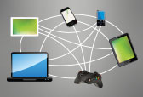
The Tech Industry
The Commission takes a balanced approach when applying antitrust and consumer protection principles to fast-paced technology markets, focusing on the facts as they develop in real time to asses when to best protect consumers and how to encourage competition.
Law Enforcement:
Apple ($32.5M settlement for in-app purchases)
Honeywell (merger of bar code scanner companies) (competition)
Nielsen (merger of audience measurement service companies) (competition)
Wise Media (Mobile Cramming case)
Jesta Digital, LLC (1st Wireless Access Protocol billing case)
Goldenshores Technologies, LLC (Popular flashlight app shares users location)
TRENDnet (Faulty software in home security cameras)
Outreach:
Payments and Billing
Using IP Cameras Safely
Mystery Charges on Your Phone Bill
Understanding Mobile Apps
Marketing Your Mobile App: Get It Right From The Start
Search Engine Guidance Letters
Policy:
Reports:
mobile payments
transparency in mobile privacy disclosures
Dot Com Disclosures Revised Report
Conferences: mobile security issues; mobile cramming; Internet of Things; online native advertising

Slide 5

Safeguarding Children
The Children’s Online Privacy Protection Act (COPPA) and the FTC’s COPPA Rule protect children’s privacy when they’re online by putting their parents in charge of who gets to collect personal information about their preteen kids. The FTC enforces COPPA by ensuring that parents have the tools they need to protect their children’s privacy.
Law Enforcement:
The Children’s Online Privacy Protection Act (COPPA Rule)
Artists Arena ($1 million)
Path ($800K)
Outreach:
Child Identity Theft
Infographic: Keeping Up with Kids’ Apps
Marketing Your Mobile App: Get it Right form the Start
Audio: Protecting Your Child’s Personal Information
Policy and Studies:
Amicus Brief Clarifying Role of COPPA
FTC Grants Approval for New COPPA Verifiable Parental Consent Method
Public Comment for iVeriFly, Inc., Proposal for Parental Verification Method
Second Staff Report examining privacy disclosures and practices of apps offered to children

Slide 6

Protecting Consumers in a Recovering Economy
Even as the economy recovers, some consumers continue to face financial challenges. The FTC takes effective actions to ensure that consumers are protected from abusive credit practices and get the information they need to make informed financial choices.
Outreach:
Deceptive Mortgage Ads
Stop Calls and Letters From Debt Collectors
Fake Debt Collectors
Law Enforcement:
American Debt Crunchers
Luebke Baker
Rumson Bolling ($700K debt collection case)
Goldman Schwartz (False threats to consumers)
Broadway Global Master (Phony Debt Collection Scam)
Innovative Wealth Builders (telemarketing credit card int. rate reduction scam)
Studies:
Debt Buyer Study

Slide 7

Protecting Consumer Privacy
As the nation’s top cop on the consumer privacy beat, the FTC’s goals are to protect consumer privacy in an evolving market for consumer information, make sure companies keep their privacy promises to consumers, and ensure that consumers have confidence to take advantage of the benefits that a dynamic marketplace offers.
Law Enforcement:
Google ($22.5M)
Wyndham Worldwide Corp.
Cbr Systems, Inc.
DesignerWare, LLC (spying on consumers)
Enforcing the Do Not Call Registry
Studies:
Mobile Privacy Disclosure Report
Outreach:
Privacy Choices for Your Personal Financial Information
Employment Background Checks
Video: Sharing Information: A Day in Your Life
Mobile App Developers: Start with Security

Slide 8
Accuracy and Transparency
in Credit Reporting Services
The agency has used its consumer
protection law enforcement tools to improve consumer services
Outreach:
Disputing Errors on Credit Reports
Blog: Keeping Your Credit Report in Check
Consumer Reports: What Information Furnishers Need to Know
Using Consumer Reports for Credit Decisions: What to Know About Adverse Action and Risk-Based Pricing Notices
Policy:
Amicus brief: Delgado v. Capital Mgmt. Services, LP
FTC Study of The U.S. Credit Reporting Industry
Law Enforcement:
Certegy Check Services, Inc. (1st Furnisher Rule action; $3.5M penalty-“2nd-largest for FCPA Matter”)
TeleCheck Services, Inc.
Time Warner Cable ($1.9M)
Equifax, HireRight & Spokeo, Inc. (FCRA)
Notes:
Delgado v. Capital Mgmt. Services, LP (unlawful for collectors to lead consumers to believe that they can face legal action for a debt even though the statute of limitations for suing to collect has expired)

Slide 9
Stopping Fraud
Law enforcement to prevent consumer fraud continues as a high priority for the agency.
Outreach:
Travel Scams
Telemarketing Scams
Mortgage Relief Scams
National Do Not Call Registry
Interactive Game: Gear Up for a Great Trip
Telemarketing
Debt Relief Services & the Telemarketing Sales Rule
Law Enforcement:
Ivy Capital
Direct Benefits Group, LLC (payday loan applicant scam)
Prime Legal Plans ($3.6M; phony mortgage relief scheme)
Mortgage Investors Corp. (record $7.5M to settle alleged telemarketing violations)
Expert Global Solutions, Inc. ($3.2M; world’s largest debt collection operation)
Multinational Effort in Travel and Timeshare Resale Scams

Slide 10

The Health Industry
The FTC is engaged in ongoing efforts to stop (1) bogus claims that unproven remedies can be used to prevent and treat serious diseases and (2) misleading claims for products promoting easy weight loss and slimmer bodies. Finally, the FTC is committed to ensuring that firms who collect that data use reasonable and appropriate security measures to prevent it from falling into the hands of identity thieves and other unauthorized users.
Law Enforcement:
LabMD, Inc (securing personal data)
St. Luke’s Health System (hospital merger case) (competition)
Operation Failed Resolution ($34M for consumer redress)
Mylan & Agila (pharmaceutical merger) (competition)
Wellness Support Network ($2.2M; phony claims re. diabetes)
Actavis (anticompetitive pay-for-delay agreements) (competition)
Policy:
Advocacy comments to legislators in Connecticut, Illinois, and Massachusetts
Outreach :
Weighing the Claims in Diet Ads
Blog – Sensa-tionalistic Claims Don’t Shake Off the Pounds
Blog – Putting the Squeeze on Bogus Weight Loss Products
Gut Check: A Reference Guide for Media on Spotting False Weight Loss Claims
Health Claims

Slide 11

Energy & Environmental Products Industries
Consumers continue to value efficient energy markets and environmentally-friendly products. The Commission devotes significant resources to ensure that competition to produce these items remains robust and that consumers are protected.
Outreach:
Shopping “Green”
Video - Green Guides
Audio Tip: Learn About Lumens
Environmental Marketing
Blog - Grading your degradability claims: The latest for green marketers
Blog – FTC to mattress companies: Don’t pad your green claims
Law Enforcement:
Tesoro & Chevron
(Acquisition of Oil Pipelines) (competition)
Lights of America ($21M LED bulbs)
Sellers of plastic products (Challenging Deceptive Biodegradable Plastics Claims for 1st Time)
Mattress + manufacturers (VOC claims)
NEW Plastics Corp. (Lumber)
Down to Earth Designs (Diapers)
Studies:
Green Guides
Staff Report: U.S. Ethanol Markets Remain Unconcentrated

Slide 12
Thank you!
My contact information:
Deon Woods Bell
Office of International Affairs
U.S. Federal Trade Commission
600 Pennsylvania Ave, N.W. H-494
Washington, D.C. 20580
Email: dwoodsbell@ftc.gov
Telephone: +1 (202) 326-3307

