Slide 1
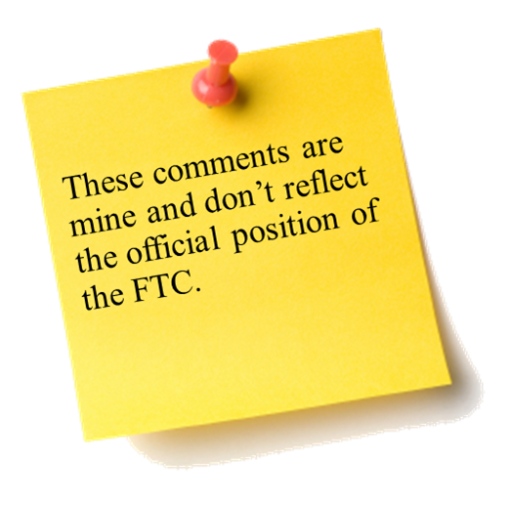



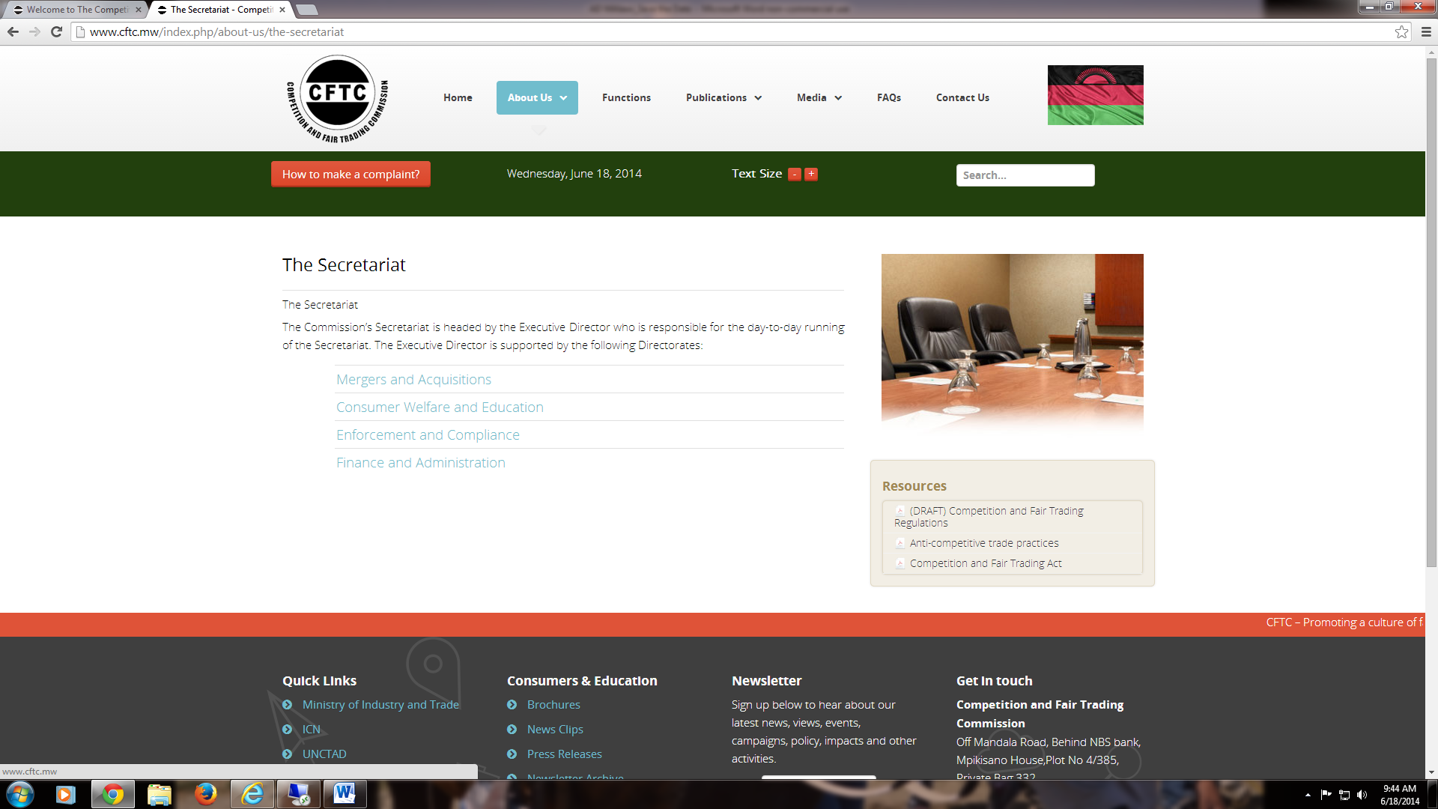
The Sixth Annual African Dialogue
Consumer Protection Conference
Energy and Environmental Case Studies
Deon Woods Bell
U.S. Federal Trade Commission
Lilongwe, Malawi
8-12 September 2014

Slide 2

Environment: Bamboo-zled!
Fact Pattern – 1/2
Talisa, a seamstress who lives in a village just outside of Yaounde, had heard from her husband, a civil servant, that one of the hit new fashions in the capital was fabric made from bamboo fibers. Apparently, he said, the shirts were seen as very environmentally friendly since they were just bamboo fibers woven together without any harsh chemicals or large energy-intensive processes. Also, the bamboo fibers apparently had anti-bacterial properties to help ward off diseases.
Talisa set to work to create a bamboo-fabric shirt for her husband to wear to work (with the idea of later making more to sell at market). While she was easily able to find some bamboo to work with, taking out the fibers and weaving them into a yarn was a long and hard process.
When she finally finished the shirt, her husband said, “Oh no! The bamboo shirts don’t feel or look anything like that! It’s way too scratchy. I don’t want it.”

Slide 3
Environment: Bamboo-zled!
Fact Pattern – 2/2
Traveling into the city with her husband, she came across some of these “bamboo” shirts in the market, which she quickly deduced were just another fabric known as rayon.
Rayon is made from wood pulp, which can include bamboo, but it’s processed down using many dangerous chemicals such as lye and sulfuric acid into a smoother form of fabric. Even if bamboo had any health properties, they would be lost through the chemical process.
Not wanting to be left out of the fashion fad, however, Talisa started buying some rayon fabric and marketed some dresses she created as “made from bamboo.”
Notes:
FTC v. Dyna-E (2009)
Press Release: http://www.ftc.gov/news-events/press-releases/2009/12/ftc-approves-final-consent-order-matter-concerning-dyna-e
Administrative Complaint: http://www.ftc.gov/sites/default/files/documents/cases/2009/06/090609admincmplt.pdf
Settled with a Consent Order

Slide 4
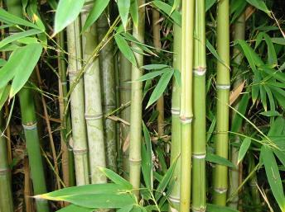
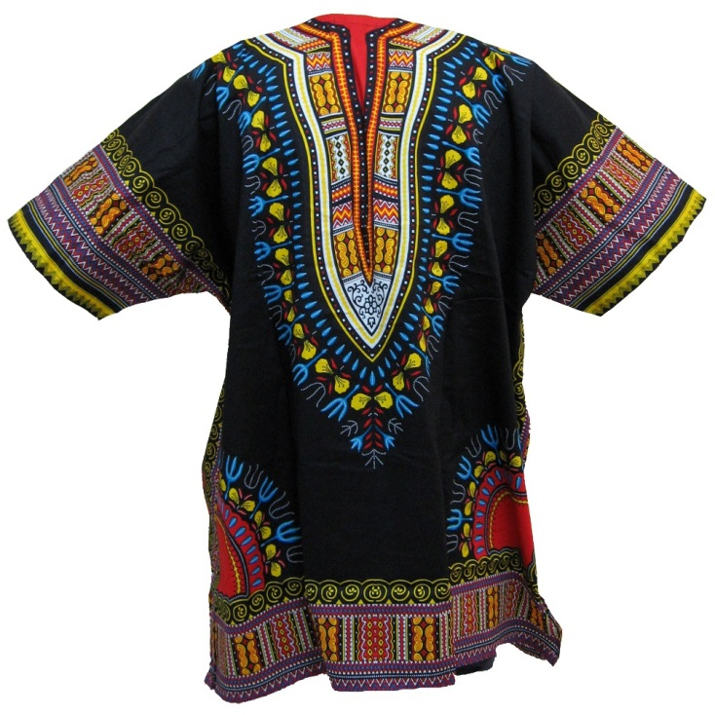
Environment: Bamboo-zled!
Exhibit A

Slide 5
Environment: Bamboo-zled!
Questions for Discussion
What exactly was the fraud committed here?
How would you go about investigating a case like this?
Is it important whether your agency has received any consumer complaints?
What factors would be important as your agency considers whether it will pursue this matter?
If you decided to pursue this matter, what would your agency have to establish?
Would it matter if the perpetrators here are not formal businesses but are individual people?
Is there any other agency that may have a role, including NPO’s and self-regulatory industry body?
What type of relief would you seek in this matter?
What type of consumer or business education, if any, do you think would be effective?

Slide 6
Energy: Solar Cooker
Fact Pattern – 1/2
Talisa’s cousin, who had moved to Côte d'Ivoire with her husband, was visiting and had told her all about this new solar powered cooker that they had recently bought . . . “Since it uses the sun, you don’t need to buy gas or fuel or wood or anything!” The cooker was made by a newly created company in Abidjan. When Talisa asked her cousin whether it still worked during the nighttime or when it was cloudy, she replied, “Oh, it has a super-duper battery attached so that it will work anytime! It’s really not a problem.”
The area where Talisa lived soon encountered a fuel shortage, and their regular oven started to break down. She started to think more closely about giving this cooker idea a try. Her husband was wary about the idea since the cooker would have to be imported from a long ways away and might get damaged or confiscated. Eventually, she and her husband decided to give the cooker a try.
Notes:
FTC Green Guides
Location: http://www.ftc.gov/enforcement/rules/rulemaking-regulatory-reform-proceedings/guides-use-environmental-marketing-claims
FTC Energy Guide Labels
Location: http://business.ftc.gov/documents/bus-82-energyguide-labels-faqs

Slide 7
Energy: Solar Cooker
Fact Pattern – 2/2
The cooker arrived in one piece. In the manual, it stated that it would provide a continuous stream of 600W of energy if placed in the correct way with full sun exposure, which would be good enough to cook everything she needed. However, without full sun, the temperature on the cooker quickly plummeted that it barely produced enough heat to warm up a cup of water.
The manual also touted the fact that “most of the cooker is biodegradable.” The cooker was mainly made out of metal with some structural parts and cords made out of biodegradable plastic.
In the manual, she eventually found the information about the warranty. However, the warranty for the product explicitly did not cover problems with the rechargeable battery.
Notes:
FTC Green Guides
Location: http://www.ftc.gov/enforcement/rules/rulemaking-regulatory-reform-proceedings/guides-use-environmental-marketing-claims
FTC Energy Guide Labels
Location: http://business.ftc.gov/documents/bus-82-energyguide-labels-faqs

Slide 8
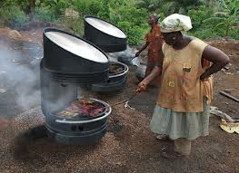
Energy: Solar Cooker
Exhibit A

Slide 9
Energy: Solar Cooker
Discussion Questions
How would you go about investigating a case like this?
What are the rules in your country regarding product warranties?
How would you approach the fact that the company here is based in another country?
Is it important whether your agency has received any consumer complaints?
What factors would be important as your agency considers whether it will pursue this matter?
If you decided to pursue this matter, what would your agency have to establish?
Is there any other agencies that may have a role, including NPO’s and self-regulatory industry body?
What type of relief would you seek in this matter?
What type of consumer or business education, if any, do you think would be effective?

Slide 10
Energy: Unplugging the Competition
Fact Pattern
It turns out that the “super-duper” style of battery normally contained in the solar cooker was banned from Cameroon by the “Energy Board”, and the kind of battery Talisa received was a cheap knock-off.
The “Energy Board” has the legal authority to license and detail the energy usage and safety of products including batteries, wires, oil and gas tanks and power generators. But, all of its members are private persons, who were selected and voted on by energy, oil and gas company workers. It was thought that they would have the most expertise in assessing the safety and soundness of energy products.
While powers are granted to them by law, the Energy Board is politically independent from the Cameroon government, and the Board’s decisions can only be challenged by a private court case.
* Fictional Agency
Notes:
FTC v. N. Car. Bd. Of Dentistry (2011)
Press-Release: http://www.ftc.gov/news-events/press-releases/2011/07/administrative-law-judge-concludes-north-carolina-dental-board
Administrative Complaint: http://www.ftc.gov/sites/default/files/documents/cases/2010/06/100617dentalexamcmpt.pdf
Currently on Appeal to the Supreme Court

Slide 11
Energy: Unplugging the Competition
Fact Pattern
When making the decision to ban the batteries, the Board had pointed to selected anecdotes where the “super-duper” batteries rarely had problems with storing too much energy to the point where they leaked harmful gas and, in at least one case, allegedly exploded. But, the Board did not conduct any official studies testing the safety of the batteries, nor did the Board contact the company who made the batteries to request records of safety tests.
A note was found in the personal files of one member that was leaked to the public said that the Board should ban the batteries “to help smother this solar power industry before it starts threatening our oil money!”

Slide 12
Energy: Unplugging the Competition
Discussion Questions
How would you go about investigating a case like this?
Does the fact that the agency here has some connections to the government affect your ability to pursue this potentially collusive or exclusionary behavior?
Is it important whether your agency has received any complaints about collusive or exclusionary behavior?
How would you balance the possible motives behind the Board’s decision (consumer safety v. personal gain) to assess whether there was any competitive harm?
What factors would be important as your agency considers whether it will pursue this matter?
If you decided to pursue this matter, what would your agency have to establish?
What type of relief would you seek in this matter?

Slide 13
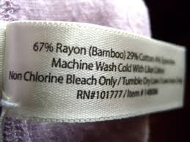
FTC v. Dyna-E
FTC charged Dyna-E with making false and unsubstantiated claims that their paper products (dry towels) were “biodegradable”
FTC’s “Green Guides” state that unqualified biodegradable claims are acceptable only if they have scientific evidence that the product will completely decompose within a reasonably short period of time under customary methods of disposal
The towels typically were disposed in landfills, incinerators, or recycling facilities, where it is impossible for waste to biodegrade within a reasonably short time
Dyne-E was barred from representing that its products were biodegradable unless it was true, and that they possess scientific evidence to substantiate its claims
Notes:
FTC v. Dyna-E (2009)
Press Release: http://www.ftc.gov/news-events/press-releases/2009/12/ftc-approves-final-consent-order-matter-concerning-dyna-e
Administrative Complaint: http://www.ftc.gov/sites/default/files/documents/cases/2009/06/090609admincmplt.pdf
Settled with a Consent Order

Slide 14
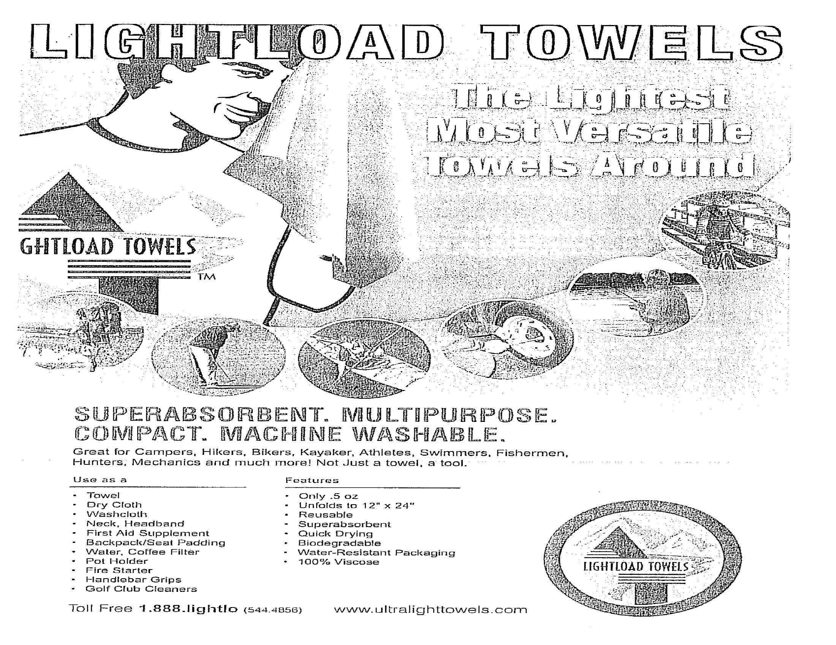

Slide 15

FTC v. Pure Bamboo
FTC charged four sellers of clothing and other textile products with deceptively labeling and advertising these items as made of bamboo fiber, when they are made of rayon
The resolution barred Pure Bamboo from misrepresenting its products
Notes:
FTC v. Pure Bamboo LLC.
Press release: http://www.ftc.gov/news-events/press-releases/2009/08/ftc-charges-companies-bamboo-zling-consumers-false-product-claims
Complaint: http://www.ftc.gov/sites/default/files/documents/cases/2009/12/091218purebamboocmpt.pdf
Resolution: http://www.ftc.gov/news-events/press-releases/2009/12/ftc-approves-final-consent-order-matter-concerning-dyna-e

Slide 16
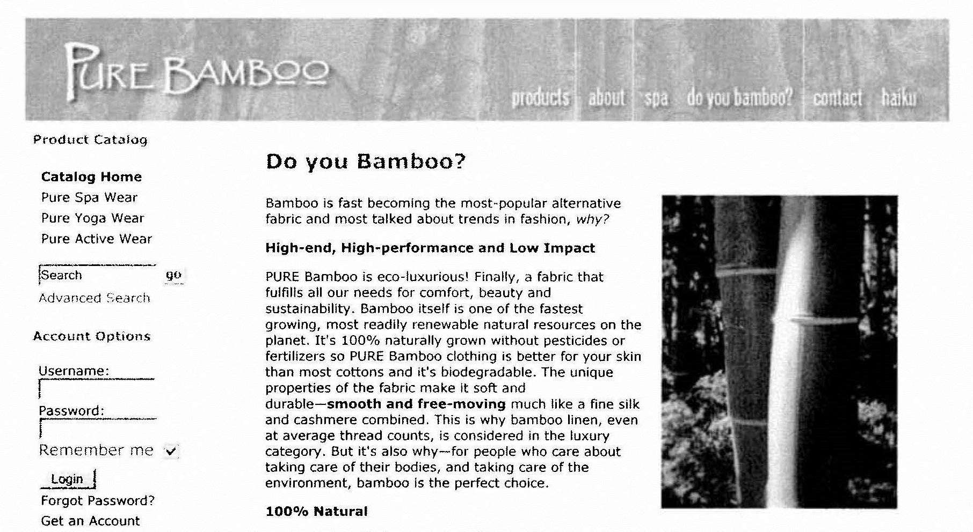
FTC v. Pure Bamboo

Slide 17
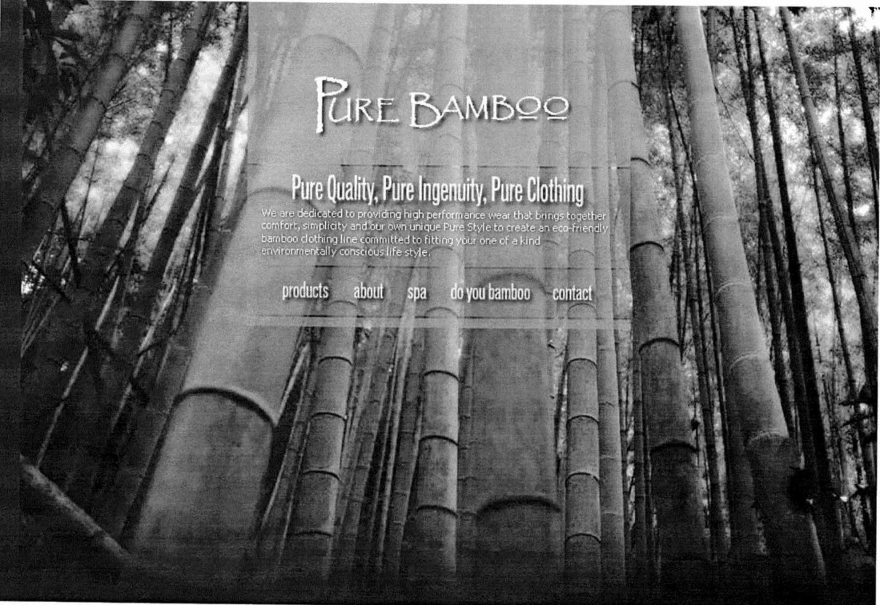

Slide 18
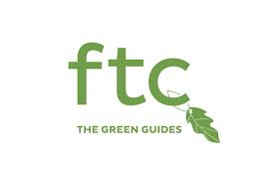
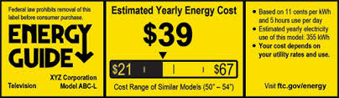
FTC Green and Energy Guides
Notes:
FTC Green Guides
Location: http://www.ftc.gov/enforcement/rules/rulemaking-regulatory-reform-proceedings/guides-use-environmental-marketing-claims
FTC Energy Guide Labels
Location: http://business.ftc.gov/documents/bus-82-energyguide-labels-faqs

Slide 19
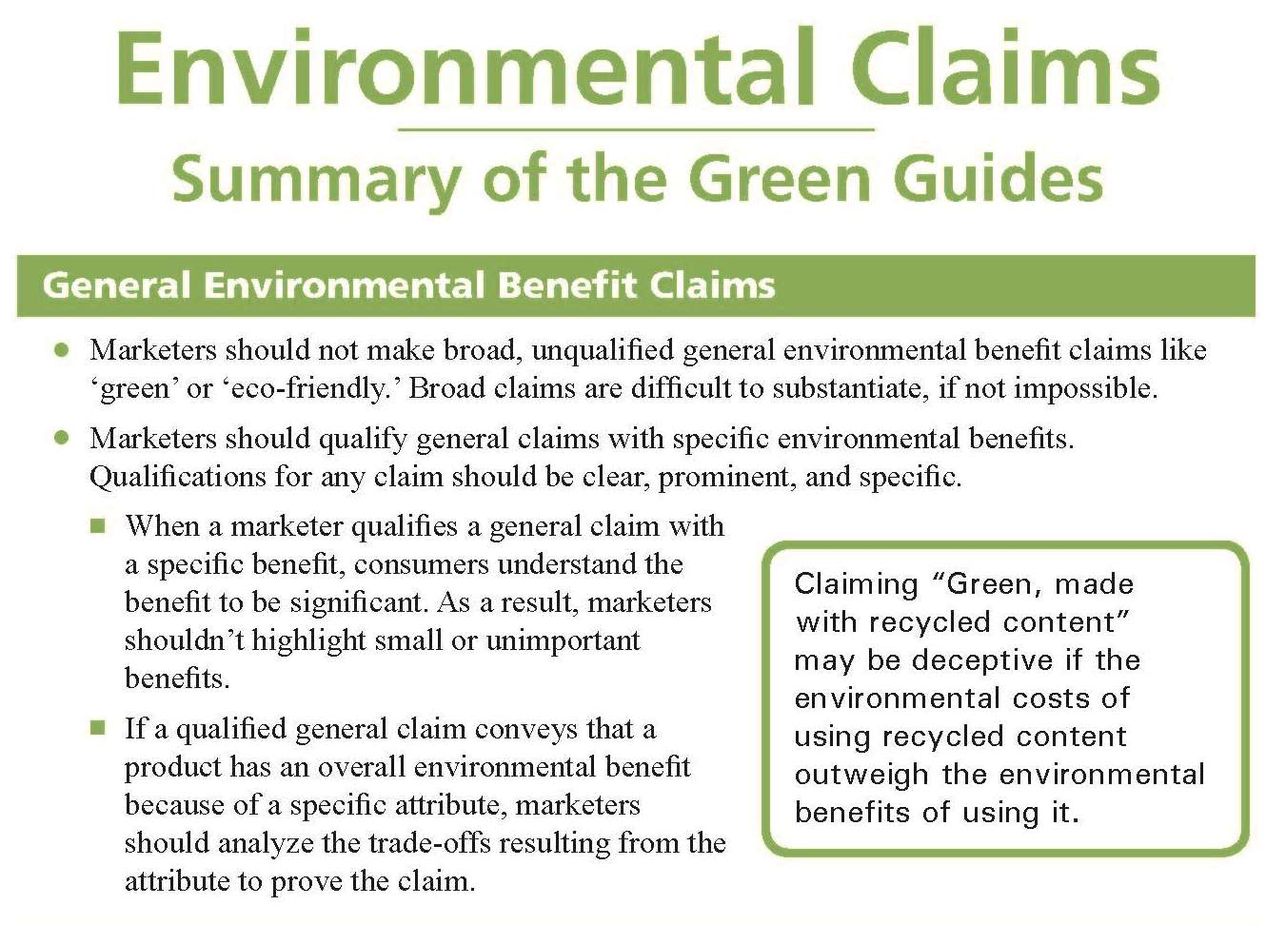
Notes:
Summary link: http://www.ftc.gov/sites/default/files/attachments/press-releases/ftc-issues-revised-green-guides/greenguidessummary.pdf

Slide 20
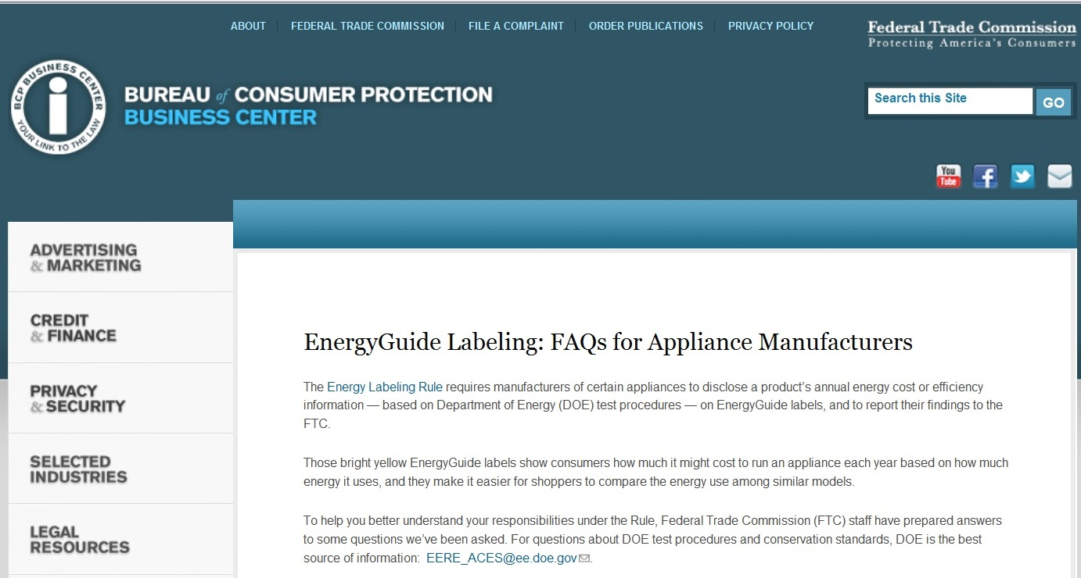
Notes:
Labeling link: http://business.ftc.gov/documents/bus-82-energyguide-labels-faqs

Slide 21


FTC v. North Carolina Board of Dentistry
North Carolina Board of Dental Examiners tried to block non-dentists in the state from providing teeth-whitening goods or services
Ninth Circuit affirmed FTC’s determination that Dental Examiners stifled competition
Notes:
FTC v. N. Car. Bd. Of Dentistry (2011)
Press-Release: http://www.ftc.gov/news-events/press-releases/2011/07/administrative-law-judge-concludes-north-carolina-dental-board
Administrative Complaint: http://www.ftc.gov/sites/default/files/documents/cases/2010/06/100617dentalexamcmpt.pdf
Currently on Appeal to the Supreme Court

Slide 22
Thank you!
My contact information:
    Deon Woods Bell
    Office of International Affairs
    U.S. Federal Trade Commission
    600 Pennsylvania Ave, N.W. H-494
    Washington, D.C. 20580
    Email: dwoodsbell@ftc.gov
    Telephone: +1 (202) 326-3307

