Slide 1


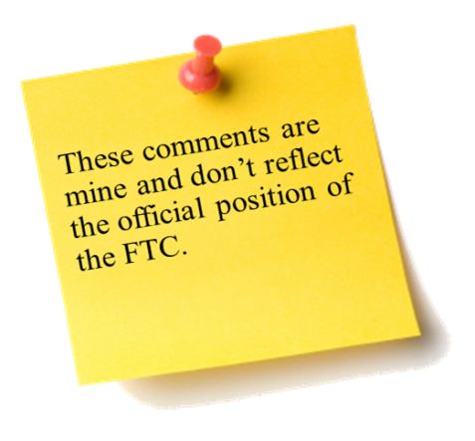
Law Enforcement Techniques and Cross-Border Collaboration: Financial Consumer Protection Issues
Sixth Annual African Dialogue Conference
Lilongwe, Malawi
September 2014
Charles Harwood U.S. Federal Trade Commission

Slide 2
“Last Dollar” Scams
Con artists take advantage of extremely financially distressed consumers and try to take their last dollar
Consumers without income are promised a job, government grant, or some other money-making opportunity
Consumers deep in debt are promised homes will be saved or credit record fixed
FTC v. Innovative Wealth Builders
FTC v. Oro Marketing

Slide 3
Mortgage Relief Fraud
Mortgage relief scammers claim they will negotiate with mortgage lenders to avoid foreclosure
Charge advance fee of hundreds or thousands of dollars paid up-front
Scammers often fail to obtain the relief they promise (and may not do anything)
FTC v. Prime Legal Plans
FTC v. Heritage Homes Group

Slide 4
Pyramid Schemes
False promises of return on investment
Participants focus on recruiting new members instead of on selling products
  Recruits only profit if they recruit more members who recruit more members
  Recruits pay a share of fees earn to their recruiter and their recruiter’s recruiter
Scheme collapses and most participants lose money
Victims in multiple countries
FTC v. BurnLounge
FTC v. Fortune Hi-Tech Marketing
FTC v. SkyBiz

Slide 5
Automobile Financing
Dealer misrepresentations in print, Internet, and video advertisements about low monthly payments to buy, no upfront payment to lease, required credit terms not disclosed in ads
Subprime auto lending company that:
  Misrepresented fees consumers owed
  Unilaterally increased principal balances
  Offered loan extensions without disclosing additional costs
  Engaged in abusive collection
Vehicle loan modification scheme
Operation Steer Clear
FTC v. Consumer Portfolio Services
FTC v. Auto Debt Consulting/Vehicle Loan Mod

Slide 6
Mortgage Advertising
Misrepresenting the terms, including the interest, fees or costs, monthly payment, taxes and insurance, among other things
Misrepresenting total costs, including money down to purchase a home, or that consumers will receive 100% financing and pay no closing costs
Illegally disclosing, selling, or transferring consumer data
FTC v. Homes Heritage Group
FTC v. GoLoansOnline.Com

Slide 7
Payday Lending Fraud
Consumers who need cash quickly turn to payday loans: short-term, high interest loans that are generally due on the consumer’s next payday after the loan is taken out
Consumers may not understand high costs
Lenders may engage in prohibited collection practices
FTC v. AMG Services
FTC v. Vantage Funding

Slide 8
Debt Collection
Most debt collectors are careful to comply with laws, but some engage in illegal collection practices
Some collectors harass and threaten consumers, demand larger payments than allowed, refuse to verify debts, disclose debts illegally
Some consumers pay collectors money they do not owe, others suffer invasions of their privacy, emotional distress, job loss
FTC v. Williams, Scott & Associates
FTC v. Asset Capital and Mgmt.
FTC v. Goldman Schwartz
FTC v. Pinnacle Payment Services

Slide 9
Phantom Debt Collection
False threats bully consumers to pay debts that do not belong to consumers
  Falsely claim affiliation with government
  Falsely claim imminent arrest, other legal action
Consumers complete online forms posted by loan brokers
Some calls come from off-shore
FTC v. Williams, Scott & Associates
FTC v. Pro Credit Group Inc.

Slide 10
Cross Border
MOU with Canadian Provincial Financial and Consumer Affairs Authority
  Agree to use “best efforts to cooperate” with investigations, cooperation in joint investigations, maintain the confidentiality of shared information
FTC v. EMG
  Mortgage relief fraud boiler room operating from Montreal
  FTC assisted by Royal Canadian Mounted Police and provincial/local law enforcement

