Slide 1


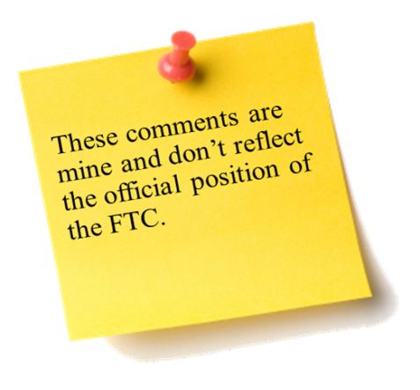
Financial Consumer Protection Issues: Crypto-currencies Sixth Annual African Dialogue Conference Lilongwe, Malawi September 2014 Charles Harwood U.S. Federal Trade Commission

Slide 2
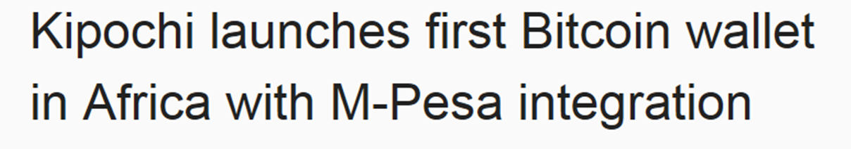
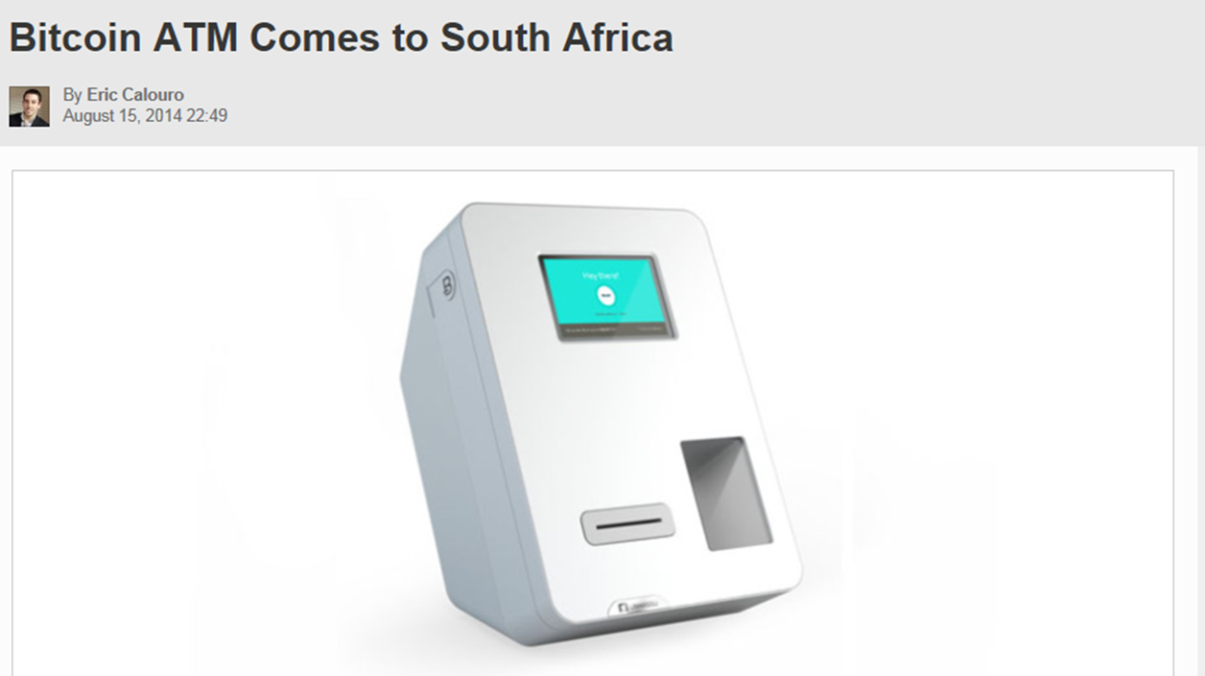

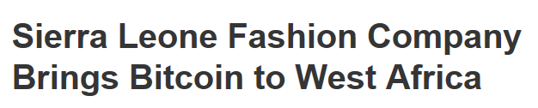
Crypto-currencies in Africa

Slide 3
Topics of Discussion
Crypto-currencies
What? How? Why?
Bitcoin and Competing Currencies
Strengths/Weaknesses
Regulation
Consumer Protection Issues

Slide 4
What is Crypto-currency?
Virtual currency
Decentralized
Peer-to-peer

Slide 5
How Does it Work?
“Mining” for coins
Crypto Exchanges
The digital wallet

Slide 6
Why Would People Use It?
Anonymity
Non-government issued currency
Investment potential

Slide 7


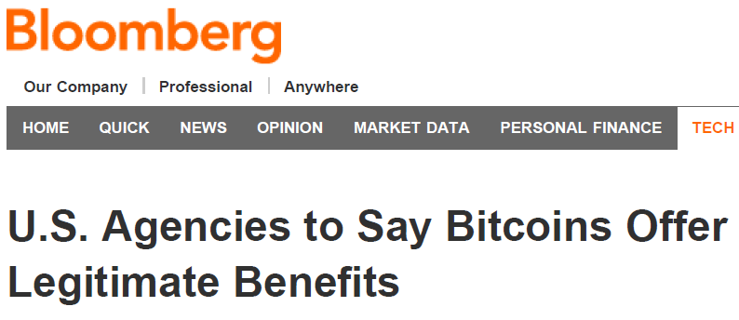
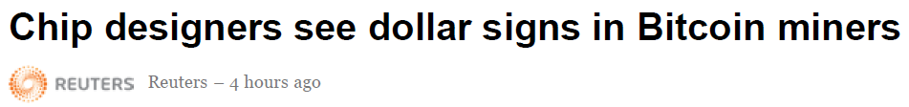
Bitcoin – The First and Most Famous

Slide 8
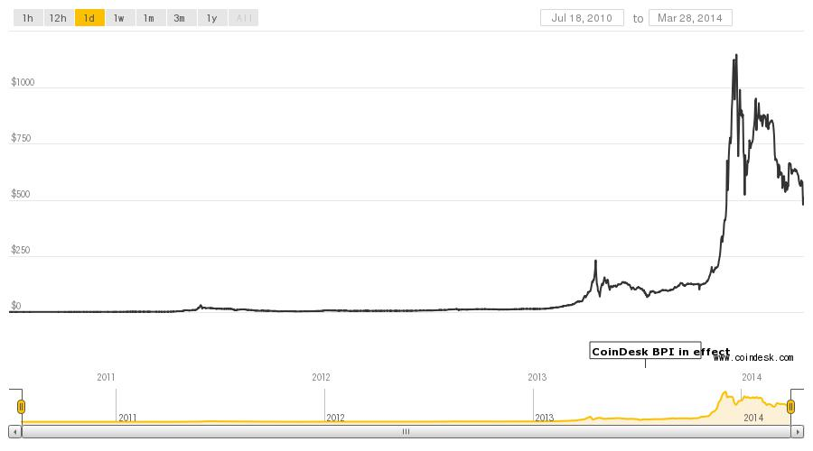
Bitcoin – What’s it worth?

Slide 9
Strengths and Weaknesses
Microtransactions
Low transaction costs
Potential Reduction in Loss of SI/PII
Ease of transactions
Unbanked/Underbanked
Means of money laundering/illegal activity
Volatility
No existing consumer protection
Security of stored coins
Liquidity trap/Hoarding

Slide 10
Future potential?
Unbanked and underbanked
Inner cities
Rural
Developing world
Cell phones
Small transactions

Slide 11
Consumer Protection Implications
Exchange rates volatile and costs unclear
Rapid value fluctuation
Undisclosed costs and fees
Hackers and scammers pose serious security threats
Potential targets for highly sophisticated hackers
Fraudsters take advantage of hype around this new currency
May be hard to obtain help or refunds for lost or stolen funds

