Slide 1



Working with Financial Authorities: Common Challenges and Regulatory Frameworks
Sixth Annual African Dialogue Conference
Lilongwe, Malawi
September 2014
Charles Harwood U.S. Federal Trade Commission

Slide 2
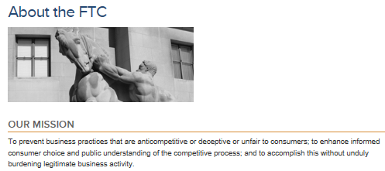
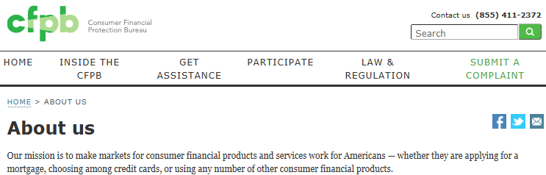

Slide 3
Creation of CFPB
Since 1938, FTC has had consumer protection authority over companies (other than banks) offering consumer financial products and services
In 2010, US Congress passed a law creating the Consumer Financial Protection Bureau
    Consumer protection jurisdiction over any company offering or providing a consumer financial product or service

Slide 4
FTC and CFPB
FTC enforcement authority was not changed
FTC to continue enforcing consumer protection laws
  Fraudulent financial products
  Debt collection
  Payday lending
New law required to agencies to cooperate and coordinate enforcement

Slide 5
FTC-CFPB MOU
Agencies signed and distributed a Memorandum of Understanding (MOU) to create and implement a framework for coordination and cooperation
  Meet regularly to coordinate
  Inform the other agency prior to initiating an investigation or bringing an enforcement action
  Consult on rulemaking and guidance initiatives
  Cooperate on consumer education
  Share consumer complaints

Slide 6
FTC-CFPB Coordination
What does “coordination” mean?
  Ensuring agencies know what each other is doing
  Ensuring consistency in approaches (where practicable and appropriate)
  Avoiding unnecessary duplication of efforts
  Avoiding adverse impact on ongoing investigations
  Avoiding unintended “double-teaming”

Slide 7
Coordination Plan
Senior management-level meetings twice a year
Mid-level management meetings on a quarterly basis
Staff-level working groups meet on a regular basis
Frequent informal communications among staff
Agencies notify each other when opening investigations
Agencies notify each other when filing law enforcement actions
CFPB Supervision notifies FTC when commencing an examination

