Slide 1
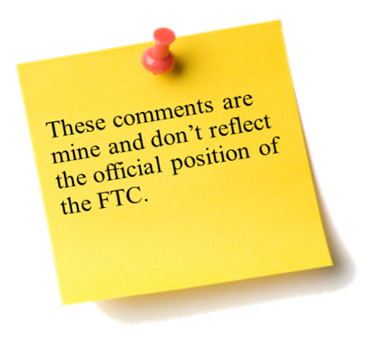



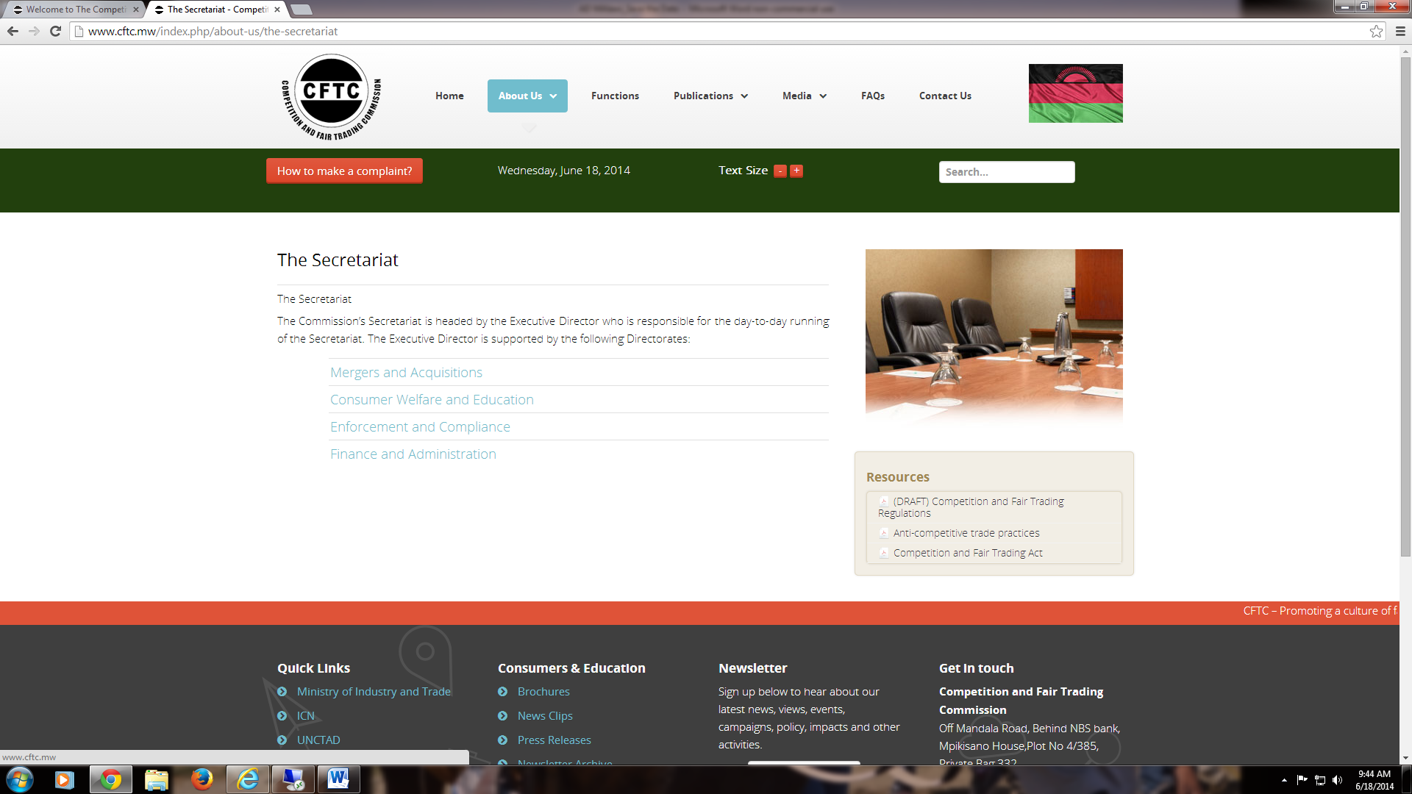
The Sixth Annual African Dialogue
Consumer Protection Conference
Mobile and Cyber Threat Case Studies
Chuck Harwood
U.S. Federal Trade Commission
Lilongwe, Malawi
8-12 September 2014

Slide 2

Cramming: Bogus Charges
Fact Pattern – 1/4
Kamau, a young man in Kenya, uses Africa Cellular, a wireless network provider headquartered in Cameroon. Africa Cellular provides its customers with a summary of their online monthly bill.
Kamau pulls up his monthly bill on his computer, and gasps, “Why is it this expensive?” Kamau wonders to himself, “I don’t think I purchased anything extra last month that would have caused the increase.”
Kamau opens the “monthly charges” tab on the online bill, and sees his charges for minutes and data. The next tab is called “use charges,” which Kamau opens. Under this tab is the category “premium charges,” but the bill provides no explanation as to what the term means. Kamau sees he has been charged 400 shillings for “premium charges.”
Notes:
FTC v. T-Mobile (2014)
Press release: http://www.ftc.gov/news-events/press-releases/2014/07/ftc-alleges-t-mobile-crammed-bogus-charges-customers-phone-bills
Complaint: http://www.ftc.gov/system/files/documents/cases/140701tmobilecmpt.pdf
Final resolution is pending

Slide 3
Cramming: Bogus Charges
Fact Pattern – 2/4
Kamau retrieves his full phone bill—nearly 50 pages in length—to see if he could unearth more information on these “premium charges.” Kamau looks into the “summary” section and the “account service detail section,” which both describe “usage charges,” but does not find itemized information on premium charges.
Finally, Kamau finds the “premium charges” section, and sees this series of digits and letters: “7777815171HrtFnderAfr3000.” It contained no additional information. “What on earth does that mean?” asks Kamau?
Notes:
FTC v. T-Mobile (2014)
Press release: http://www.ftc.gov/news-events/press-releases/2014/07/ftc-alleges-t-mobile-crammed-bogus-charges-customers-phone-bills
Complaint: http://www.ftc.gov/system/files/documents/cases/140701tmobilecmpt.pdf
Final resolution is pending

Slide 4

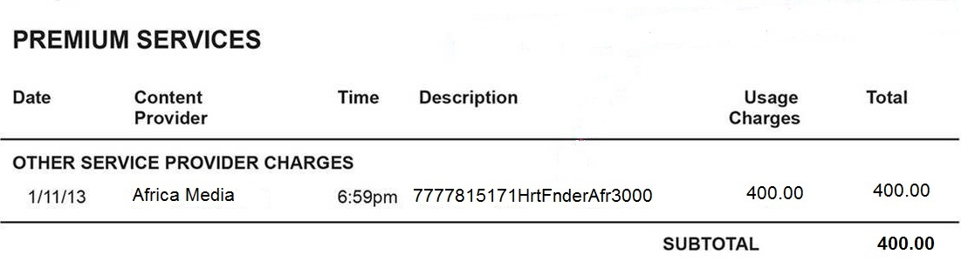
Cramming: Bogus Charges
Exhibit A

Slide 5
Cramming: Bogus Charges
Fact Pattern – 3/4
Kamau contacts Africa Cellular, hoping to discover what the mysterious “premium charges” are.
After considerable wait, Kamau gets an Africa Cellular rep.
“Hello, how can I help you?” asks the rep.
“I discovered a ‘premium charge’ on my phone, and don’t know what it is.” says Kamau.
The rep pulls up his bill and says, “That charge is to a mobile service that provides flirting tips. ‘HrtFnderAfr’ is an abbreviated form of ‘Heart Finder of Africa.’”
Notes:
FTC v. T-Mobile (2014)
Press release: http://www.ftc.gov/news-events/press-releases/2014/07/ftc-alleges-t-mobile-crammed-bogus-charges-customers-phone-bills
Complaint: http://www.ftc.gov/system/files/documents/cases/140701tmobilecmpt.pdf
Final resolution is pending

Slide 6
Cramming: Bogus Charges
Fact Pattern – 4/4
“What?” Kamau says forcefully. “I never authorized that purchase. Number two, I would never need such advice. I demand a refund immediately.”
“Sir, please calm down,” says the rep. “If it’s on your bill, then you authorized it.”
“The hyena cannot smell its own stench!” Shouts Kamau, and he hangs up the phone.
Notes:
FTC v. T-Mobile (2014)
Press release: http://www.ftc.gov/news-events/press-releases/2014/07/ftc-alleges-t-mobile-crammed-bogus-charges-customers-phone-bills
Complaint: http://www.ftc.gov/system/files/documents/cases/140701tmobilecmpt.pdf
Final resolution is pending

Slide 7
Cramming: Bogus Charges
Questions for Discussion
How would your agency investigate a matter like this?
How would you approach the cross-border dimension?
What other agencies would play a role?
Is it important whether your agency has received any consumer complaints?
What factors would are important as your agency considers such a matter?
How would your agency remedy a case like this?

Slide 8
Mobile Security: A Dance Not Erased
Fact Pattern – 1/3
Kolawole, a Nigerian, is a consumer and fan of eConnectAfrica, a mobile app developer based in Ghana. Kolawole has downloaded several of its apps before, such as its popular PinFridge app, which allows users to place pictures on a virtual refrigerator and share with friends.
Kolawole is interested in eConnectAfrica’s latest app, InstaFilm. He pulls it up on his phone, and the description reads as follows:
  Send videos clips that you record on your phone to friends and family with Instafilm. Simply open Instafilm, tap the record button on screen, and capture your video. The videos may be a maximum of fifteen seconds. Before sending the video, designate a period of time that the recipient will be allowed to view the video. After the timer expires, the video will be erased—for all time.
Notes:
FTC v. Snapchat (2014)
Press release and resolution: http://www.ftc.gov/news-events/press-releases/2014/05/snapchat-settles-ftc-charges-promises-disappearing-messages-were
Complaint: http://www.ftc.gov/system/files/documents/cases/140508snapchatcmpt.pdf

Slide 9
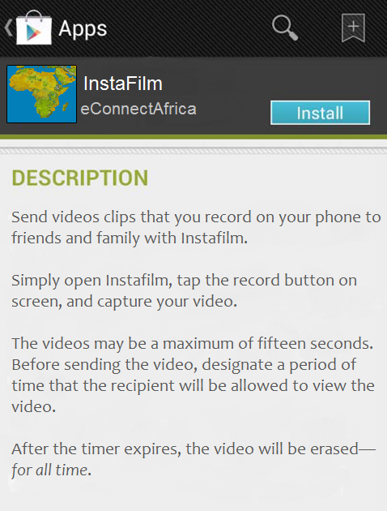
Mobile Security: A Dance Not Erased
Exhibit A

Slide 10
Mobile Security: A Dance Not Erased
Fact Pattern – 2/3
The idea of the video disappearing appeals to Kolawole, as he does not want his personal message floating in cyberspace indefinitely. Kolawole downloads the app.
To kick off his new download, Kolawole decides to do something special: record himself doing the Alanta dance. He is eager to impress, so he puts extra effort into making a trance-like expression, while aggressively moving his legs and hips.
The recipient of his video, Chisom, thinks the video is funny, and wants to share it with her friends. She realizes that the video supposedly vanished after the timer expired, but, being tech savvy, she thinks she can retrieve it. She plugs her cellphone into her laptop via USB, and discovers that the video had been saved outside of InstaFilm’s “sandbox” in an unrestricted area. She opens the video, and then sends it via mass text message to twenty of her friends.
Notes:
FTC v. Snapchat (2014)
Press release and resolution: http://www.ftc.gov/news-events/press-releases/2014/05/snapchat-settles-ftc-charges-promises-disappearing-messages-were
Complaint: http://www.ftc.gov/system/files/documents/cases/140508snapchatcmpt.pdf

Slide 11
Mobile Security: A Dance Not Erased
Fact Pattern – 3/3
  A few weeks later, Kolawole is surfing the Internet, and discovers that videos from Instafilm have been uploaded online. Kolawole is puzzled, as InsaFilm stated the videos would be erased forever.
  Kolawole digs deeper, and sees that his video has been uploaded online.
  Now, Kolawole is quite proud of his rendition of the Alanta dance, but feels deceived and exploited by both InstaFilm and Chisom.
Notes:
FTC v. Snapchat (2014)
Press release and resolution: http://www.ftc.gov/news-events/press-releases/2014/05/snapchat-settles-ftc-charges-promises-disappearing-messages-were
Complaint: http://www.ftc.gov/system/files/documents/cases/140508snapchatcmpt.pdf

Slide 12
Mobile Security: A Dance Not Erased Questions for Discussion
  What factors are important in deciding whether to pursue this case?
  How would you approach the cross-border dimension?
  What other agencies would play a role?
  Was the app deceptive?
  How much responsibility does Chisom bear?
  What type of relief would you seek?
  Would consumer education be effective?

Slide 13
Children and Mobile Security: A Race to the Bank
Fact Pattern – 1/5
Malikah is an adventurous nine-year-old girl, who actively uses her smartphone. She accesses the app store, in search of a new game to download. She stumbles across “Okada Racer: Free Edition,” a game developed by a Benin company.
The game’s description reads as follows:
  Hop on your Okada and race through cities all across Africa, including Lagos, Cairo, and Cape Town. Switch between first person and third person to enhance the racing experience. Use virtual currency to upgrade your Okada. Race against your friends, and leave them in the DUST!
Notes:
FTC v. Apple (2014)
Press release and resolution: http://www.ftc.gov/news-events/press-releases/2014/01/apple-inc-will-provide-full-consumer-refunds-least-325-million
Complaint: http://www.ftc.gov/sites/default/files/documents/cases/140115applecmpt.pdf

Slide 14

Children and Mobile Security: A Race to the Bank
Exhibit A

Slide 15
Children and Mobile Security: A Race to the Bank
Fact Pattern – 2/5
Malikah hits the “download now” button, and a password prompt appears. Because Malikah is not the account holder, she must have a parent’s approval—via the password—before accessing the game.
“Mom, I need the password!” says Malikah.
“For what?” asks her mother.
“A new racing game! It’s free.” replies Malkiah.
“OK,” says her mother, as she plugs in the password. “But don’t play too long—you need to finish your chores.”
Notes:
FTC v. Apple (2014)
Press release and resolution: http://www.ftc.gov/news-events/press-releases/2014/01/apple-inc-will-provide-full-consumer-refunds-least-325-million
Complaint: http://www.ftc.gov/sites/default/files/documents/cases/140115applecmpt.pdf

Slide 16
Children and Mobile Security: A Race to the Bank
Fact Pattern – 3/5
As Malikah begins playing the game, she is given 100 virtual coins to spend on upgrading her Okada. She opens the virtual “bike shop” and a table appears listing the name of the item and how much it costs.
Some items’ costs are listed in the virtual currency, whereas others are listed in real money. The prices—virtual and real—are both listed on bright blue buttons.
Notes:
FTC v. Apple (2014)
Press release and resolution: http://www.ftc.gov/news-events/press-releases/2014/01/apple-inc-will-provide-full-consumer-refunds-least-325-million
Complaint: http://www.ftc.gov/sites/default/files/documents/cases/140115applecmpt.pdf

Slide 17
Children and Mobile Security: A Race to the Bank
Fact Pattern – 4/5
Malikah presses the button for new tires, which costs 50 virtual coins. She then presses the buttons for enhanced shock-absorbers, which cost 20 Moroccan Dirhams, and a more powerful headlight, which costs 10 Moroccan Dirhams.
“Awesome!” says Malkiah. “My friends don’t stand a chance, now.”
Malikah continues buying new items in the following weeks.
Notes:
FTC v. Apple (2014)
Press release and resolution: http://www.ftc.gov/news-events/press-releases/2014/01/apple-inc-will-provide-full-consumer-refunds-least-325-million
Complaint: http://www.ftc.gov/sites/default/files/documents/cases/140115applecmpt.pdf

Slide 18
Children and Mobile Security: A Race to the Bank
Fact Pattern – 5/5
Malkiah’s mother retrieves the mobile bill at the end of the month. “Malikah,” she says, “come here.”
“Yes, mother?” asks Malikah.
“You ran up an extra 200 Dirhams on the bill this month. Did you find out the account password?”
“No, didn’t.”
“If at noon the King declares it night, behold the stars.”
“I swear I didn’t!”
Notes:
FTC v. Apple (2014)
Press release and resolution: http://www.ftc.gov/news-events/press-releases/2014/01/apple-inc-will-provide-full-consumer-refunds-least-325-million
Complaint: http://www.ftc.gov/sites/default/files/documents/cases/140115applecmpt.pdf

Slide 19
Children and Mobile Security: A Race to the Bank
Questions for Discussion
Would your agency investigate this case?
How would you approach the cross-border dimension?
What other agencies would play a role?
Were the parental controls adequate?
Did the app exploit children?
What type of relief would you seek?

Slide 20
Spamming Burns
Fact Pattern – 1/3
Kafele is an avid Shoprite customer. He visits the Shoprite in Malwai, and buys flour, salt, baking powder, sugar, eggs, milk, and oil. He heads home to make one of his favorite snacks: Mandasi.
Once home, Kafele begins mixing the flour, salt, and baking powder in a bowl. He then adds sugar, egg, and milk, and mixes it thoroughly. Kafele drops spoonfuls of his batter into a pan of hot oil.
Notes:
FTC v. CPATank (2014)
Press release and resolution: http://www.ftc.gov/news-events/press-releases/2014/02/another-group-marketers-behind-phony-gift-card-text-spam-settles
Complaint: http://www.ftc.gov/system/files/documents/cases/140228cpatankcmpt.pdf

Slide 21
Spamming Burns
Fact Pattern – 2/3
“Mmm!” Kafele says with an air of self satisfaction.
Moments later, Kafele’s phone vibrates. He opens his phone and sees a new text message. The message reads as follows:
  Dear Shoprite consumer. your purchase last month won a 1000 GH₵ Gift Card, go to www.AfricanTwentyFourSevenShopping.com/redeem within 24 hours to claim.
Kafele thinks to himself that it couldn’t be a coincide that he did in fact shop at Shoprite last month.
Kafele clicks on the link, and it takes him to the website address, which is unaffiliated with Shoprite. The website reiterates that Ali has won the 1000 GH₵ gift card. However, the website also states that Kafele must complete ten offers to qualify for the gift card.
Notes:
FTC v. CPATank (2014)
Press release and resolution: http://www.ftc.gov/news-events/press-releases/2014/02/another-group-marketers-behind-phony-gift-card-text-spam-settles
Complaint: http://www.ftc.gov/system/files/documents/cases/140228cpatankcmpt.pdf

Slide 22
Spamming Burns
Fact Pattern – 3/3
Kafele clicks on the first offer link, and it takes him to a bank website, where he is required to apply for a credit card.
Kafele enters his name, mailing address, email address, date of birth, cell phone number, and home phone number. Kafele will have to incur expenses of his own to complete the ten offers, but that is not disclosed.
Kafele opens the second offer link, and sees he must inset more personal information.
Meanwhile, Kafele sniffs the air. “What’s that smell?” he wonders out loud. He frantically turns around and sees that his Mandasi has been burnt to a crisp!
Notes:
FTC v. CPATank (2014)
Press release and resolution: http://www.ftc.gov/news-events/press-releases/2014/02/another-group-marketers-behind-phony-gift-card-text-spam-settles
Complaint: http://www.ftc.gov/system/files/documents/cases/140228cpatankcmpt.pdf

Slide 23
Spamming Burns
Questions for Discussion
How would your agency approach this case?
What other agencies would play a role?
If you decided to pursue this case, what would your agency have to establish?
Is it important that your agency received consumer complaints?
What relief would you seek?
Lerato is a South African mother who recently gave birth to a baby boy.
She is quite protective, and wants to find a way to more closely supervise her child.
Lerato pulls up the Internet to do some research. She stumbles across a U.S. company called EAGLEnet, which sells cameras for monitoring one’s home.
Notes:
FTC v. CPATank (2014)
Press release and resolution: http://www.ftc.gov/news-events/press-releases/2014/02/another-group-marketers-behind-phony-gift-card-text-spam-settles
Complaint: http://www.ftc.gov/system/files/documents/cases/140228cpatankcmpt.pdf

Slide 24
Data Security: Who’s Watching the Baby?
Fact Pattern – 1/4
Lerato is a South African mother who recently gave birth to a baby boy.
She is quite protective, and wants to find a way to more closely supervise her child.
Lerato pulls up the Internet to do some research. She stumbles across a U.S. company called EAGLEnet, which sells cameras for monitoring one’s home.
While in another room of the home, Lerato logs into her account on her computer and pulls up the live stream of her baby.
She seems him sleeping in his crib.
Lerato is proud of what a conscious mother she is.
Notes:
FTC v. Trendnet (2013)
Press release: http://www.ftc.gov/enforcement/cases-proceedings/122-3090/trendnet-inc-matter
Complaint: http://www.ftc.gov/system/files/documents/cases/140207trendnetcmpt.pdf
Resolution: http://www.ftc.gov/news-events/press-releases/2014/02/ftc-approves-final-order-settling-charges-against-trendnet-inc

Slide 25
Data Security: Who’s Watching the Baby?
Fact Pattern – 2/4
She reads more, and finds this information from the description:
  With EAGLEnet’s SecureStream cameras, you can monitor loved ones 24/7. Our cameras are particularly well-suited for keeping a close eye on newborns, infants, and young children.
Lerato purchases the camera, and installs it a few days later.
As part of the SecureStream package, Lerato is able to view the stream from her mobile phone or laptop—anywhere she can access the Internet.
Lerato sets up a login password, and activates the live stream on her laptop.
Notes:
FTC v. Trendnet (2013)
Press release: http://www.ftc.gov/enforcement/cases-proceedings/122-3090/trendnet-inc-matter
Complaint: http://www.ftc.gov/system/files/documents/cases/140207trendnetcmpt.pdf
Resolution: http://www.ftc.gov/news-events/press-releases/2014/02/ftc-approves-final-order-settling-charges-against-trendnet-inc

Slide 26
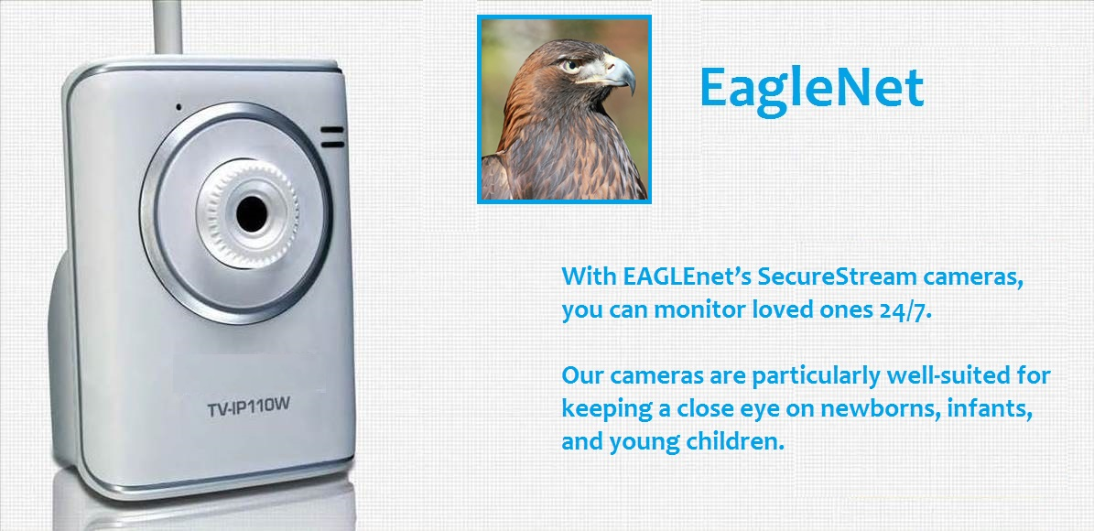
Data Security: Who’s Watching the Baby?
Exhibit A

Slide 27
Data Security: Who’s Watching the Baby?
Fact Pattern – 3/4
While in another room of the home, Lerato logs into her account on her computer and pulls up the live stream of her baby.
She seems him sleeping in his crib.
Lerato is proud of what a conscious mother she is.
Notes:
FTC v. Trendnet (2013)
Press release: http://www.ftc.gov/enforcement/cases-proceedings/122-3090/trendnet-inc-matter
Complaint: http://www.ftc.gov/system/files/documents/cases/140207trendnetcmpt.pdf
Resolution: http://www.ftc.gov/news-events/press-releases/2014/02/ftc-approves-final-order-settling-charges-against-trendnet-inc

Slide 28
Data Security: Who’s Watching the Baby?
Fact Pattern – 4/4
A few weeks later, Lerato gets a call from her friend Kagiso.
“Hey, Lerato,” says Kagiso. “Did you hear the news on those private video cameras?’
“What news?”
“The streams were hacked and leaked online.”
“Oh, no!” Lerato gasps. “I installed such a system shortly ago.”
Lerato looks further into the issue, and discovers that EAGLEnet transmitted users’ login information through unsecure channels, and failed to monitor the security of the software.
Notes:
FTC v. Trendnet (2013)
Press release: http://www.ftc.gov/enforcement/cases-proceedings/122-3090/trendnet-inc-matter
Complaint: http://www.ftc.gov/system/files/documents/cases/140207trendnetcmpt.pdf
Resolution: http://www.ftc.gov/news-events/press-releases/2014/02/ftc-approves-final-order-settling-charges-against-trendnet-inc

Slide 29
Data Security: Who’s Watching the Baby?
Questions for Discussion?
How would your agency approach this case?
How would you approach the cross-border dimension?
What other agencies would play a role?
If you decided to pursue this case, what would your agency have to establish?
Is it important that your agency received consumer complaints?
What relief would you seek?

Slide 30

FTC v. T-Mobile
FTC charged T-Mobile with including crammed charges on consumers’ bills and then profiting from the unauthorized charges.
FTC also alleges that the charges are buried in consumer’s bills so that it was hard to find them.
Notes:
FTC v. T-Mobile (2014)
Press release: http://www.ftc.gov/news-events/press-releases/2014/07/ftc-alleges-t-mobile-crammed-bogus-charges-customers-phone-bills
Complaint: http://www.ftc.gov/system/files/documents/cases/140701tmobilecmpt.pdf
Final resolution is pending
Facts:
T-Mobile knowingly crammed unauthorized charges onto consumers’ bills.
FTC profited from these charges.
An example of a charge is a subscription for flirting tips.
The charges were buried deep in the bill under the title “premium charges.”
A description of the premium charge was not given on the bill; rather, a series of numbers and letters would appear.
T-Mobile continued to allow these charges even after receiving consumer complaints.
Resolution pending

Slide 31
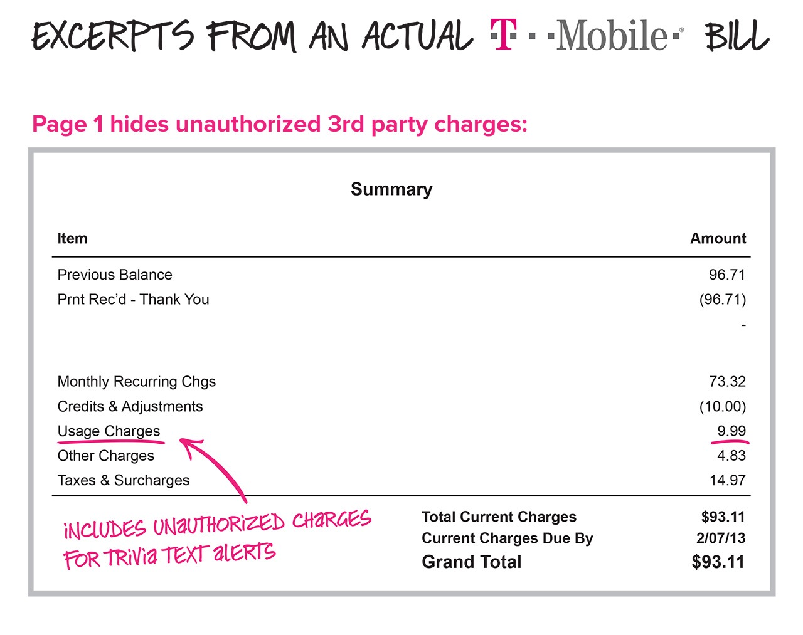
FTC v. T-Mobile

Slide 32
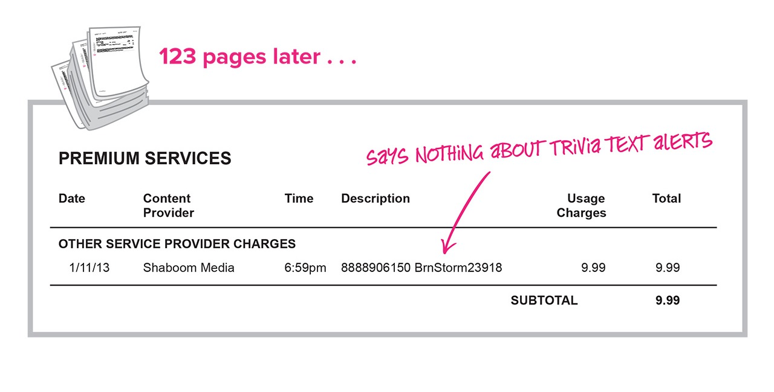
FTC v. T-Mobile

Slide 33

FTC v. Snapchat
FTC alleged that Snapchat’s assurance that after sending a photo and video, and after the timer expired, the pictures and videos would “disappear forever” was deceptive
Notes:
FTC v. Snapchat (2014)
Press release and resolution: http://www.ftc.gov/news-events/press-releases/2014/05/snapchat-settles-ftc-charges-promises-disappearing-messages-were
Complaint: http://www.ftc.gov/system/files/documents/cases/140508snapchatcmpt.pdf
Facts:
Before sending a photo or video, the application requires the sender to designate a period of time that the recipient will be allowed to view the photo or video.
Snapchat told consumers that, after the timer expired (a maximum of ten seconds, the pictures and videos they sent would “disappear forever.”
This was untrue: for example, when a recipient received a video message, the application stored the video file outside of the application’s “sandbox” (i.e., the application’s private storage area on the device that other applications cannot access)
As a result, a recipient could connect his or her mobile device to a computer and use simple file browsing tools to locate and save the video file.
Proposed settlement:
Prevents Snapchat from misrepresenting the extent to which it maintains the privacy, security, or confidentiality of users’ information, and requires it to implement a comprehensive privacy program that will be monitored by an independent privacy professional for the next 20 years
Resolution pending

Slide 34
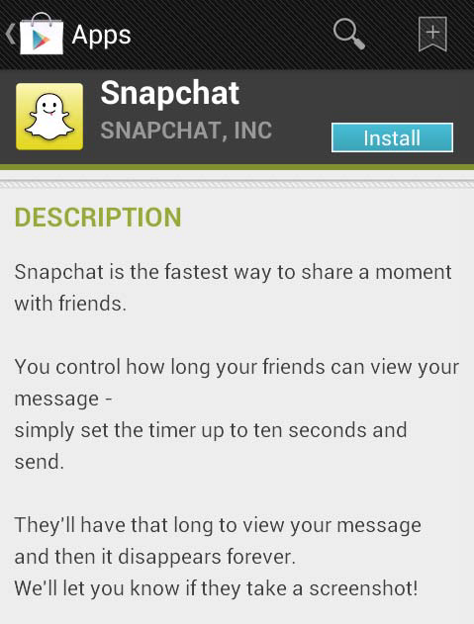
FTC v. Snapchat

Slide 35

FTC v. Apple
FTC charged Apple with charging consumers for in-app purchases made by their children without parental consent. By entering in their password, parents were not only approving a single in-app purchase, but also allowing their children 15 minutes of unlimited purchases without having to enter their password again.
Apple settled and agreed to rework the payment framework so that express consent was required before payment was received.
Notes:
FTC v. Apple (2014)
Press release and resolution: http://www.ftc.gov/news-events/press-releases/2014/01/apple-inc-will-provide-full-consumer-refunds-least-325-million
Complaint: http://www.ftc.gov/sites/default/files/documents/cases/140115applecmpt.pdf
Facts:
Apple failed to tell parents that by entering a password they were not just approving a single in-app purchase; rather, they were approving 15 minutes of additional unlimited purchases their children could make without further action by the parent.
Many of these charges are for virtual items or currency used in playing a game.
These charges generally range from 99 cents to $99.99 per in-app charge.
Resolution requires the following:
Apple to modify its billing practices to ensure that Apple obtains consumers’ express, informed consent prior to billing them for in-app charges, and that if the company gets consumers’ consent for future charges, consumers must have the option to withdraw their consent at any time.
To provide full refunds, totaling a minimum of $32.5 million, to consumers who were billed for in-app charges that were incurred by children and were either accidental or not authorized by the consumer.
Apple must make these refunds promptly, upon request from an account holder.
Apple is required to give notice of the availability of refunds to all consumers charged for in-app charges with instructions on how to obtain a refund for unauthorized purchases by kids.
Should Apple issue less than $32.5 million in refunds to consumers within the 12 months after the settlement becomes final, the company must remit the balance to the Commission.

Slide 36
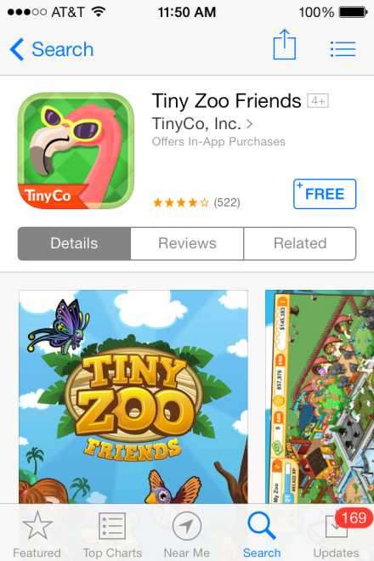
FTC v. Apple

Slide 37
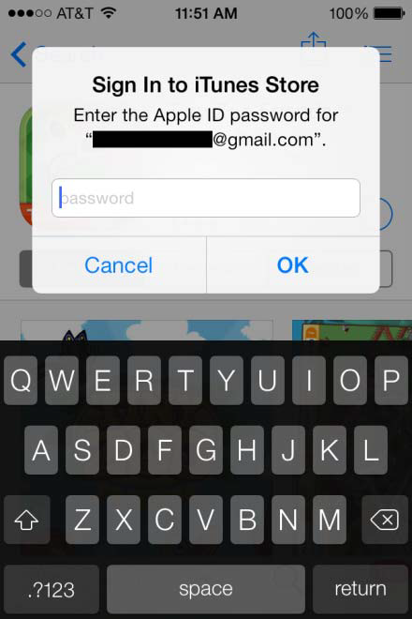
FTC v. Apple

Slide 38
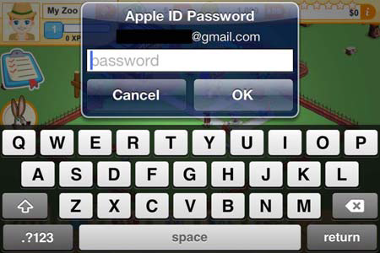
FTC v. Apple

Slide 39

FTC v. TRENDnet
FTC charged TRENDnet with implementing lax security practices, which exposed the private lives of hundreds of consumers to public viewing on the Internet.
This was the agency’s first action against a marketer of an everyday product with interconnectivity to the Internet and other mobile devices – commonly referred to as the “Internet of Things.”
TRENDnet settled and was required to implement a comprehensive information security, notify consumers of security problems and provide free technical support, among other measures.
Notes:
FTC v. Trendnet (2013)
Press release : http://www.ftc.gov/news-events/press-releases/2013/09/marketer-internet-connected-home-security-video-cameras-settles
Complaint: http://www.ftc.gov/system/files/documents/cases/140228cpatankcmpt.pdf
Resolution: http://www.ftc.gov/news-events/press-releases/2014/02/ftc-approves-final-order-settling-charges-against-trendnet-inc
Facts:
A company marketed video cameras designed to allow consumers to monitor their homes remotely.
This was the agency’s first action against a marketer of an everyday product with interconnectivity to the Internet and other mobile devices – commonly referred to as the “Internet of Things.”
TRENDnet marketed its SecurView cameras for purposes ranging from home security to baby monitoring, and claimed in numerous product descriptions that they were “secure.”
In fact, the cameras had faulty software that left them open to online viewing, and in some instances listening, by anyone with the cameras’ Internet address.
Resolution:
TRENDnet is prohibited from misrepresenting the security of its cameras or the security, privacy, confidentiality, or integrity of the information that its cameras or other devices transmit.
The company is barred from misrepresenting the extent to which a consumer can control the security of information the cameras or other devices store, capture, access, or transmit.
TRENDnet is required to establish a comprehensive information security program designed to address security risks that could result in unauthorized access to or use of the company’s devices, and to protect the security, confidentiality, and integrity of information that is stored, captured, accessed, or transmitted by its devices.
The company is required to obtain third-party assessments of its security programs every two years for the next 20 years.
TRENDnet must notify customers about the security issues with the cameras and the availability of the software update to correct them, and to provide customers with free technical support for the next two years to assist them in updating or uninstalling their cameras.

Slide 40
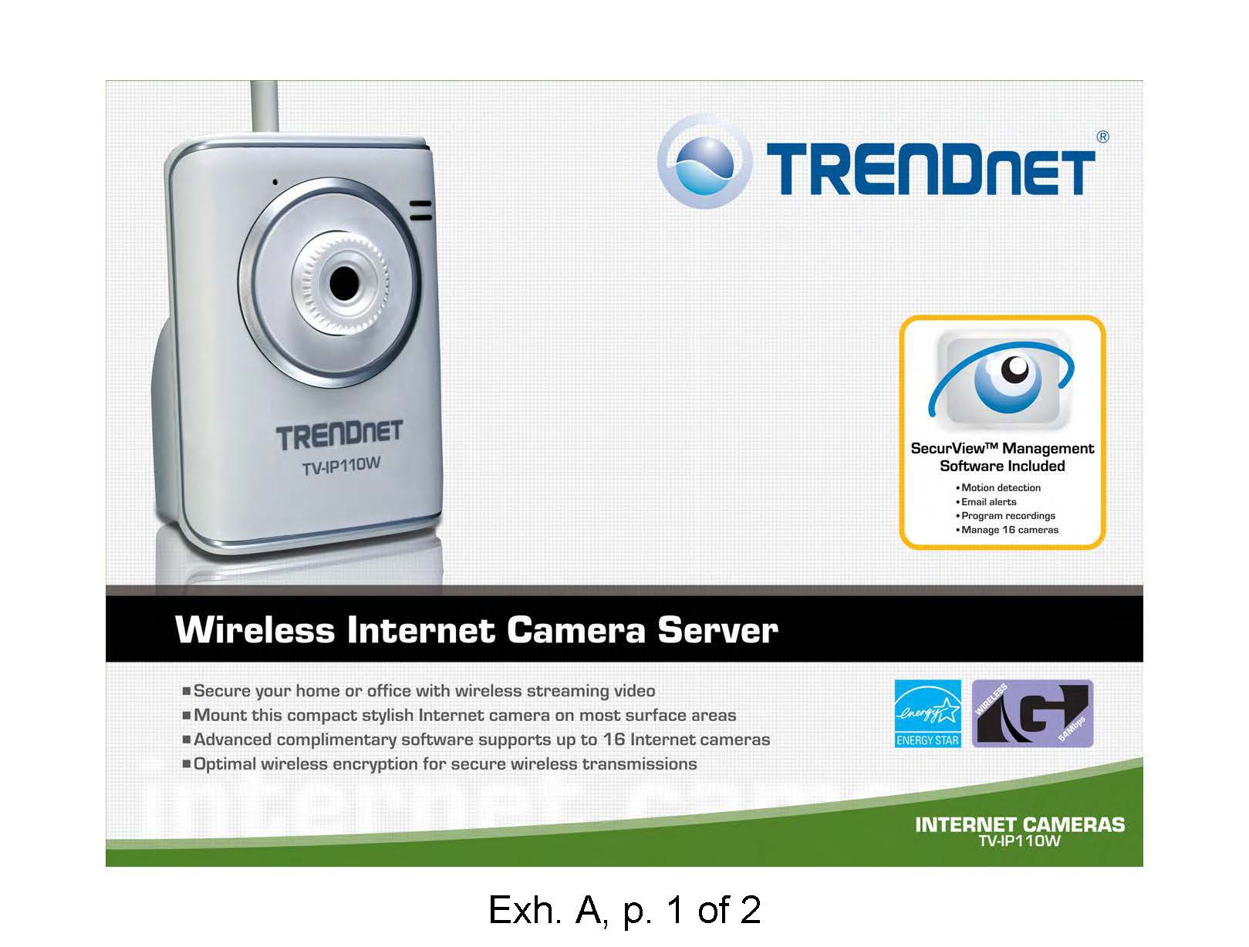

Slide 41
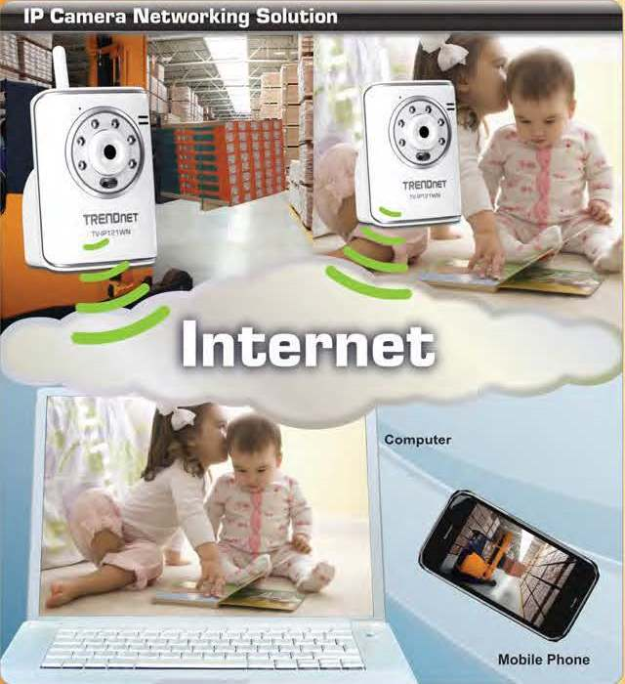

Slide 42
FTC v. CPA Tank
FTC alleged a group of marketers took part in scheme that bombarded consumers with tens of millions of spam text messages that lured consumers with phony gift card offers, and then directed recipients to deceptive websites
The deceptive websites requested personal information and asked consumers to sign up for additional offers, which often involved paid subscriptions
The settlement required the marketers from making misrepresentations that producers or services are free, among other things
Notes:
FTC v. CPA Tank (2014)
Press release and resolution: http://www.ftc.gov/news-events/press-releases/2014/02/another-group-marketers-behind-phony-gift-card-text-spam-settles
Complaint: http://www.ftc.gov/system/files/documents/cases/140228cpatankcmpt.pdf
Facts:
CPA and Eagle paid affiliates to send out the spam text messages promoting supposedly “free” merchandise, such as $1,000 gift cards for Wal-Mart and Best Buy.
People who clicked on the links in the text message did not receive the promised items.
Instead, they were taken to websites that requested they provide personal information and sign up for numerous additional offers – often involving other purchases or paid subscriptions.
Resolution:
Prohibits them from making misrepresentations in marketing any good or service, including misrepresentations that a product or service is "free" or without cost or obligation.’
Requires defendants, if they offer products or services in the future, to disclose all material terms and conditions of such offers, and prohibits them from making, or initiating the transmission of, unauthorized or unsolicited commercial electronic text messages to mobile telephones or other wireless devices.
The settlement imposes a $200,000 judgment against the defendants, most of which is suspended, due to their inability to pay.
It requires them to turn over $30,000 in cash plus the proceeds from the sale of Glazers’ 2007 Bentley automobile and Eagle’s 2006 Range Rover.

Slide 43
Thank you!

