Slide 1
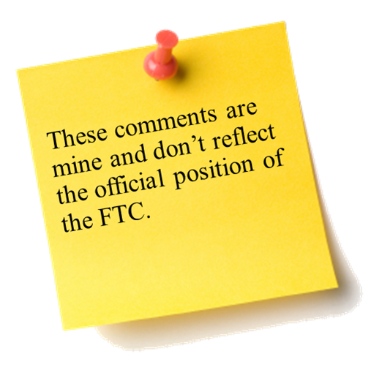



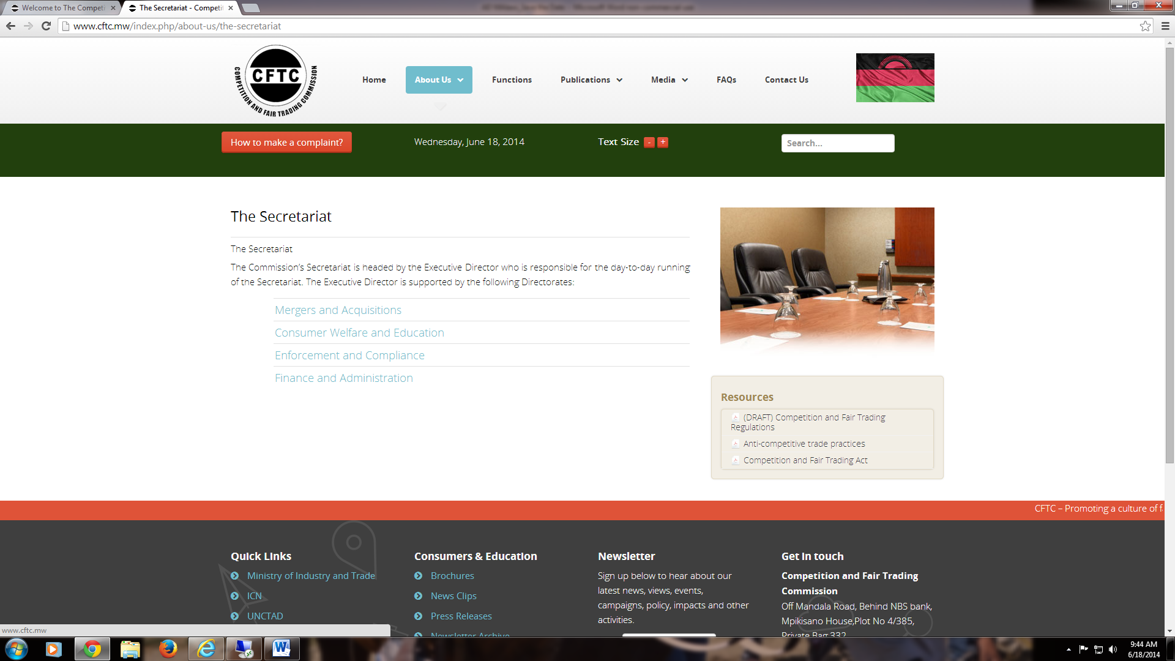
The Sixth Annual African Dialogue
Consumer Protection Conference
Investigation Planning: Case Studies
Lilongwe, Malawi
8-12 September 2014

Slide 2



How do we bring this case?
Case Study 1 - [[CoolTunes]]
Case Study 2 – eConnectAfrica / InstaFilm

Slide 3


Planning Documents – Be Specific and Keep Updated!
  Investigative Plan
  Proof Chart

Slide 4
General Case Planning
Legal Considerations:
  Determine potential causes of action / law violations and divide each one into its necessary elements
  Analyze business practices at issue and how they may violate the law
  Consider possible arguments and defenses, and how you will respond
  Assess potential remedies to address consumer injury at issue
Evidentiary Questions:
  What evidence exists and how does it relate to your case?
  How will you obtain it?
  How much you need?

Slide 5
Case Determinations –
Legal Framework
  Jurisdiction: Can you bring the case? If so, where? Do you need to contact other authorities? Are there international considerations?
  Legal: Questions / unclear areas of law that will require research?
  Economic issue: Economist on staff or on the case team?

Slide 6
Case Determinations –
Evidentiary Requirements
  Background information: Can you obtain copies of websites, advertisements, corporate registrations, etc?
  Consumers: Do you have / need complaints? Can you obtain consumer testimony and documents?
  Third parties: Do third parties - such vendors or banks – have information? Can / should you contact them? How?
  Defendants: Is there evidence only (potential) defendants themselves would have? Can / should you contact them?
  Expert witnesses: Would an expert opinion or survey provide relevant evidence? Can you hire an expert ?

Slide 7
Case Determinations –
How to Proceed
Should you close the investigation or continue with the case?
Can /should you contact the company for information?
Should you enter into settlement negotiations?
Do you file a complaint? Should you file an ex parte / emergency complaint to preserve assets and evidence?
Should you partner with other law enforcement agencies?
Could there be a role for consumer or business education?

Slide 8
Confidentiality Considerations
During the investigation, you may obtain potentially privileged, confidential or personal information. Consider:
  Do you need this information?
  How will you maintain confidentiality?
  How will you keep the information secure?
  How and when will the information be used?
  Do you need to notify the provider if you use the information? If so, how and when will you do this?

Slide 9
Case Administration
Resources: What resources will you need? How will you obtain them?
Action Items: Which team member should be in charge of which task? How will team keep track of work and completion dates?
Timing: Do you have external deadlines? What deadlines should you set internally?
Approvals: What approvals within your agency do you need? How and when will you obtain them?

Slide 10

Case Study 1 - [[CoolTunes]]

Slide 11

Music to His Ears, Music to Their Wallets
Facts 1/2
Mosegi, a park ranger from Botswana, received an e-mail from his good friend, Baruti, about a new website that he said was really awesome.
The Kenyan website, [[CoolTunes]] had two main features: a streaming service containing a large selection of music and a premium service access to a synthesizer where someone could compose their own music.
The premium service also gave users access to a personal website where he could publish his music and sell it to others.

Slide 12
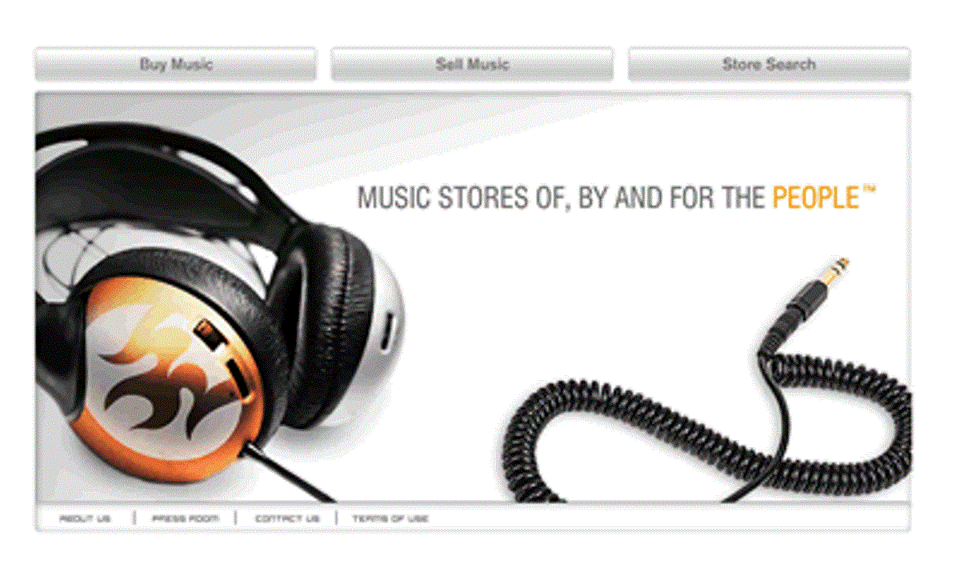
Music to His Ears, Music to Their Wallets
Exhibit A

Slide 13
Negative Options
Facts 2/2
Mosegi signed up for a free seven-day trial for the premium version. When Mosegi signed up for the trial, the website asked him for his debit card information “as a means of identifying him.” When trying out the website, he found that a lot of his favorite music wasn’t available for streaming (most of it had labels such as “COMING SOON”). He tried out the synthesizer, but a lot of instruments he wanted to use were missing. Composing songs also took a lot more time and effort than he had thought, and the price was very steep for a monthly package. Mosegi therefore decided against buying anything.
Buried in the terms and conditions was a sentence saying that users of the trial would automatically be charged for a month’s service once the seven days were over if they did not call a number to cancel the service. The trial period ended just before Mosegi’s payday at his job, so there was not enough left in his account for the charge. When Mosegi went to the bank the next day to cash in his paycheck, he noticed the large overdraft charge on the account in addition to the large payment to the music site.
Notes:
FTC v. LeanSpa, LLC
Press Release: http://www.ftc.gov/news-events/press-releases/2014/01/sensa-three-other-marketers-fad-weight-loss-products-settle-ftc
Complaint: http://www.ftc.gov/sites/default/files/documents/cases/2011/12/111201leanspacmpt.pdf
Stipulated Settlement

Slide 14
Negative Options
Questions for Discussion
Does the fact that Mosegi used a debit card instead of a credit card or mobile payment system matter to the way you would handle the case?
How would you go about investigating a case like this?
How would you approach the fact that the company here is based in another country?
What factors would be important as your agency considers whether it will pursue this matter?
Does your country require that consumers affirmatively agree to a service before they can be charged for something like this?
If you decided to pursue this matter, what would your agency have to establish?
Is there any other agencies that may have a role, including NPO’s and self-regulatory industry body?
What type of relief would you seek in this matter?
What type of consumer or business education, if any, do you think would be effective?

Slide 15


Case Study 2 - InstaFilm

Slide 16
Mobile Security: A Dance Not Erased
Fact Pattern – 1/3
Kolawole, a Nigerian, is a consumer and fan of eConnectAfrica, a mobile app developer based in Ghana. Kolawole has downloaded several of its apps before, such as its popular PinFridge app, which allows users to place pictures on a virtual refrigerator and share with friends.
Kolawole is interested in eConnectAfrica’s latest app, InstaFilm. He pulls it up on his phone, and the description reads as follows:
  Send videos clips that you record on your phone to friends and family with Instafilm. Simply open Instafilm, tap the record button on screen, and capture your video. The videos may be a maximum of fifteen seconds. Before sending the video, designate a period of time that the recipient will be allowed to view the video. After the timer expires, the video will be erased—for all time.
Notes:
FTC v. Snapchat (2014)
Press release and resolution: http://www.ftc.gov/news-events/press-releases/2014/05/snapchat-settles-ftc-charges-promises-disappearing-messages-were
Complaint: http://www.ftc.gov/system/files/documents/cases/140508snapchatcmpt.pdf

Slide 17
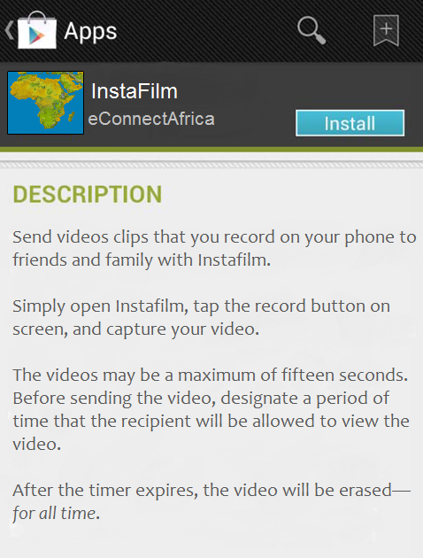
Mobile Security: A Dance Not Erased
Exhibit A

Slide 18
Mobile Security: A Dance Not Erased
Fact Pattern – 2/3
The idea of the video disappearing appeals to Kolawole, as he does not want his personal message floating in cyberspace indefinitely. Kolawole downloads the app.
To kick off his new download, Kolawole decides to do something special: record himself doing the Alanta dance. He is eager to impress, so he puts extra effort into making a trance-like expression, while aggressively moving his legs and hips.
The recipient of his video, Chisom, thinks the video is funny, and wants to share it with her friends. She realizes that the video supposedly vanished after the timer expired, but, being tech savvy, she thinks she can retrieve it. She plugs her cellphone into her laptop via USB, and discovers that the video had been saved outside of InstaFilm’s “sandbox” in an unrestricted area. She opens the video, and then sends it via mass text message to twenty of her friends.
Notes:
FTC v. Snapchat (2014)
Press release and resolution: http://www.ftc.gov/news-events/press-releases/2014/05/snapchat-settles-ftc-charges-promises-disappearing-messages-were
Complaint: http://www.ftc.gov/system/files/documents/cases/140508snapchatcmpt.pdf

Slide 19
Mobile Security: A Dance Not Erased
Fact Pattern – 3/3
  A few weeks later, Kolawole is surfing the Internet, and discovers that videos from Instafilm have been uploaded online. Kolawole is puzzled, as InsaFilm stated the videos would be erased forever.
  Kolawole digs deeper, and sees that his video has been uploaded online.
  Now, Kolawole is quite proud of his rendition of the Alanta dance, but feels deceived and exploited by both InstaFilm and Chisom.
Notes:
FTC v. Snapchat (2014)
Press release and resolution: http://www.ftc.gov/news-events/press-releases/2014/05/snapchat-settles-ftc-charges-promises-disappearing-messages-were
Complaint: http://www.ftc.gov/system/files/documents/cases/140508snapchatcmpt.pdf

Slide 20
Mobile Security: A Dance Not Erased Questions for Discussion
  What factors are important in deciding whether to pursue this case?
  How would you approach the cross-border dimension?
  What other agencies would play a role?
  Was the app deceptive?
  How much responsibility does Chisom bear?
  What type of relief would you seek?
  Would consumer education be effective?

