Slide 1
Pay-for-Performance: The Next Generation of Program Designs
R. Adams Dudley, MD, MBA
Director, UCSF Center for Healthcare Value
Assoc. Dir. for Research, Philip R. Lee Institute for Health Policy Studies
University of California, San Francisco
adams.dudley@ucsf.edu
Follow on Twitter: @RAdamsDudleyMD
Support: AHRQ, California Health Care Foundation, California Department of Insurance, Robert Wood Johnson Foundation, Robin Hood Foundation
No financial relationships to disclose.

Slide 2
Outline
Pay-for-performance: Not knocking our socks off
But it works
Next generation ideas
Linking PFP to other novel payment approaches

Slide 3
Summary of the P4P Literature (So Far)
Mainly positive results, but small effects
Some mistakes we’ve made in design:
  Setting up tournaments (e.g., top 10% get a bonus)
    Disadvantages: lower performers at baseline don’t try, middle performers have uncertainty about whether there is a good ROI
  Pay on percent performance
    Disadvantages: encourages avoidance of difficult patients
  Choose unimportant aspects of care to measure
    Reasons for unimportance: topped out, minor clinical process

Slide 4



Pay-for-Performance in High-Medicaid Practices: Implications from a Cluster-Randomized Trial in New York City
Bardach, NS, Wang, JJ, De Leon, SF, Shih, SC, Boscarin, WJ, Goldman, LE, Dudley, RA. Effect of Pay-for-Performance Incentives on Quality of Care in Small Practices with Electronic Health Records: A Randomized Trial. JAMA, 2013 Sep 11;310(10):1051-9
Notes:
Points to make re: the incentive design: addresses the issue of benchmarks by taking a piece-rate approach (an incentive that pays for every success, which is how we want to motivate providers to act), uses a graduated incentive structure that pays more for doing what is hard, addresses the issues of building infrastructure, and focused on outcomes.

Slide 5
Study Design
A cluster-randomized, controlled trial of incentives
  Clustered at the clinic level for randomization
  Incentives also paid at the clinic level
P4P incentive design BASED ON PHYSICIAN FEEDBACK
Notes:
Cluster randomized to avoid contamination; Paid at the clinic level to incentivize practice-level investments. Doing more for what is hard can include spending more time one on one with the patient, and also investing in clinic-level registries, additional care coordinator or care manager time to call in patients for BP checks, nutritional counseling and diabetes management.
Consider mentioning the pragmatic design.

Slide 6
Population
84 small (1-2 providers) practices in New York City with a high % of Medicaid patients
All practices were participants in Primary Care Improvement Project (PCIP)
  Electronic Health Record (EHR) with clinical decision support reminders for measures
  Ongoing quality improvement site visits available (not required)
Notes:
84 small provider practices in NYC, with 40-50% Medicaid patients by self report, so these are the practices supposedly least likely to be able to succeed.
PCIP is a City state and federally funded project in NYC that was implemented prior to the start of the study. It put an EHR in every clinic in the study, using the same software in each clinic, with clinical decision support reminders for the study measures as well as for a much broader set of quality measures.
The EHR was the source of the data for the project.
PCIP also provided periodic visits from a quality improvement specialist to support improved documentation of measures and use of patient registries to improve care. These interventions were in place at both the control and the intervention arm clinics.

Slide 7
Incentive Structure: Pay More for What Is Harder
 | Base Payment | Payment for High-Risk Patients |  |  | Total Possible Payment per Patient
 | Insurance: Commercial Co-morbidity: No IVD or DM | Qualifying Insurance: Uninsured Medicaid | Qualifying Co-Morbidities: IVD or DM | Combination of qualifying insurance and co-morbidity: Uninsured/Medicaid and IVD/DM
Aspirin | - | - | $20 | $20 | $20
BP Control | $20 | $40 | $40 | $80 | $80
Smoking Cessation | $20 | $20 | $20 | $20 | $20
Maximums: $200 per patient. $100,000 per practice
IVD: Ischemic Vascular Disease; DM: Diabetes Mellitus
Notes:
This illustrates what we mean by “graduated” incentives. It is the same graphic that was distributed to incentive group practices after assignments were made.

Slide 8
Research questions
What is the effect of a pay-for-performance program in small, Medicaid-focused practices on cardiovascular outcomes and processes when the program has the following features?:
  Pay for each patient where the outcome is achieved (not a percent of patients, not a tournament)
  Pay more for what is harder—achieving the outcome in patients who are harder for clinical or socioeconomic reasons
How will providers feel about the program?
Notes:
Points to make re: the incentive design: addresses the issue of benchmarks by taking a piece-rate approach (an incentive that pays for every success, which is how we want to motivate providers to act), uses a graduated incentive structure that pays more for doing what is hard, addresses the issues of building infrastructure, and focused on outcomes.

Slide 9
Quality measures
Antithrombotic Rx
Blood pressure control(“BP”)
Smoking Cessation Intervention
Antithrombotic prescribed
Patients with Diabetes or IVD*
A
BP controlled (<140/90 or <130/80)
Patients with hypertension
B
S
Intervention delivered
Patients who smoke
*IVD: Ischemic Vascular Disease; TC: Total Cholesterol; LDL: Low Density Lipoprotein
Notes:
These are a selection of measures that were the focus of the incentives project. There was neither time nor space to include all 7, but the patterns in the others were similar.

Slide 10
Analysis
Difference-in-differences approach to quantify the effect size in each cohort
  Compares the difference in performance change over time between intervention and control clinics

Slide 11
Baseline Characteristics of Intervention and Control Clinics
Clinic Characteristics | Incentive | Control | P value
Clinicians, median (IQR) | 1 (1-2) | 1 (1-2) | 0.77
Patients, median (IQR) | 2500 (1200-4607) | 2000 (1100-3500) | 0.45
Time since EHR implementation, mo | 9.93 (4.47) | 9.57 (4.44) | 0.81
QI specialist visits | 5.17 (3.43) | 4.24 (2.73) | 0.25
Insurance, %
Commercial | 33.8 (23.9) | 32.1 (21.6) | 0.89
Medicare | 25.6 (22.0) | 26.8 (17.6) | 0.32
Medicaid | 35.3 (28.3) | 35.7 (24.8) | 0.88
Uninsured | 4.3 (4.8) | 4.7 (4.9) | 0.60
Notes:
Other comparison metrics not shown: patient characteristics, provider characteristics, and survey items regarding attitudes towards and prior experience with P4P and quality measurement and reporting. Few significant differences between groups noted in any of these metrics.

Slide 12
Results: Baseline Performance
Measure | Control (%) | Incentive (%) | P value
Aspirin therapy, CAD or DM | 54.4 | 52.6
BP control, no comorbidities | 31.8 | 52.1 | <0.05
Blood pressure control, CAD | 46.0 | 68.4
BP control, DM | 10.4 | 16.8 | <0.05
Cholesterol control, non-comorbid | 89.7 | 88.2
Smoking cessation intervention | 19.1 | 17.1
Year 1
Notes:
Performance was high in cholesterol control (so we somehow managed to pick a topped out measure!). There were differences in baseline performacnce. Sensitivity analyses showed that this was ok.

Slide 13
Results: Baseline Performance
Measure | Control (%) | Incentive (%) | P value
Aspirin therapy, CAD or DM | 54.4 | 52.6
BP control, no comorbidities | 31.8 | 52.1 | <0.05
Blood pressure control, CAD | 46.0 | 68.4
BP control, DM | 10.4 | 16.8 | <0.05
Cholesterol control, non-comorbid | 89.7 | 88.2
Smoking cessation intervention | 19.1 | 17.1
Year 1
Notes:
Performance was low in DM

Slide 14
Performance of Incentive Arm Compared to Control Arm
Measure | Absolute difference in performance improvement between groups over study period (%) | P-value
Aspirin therapy, CAD or DM | 6.0 | 0.001
BP control, no comorbidities | 5.5 | 0.01
Blood pressure control, CAD | -9.1 | 0.23
BP control, DM | 7.8 | 0.007
Cholesterol control, non-comorbid | -1.2 | 0.22
Smoking cessation intervention | 4.7 | 0.02
Year 1
Notes:
I highlighted the measures that showed statistically significant differences in improvement between the two groups.

Slide 15
Providers Attitudes about the Quality Measures and the P4P Program
Begum, R, Smith Ryan, M, Winther, CH, Wang, JJ, Bardach, NS, Parsons, AH, Shih, SC, Dudley, RA. Small Practices’ Experience with EHR, Quality Measurement, and Incentives. American Journal of Managed Care, 2013 Nov;19(10 Spec No):eSP12-8

Slide 16
Clinician Experiences and Attitudes towards QI
N=104 (74% response rate)
Had a visit with QI staff (p=0.01)
  Incentive 67.9%
  Control 42.9%
Future intention to generate QI reports (p=0.09)
  Incentive 86.5%
  Control 71.7%
Future intention to track clinic progress on ABCS (p=0.07)
  Incentive 90.6%
  Control 78.3%
Notes:
Very high response rate=engagement with the program

Slide 17
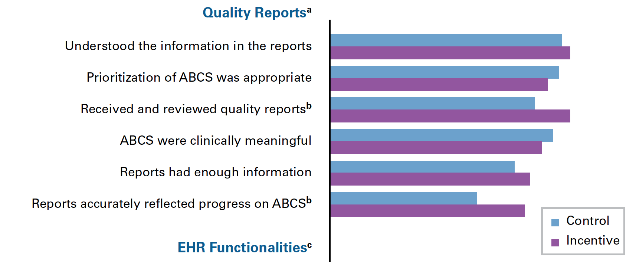
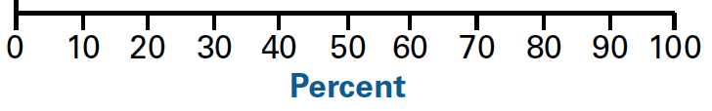
Notes:
Everyone agreed that the information was understandable, and that the metrics were important.
For incentive clinicians: More signal
More buy-in on the reports

Slide 18
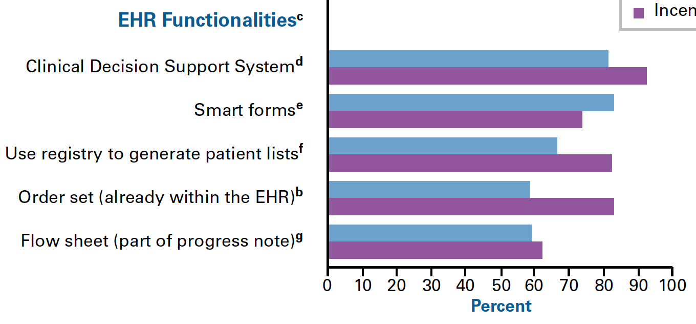
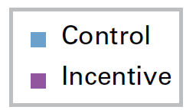
Notes:
The only statistically significant difference between control and incentive groups for questions on EHR functionalities was is in their comfort using Order sets, with there being a more than 20 percentage point difference in proportion of incentive clinicials who were comfortable compared to control clinicians.

Slide 19
Future of P4P
Pay more for what’s harder
Pay for each patient (not %s or tournaments)
Avoid topped out measures
P4P probably more acceptable when introduced in a context where support for improvement is also available
Advice to clinics: invest in using QI tools—decision support, registries

