Slide 1
Consumer Decisions on Health Insurance Exchanges
Keith Marzilli Ericson
February 24, 2015
Boston University and NBER
www.practicingeconomist.com

Slide 2
Consumer Decisions on HIX
Price Sensitivity: Varies by Age
Standardization and Plan Generosity
Valuing (and Observing?) Networks
Renewal Decisions and Defaults

Slide 3


Learning from Pre-ACA HIX
Medicare Part D
Massachusetts HIX
Rx drug insurance for elderly, 2006+
Guaranteed issue, community rating
Risk adjustment, subsidies
Result of state reform
Guaranteed issue, modified community rating
2007-2013: no risk adjustment, no subsidies (separate subsidized plans)

Slide 4
Consumer Price Sensitivity on Mass. HIX
How do consumers substitute among plans when insurers raise premiums?
Determines how insurers set price markups
Result: big gain to being the cheapest plan
Equivalent to $300-$550/year premium decrease
Consistent with heuristic “choose the cheapest”; cheapest plan is listed first
Competition at bottom of the market may be quite different from top of the market
Ericson and Starc. 2012. "Heuristics and Heterogeneity in Health Insurance Exchanges”. American Economic Review

Slide 5
Consumer Price Sensitivity on Mass. HIX
Over/under age 45: older half as price sensitive
… because sicker, richer, or relationship w/doctor
Result: insurers want higher markups for older
Limiting age-based pricing links prices of old/young
Leads to transfers from young to old
Also lowers insurers profits by ≈$300 pp/year
Why? Insurers price to marginal consumer, who is young and inexpensive
Raises consumer surplus by ≈$600 pp/year
Ericson and Starc. Forthcoming. "Pricing Regulation and Imperfect Competition”. Review of Economics and Statistics

Slide 6
Standardization and Plan Generosity
Arranging plans in tiers helps consumer compare
Non-neutral names: “gold” is a recommendation
Hard to compare within tier
Is a $250 increase in deductible worth a 5% decrease in coinsurance?
Massachusetts, 2010: Standardized cost sharing parameters within tier
Ericson and Starc. 2013. "How Product Standardization Affects Choice”. NBER WP.

Slide 7
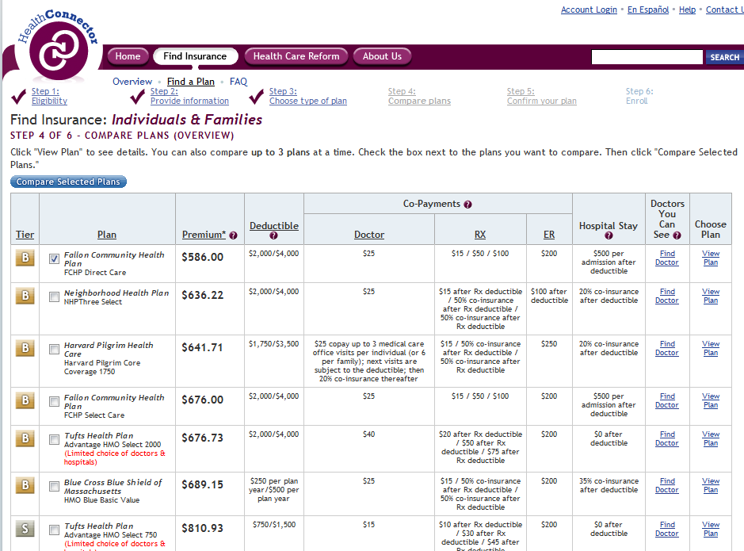
Choice Process: Pre-Standardization

Slide 8
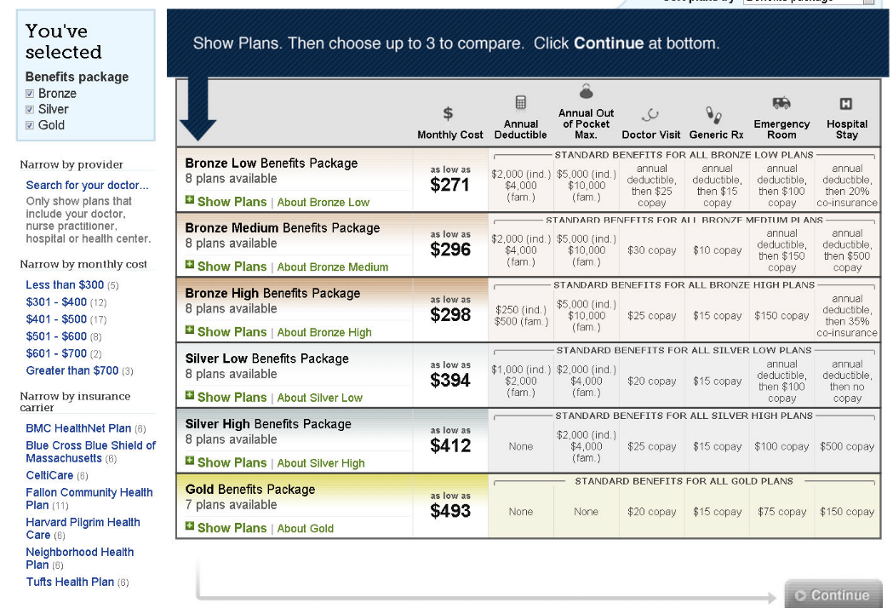
Choice Process: Post-Standardization

Slide 9
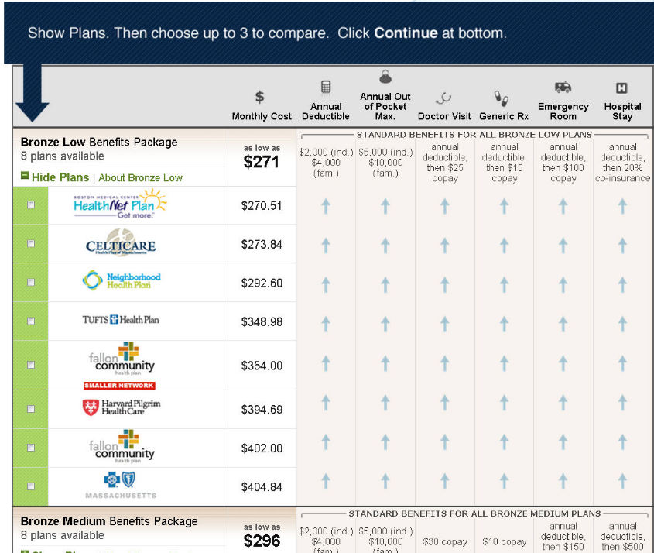
Choice Process: Post-Standardization

Slide 10
Result of Standardization
More generous plans chosen.
Tier became more important in decisions
Little change in price sensitivity
Major shift in brand choices
Made consumers better off

Slide 11
Networks
How do consumers value provider coverage network?
Hard to observe network (many doctors, hospitals)
No direct choice evidence until now
Massachusetts HIX 2009-2010
Had useful search tool
Measure network breadth by % of all hospital admissions statewide that would be covered by insurer
Measure willingness to pay from plan choices

Slide 12
Networks
Consumers willing to pay for broader network
It varies by age
$750/year for 30 year olds, $1500/year for 60 year olds
Hard to distinguish different networks within brand
Don’t know much about contexts with opaque network info
Or unfamiliar brands
Ericson and Starc. Forthcoming. "Measuring Consumer Valuation of Limited Provider Networks”. American Econ. Rev.

Slide 13
Inertia in Plan Choice: Defaults Matter
Medicare Part D
Initial assignment default:
Low Income Subsidy (LIS) recipients assigned to plan below threshold
Matters in year 1 and beyond
Automatic switching default
If firm raises price in year 2, LIS switched to cheaper plan
High income enrollees have to actively switch
Ericson. 2014. "Consumer Inertia and Firm Pricing in Medicare Part D ”. AEJ Policy.

Slide 14
Inertia in Plan Choice: Defaults Matter
Insurers respond by using “invest-then-harvest” pricing
Offer low prices in early years, capture enrollees
Costly to switch
Raise prices in later years
Result: unnecessary churn between plans, lower investment in enrollee health
Result: Older plans are 20% more expensive than equivalent newly introduced plans
(weighted by enrollment)
Ericson. 2014. "Consumer Inertia and Firm Pricing in Medicare Part D ”. AEJ Policy.

Slide 15
Consumer Decision-Making on HIX
HIXs: more choice but difficult choices
HIX design can help consumers
Defaults
Recommendations
Standardization for comparison
Employers played this role in employer-sponsored insurance
More work: consumers and provider networks, including disclosure of network info

