Slide 1
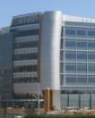

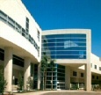





Sharp HealthCare ACO
Alison Fleury
Senior Vice President, Business Development, and
Chief Executive Officer, Sharp HealthCare ACO

Slide 2
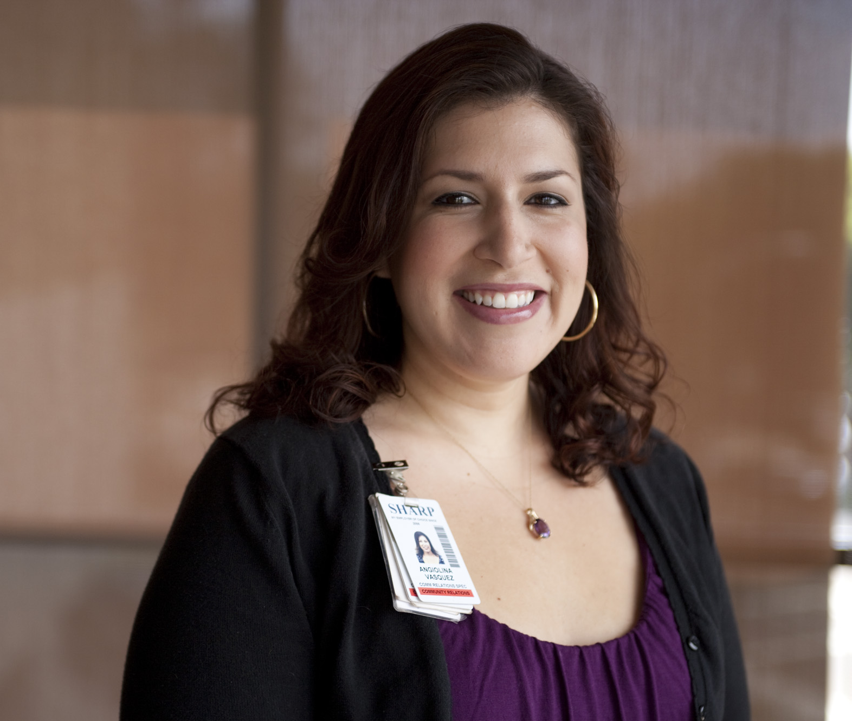
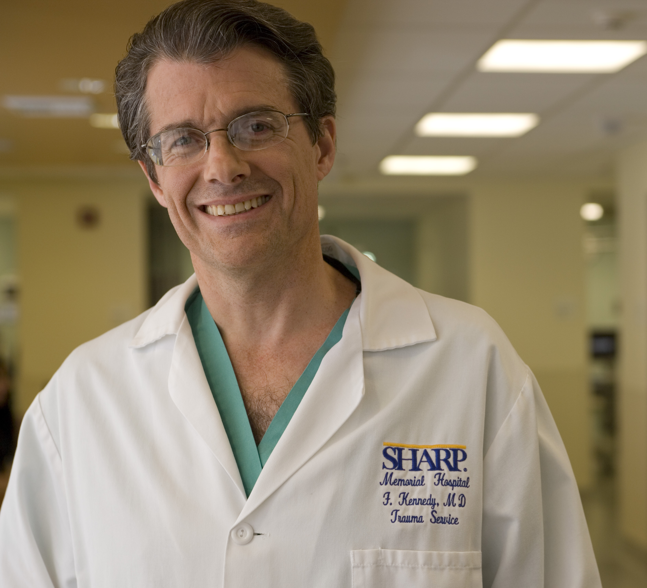
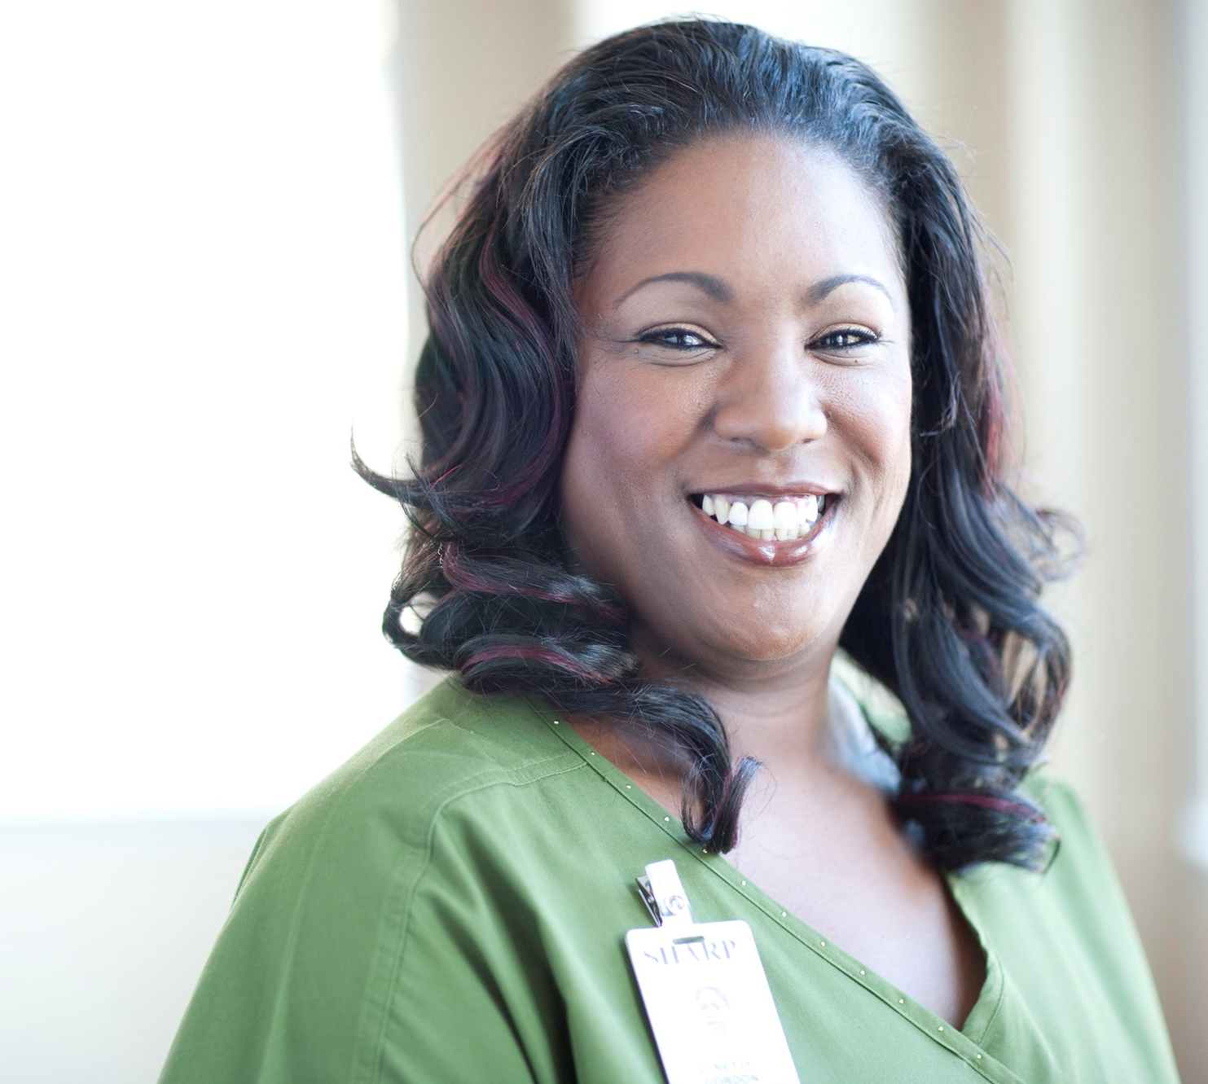
Sharp HealthCare
San Diego’s Health Care Leader
Not-for-profit serving 3.2 million residents of San Diego County
Grew from one hospital in 1955 to an integrated health care delivery system
Fully integrated information technology systems and infrastructure
Centralized system support services
Largest health care system in San Diego with highest market share
2 affiliated medical groups, 4 acute care hospitals, 3 specialty hospitals, 3 skilled nursing facilities, a health plan, 21 outpatient clinics, 5 urgent care centers, home health, hospice, and home infusion programs
Only health system in San Diego to increase market share each of the past 14 years
Largest private employer in San Diego
17,000 employees, 2,600 affiliated physicians, 3,000 volunteers

Slide 3
Advancing Population Health Management
44,000
Senior Enrollees
277,000
Commercial Enrollees
39,000
Commercial ACO Members
29,000
Pioneer ACO Beneficiaries (Medicare)*
Over 30 years of experience in managing care under population-based payment structures
* As of January 1, 2014. Sharp HealthCare ACO withdrew from the Pioneer program in June 2014.

Slide 4
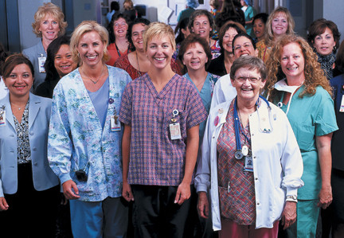
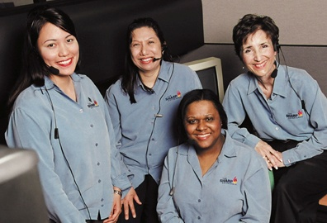
Sharp HealthCare ACO, LLC
Began January 1, 2012
Collaboration between:
Sharp HealthCare
Sharp Community Medical Group (SCMG)
Sharp Rees-Stealy Medical Group (SRSMG)
29,000 aligned beneficiaries
70% with SCMG
San Diego’s largest Independent Practice Association
30% with SRSMG
San Diego’s first and oldest multi-specialty medical group

Slide 5

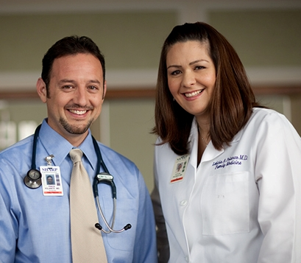
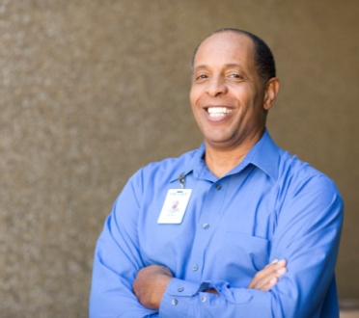
Sharp ACO Drivers of Success
Best Health, Best Care, Best Experience
Care Delivery Models
Care Coordination
Patient Engagement
Information Technology and Analytics
Alignment of Incentives

Slide 6
Sharp ACO Results
2013 (PY2) Utilization
Inpatient bed days per 1,000 decreased 17% from January 2013 to December 2013
Readmission rates decreased from 14.8% to 13.1%
2013 (PY2) Quality Rating
84% on 33 quality measures (8 pay-for-reporting measures)
2013 (PY2) Financial Performance
Shared loss of 1.3% (“breakeven”)
Despite favorable utilization and quality performance, Sharp ACO had “breakeven” financial performance under the Pioneer model

Slide 7
Pioneer ACO Financial Model
2012-2014 benchmarks developed based on 2009-2011 costs for aligned beneficiaries, trended forward using national inflation factors (“cohort” model)
National trend factors are not adjusted for specific conditions that an ACO is facing in a particular region (e.g., San Diego County)
Area Wage Index
Medicare Disproportionate Share

Slide 8
Area Wage Index (AWI)
Final AWI for San Diego County | AWI | Trend | Cumulative Trend
Fiscal 2011 | 1.1870 | - | -
Fiscal 2012 | 1.1950 | 0.7% | 0.7%
Fiscal 2013 | 1.2282 | 2.8% | 3.5%
Fiscal 2014 | 1.2477 | 1.6% | 5.1%
Fiscal 2015 | 1.2881 | 3.2% | 8.5%
Reference Population (Benchmark) | 1.0000 | 0.0% | 0.0%
The Pioneer benchmark for inpatient DRG-based reimbursement is understated by 5.1% through September 30, 2014 and 8.5% from October 1, 2014 through December 31, 2014

Slide 9
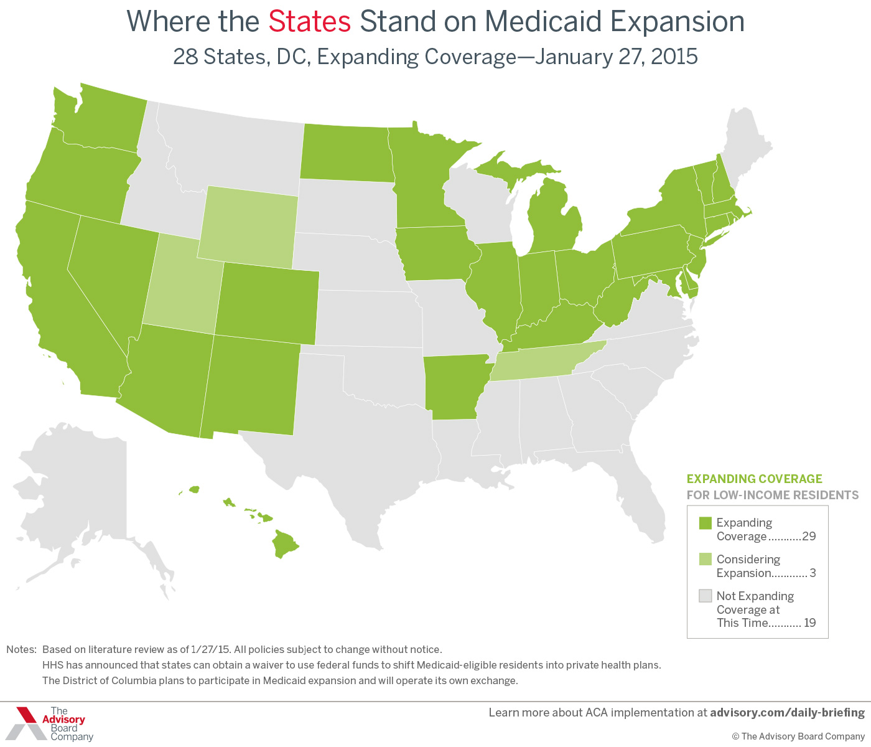
Medicaid expansion is not uniform across the country 28 States, D.C. Expanding Coverage – January 27, 2015
Disproportionate Share

Slide 10
“The Second Curve”
Support the shift from a volume-based business model to a value-based business model
Support the Triple Aim
Improve the patient experience of care (including quality and satisfaction)
Improve the health of populations
Reduce the per capita cost of health care
Ensure value-based incentives align with underlying utilization, quality, and experience results

