Slide 1
PROVIDER CONSOLIDATION FTC-DOJ Public Workshop on U.S. Health Care Competition Washington, D.C. February 25, 2015
Kenneth W. Kizer, MD, MPH
Distinguished Professor, UC Davis School of Medicine and Betty Irene Moore School of Nursing
and
Director, Institute for Population Health Improvement

Slide 2
PROVIDER CONSOLIDATION
Driven by the need to achieve clinical integration
New value-based payment models
May be important for quality improvement of some services
Essential for population health management
Independent physicians – an endangered species??
The rhetoric vs the reality of consolidation-derived efficiencies and quality improvements
Cost
Quality of care
Service satisfaction
Health outcomes
Clinical integration is about integrating patient care, not organizations

Slide 3
CLINICAL INTEGRATION: Form vs Function
“Integrated patient care” and “integrated delivery system” are not synonymous; full financial integration is not synonymous with effective clinical integration
Integrated delivery system (IDS) is a generic term for a variety of organizational structures having varying degrees of administrative, financial and/or clinical integration; there is no standardized definition of what constitutes an IDS
Integrated delivery systems do not necessarily produce integrated care – e.g., VA early 1990s, DOD-Military Treatment Facilities
Achieving clinical integration is dependent on key organizational functionalities, not a particular structure; no single organizational form has been shown to be superior to others for achieving integrated care

Slide 4
CLINICAL INTEGRATION: Core Functionalities
A common vision of health care service delivery having
Shared and widely understood clinical objectives and goals
A patient-centric and population health focus
Information management tools (e.g., EHRs, HIEs, data analytics) and other supporting infrastructure
Policies and procedures for coordinating care across providers, settings, conditions, and time
Team-based care
Methods of accountability, including a performance management system that consistently measures and monitors clinical performance
Strong clinical leadership that drives integrated care and engages front line providers
Shared financial risks and rewards for clinical outcomes

Slide 5
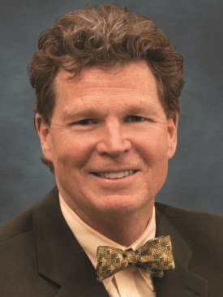
Published on FierceHealthcare (http://www.fiercehealthcare.com)
Healthcare systems fall short in physician engagement, docs report
June 9, 2014 | By Julie Bird
Healthcare systems that engage with physicians can improve their recruitment and retention and improve their chances of reaching other high-priority goals…
Doctors who feel engaged are more likely to be satisfied in their work, according to a summary of the findings published online in the American Hospital Association's Hospitals & Health Networks Forum. But "engagement levels over the past three years have grown at a lukewarm pace, at best," according to the symmary by Physician Wellness Services consulting physicians Daniel Whitlock, M.D., M.B.A., and Robert Stark, M.D.
The five most important elements to feeling engaged, according to the survey were:
Feeling respected for competency and skills
Feeling that opinions and ideas are valued
Maintaining a good relationship with peers
Achieving a good work/life balance
Having a voice in how the doctor's time is structured and used
The problem is many organizations don't know how to bring physicians into their fold and have successful outcomes, said Angood. There is more to integration than recruitment and getting physicians to sign a contract, he said.
Peter Angood, MD
CEO, ACPE
February 2014

Slide 6
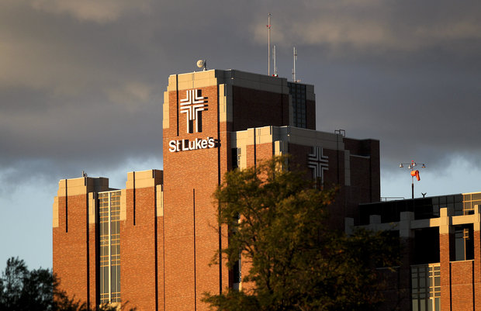
LESSONS FROM
FTC, et al v. St. LUKES , et al

Slide 7

LESSONS FROM ST. LUKE’S
Assertions of improved efficiency and quality must be more than aspirational or speculative
Need baseline performance data
Evidence of improvement must be able to withstand scrutiny
Improved functioning must be clearly linked to the consolidation
Employment is not required for physicians to gain access to electronic medical record systems or data analytics (population health management) tools

Slide 8
LESSONS FROM ST. LUKE’S
Asserting that a core number of primary care physicians is essential to provide integrated care is not supported by the evidence
Employment of physicians is not necessary to align incentives and transition to value-based payment nor required to achieve clinical integration

