Slide 1
Provider Network Design, Contracting Practices, and Regulatory Activity
James H. Landman, JD, PhD
Director, Healthcare Finance Policy, Perspectives & Analysis, Healthcare Financial Management Assoc.
FTC/DOJ Examining Healthcare Competition Workshop
February 24, 2015

Slide 2
About HFMA
Over 40,000 individual members
Membership distributed over wide range of settings (hospital and health system, physician practice, payer, consultant, vendor)
Focus on building and support coalitions with other healthcare associations and industry groups to achieve consensus on solutions for the challenges the U.S. healthcare system faces today

Slide 3
Majority of HFMA Survey Respondents See Moderate to High Exposure to Narrow/Tiered Networks
Source: HFMA Value Project Survey of Senior Financial Executive Members, October 2014

Slide 4
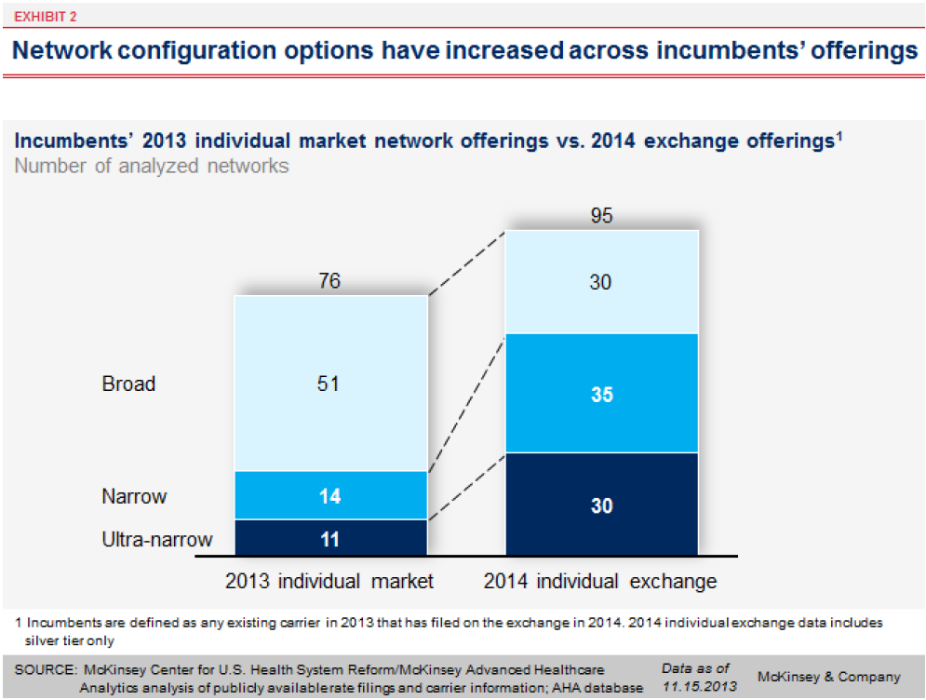
Participation in Exchanges Drove Significant Narrowing of Networks

Slide 5
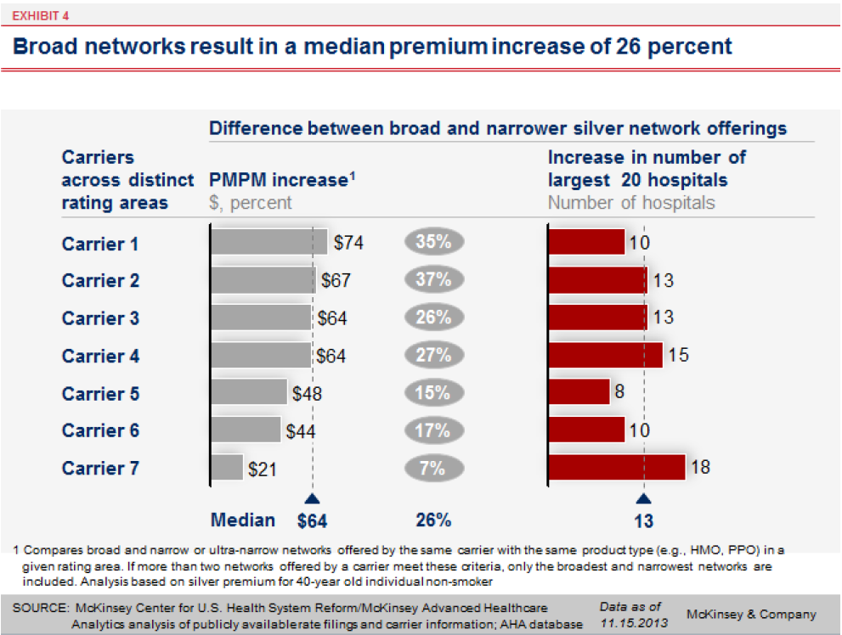
Narrowing of Networks Produced Premium Savings

Slide 6
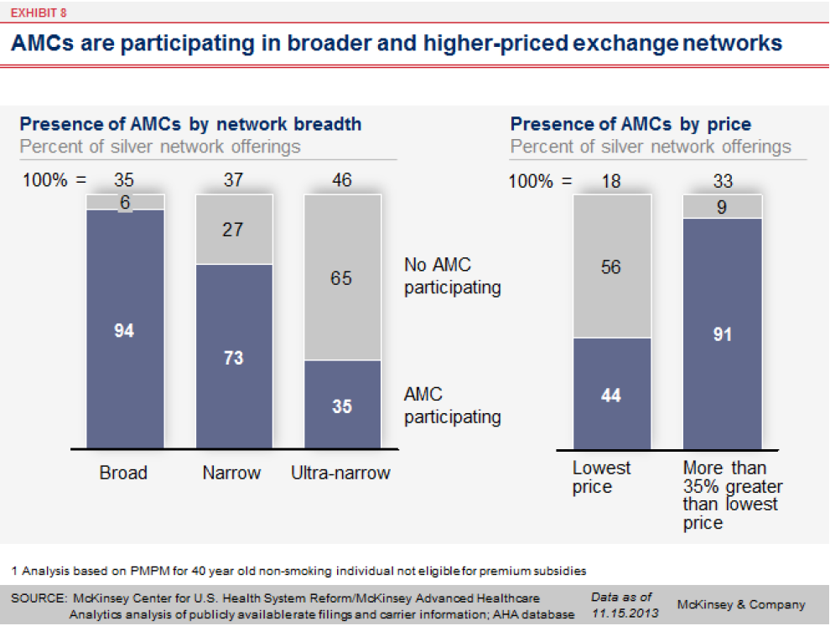
But Lower-Priced, Narrower Networks More Likely to Exclude AMCs

Slide 7
Do Consumers Understand What They Are Buying?
In one study:¹
  Only 14% of individuals could correctly identify four basic components of traditional insurance design: deductible, copay, coinsurance, and out-of-pocket maximum
  Only 11% could correctly answer a fill-in-the-blank question about the cost of a hospitalization
Do consumers understand and have accurate information on who is in (and who is not in) the network?
¹Source: George Loewenstein et al., “Consumers’ Misunderstanding of Health Insurance,” Journal of Health Economics 32 (2013): 850-862

Slide 8
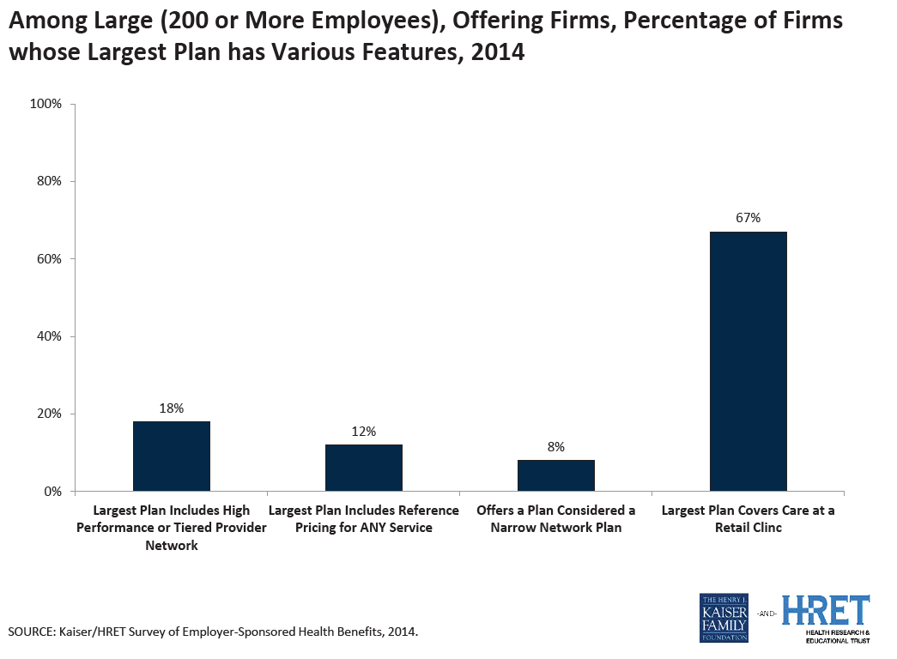
Low Employer Adoption of Tiered and Narrow Network Plans (Thus Far)

Slide 9
Additional Questions For Providers
How many providers are in the network and what services will they be contracted to provide?
Can I trust my projections regarding rates and volumes for the term of the contract?
Is there transparency of the criteria for tier designation or for inclusion in a (non-exclusive) narrow network?
Will my payment be fee-for-service or tied to total cost of care/risk-based?
Who will take the lead on care management with patients (payer or provider)?
What data will I have access to?

