Slide 1


Reflections of a CO-OP as a New Market Entrant

Slide 2

Creation of Consumer Operated and Oriented Plans (CO-OPs)
CO-OP program created by ACA, s. 1322, to introduce greater competition and choice within Marketplaces
Alternative to public payer
Member-directed: Majority of Board Directors must be Members; all Directors elected by Members
Enhanced competition and transparency within the health insurance marketplace (“exchanges”)
2/3 of all contracts must be in individual and small group markets
ACA requires CO-OPs to offer silver and gold products on Exchange
Currently 22 CO-OPs operating in 23 states
Made possible through start-up and solvency loans of the ACA (administered by CMS)

Slide 3
Early Impact of CO-OPs
Summary Results
In several markets, e.g. Maine, CO-OPs provided the only other carrier choice in 2014
In 23 states with CO-OPs, overall health insurance premiums are roughly 8% lower than in states without them
In CO-OPs states, CO-OPs offer 37% of the lowest-priced plans
CO-OP plans are the most likely of all insurers to be within 10 percent of the lowest-priced plan
From 2014 to 2015, premiums for the second lowest cost silver plan dropped by 1.9%, but had risen by 1.5% in non-CO-OP states.
Enrollment at end of 2014 topped half a million; expectation of significant gains through 2015 open enrollment period

Slide 4
Maine Community Health Options
Mission
To partner locally with Members, businesses and health professionals to provide affordable, high quality benefits that promote health and well-being.
Vision
To be a leader in transforming and improving individual and community health and positively affecting local economies.

Slide 5
MCHO Purpose
To deliver meaningful health insurance benefits designed to improve consumer health and well-being by:
Integrating and coordinating care
Paying for what matters by engaging in market reform and payment incentives to improve efficiency and quality
Working collaboratively with Providers and Members towards Triple Aim Achievement
Value Based Insurance Design
Chronic Illness Support Program
Behavioral Health Integration
PCMH Support & Care Mgmt Coordination w/ providers
Broad PPO Network – e.g., All Hospitals in both Maine and NH included, plus access to national network
IFP Products: 10 total: Gold, Silver, Bronze, Catastrophic
Small Group: 8 total: Platinum, Gold, Silver, Bronze

Slide 6
Challenges
New entrants lack comparative leverage given starting enrollment of zero, and therefore suffer on pricing
Gaining brand name recognition, especially given that CO-OPs have been prohibited from using federal start-up loans for marketing
Establishing consumer awareness of coverage opportunity through the Marketplace
Balancing enrollment growth with solvency requirements and sufficiency of capital, especially in light of shifting parameters and timeframes
CO-OPs held to higher RBC standard (500% RBC)
CO-OP business model aligned closely with Marketplace, and therefore 3Rs and Cost Share Reductions

Slide 7
Results
Enrollment in 2014, two and a half times greater than enrollment projections, and 83% marketshare of Maine FFM
At end of Open Enrollment 2.0, MCHO enrollment now stands at over 73,000 and 81% marketshare of Maine FFM
From 2014 to 2015, MCHO decreased premium pricing
By 0.8% for IFP
By 10% for small group
MCHO expanded to all of New Hampshire, all 10 counties, and all hospitals in network

Slide 8
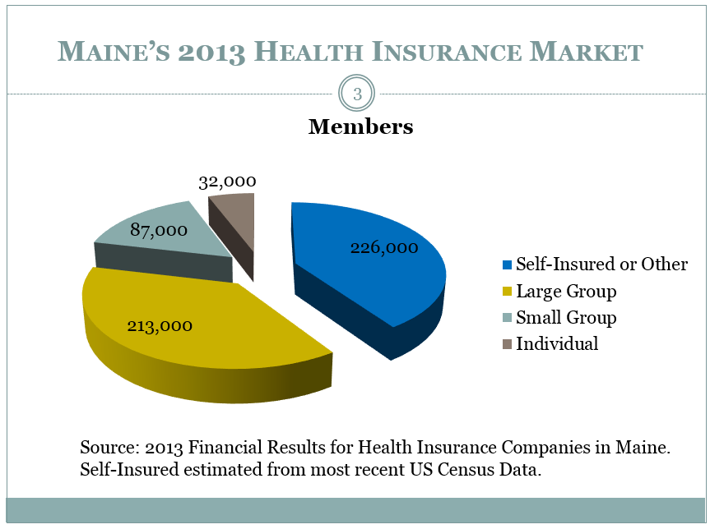
Coverage Profile on Eve of ACA’s Open Enrollment
Source: Bureau PowerPoint Presentation on ACA and Maine; http://www.maine.gov/pfr/insurance/

Slide 9
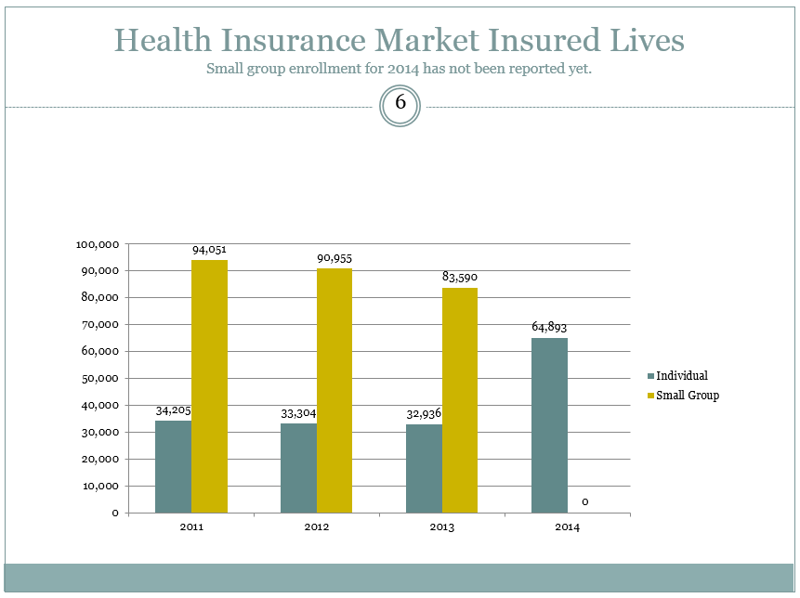
Jump in Coverage via ACA
Doubling of Non-group coverage from 2013 to 2014 (Increase by 31,957)
Source: Bureau PowerPoint Presentation on ACA and Maine; http://www.maine.gov/pfr/insurance/

Slide 10
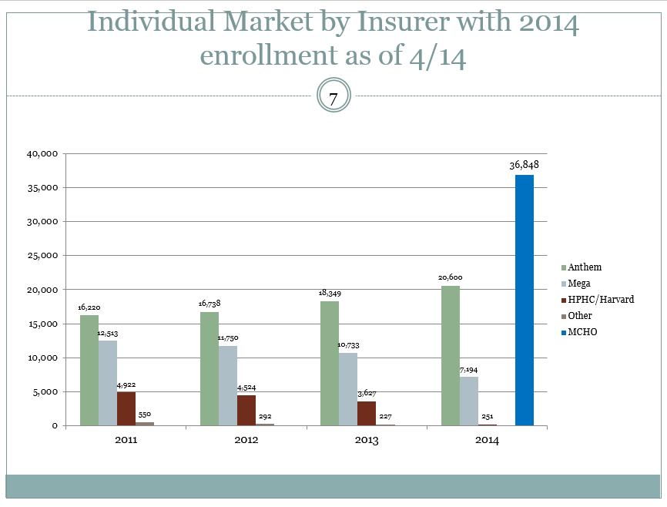
MCHO Gains Strong I&FP Enrollment
MCHO captures 83% of FFM Enrollment and 57% of all non-group enrollment
Source: Bureau PowerPoint Presentation on ACA and Maine; http://www.maine.gov/pfr/insurance/

Slide 11
Future Goals
Payment reform
ACO work
Ongoing consumer & provider engagement
Enhanced portals
Improved prior auth process (including self-service)
Easier use of accumulators and evidence based guidelines
Appropriate data sharing to enhance improved utilization and delivery of care

Slide 12

Questions?
Kevin Lewis, CEO
Maine Community Health Options
207-402-3330
www.maineoptions.org

