Slide 1
Overview of the ACO Landscape
David Muhlestein, PhD JD
Senior Director of Research & Development
Leavitt Partners
Examining Health Care Competition Workshop
February 24-25, 2015

Slide 2
Aco growth
Overall Trajectory

Slide 3
Growth by contract type
For New and Existing ACOs

Slide 4
Aco growth vs contract growth
Overall Trajectory

Slide 5
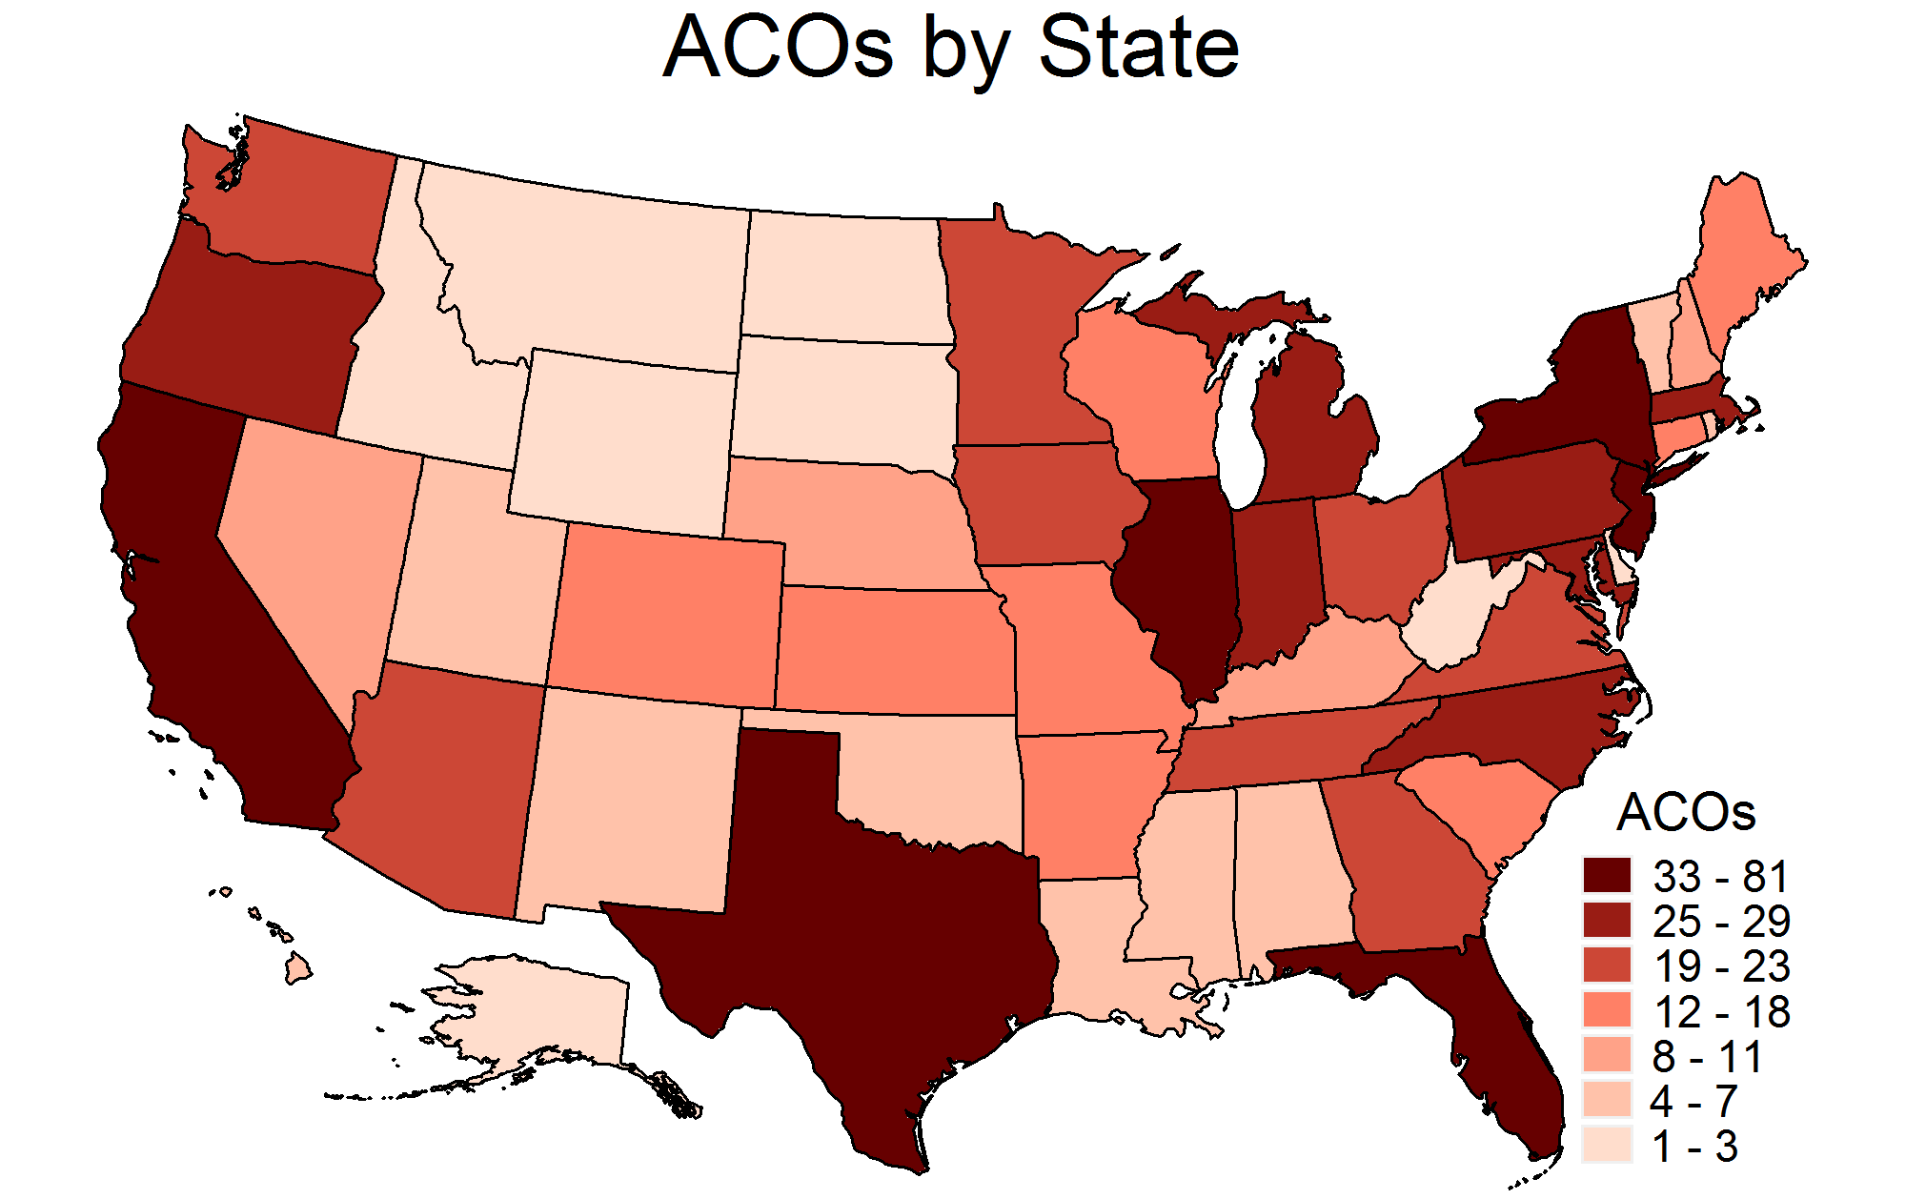
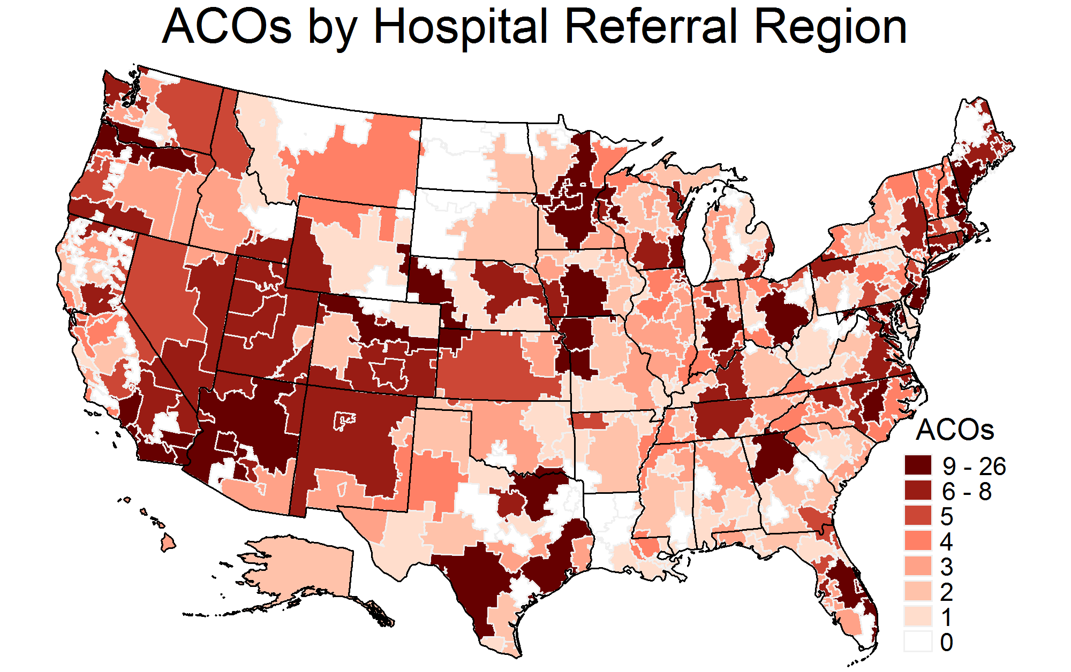
Where are they forming?
Source: Leavitt Partners Center for Accountable Care Intelligence

Slide 6
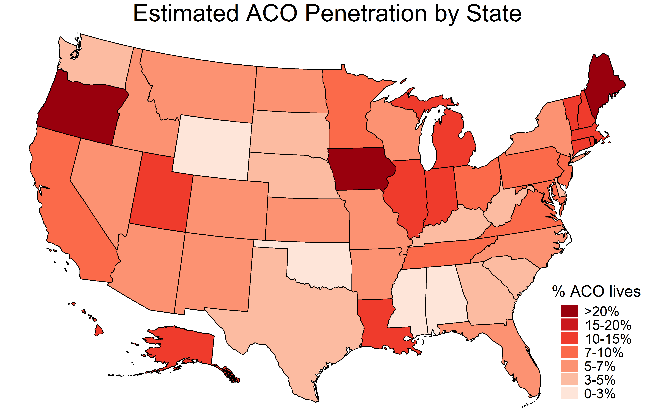
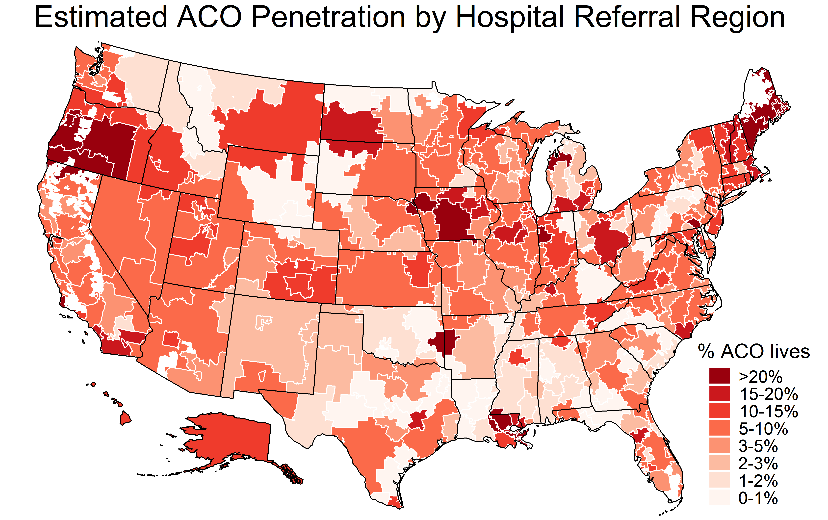
How many lives?
Source: Leavitt Partners Center for Accountable Care Intelligence

Slide 7
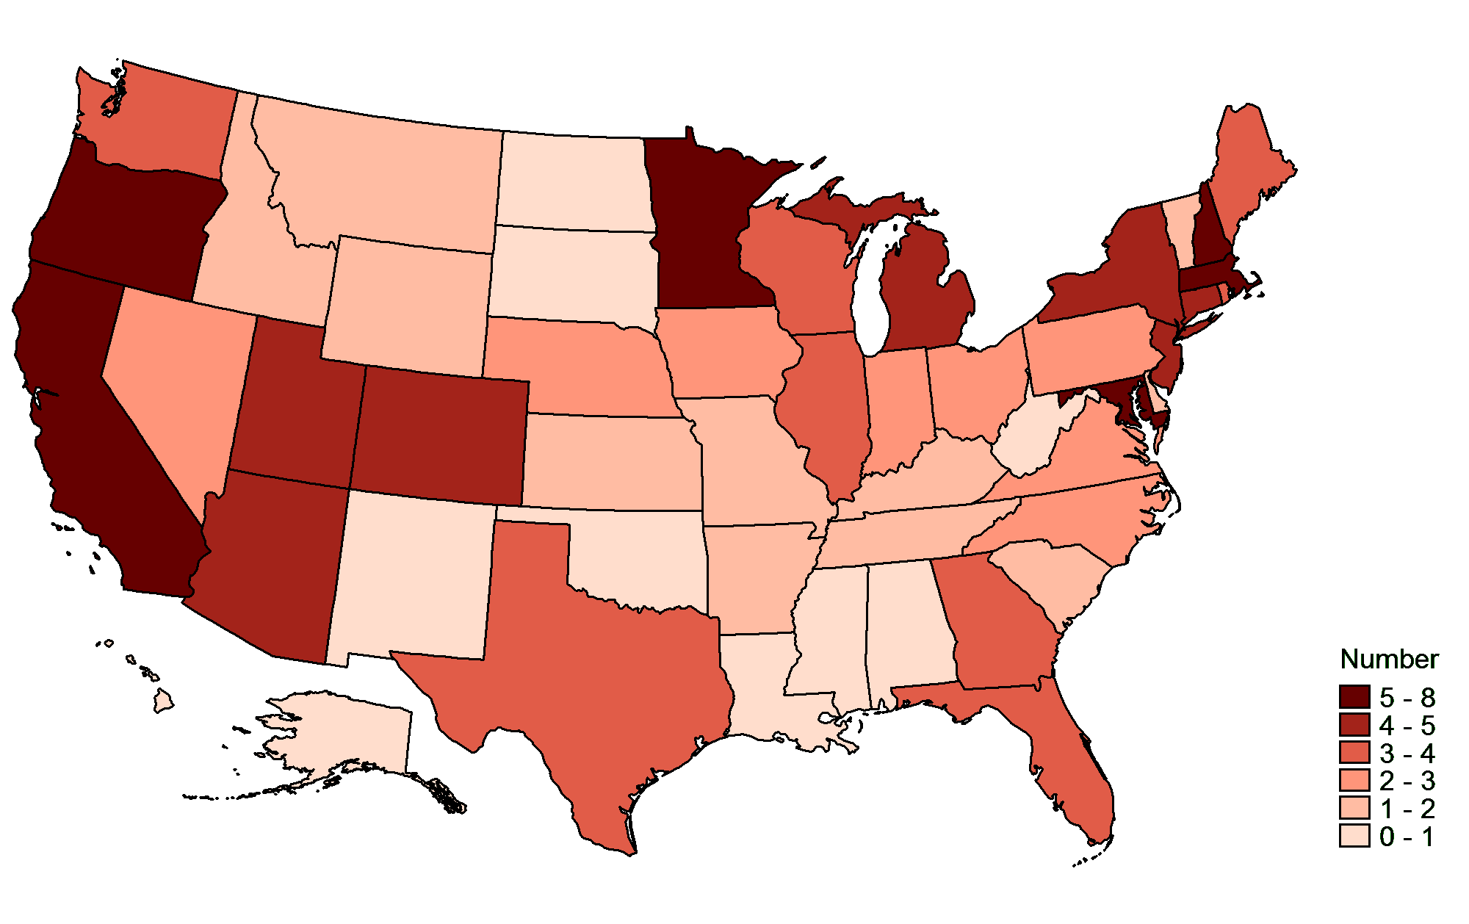
Average number of ACOs
Based on patient location
Source: Leavitt Partners Center for Accountable Care Intelligence

Slide 8
Size of the aco movement
Millions

Slide 9
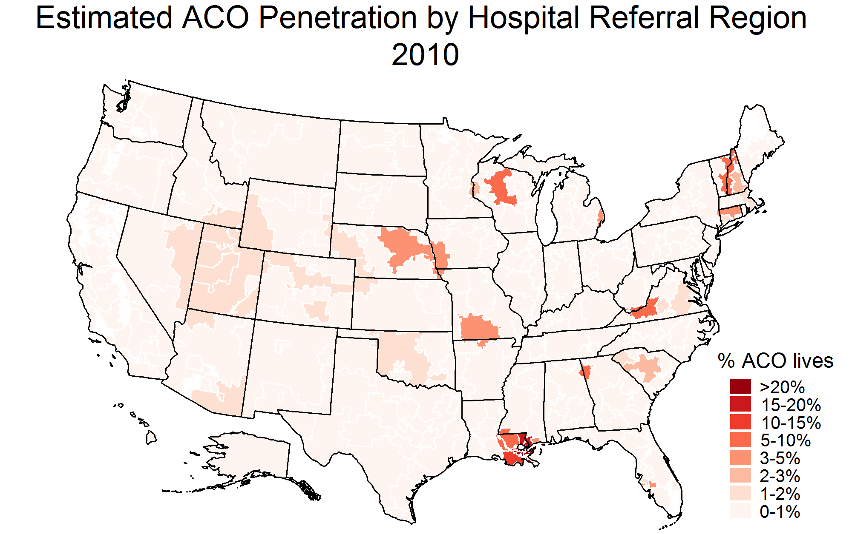
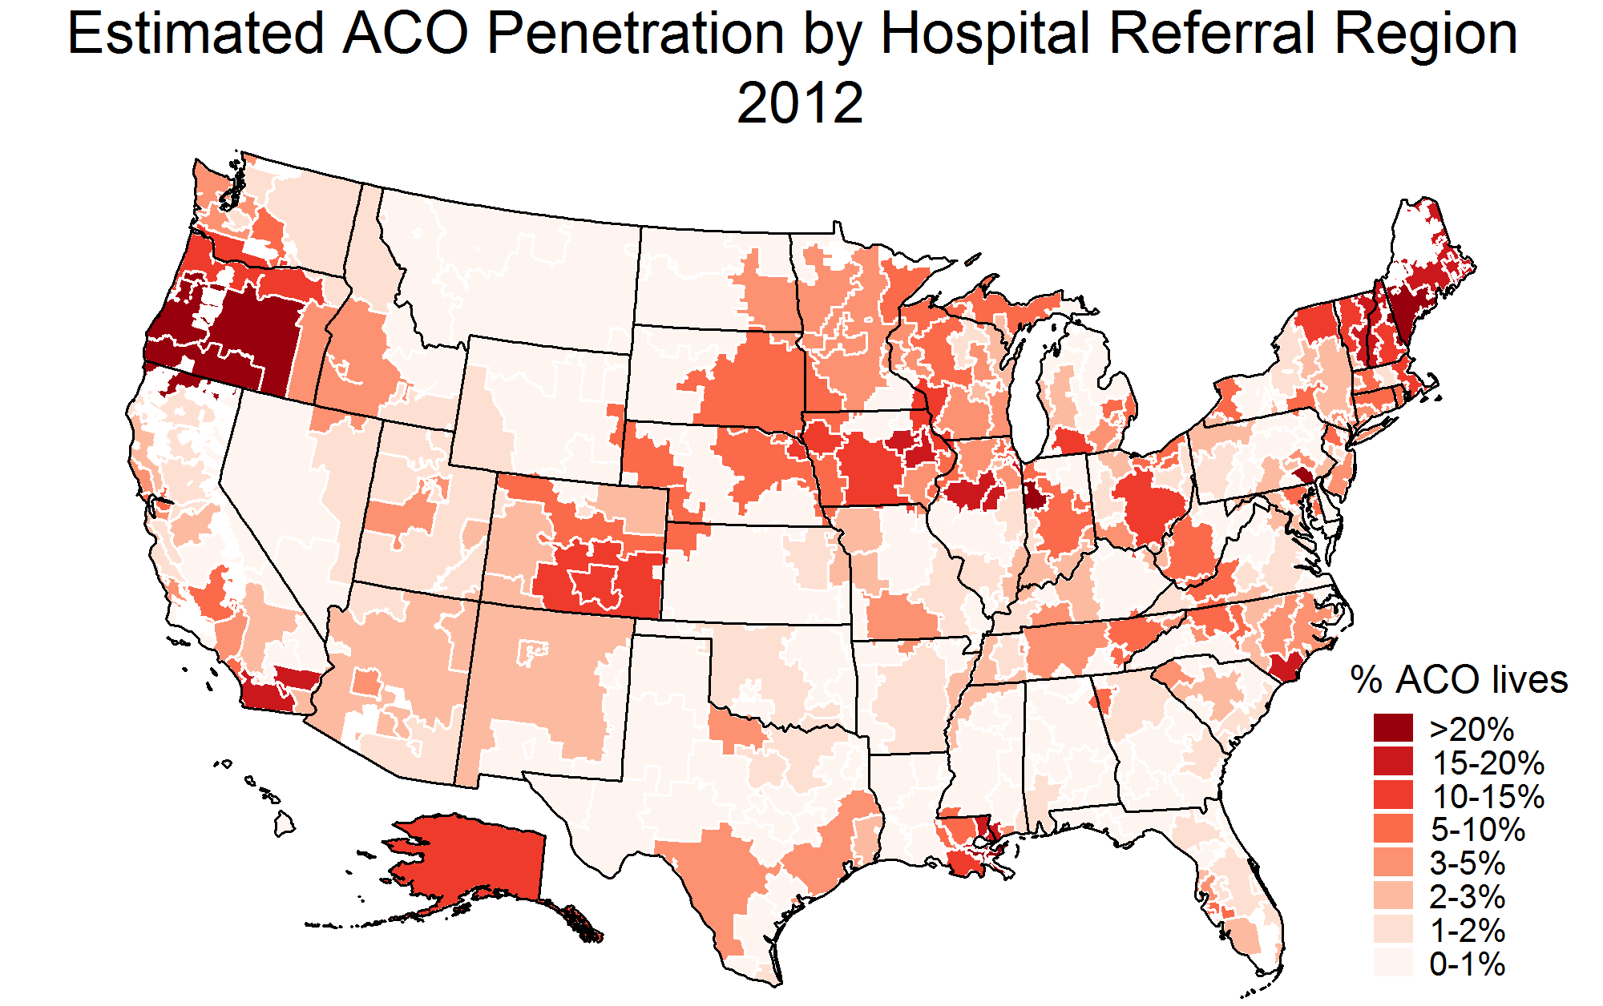
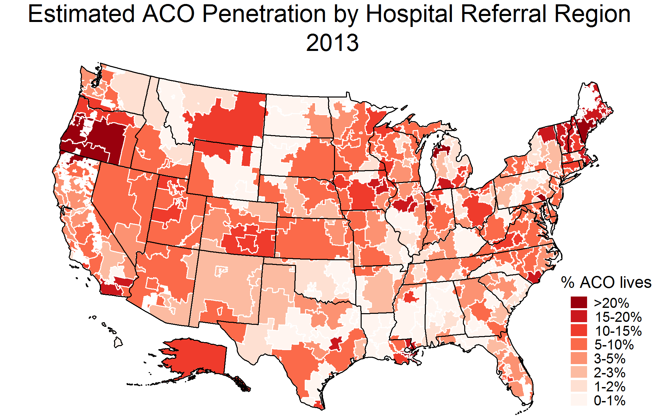
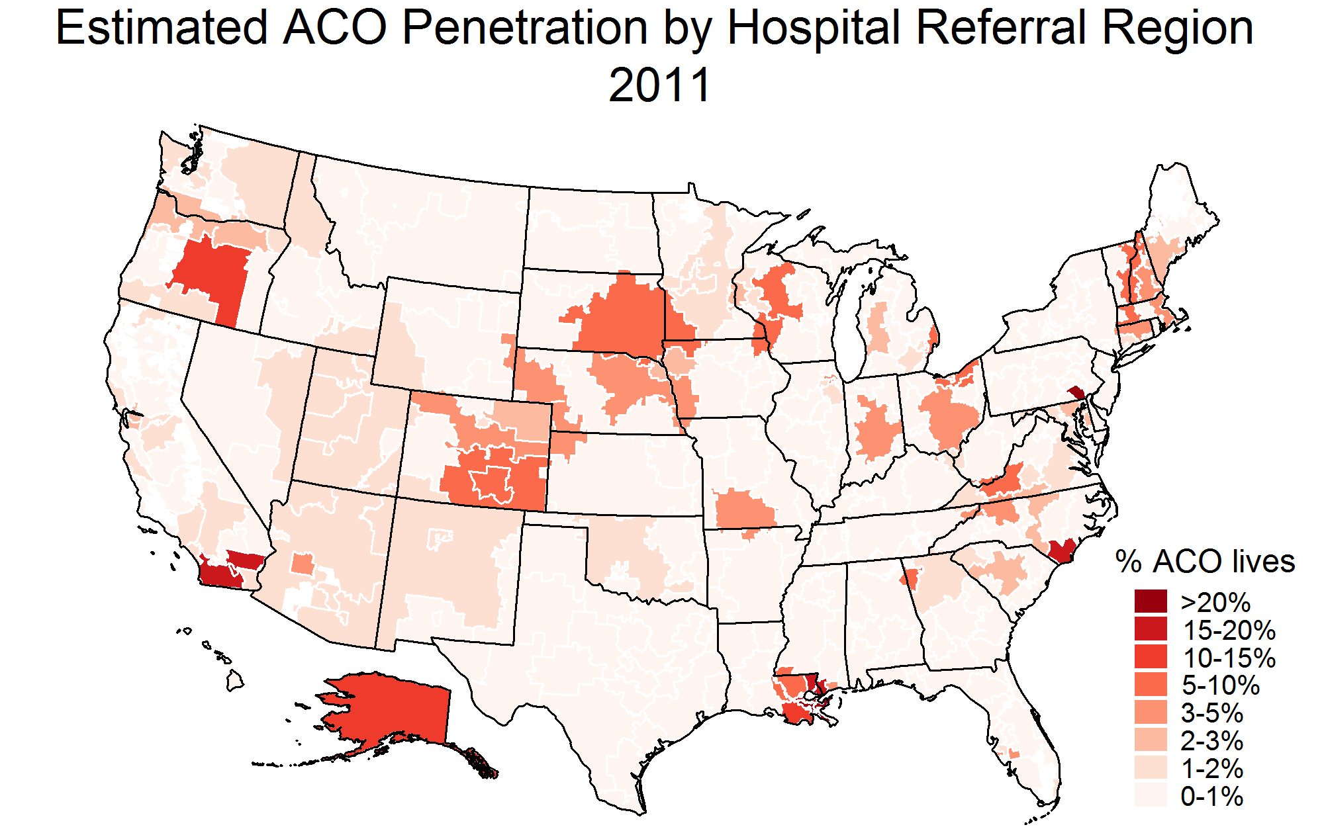

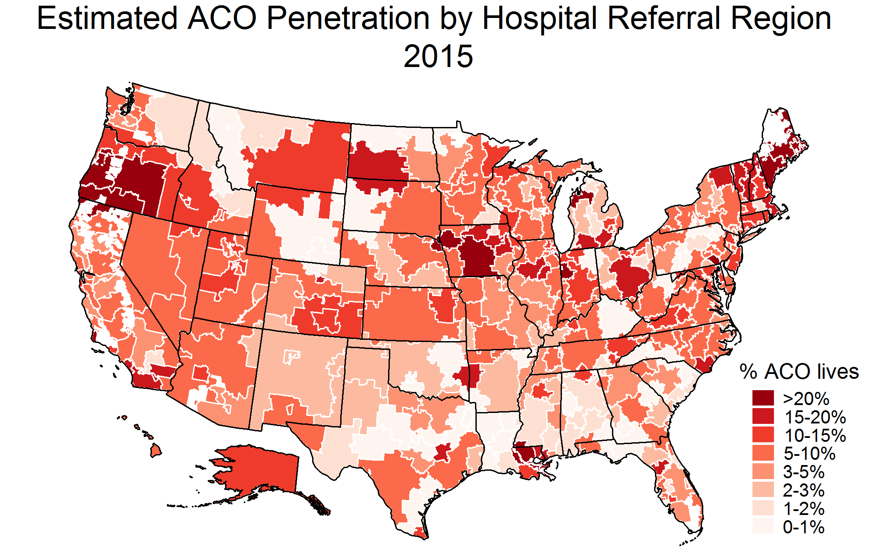
ACO Penetration of lives over time

Slide 10
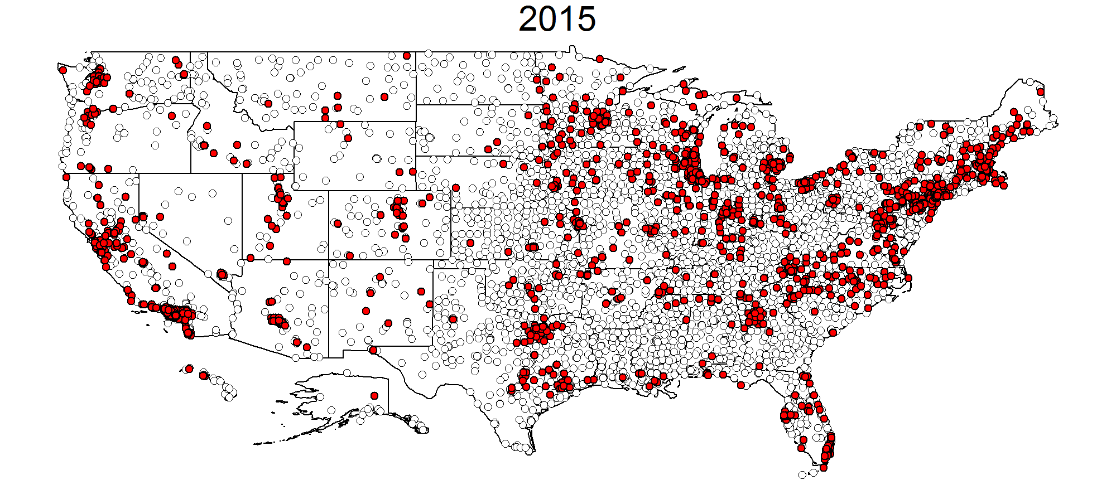
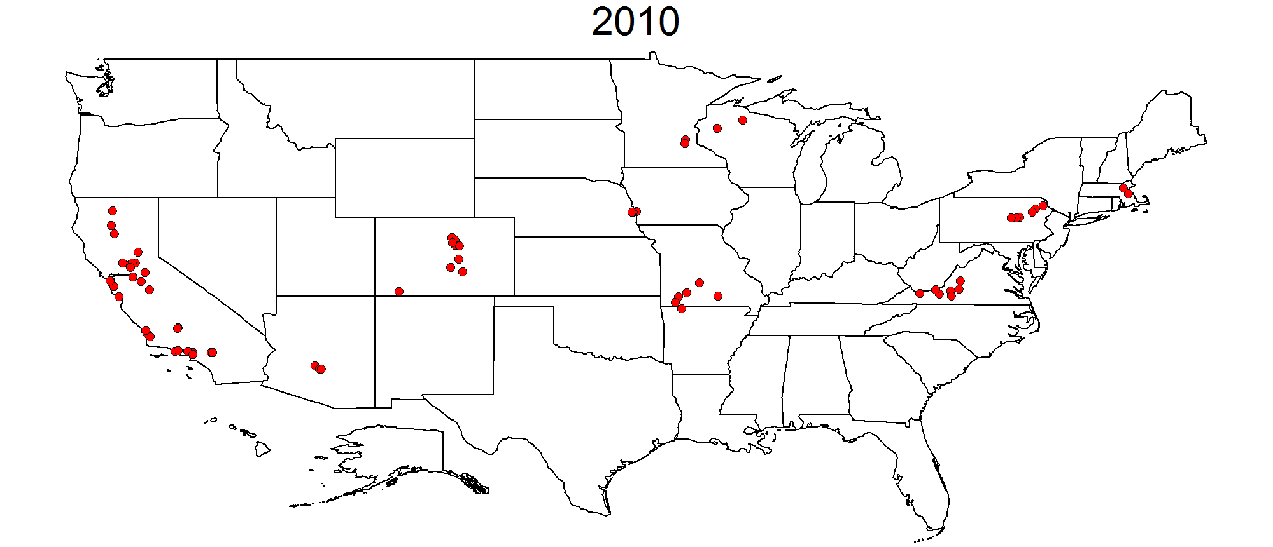
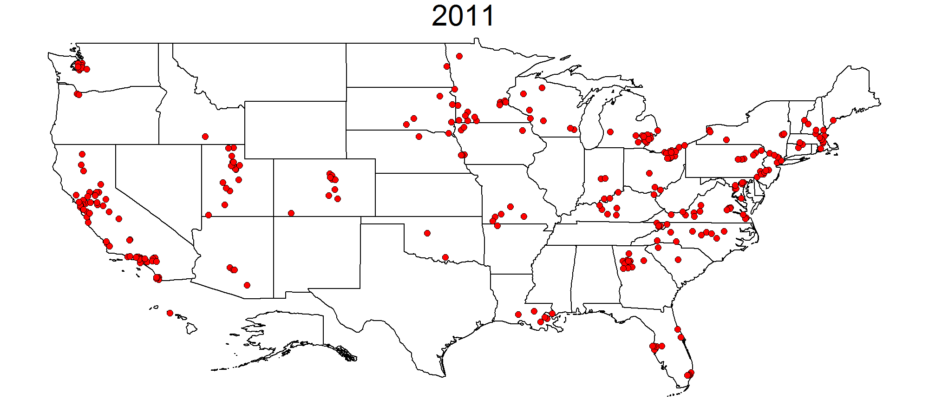
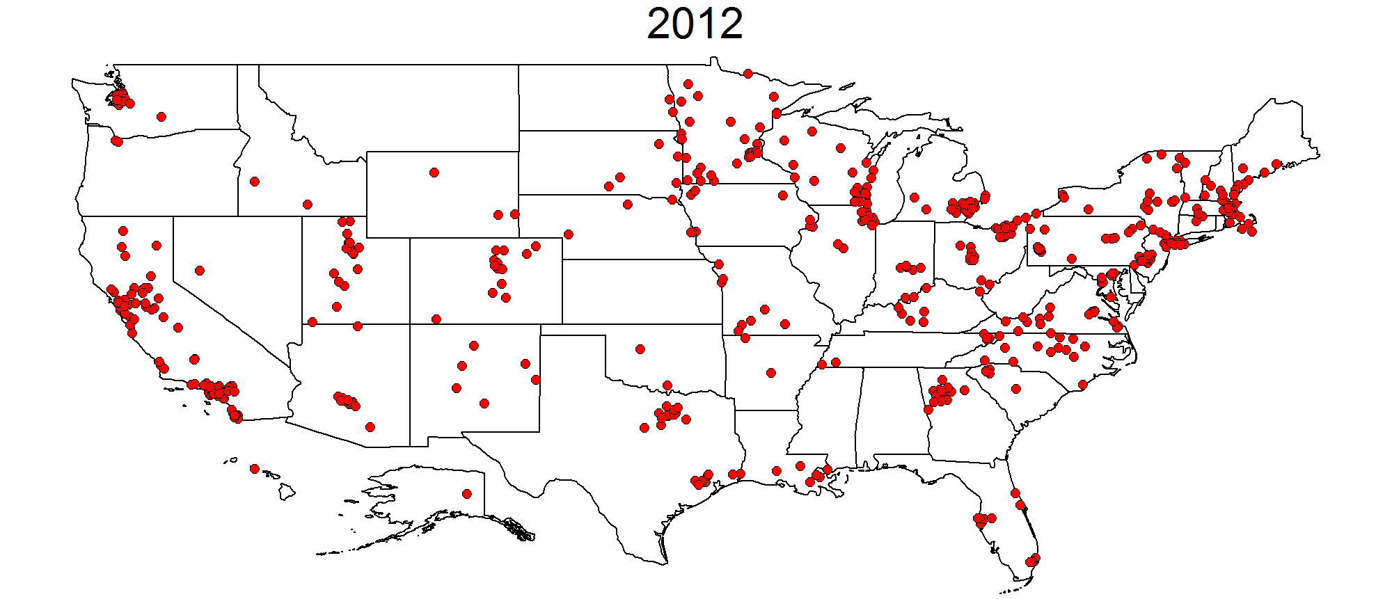
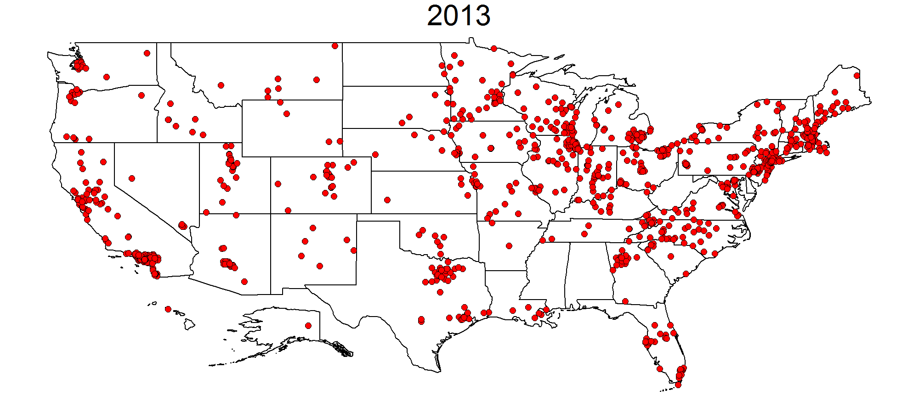
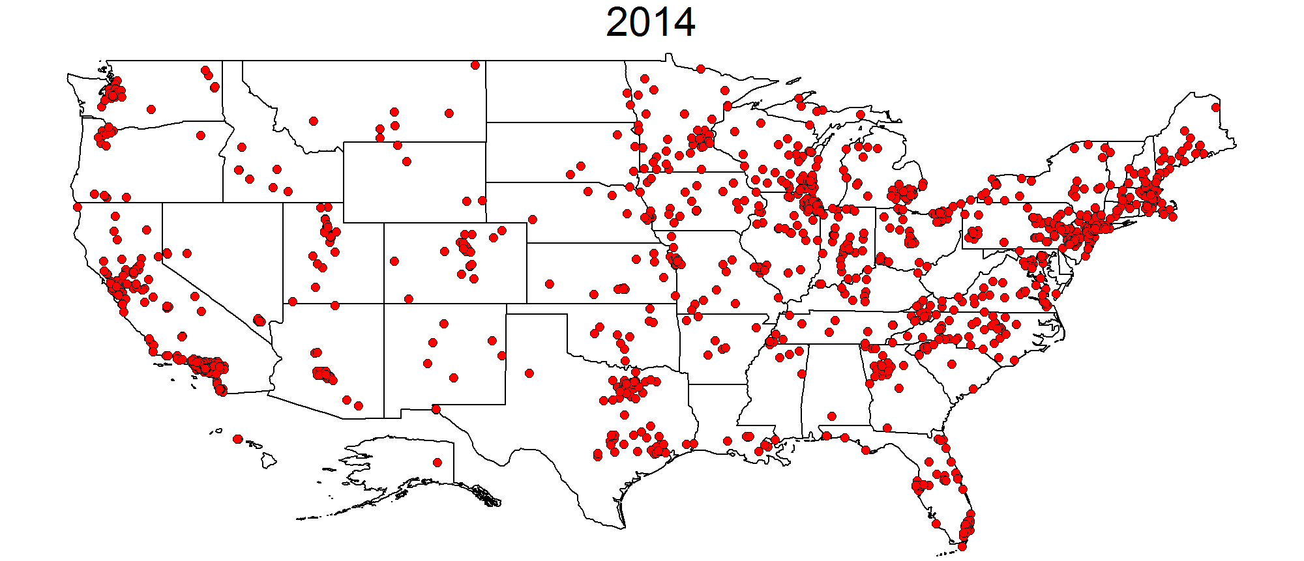
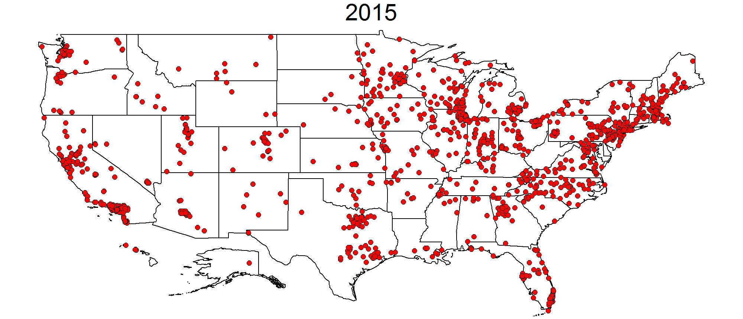
Hospitals in ACOs over Time

Slide 11




ACOs attract a Wide range of providers
Small physician group of ~40 PCPs and specialists
MSSP contract
$0 shared savings PY1
Single Hospital
900 physicians
MSSP and commercial contracts
Rural ACO
9 independent family practices
MSSP and commercial contracts
17 hospitals in Iowa, Illinois and Wisconsin
30,000 employees including hospital staff, clinics and home health
Government and commercial contracts
Across multiple ACOs has earned shared savings of $8.6 million

Slide 12
ACO Program differences
MSSP:
5,000 beneficiary minimum
3-year agreement
2 Tracks
PCP attribution
33 quality measures
Commercial:
Wide range of population sizes
3-5 year agreement
Variations of risk-sharing
Attribution based on product
Quality measures vary

Slide 13

Becoming an ACO Takes time
Engaging physicians, integrating cultures
Designing a structure – many approaches will require the development of a new legal entity and a new governance structure
Assessing population health capabilities, identifying operational gaps
Implementing HIT
Developing a quality program – metrics, physician education, reporting, incentives
Market expertise

