Slide 1
Improving Health Care Quality While Slowing Spending Growth: The Alternative Quality Contract (AQC)
Dana Gelb Safran, Sc.D.
Senior Vice President
Performance Measurement and Improvement
Presented at:
Federal Trade Commission & Department of Justice Workshop:
Alternatives to Traditional Fee-for-Service Payment Models Panel
25 February 2015
Notes:
1
Andrew Dreyfus
Why you’re here…..
…. As Benefits Consultants you are on the cutting edge of the process…. You are the facilitators of change. In a new transformed health care system, you will be asked to assist both employers and providers to – not just adjust to or adapt to, but embrace a new way of interacting with the system. A new and better, more quality and outcomes driven and patient-focused system. We’re here today to discuss Blue Cross Blue Shield of Massachusetts’ intention and our approach. We hope you’ll see the value in it and help us all achieve our larger goal of a transformed – improved – healthcare system that achieves the true measure of value of which it is capable….

Slide 2
The Alternative Quality Contract:
Twin goals of improving quality and slowing spending growth
In 2007, leaders at BCBSMA challenged the company to develop a new contract model that would improve quality and outcomes while significantly slowing the rate of growth in health care spending.
The Massachusetts health reform law (2006) caused a bright light to shine on the issue of unrelenting double-digit increases in health care spending growth (Health Care Reform II).
Sources: BCBSMA, Bureau of Labor Statistics.
Notes:
2
2

Slide 3
Key Components of the AQC Model
Unique contract model:
Accountability for quality and resource
use across full care continuum
Long-term (5-years)
Controls cost growth:
Global population-based budget
Shared risk: 2-sided symmetrical
Health status adjusted
Annual inflation targets set at baseline for each year of the contract and designed to significantly moderate cost growth
Improved quality, safety & outcomes:
Robust performance measure set creates accountability for quality, safety & outcomes across continuum
Substantial financial incentives for high performance and for improvement
Performance on quality
Inflation (cumulative)
Identify savings within budget
PERFORMANCE-BASED PAYMENT OPPORTUNITIES
INITIAL GLOBAL PAYMENT LEVEL
INITIAL GLOBAL PAYMENT LEVEL
Year 1
Year 2
Year 3
Year 4
Year 5
Notes:
3
3
Before I describe the details of the Alternative Quality Contract model, I’d like to give you some context.
We have all heard that the health care industry is facing a crisis of increasing costs along with significant issues related to quality and safety of care. Many of these issues are unintended consequences of the dominant reimbursement model, fee-for-service, which rewards doctors and hospitals for the quantity and complexity of services provided instead of rewarding the quality and outcomes of care.
To do our part as a health plan to move toward solutions, Blue Cross evaluated how our payment methodology could be changed to better support high-value health care.

Slide 4
AQC Physician Participation (Current as of January 2015)
85%
89%
* All 2015 figures as of January
Notes:
As of April 2014, AQC physicians totaled 85% of Blue Cross Blue Shield of Massachusetts’ overall network of contracted primary care providers and 89% of specialists.
4

Slide 5
Results Under The AQC: Improvement of the 2009 Cohort of AQC Groups from 2007-2012
Adult Chronic
Care
Pediatric Care
Adult Health
Outcomes
100
Optimal Care
50
=
These graphs show that the AQC has accelerated progress toward optimal care since it began in 2009. The first two scores are based on the delivery of evidence-based care to adults with chronic illness and to children, including appropriate tests, services, and preventive care. The third score reflects the extent to which providers helped adults with serious chronic illness achieve optimal clinical outcomes. Linking provider payment to outcome measures has been one of the AQC’s pioneering achievements.
Notes:
5
Shown here are the groups that are currently in the AQC.
Our first groups started with us in 2009; Our newest groups for 2012 include Cooley Dickinson, Children’s, Boston Medical Center, and Lahey.
As you can see, there is a wide range of groups represented here. The AQC payment model can work for a variety of provider organizations—including urban hospitals and community health centers.
The AQC is not prescriptive as to what form the provider organization takes, but it must include PCPs that care for at least 5,000 BCBSMA members.
Some AQC agreements are with physician groups alone, while others include both physicians and hospitals.

Slide 6
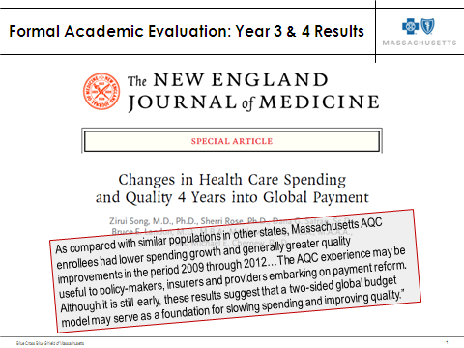
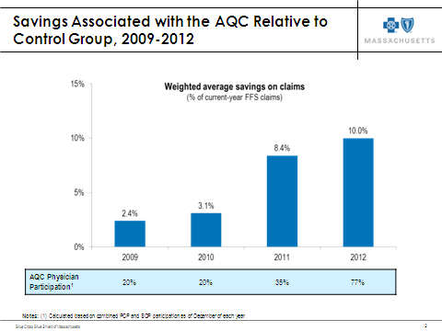
AQC Results: Formal Evaluation Findings
Source: Song Z, et al. Changes in Health Care Spending and Quality 4 Years into Global
Payment. The New England Journal of Medicine. 2014.

Slide 7
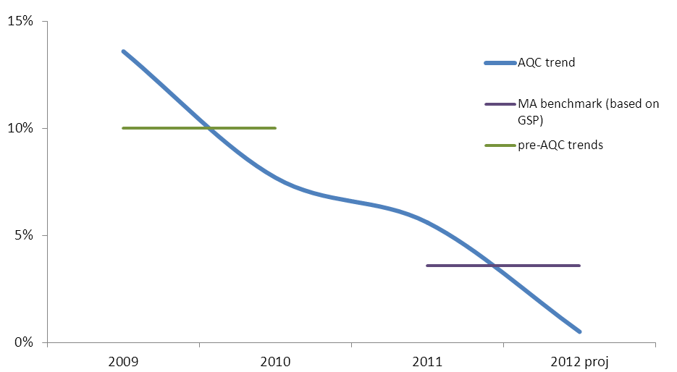
Total Cost Results
The Harvard evaluation documented that AQC is reducing medical spending, but accounts also want to see reductions in total spending
By Year-3, BCBSMA met its goal of cutting trend in half (2 years ahead of plan)
By Year-4, BCBSMA total cost trend was below state general economic growth benchmark (<3.6%)
AQC Total Cost Increases (FFS + incentives)

Slide 8
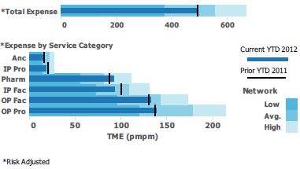



Components of the AQC Support Model
Our four-pronged support model is designed to help provider groups succeed in the AQC.
Data and Actionable Reports
Consultative Support
Best Practice Sharing and Collaboration
Training and Educational Programming

Slide 9
Summary and Priority Issues Ahead
Summary
Priority Issues Ahead
Payment reform gives rise to significant delivery system reform
Rapid and substantial performance improvements are possible in the context of:
Meaningful financial incentives
Rigorously validated measures & methods
Ongoing and timely data sharing and engagement
Committed leadership
For payment reform, deep provider relationships and significant market share are advantageous
For national payers, remote provider relationships pose engagement challenges; member-facing incentives (benefit design) an attractive lever
Expanding payment reform to include PPO presents unique challenges
Gaining strong employer buy-in & support will be important; and this means models must offer value from day-1
Continued evolution of performance measures to fill priority gaps
Focus on outcomes, including patient reported outcomes (functional status, well being)
Continued evolution of the delivery system:
Evolving the role of hospitals in the delivery system
Building deeper engagement of specialists
Bringing incentives (financial & non-financial) to front lines
Advancing innovations in virtual care
Payment incentives to front line clinicians need continued attention

Slide 10

For More Information
dana.safran@bcbsma.com
Notes:
10

