Slide 1


Slide 2
Welcome
Todd Kossow
Acting Regional Director, Midwest Region
Federal Trade Commission

Slide 3
Introductory Remarks
James B. Speta
Senior Associate Dean for
Academic Affairs & International Initiatives
Northwestern Pritzker School of Law

Slide 4
Opening Remarks
Maureen Ohlhausen
Commissioner, Federal Trade Commission

Slide 5
Panel 1
Building a Security Culture

Slide 6
Featuring
Aaron Bedra, Chief Security Officer, Eligible
John Downey, Security Lead, Braintree
Arlan McMillan, Chief Information Security Officer, United Airlines
Marc Varner, Corporate Vice President & Global Chief Information Security Officer, McDonald’s Corp.
Moderator: Cora Han, Division of Privacy & Identity Protection, FTC

Slide 7
Building a Security Culture

Slide 8
Building a Security Culture
Security as Core Value
  Founders, executives, and employees
Building Security Expertise
  It’s not “us” versus “them”
Risk Assessments and Threat Modeling
  Critical tools for establishing priorities
Leveraging the Security Community
  Don’t reinvent the wheel

Slide 9


Slide 10
Panel 2
Integrating Security into the Development Pipeline

Slide 11
Featuring
Michael Allen, Chief Information Security Officer, Morningstar
Matt Konda, Founder & Chief Executive Officer, Jemurai; Chair, OWASP Global Board of Directors
Alex Lock, Senior Software Engineer, Application Security, Groupon
Lyle Sudin, Manager, Mandiant Consulting Services
Moderator: Jim Trilling, Division of Privacy & Identity Protection, FTC

Slide 12
Integrating Security into the Development Pipeline

Slide 13
Integrating Security into the Development Pipeline
Integrate security into development to achieve efficiencies and cost savings
Employ different security-related tools in different phases of development
Use tools you already use for other purposes
Automate testing and feedback where possible
Speak to developers in their language

Slide 14


Slide 15
Panel 3
Considering Security When
Working with Third Parties

Slide 16
Featuring
Erin Jacobs, Founding Partner, Urbane Security
Jeff Jarmoc, Lead Product Security Engineer, Salesforce
Nathan Leong, Corporate Counsel, Microsoft
Jon Oberheide, Co-Founder & Chief Technology Officer, Duo Security
Moderator: Steve Wernikoff, Office of Technology Research & Investigation, & Midwest Region, FTC

Slide 17
Considering Security When
Working with Third Parties

Slide 18
Considering Security When
Working with Third Parties
Conduct due diligence on security impact before selecting a 3rd party service provider or vendor
Companies cannot simply rely on a service provider to handle all of their security issues
Formulate an authentication strategy that appropriately limits access to cloud services used by your company

Slide 20
Panel 4
Recognizing and Addressing Network Security Challenges

Slide 21
Featuring
Jibran Ilyas, Director, Incident Response, Stroz Friedberg
Nick Percoco, Chief Information Security Officer, Uptake
Sunil Sekhri, Director, Forensic Technology Solutions, PwC
Moderator: Andrea Arias, Division of Privacy & Identity Protection, FTC

Slide 22
Recognizing and Addressing
Network Security Challenges

Slide 23
Recognizing and Addressing
Network Security Challenges
Require secure passwords and authentication
Secure remote access to your network
Restrict access to sensitive data and limit administrative access
Segment your network and monitor who’s trying to get in and out
Put procedures in place to keep your security current and address vulnerabilities that may arise

Slide 24
Closing Remarks

Slide 25
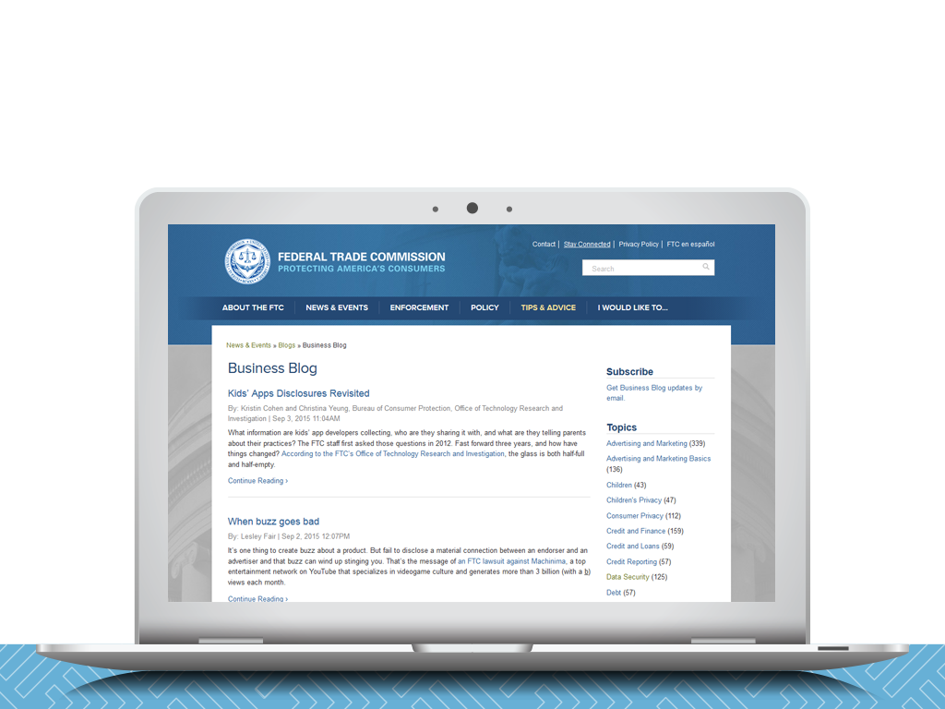
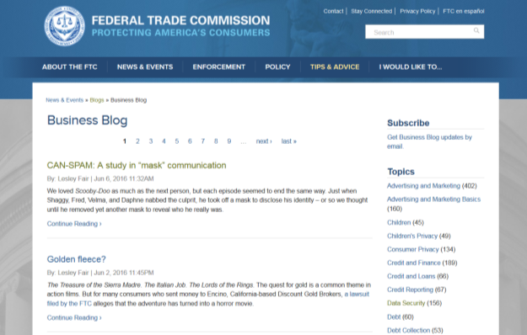
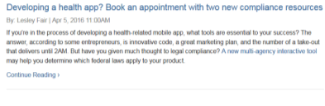
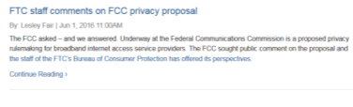
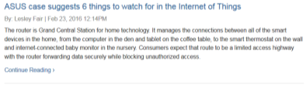

Subscribe to the FTC Business Blog
business.ftc.gov/blog

Slide 26

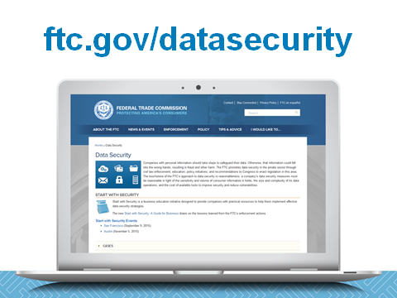
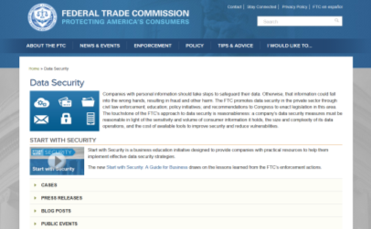

Slide 27
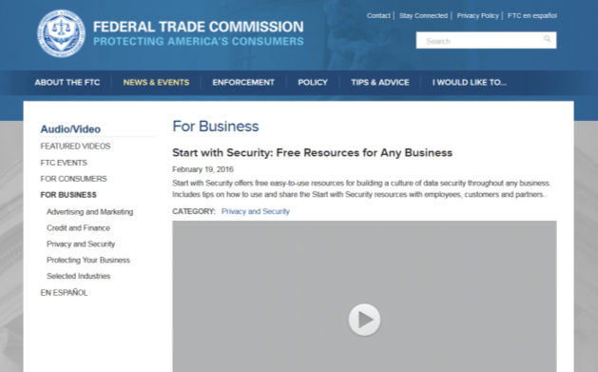



Start with Security videos
ftc.gov/videos

Slide 28
Learn More
Start with Security: A Guide for Business
  ftc.gov/startwithsecurity
Protecting Personal Information
  https://www.ftc.gov/tips-advice/business-center/guidance/protecting-personal-information-guide-business
Slides & Videos from Start with Security events
  https://www.ftc.gov/news-events/events-calendar/2016/06/start-security-chicago
  ftc.gov/startwithsecurityseattle
  ftc.gov/startwithsecurityaustin
  www.ftc.gov/news-events/events-calendar/2015/09/start-security-san-francisco

