Slide 1
Navigating Charitable Giving Today
Bob Carlson
Amy Sample Ward
Bennett Weiner
Danny Gordon
David Hessekiel
Tiffany Neill

Slide 2
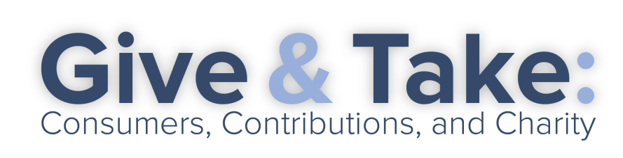

Fundraising through the Mail and On the Phone
State of the business March, 2017

Slide 3

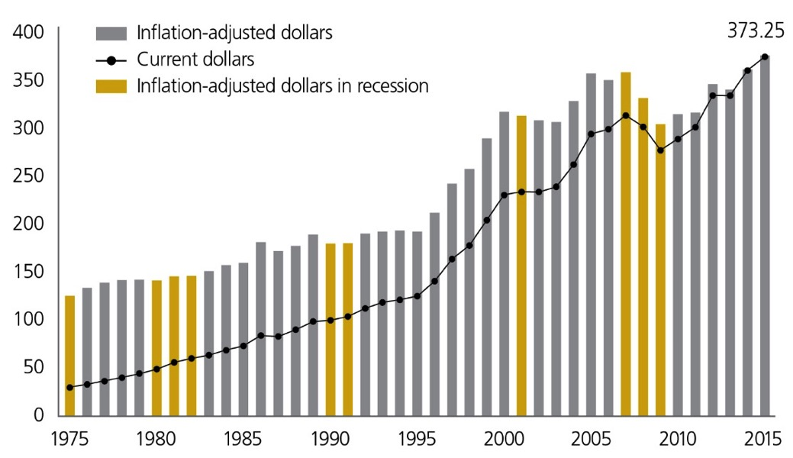
Total Charitable Giving in 2015 was $373.25 Billion
Source: Giving USA Foundation – Giving USA 2016

Slide 4
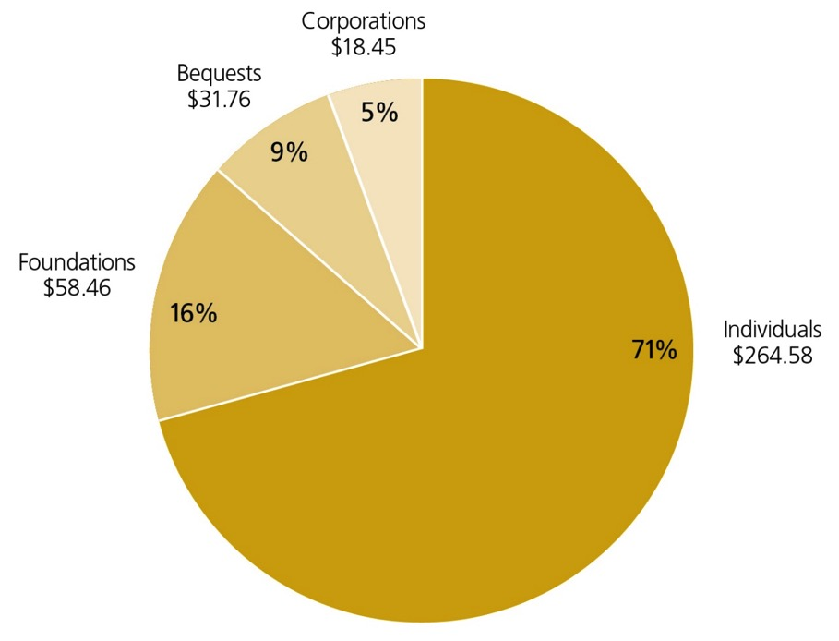
Most of that was from Individuals
Source: Giving USA Foundation – Giving USA 2016

Slide 5
what part of that is mail or phone?
Of the 2,000 nonprofits who participate in the Blackbaud cooperative database:
  76% of their donors give to direct mail (average gift $32)
  25% of their donors give to telefundraising (average gift $33)

Slide 6
Why does fundraising By mail and phone still work?
Great way to communicate with people who have time – retired, educated – and build relationships.
And those people are GREAT donors.
Predictable model of investment fundraising
Donors acquired, cultivated and renewed through mail and phone proven to be strong prospects for major and planned gifts.

Slide 7
Responsible investment fundraising
Acquire donors with long-term objectives
Measure success over years
Donor lists remain with the nonprofit

Slide 8
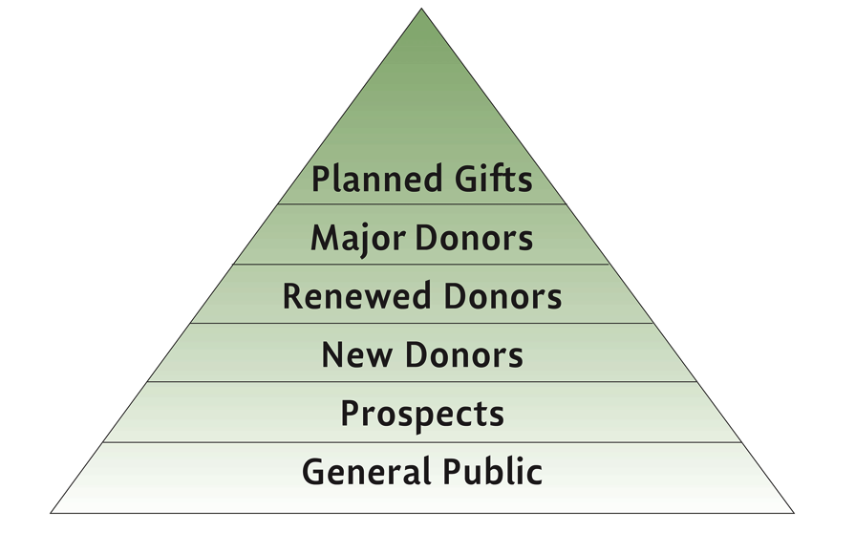
Communication with Donors to Build Relationships
Share information
Transparency about achieving goals
Measure success

Slide 9
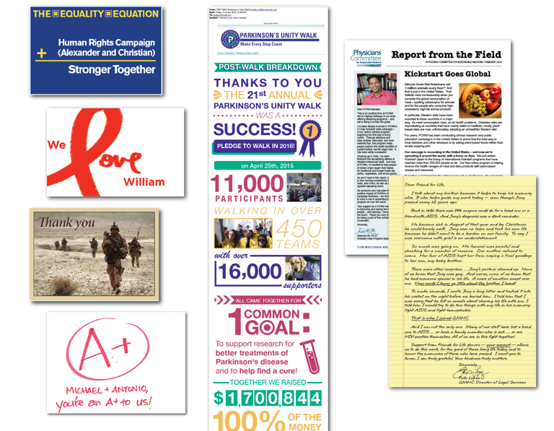
Responsible Mail and Phone
Mix of Solicitations and Cultivation
Communicate with donors in all channels (mail + phone + email)
Consistent messages
Consider ROI of selected messages/channels

Slide 10
What Can Hurt fundraising
& the public confidence
When the nonprofit does not keep control of their list of donors.
When relationships with outside fundraisers are not transparent and contracted.
When the long-term view is lost.

Slide 11
Ethical approaches long established
Association of Fundraising Professionals
DMA Nonprofit Federation
Association of Direct Response Fundraising Counsel
Disclosures on 990s

Slide 12
The next Chapter?
Demographics are in our favor.
More robust data targeting can increase cost effectiveness.
Donors have more ways to become educated about organizations.
Better ways to reach the right people!

Slide 13
FTC Conference
Give & Take:
Consumers, Contributions and Charity
Bennett Weiner, COO
BBB Wise Giving Alliance
March 21, 2017
Notes:
13

Slide 14
BBB WGA Perspective
BBB Wise Giving Alliance (Give.org) is a
Standards-Based Charity Evaluator
Standard 15: Appeals Are Accurate, Truthful and Not Misleading, Both in Whole and in Part
PHOTOS, STORIES, FINANCES
BBB SCAM TRACKER (bbb.org/scamtracker/us)
421 alleged charity scams since 2015
20% are police, fire and veterans appeals

Slide 15
Online Fundraising Overview
Amy Sample Ward

Slide 16
Online Fundraising Types
Type 1: Passive Asks

Slide 17
PASSIVE FUNDRAISING

Slide 18
PASSIVE FUNDRAISING

Slide 19
Online Fundraising Types
Type 2: Active Asks on Website

Slide 20
ACTIVE FUNDRAISING

Slide 21
Online Fundraising Types
Type 2: Active Asks by Email

Slide 22
ACTIVE FUNDRAISING

Slide 23
Online Fundraising Types
Type 2: Active Asks by Social Media

Slide 24
ACTIVE FUNDRAISING

Slide 25
Online Fundraising
Risks & Considerations

Slide 26
RISKS & CONSIDERATIONS
Nonprofit Reality
Limited data
Relying on multiple channels to drive donations
Offline actions or events matter
Website is a resource even if not channel of donation
Reliance on third party donation processors

Slide 27
BBB WGA Perspective
ONLINE GIVING
Standard 17: WEBSITE DISCLOSURES – access to annual report information and IRS Form 990
Standard 18: DONOR PRIVACY - Clear and easily accessible privacy policy on charity websites (four elements - notice, access, choice, security)
Other Issues:
Disaster Appeals
Third-party Online Giving Platforms
Millennials - “Cracking the Invulnerability Illusion”

Slide 28

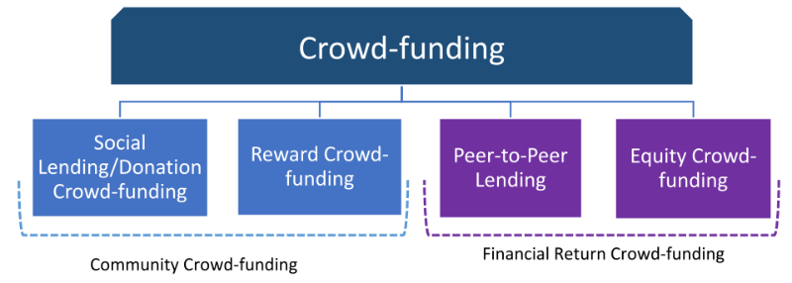

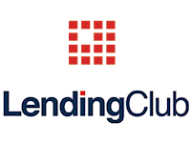






What is Crowdfunding?

Slide 29
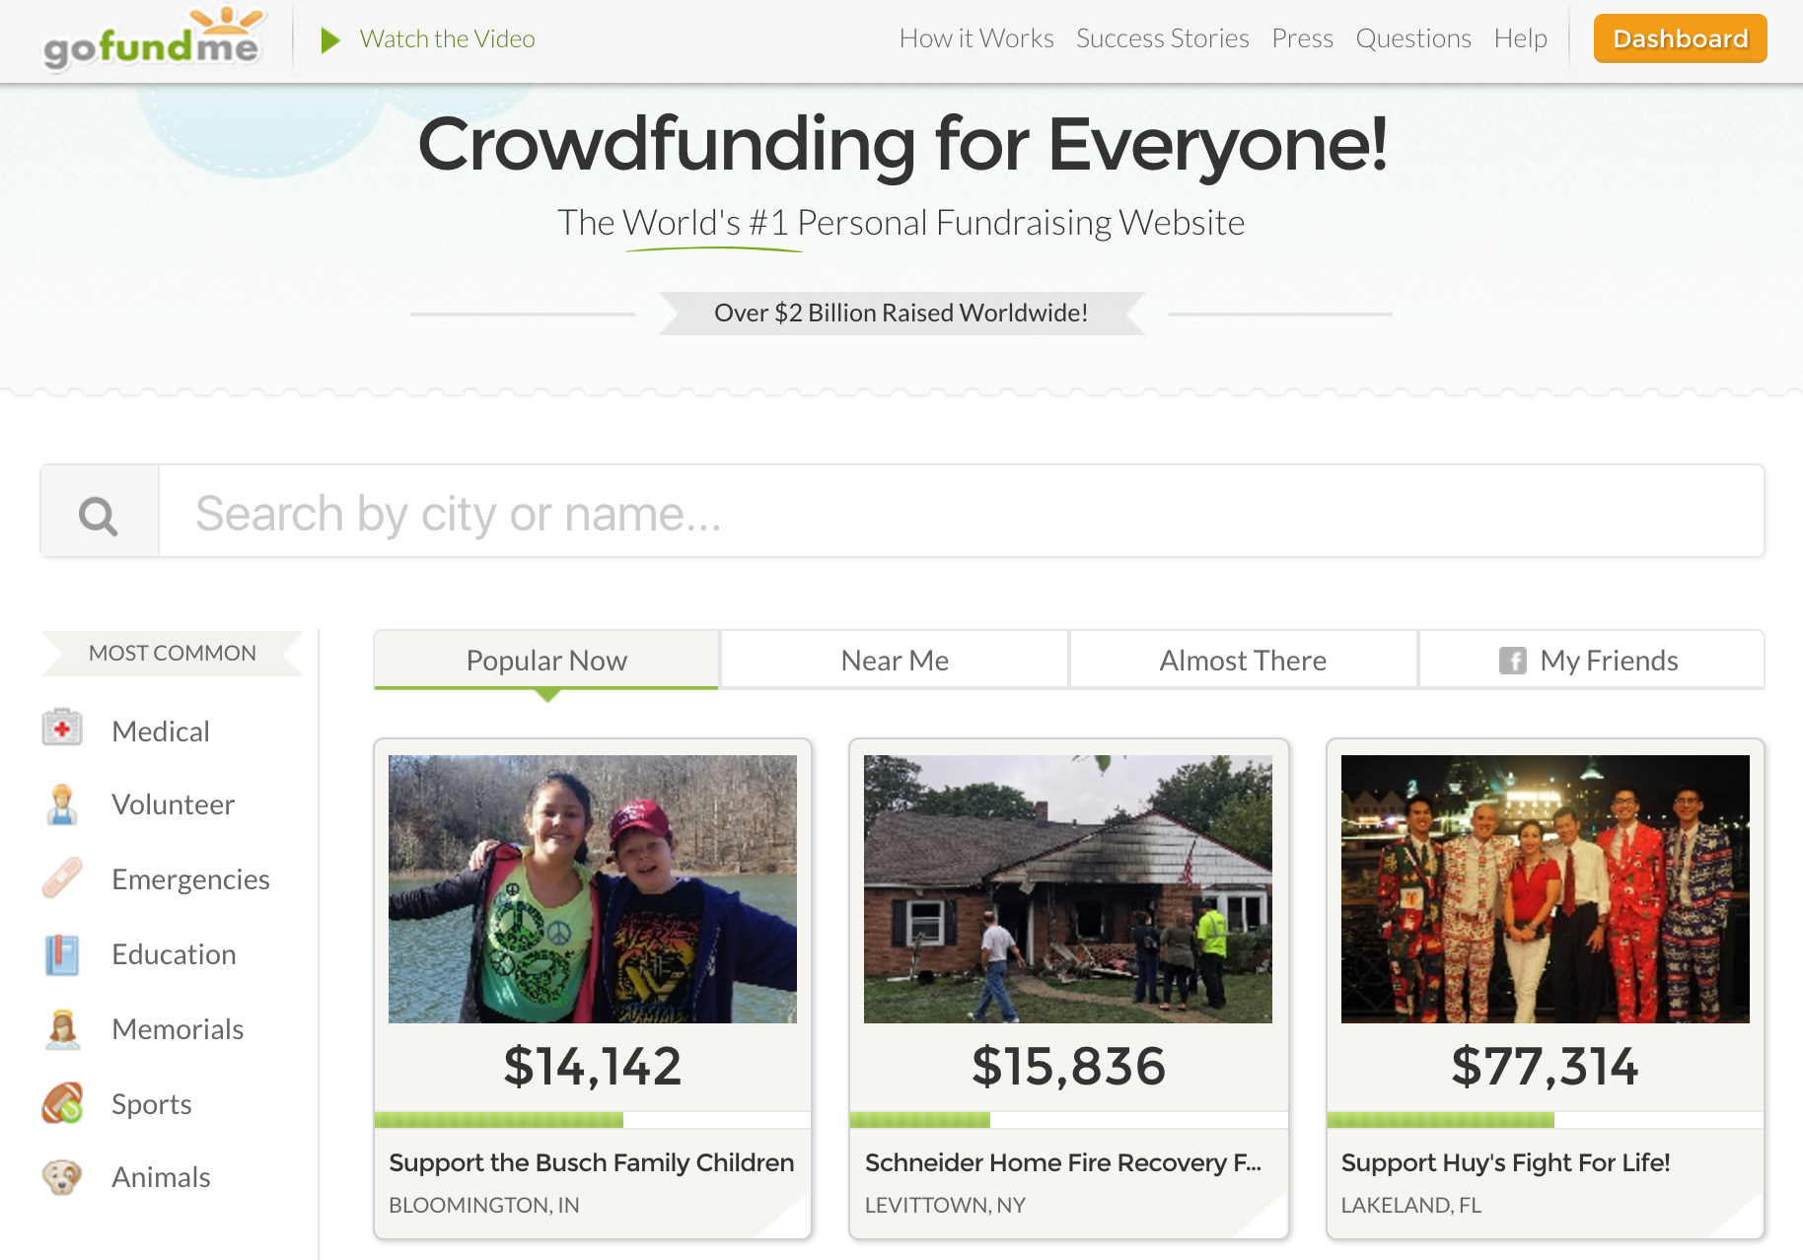
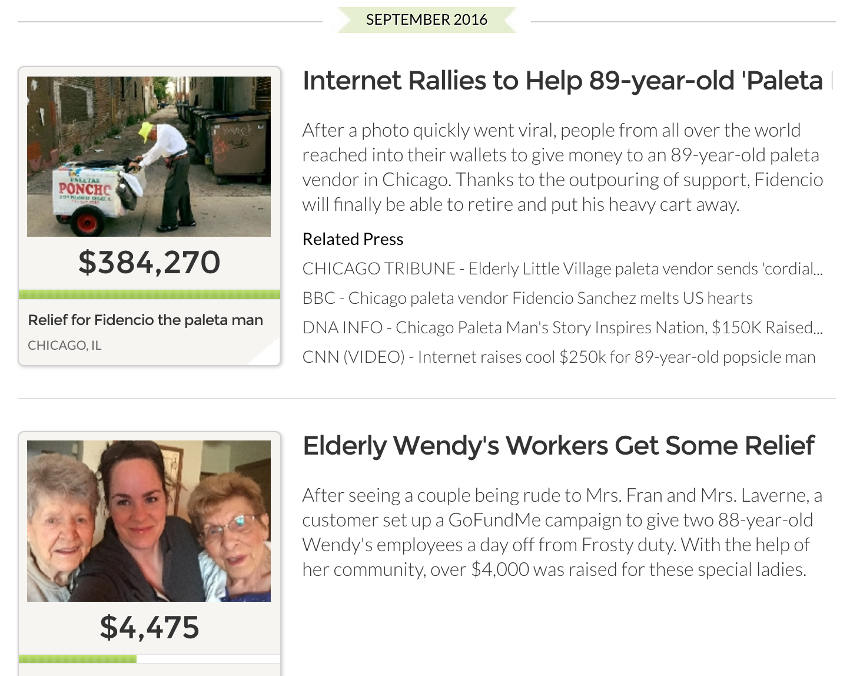
Intro to GoFundMe
“Give People the Power to Change Their World”
“See Something, Do Something”
Over $3BN given by over 25M donors
~200 employees with US offices in San Diego and Redwood City, CA
Social storytelling layered over payments

Slide 30
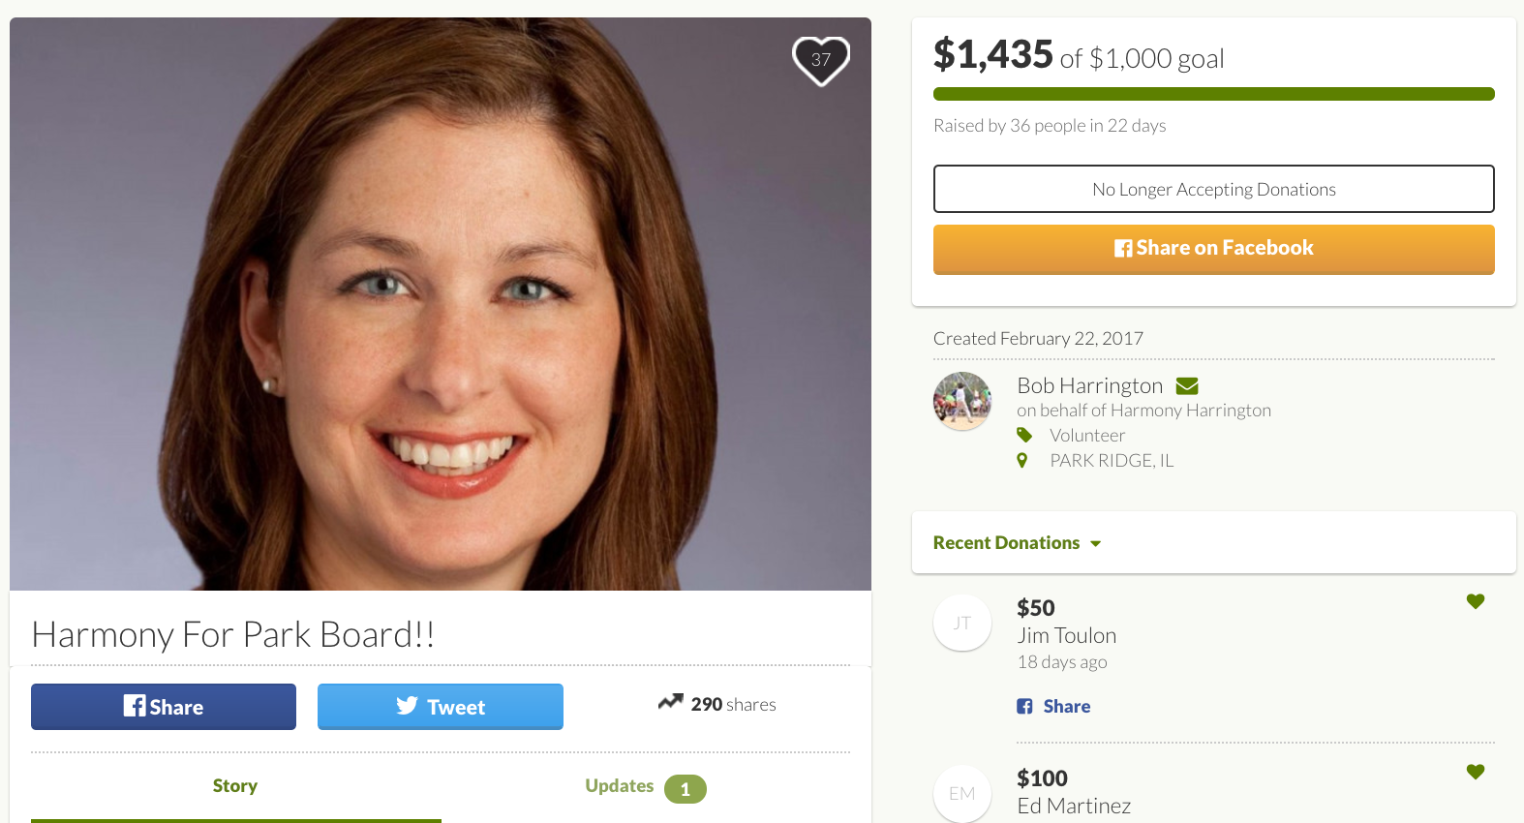
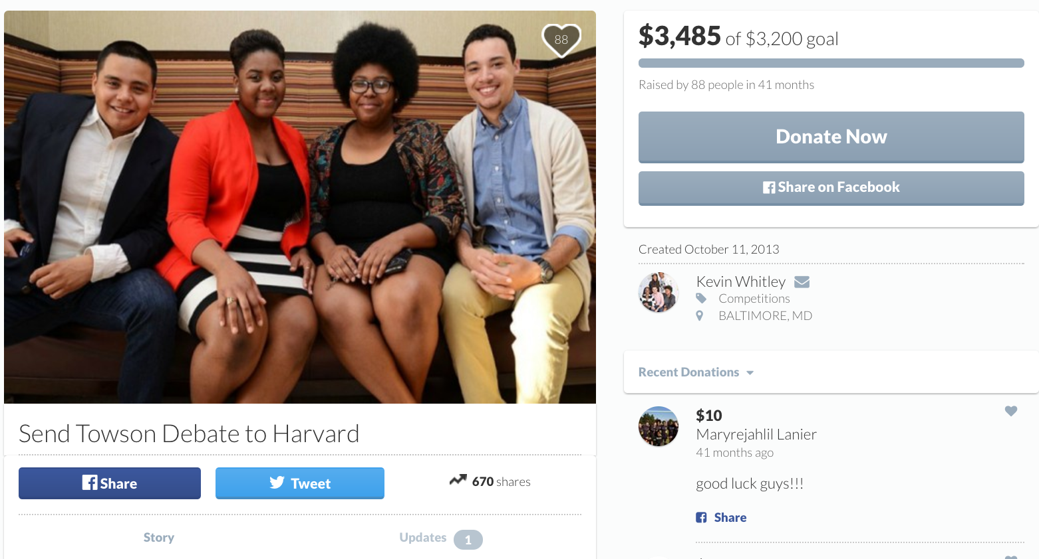
GoFundMe Campaigns
Common campaign categories
Medical Education Volunteerism
Athletics Animal Care Memorials
Charities Emergencies Political
Majority of campaigns are created by individuals for their own benefit
Grassroots: Most campaigns raise < $900 from donors in organizer’s 1st social circle, but many campaigns are more successful
Funds deemed personal gifts, not tax-deductible (exception for charities)

Slide 31
Trust & Safety Department
Create and enforce layers of trust between GoFundMe, its users, and stakeholders to prevent Platform misuse and empower the GFM community
Trust
Community Management
Manage the GoFundMe Guarantee
Investigate reports of fraud and misuse
Ensure the correct flow of funds for high risk accounts
Assist law enforcement with investigations
Enforce terms of service across the Platform
Moderate user-generated content
Manage beneficiary risk and use case-specific funds flows (e.g., trusts, scholarships)
Proactively reach out to law enforcement when a campaign organizer threatens public safety
Identify and oversee mass campaigns related to newsworthy events
Payments Risk
Identify and prevent credit card fraud
Manage AML, anti-terrorist financing policies

Slide 32
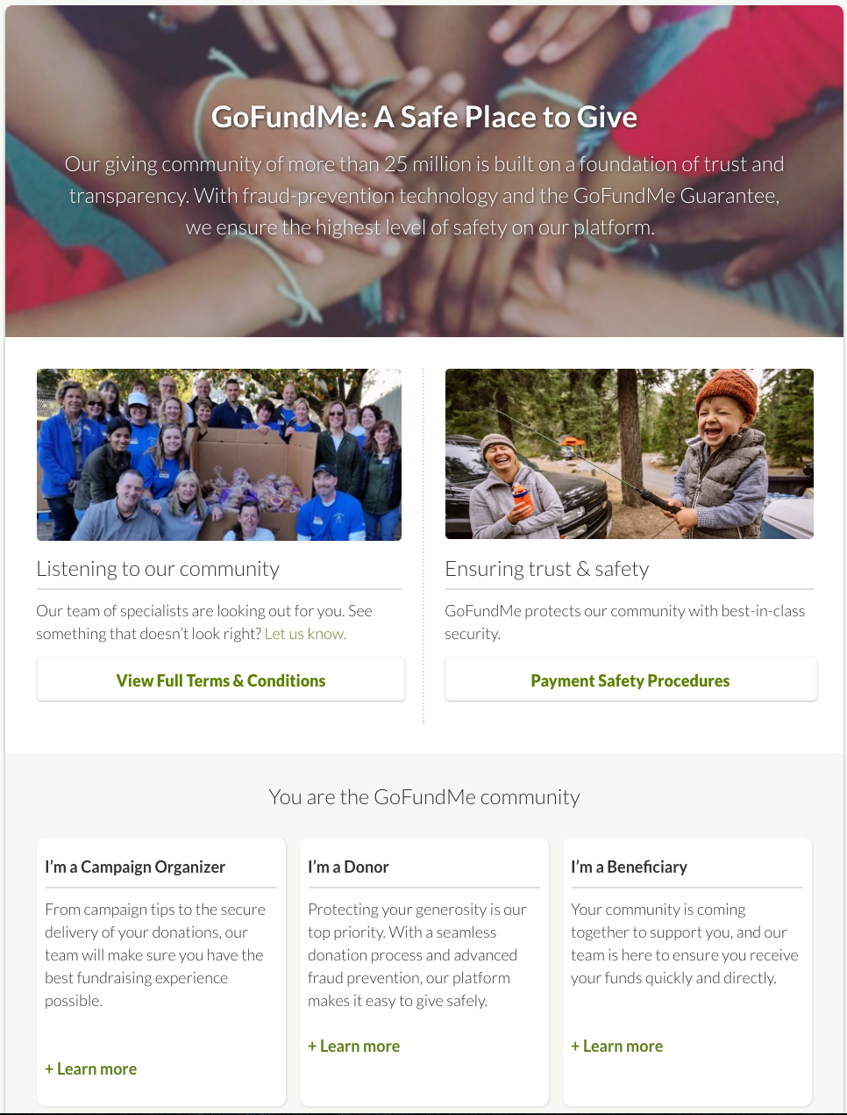
Trust Challenges
Unique Challenges
Hard to build eBay-styled reputations (few repeat organizers)
Laborious and intrusive to require manual investigation for every campaign
Good samaritans may lack direct, personal connection to a cause or other individuals (not necessarily “fraud”)
Campaign velocity around news events
Money creates controversy (friends and family)

Slide 33
Trust Challenges, cont.
Unique Platform Characteristics
Connecting to social media profiles is virtually required for sharing and receiving donations
High barriers for someone to defraud 1st degree social circle (those who are most likely to donate)
Campaigns may have similar themes and content
Rich data related to organizer and donor identities and behavior
Funds can be held, refunded, or distributed in a variety of flows

Slide 34



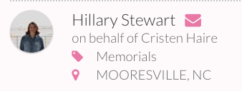
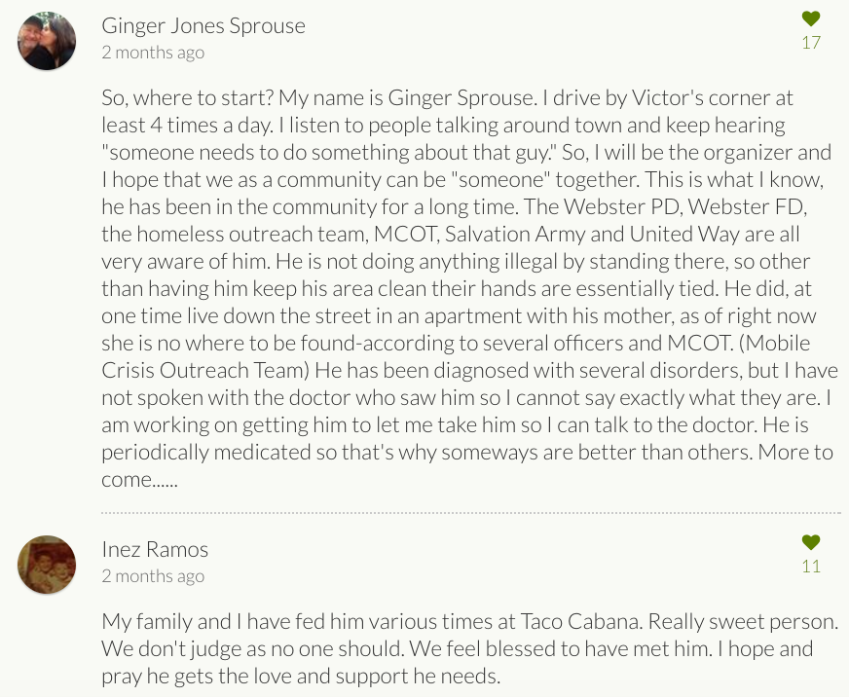
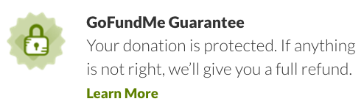
Trust Challenges, cont.
Solution = leverage platform characteristics to build “Trust Features”
Leverage rich social identities to surface organizer and relationships to donors and GFM team
Social proof derived from early donor activity and user social behaviors, beneficiary invitations, and more
Machine learning models identify high-risk campaigns and organizers, both from internal and offline data
GFM investigates and reviews campaigns from user reporting
Build product and policy to guide organizers to safest choices and protect donors

Slide 35
BBB WGA Perspective
CROWDFUNDING
Charities can be checked.
Deductibility of gifts to individuals.
Be careful after a disaster or tragedy.
Specialized crowdfunding sites.
Read the fine print.

Slide 36
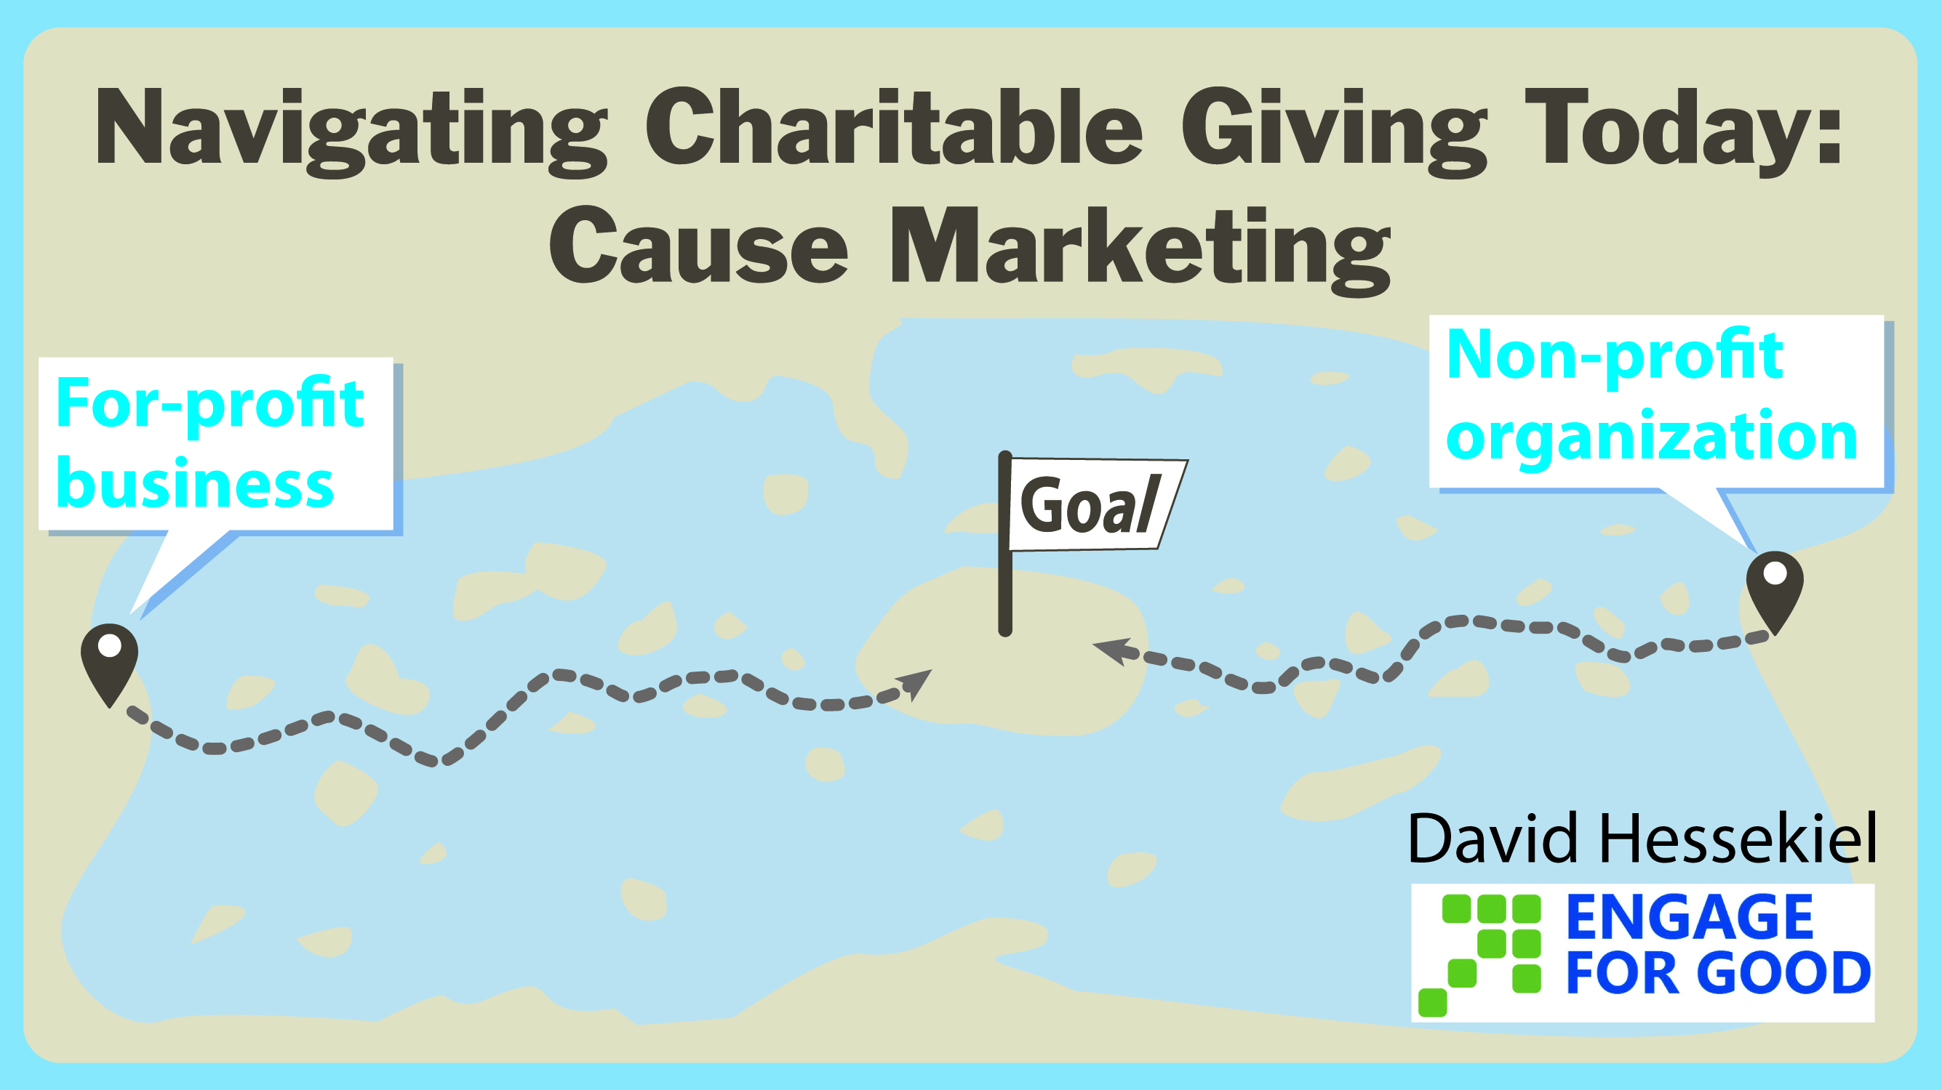
Cover to come

Slide 37
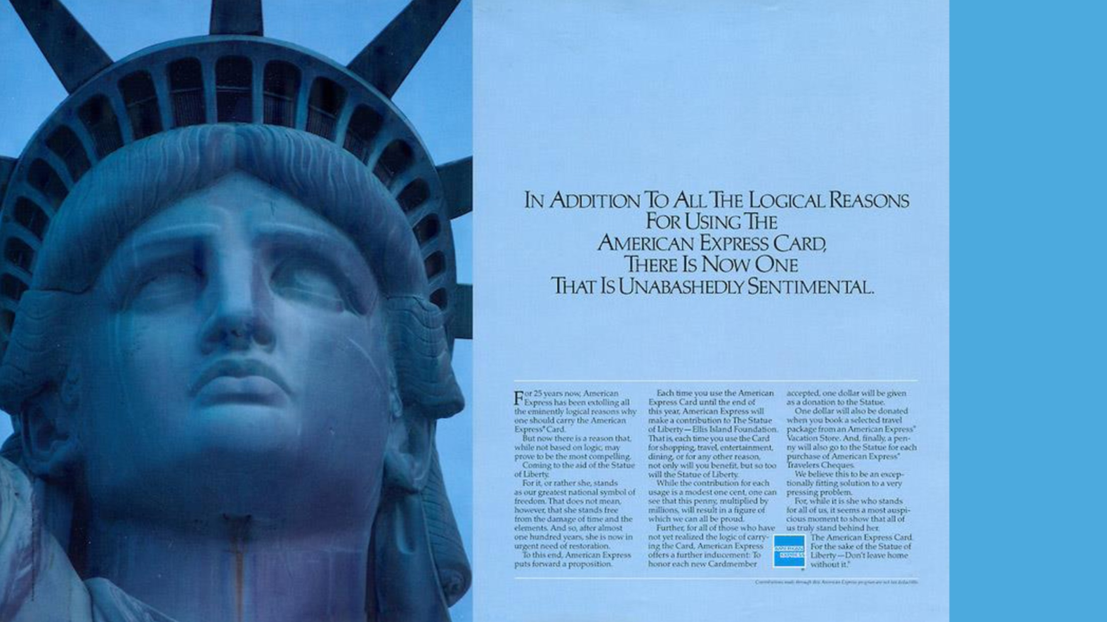


Slide 38
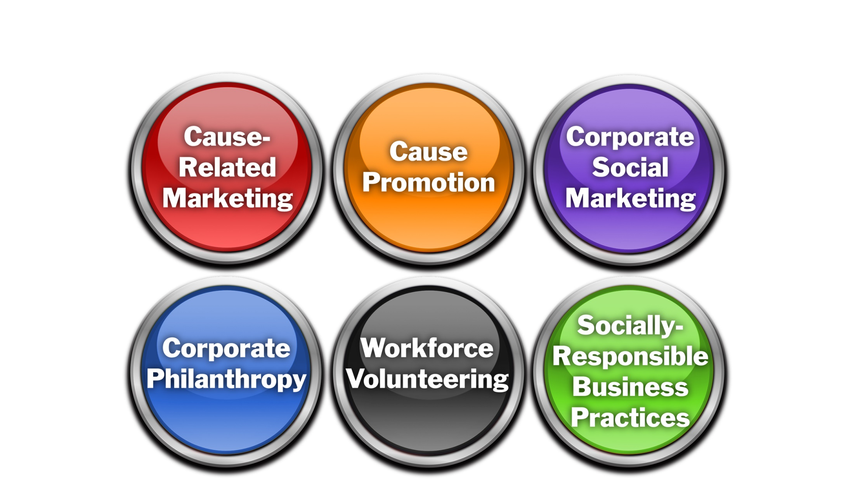
6 Types of Corporate Social Initiatives

Slide 39
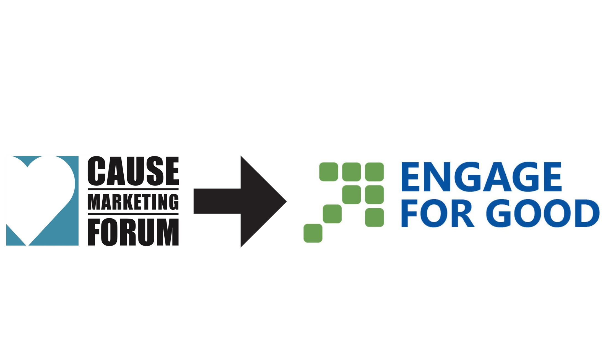
Cause Marketing Forum is now Engage for Good

Slide 40
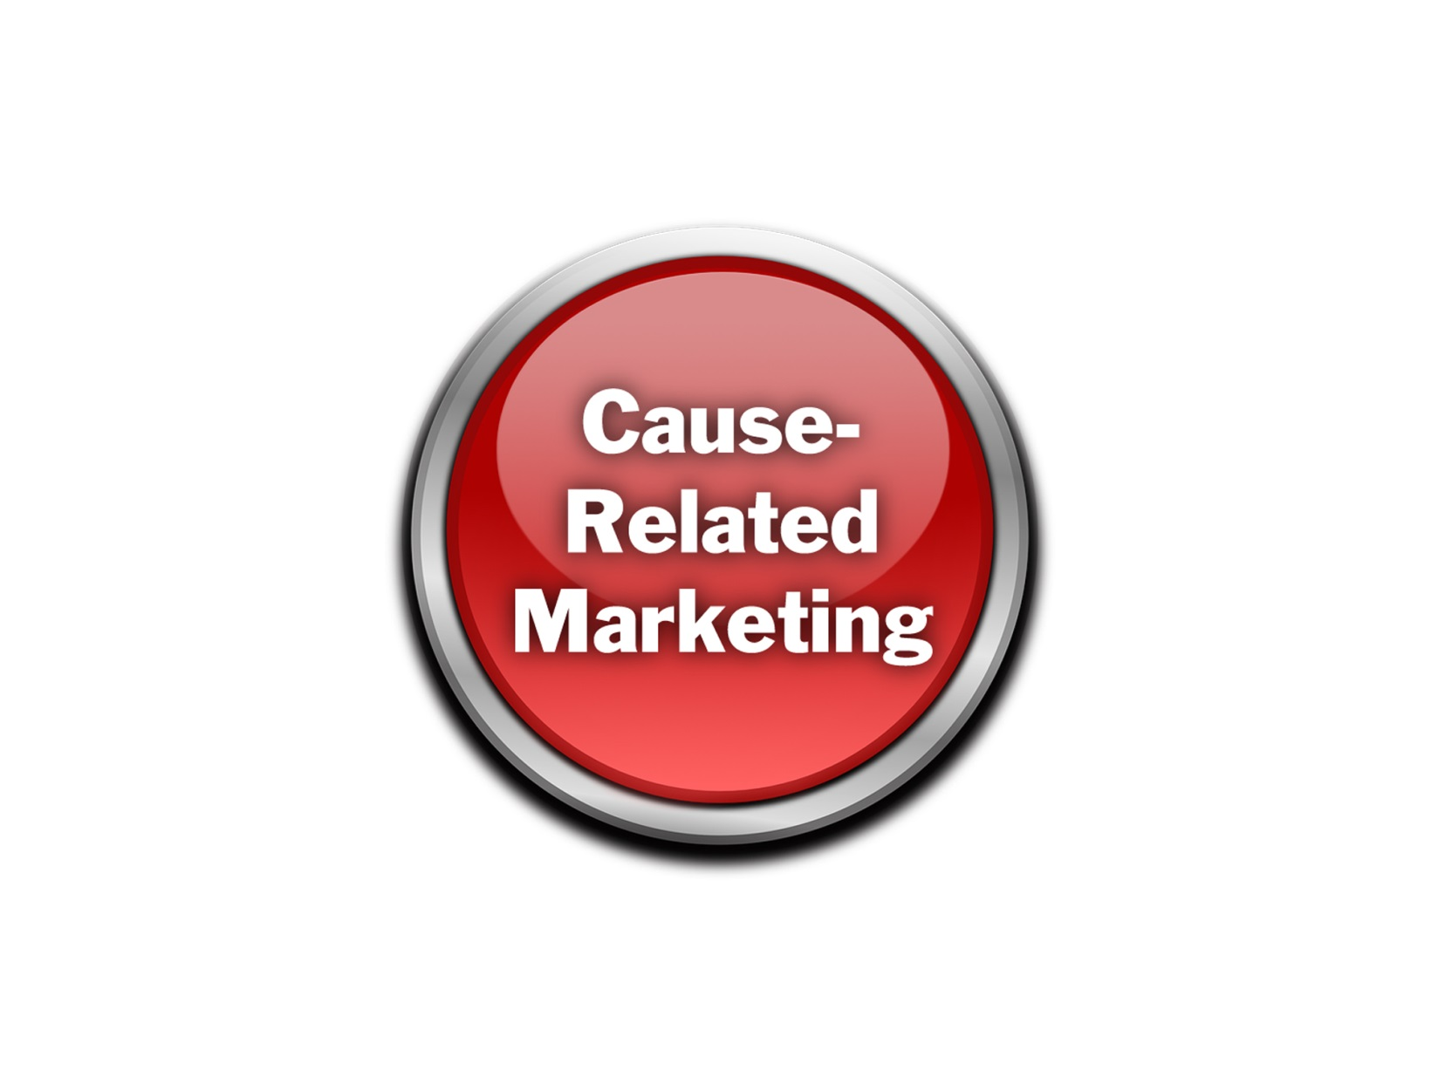

Slide 41

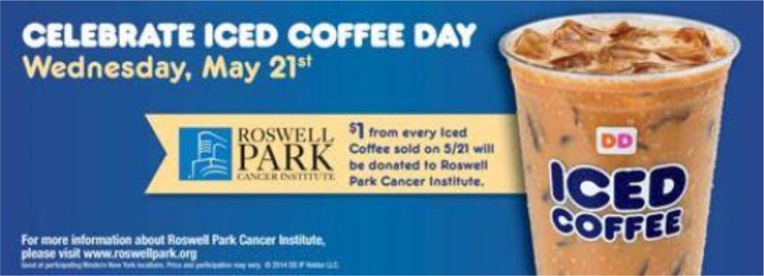
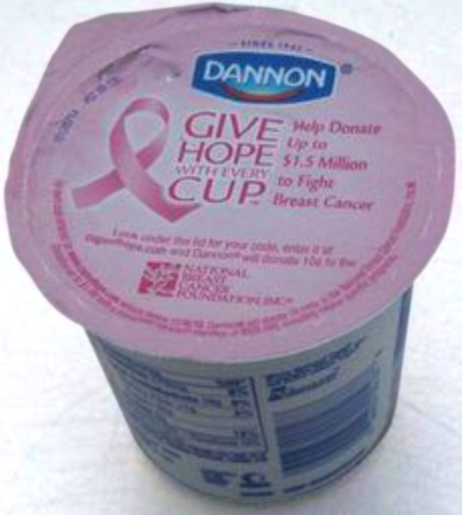

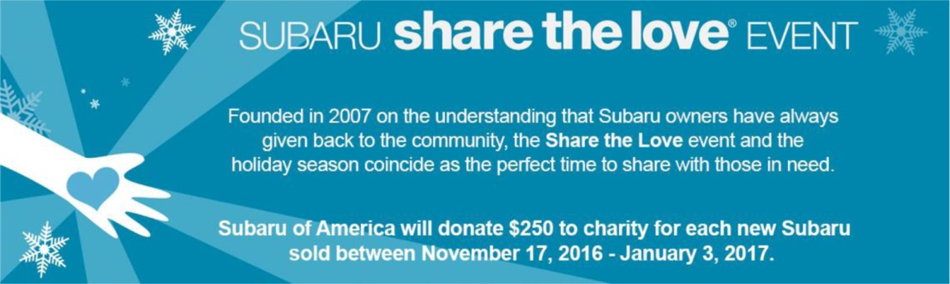

Slide 42
Commercial Co-Venture

Slide 43
What can go wrong?
Business takes advantage of nonprofit
Does not get nonprofit’s permission
Does not make promised donation
Business deceives consumers
Misleading offer
Lack of transparency

Slide 44
What has gone wrong?

Slide 45
What would I like to see?
More cause-related marketing
More transparent cause marketing
More meaningful enforcement
– if there are bad actors out there

Slide 46
Today’s multi-state regulatory system
Discourages CRM
Does not enlighten or protect consumers
Does not reflect new modalities and players

Slide 47
Lets move to
Unified national system
Unified database consumers can tap to learn more

Slide 48
Thank you!
David Hessekiel, Engage for Good www.engageforgood.com

Slide 49
BBB WGA Perspective
CAUSE-RELATED MARKETING
Standard 19:
Actual or anticipated portion of purchase price that will benefit the specified charity.
Duration of campaign.
Any maximum or guaranteed minimum contribution amount.
“5 cents contributed to ABC Charity for every XYZ Company Product sold during the month of October up to a maximum of $200,000”

